Slide 1

Step out of the car
Predicting Arrests During Traffic Stops
Tim Meehan
8/7/2019

Slide 2
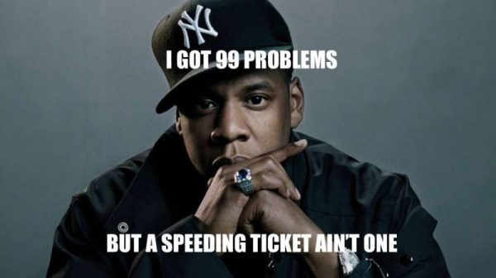
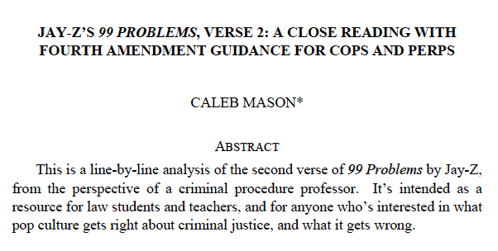
Two Lessons From Jay-Z’s “99 Problems”

Slide 3
Lesson 1
“…the number and scope of traffic regulations [in the United States] is so extensive that the police can…find a perfectly legitimate traffic-law basis for stopping any car they choose, just by following it for a few blocks.”
- Mason (2012) St. Louis University Law Journal

Slide 4
Lesson 2
“…there is no constitutional problem with arresting someone for a traffic violation, no matter how minor.”
- Mason (2012) St. Louis University Law Journal

Slide 5

Notes:
Any time you’re pulled over, there is a risk of arrest, even for a minor offense. Can we predict whether an arrest will occur?

Slide 6

Can We Predict Arrests in Traffic Stops?
Repository of US traffic stop data
Subset used: Florida Highway Patrol
2.8 million stops (2009-2015)
Features:
Driver age, race, sex
Officer age, race, sex
Time and location of stop
Violation, search performed
Feature Engineering +
Classification
→→→
97%
3%
NO ARREST
ARREST

Slide 7
Who Can Use The Predictions?
Public Resource:
> 20 million traffic stops per year
Better understand what drives arrest outcomes
Tool for civilians:
Be alerted of higher arrest probability while driving
Based on personal information, driving habits, location, etc.

Slide 8
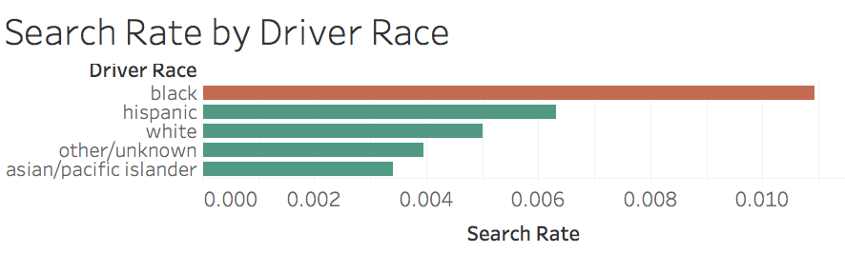
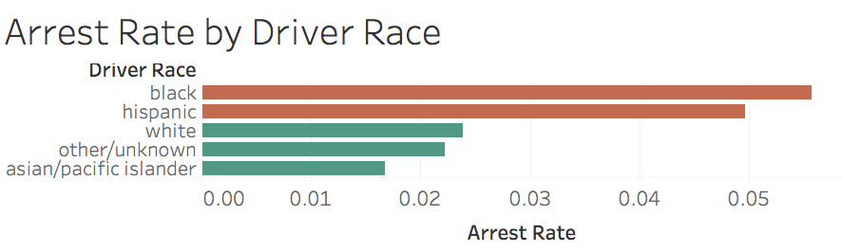
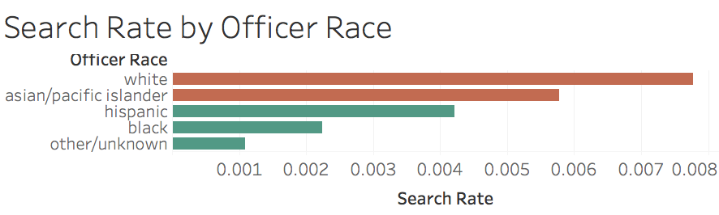

Slide 9
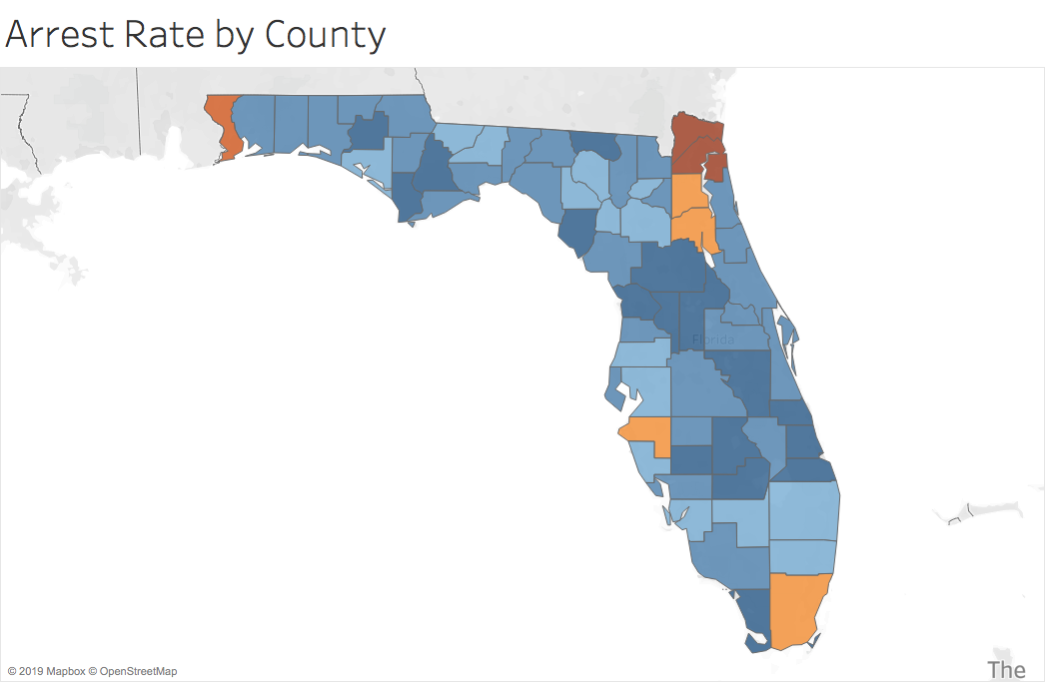
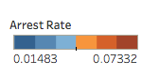
Jacksonville
Pensacola
Tampa
Miami

Slide 10
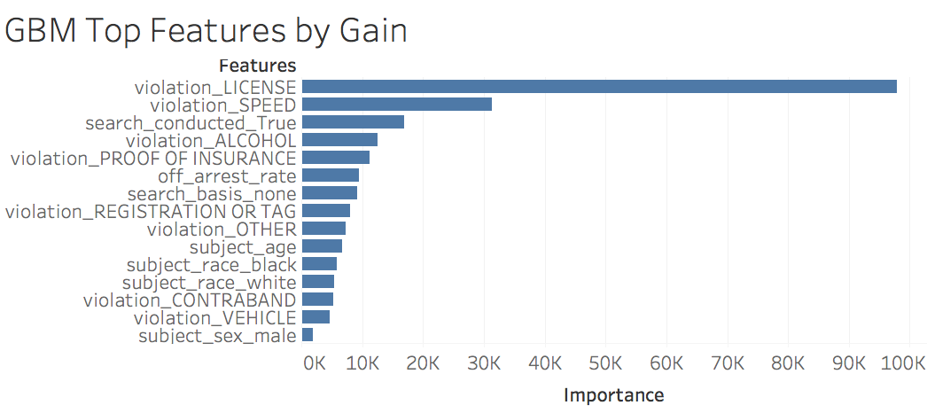
The Best Model
Gradient Boosted Machine (oversampled)
Test F1 Score: .451
Notes:
Logistic F1 = .37
GBM F1 = .451

Slide 11
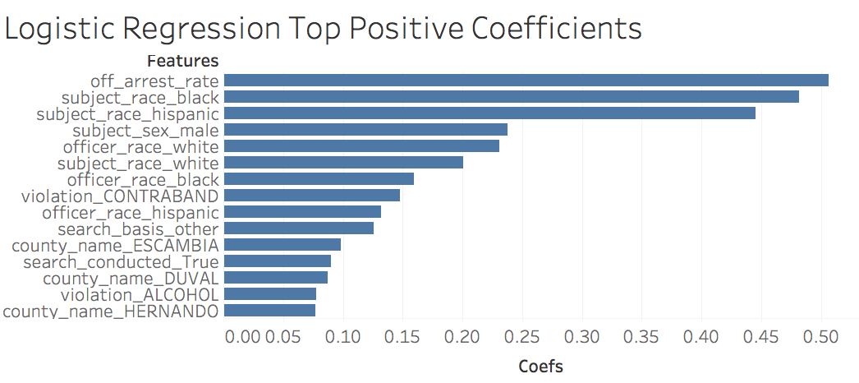
More Interpretable Model
Logistic Classifier (adj class weights)
Test F1 Score: .37
Notes:
Logistic F1 = .37
GBM F1 = .451

Slide 12
Conclusions
Two competing interpretations
Neither model performs well, no strong conclusions warranted (human interactions hard to predict)
More feature engineering needed
Use nationwide data ~ 100 million potential observations

Slide 13




thank you!
Acknowledgements

Slide 14
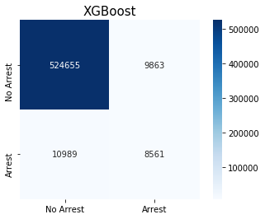
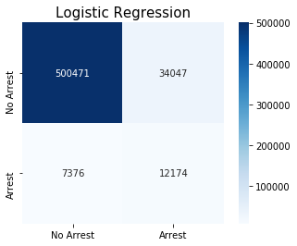
APPENDIX

