Slide 1
Containers for Data Science

Slide 2
Reproducible Research
Wet lab
Setup apparatus
Take measurements
(…etc)
Document procedure and results
Publish
Repeat (peer review)
Profit

Slide 3
Reproducible? Research
Computer lab
Setup environment and copy input data
Install and configure scientific software
Process data with scientific software
Generate fancy plots
Document procedure and results
Publish
Repeat (peer review)
Profit (?)

Slide 4
Reproducible Research
IT-induced hatred for life
Computer lab
Setup environment and copy input data
Fail to install scientific software
Ask software author for help, wait months
Get told “worksforme”
Ask SysAdmin for help, wait some more
SysAdmin says he can’t do anything while muttering something about “dependency hell”
Contemplate your life choices

Slide 5
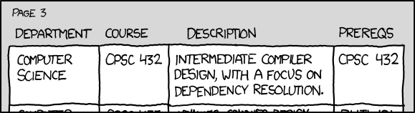
Dependency Hell
“The prereqs for CPSC 357, the class on package management, are CPSC 432, CPSC 357, and glibc2.5 or later.”
https://xkcd.com/754/

Slide 6
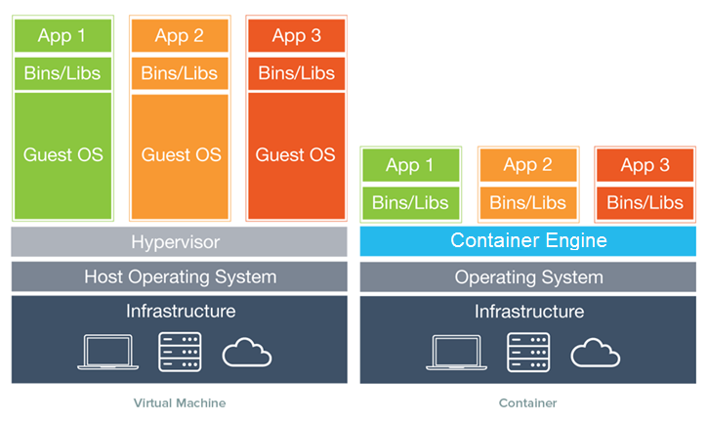
What are Containers?

Slide 7


Container Engines in powerPlant

Slide 8
Using containers (Docker)
[user@aklppf31:~]$ /usr/bin/docker run --name=poretools_docker --rm \
-v /input/genomic/viral/minION_lambda_phage_burn_in:/input:ro \
-v $(pwd)/docker_output:/output \
--entrypoint=poretools
containerhub.powerplant.pfr.co.nz/appiarium/poretools:0.6.0a \
-h
usage: poretools [-h] [-v]
{combine,fastq,fasta,stats,hist,events,readstats,tabular,nucdist,metadata,index,qualdist,qualpos,winner,squiggle,times,yield_plot,occupancy,organise}
...
optional arguments:
-h, --help show this help message and exit
-v, --version Installed poretools version
[sub-commands]:
(…)

Slide 9
Using containers (Singularity)
[user@aklppf31:~]$ module load gromacs
[user@aklppf31 ~]$ singularity help /software/chemistry/gromacs-2018/gromacs-2018.img
This Singularity container provides Gromacs 2018
Usage:
------
NOTE: you must be able to run Singularity in your cluster, and the `singularity` command should be in your PATH.
You can run this container in several ways:
a) Execute the image file directly:
$ gromacs-2018.img <subcommand> <subcommand args>
b) Using the `singularity run` syntax:
$ singularity run gromacs-2018.img <subcommand> <subcommand args>
c) Opening a shell inside the container with `singularity shell`:
$ singularity shell gromacs-2018.img
Singularity gromacs-2018.img:~> source /usr/local/gromacs/bin/GMXRC
Singularity gromacs-2018.img:~> gmx <subcommand> <subcommand args>

Slide 10
More information and examples
https://powerplant.pfr.co.nz/guide/docker
http://singularity.lbl.gov/
https://powerplant.pfr.co.nz/case-studies/
https://jupyterhub.powerplant.pfr.co.nz/user/hraegb/notebooks/00.jupyter_examples/analysing_data_using_docker_containers.ipynb
https://jupyterhub.powerplant.pfr.co.nz/user/hraegb/notebooks/cfleit/ShinyClimateChange/runApsimClassicBash.ipynb

Slide 11
The New Zealand Institute for Plant & Food Research Limited
Thank you

