Slide 1
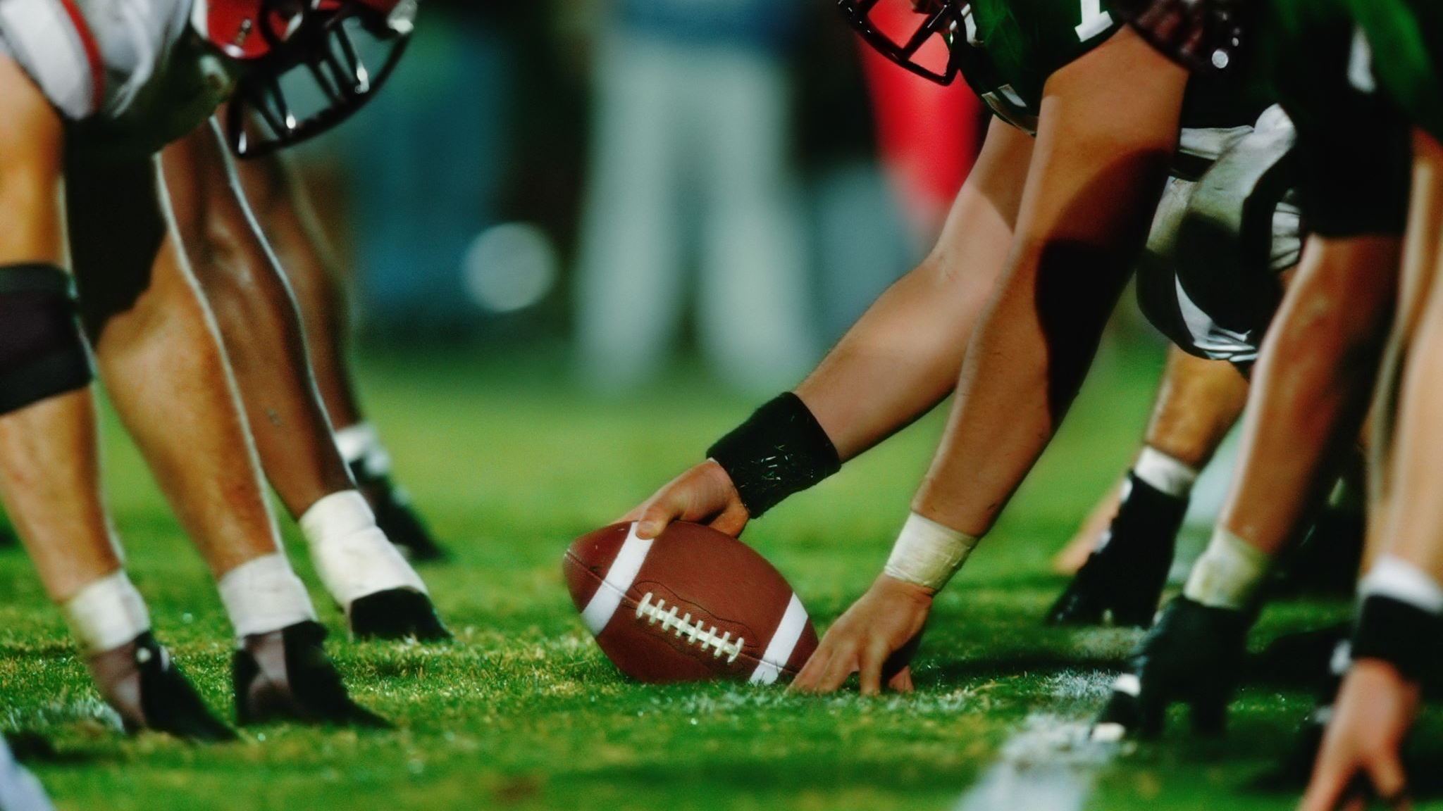
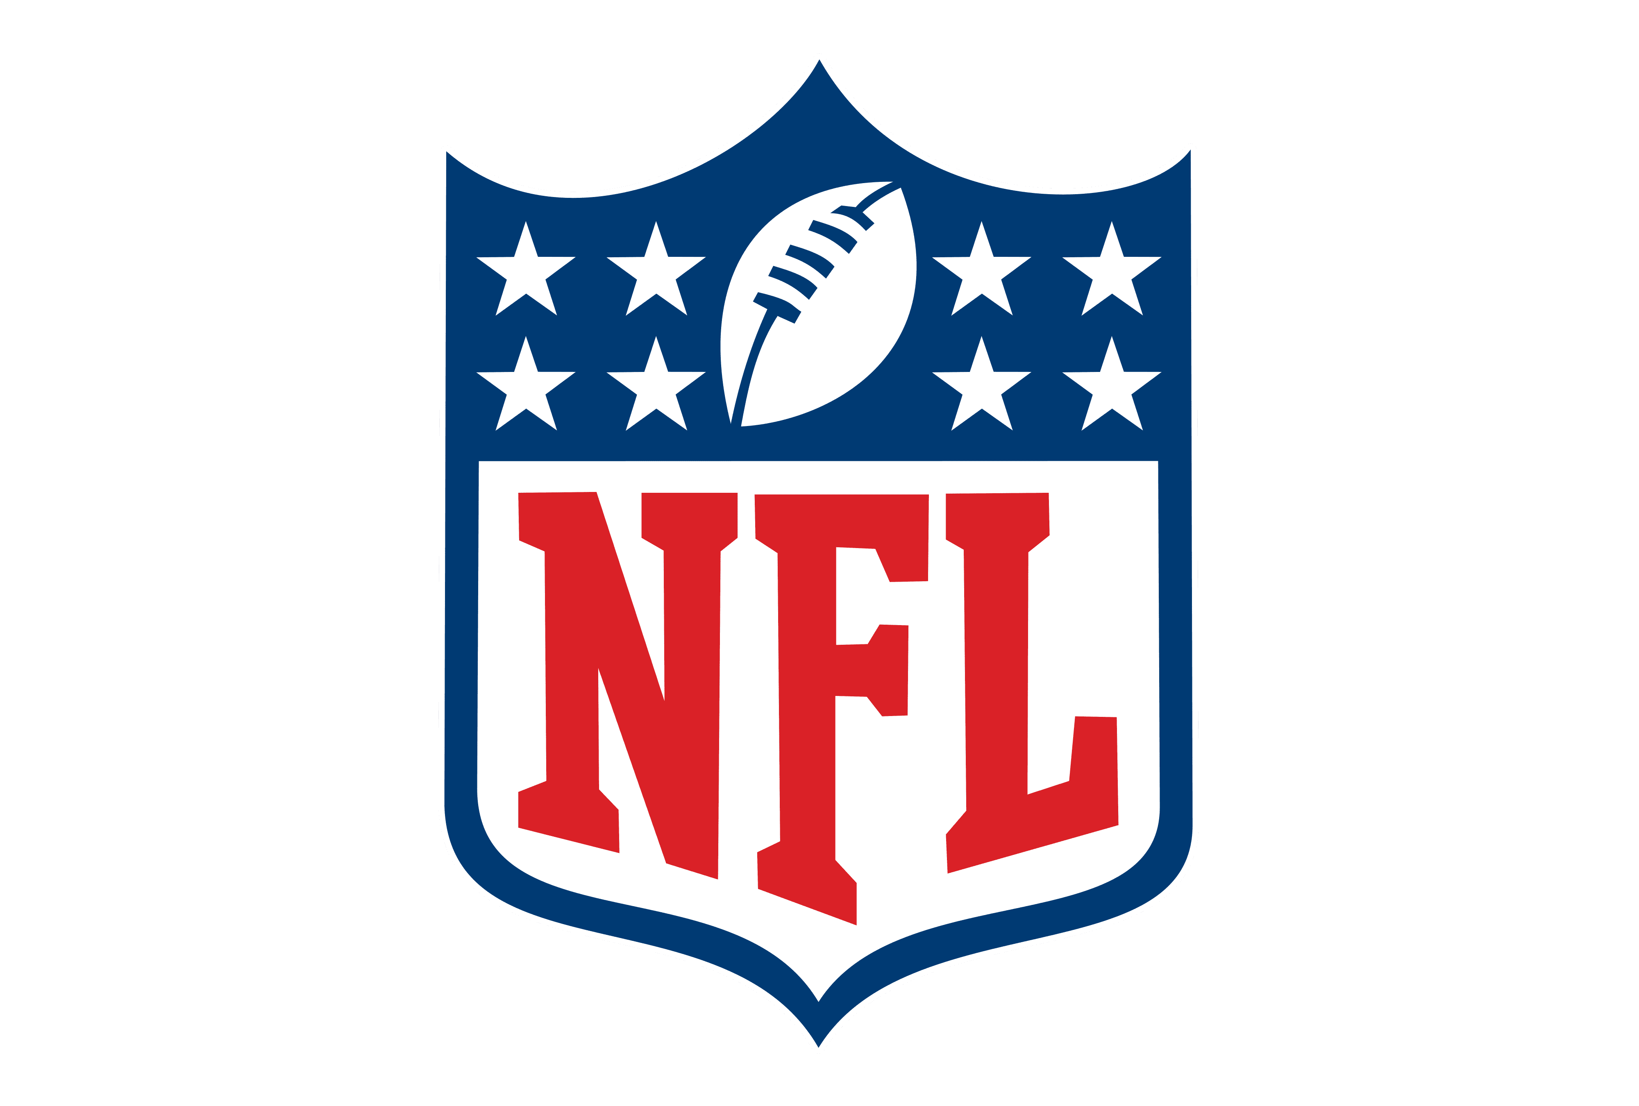
Analyzing NFL Injuries & Impact
Tim Pao, Ken Schoel, Nick Rasmuson

Slide 2
Introduction
Background
Established in 1920.
Currently has 32 teams and 1,696 players.
The League is trying to increase player safety through advancements in technology and equipment.
Problem Statement
How can we protect players by anticipating and preventing injuries before they occur?
Are there positions that are at a higher risk?
What factors contribute to a greater risk of injury?
Problem Objective
Exploratory Analysis
Basic statistical and visual analysis
Time-trend analysis
Predictive Analysis
Decision tree analysis

Slide 3
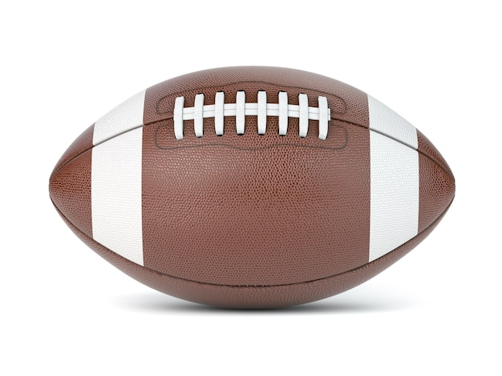
Methodology
Data
Observed NFL Concussion Data from 2012-2014
Seventeen variables total
Seven categorical variables
Position, Team, Winning Team
Ten numerical variables
Average Time Before Injury, Average Time After Injury, Games Missed
Key Assumptions
Patterns from the data are still significant today
There is crossover into other contact sports and common injury types
The population of injuries in our time period is a good sample representation of the entire league as a whole

Slide 4
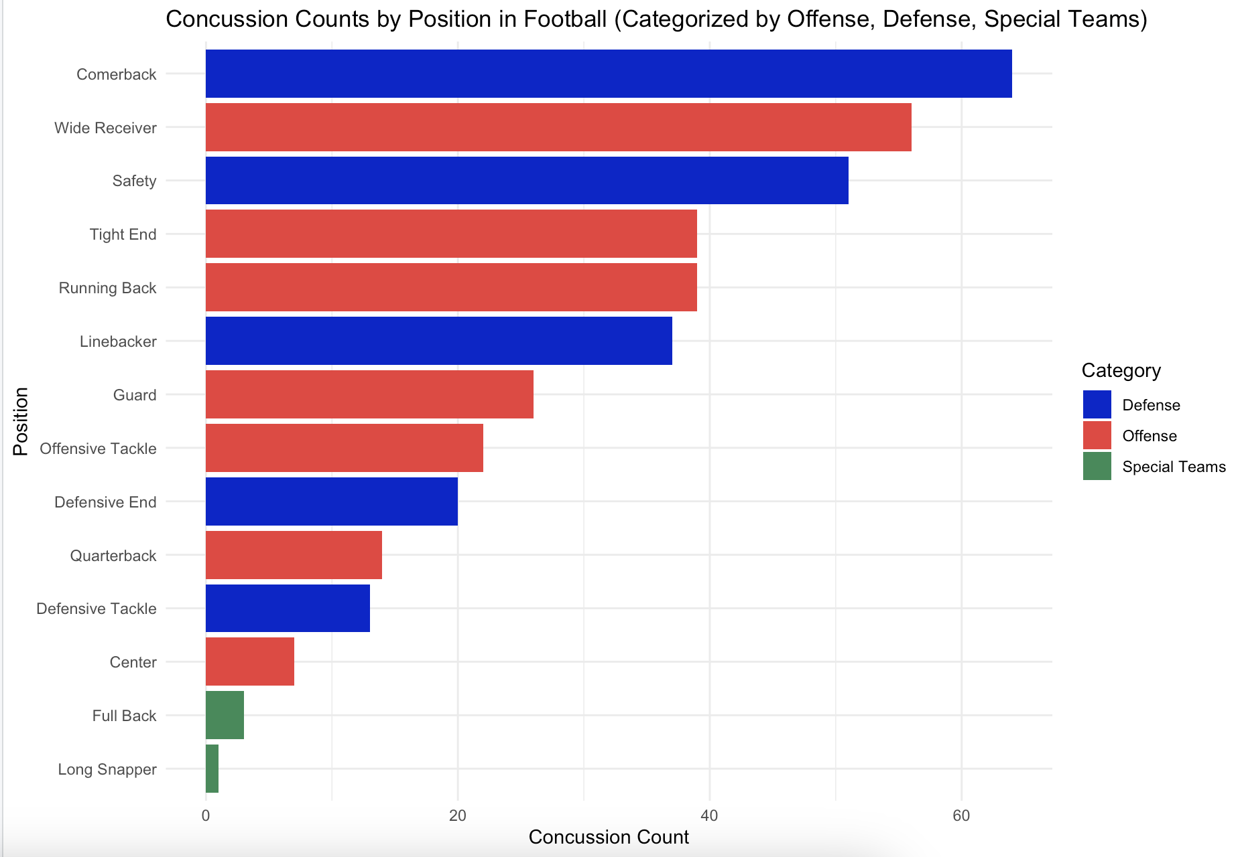
Finding 1: Position Matters
Our reports state that cornerbacks have the highest concussion rate out of any position.
The positions with the highest concussion rate tend to be in the open field.

Slide 5
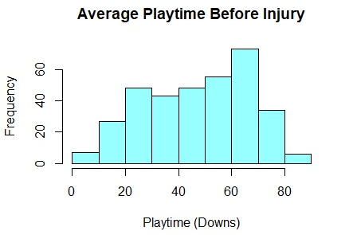
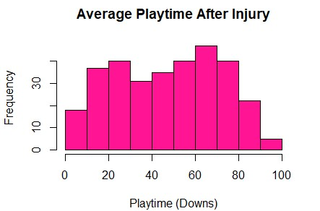
Finding 2: Playtime Decreases Post-Injury
The histogram of playtime before injury shows a slightly right skewed distribution
The histogram of playtime after injury is less skewed
These histograms shows that average playtime tends to decrease post-injury with a higher frequency of playtimes less than 20 downs

Slide 6
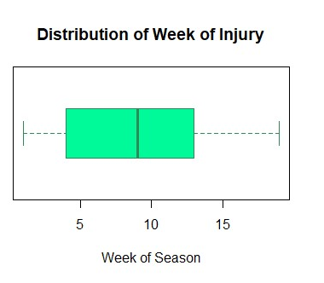
Finding 3: Most Likely to Get Injured Halfway Through Season
An NFL football season is 18 weeks
Based on the boxplot, we can see that the median is right under 10 weeks, hovering around 9 weeks
This is approximately halfway through the NFL football season
The boxplot is also right skewed
More likely to get injured in the 1st half of the season

Slide 7
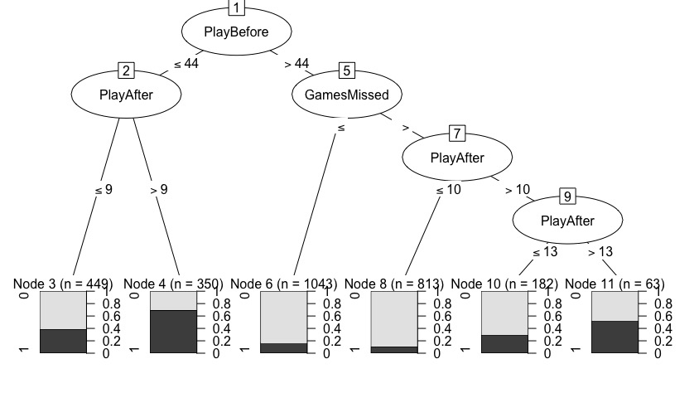
Finding 4: Team Success is Directly Correlated With Injury
Decision Tree
Target dependent variable: Is the team a winning team or not?
Key Nodes
PlayBefore: The amount of time a player is on the field
PlayAfter: The amount of time a player is on the field after an injury
GamesMissed: Are the coaches adhering to concussion protocol and benching players
Notes:
Association
Key measures:
1.Support/Count: frequency of the item set
2.Confidence: if ‘basket’ contains A, what is the probability it also contains B
3.Lift Ratio: a general measure of the association (Criteria?)
Should Remember:
1.Formula
2.Interpretation
3.Symmetrical?

Slide 8
Implications
Referees need to be on high alert for player safety in the middle of the season.
Skill positions are at the highest risk for injury.
Players can educate themselves on safe tackling practices and avoid big hits.
Too many players are remaining on the field after an injury.

Slide 9
Conclusion
Analyzing the concussion trends in the NFL allows us to conclude that the main takeaways players and referees should keep in mind are:
The NFL has made progress by improving policy, but there is still a lot of work that needs to be done.
Concussions are not just common with linemen and frequent heavy hitters.
Policy needs to be strictly enforced and strengthen penalties for violation of concussion protocol.

Slide 10
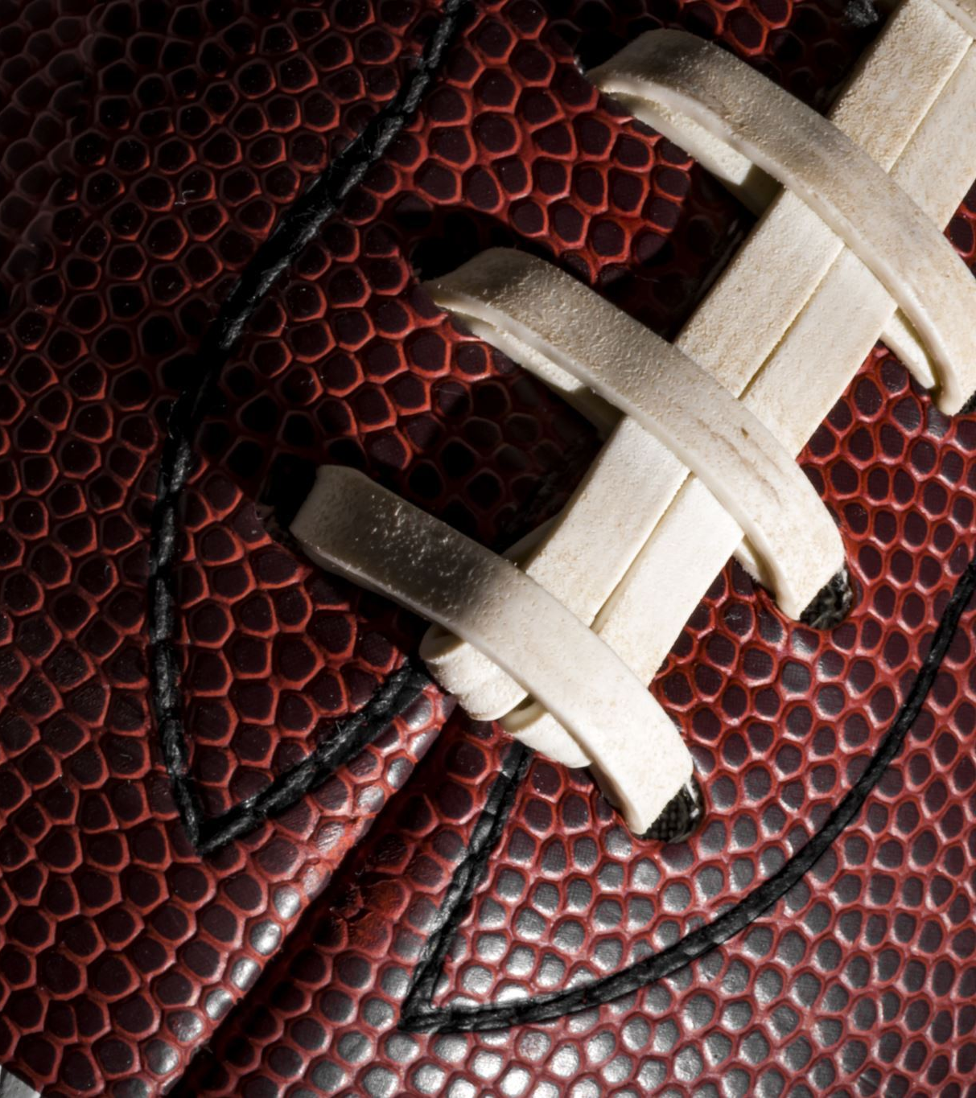
References
https://www.kaggle.com/datasets/rishidamarla/concussions-in-the-nfl-20122014
http://nflcombineresults.com/nflcombinedata_expanded.php?year=1999&pos=&college=
https://data.world/datasets/nfl

