Slide 1
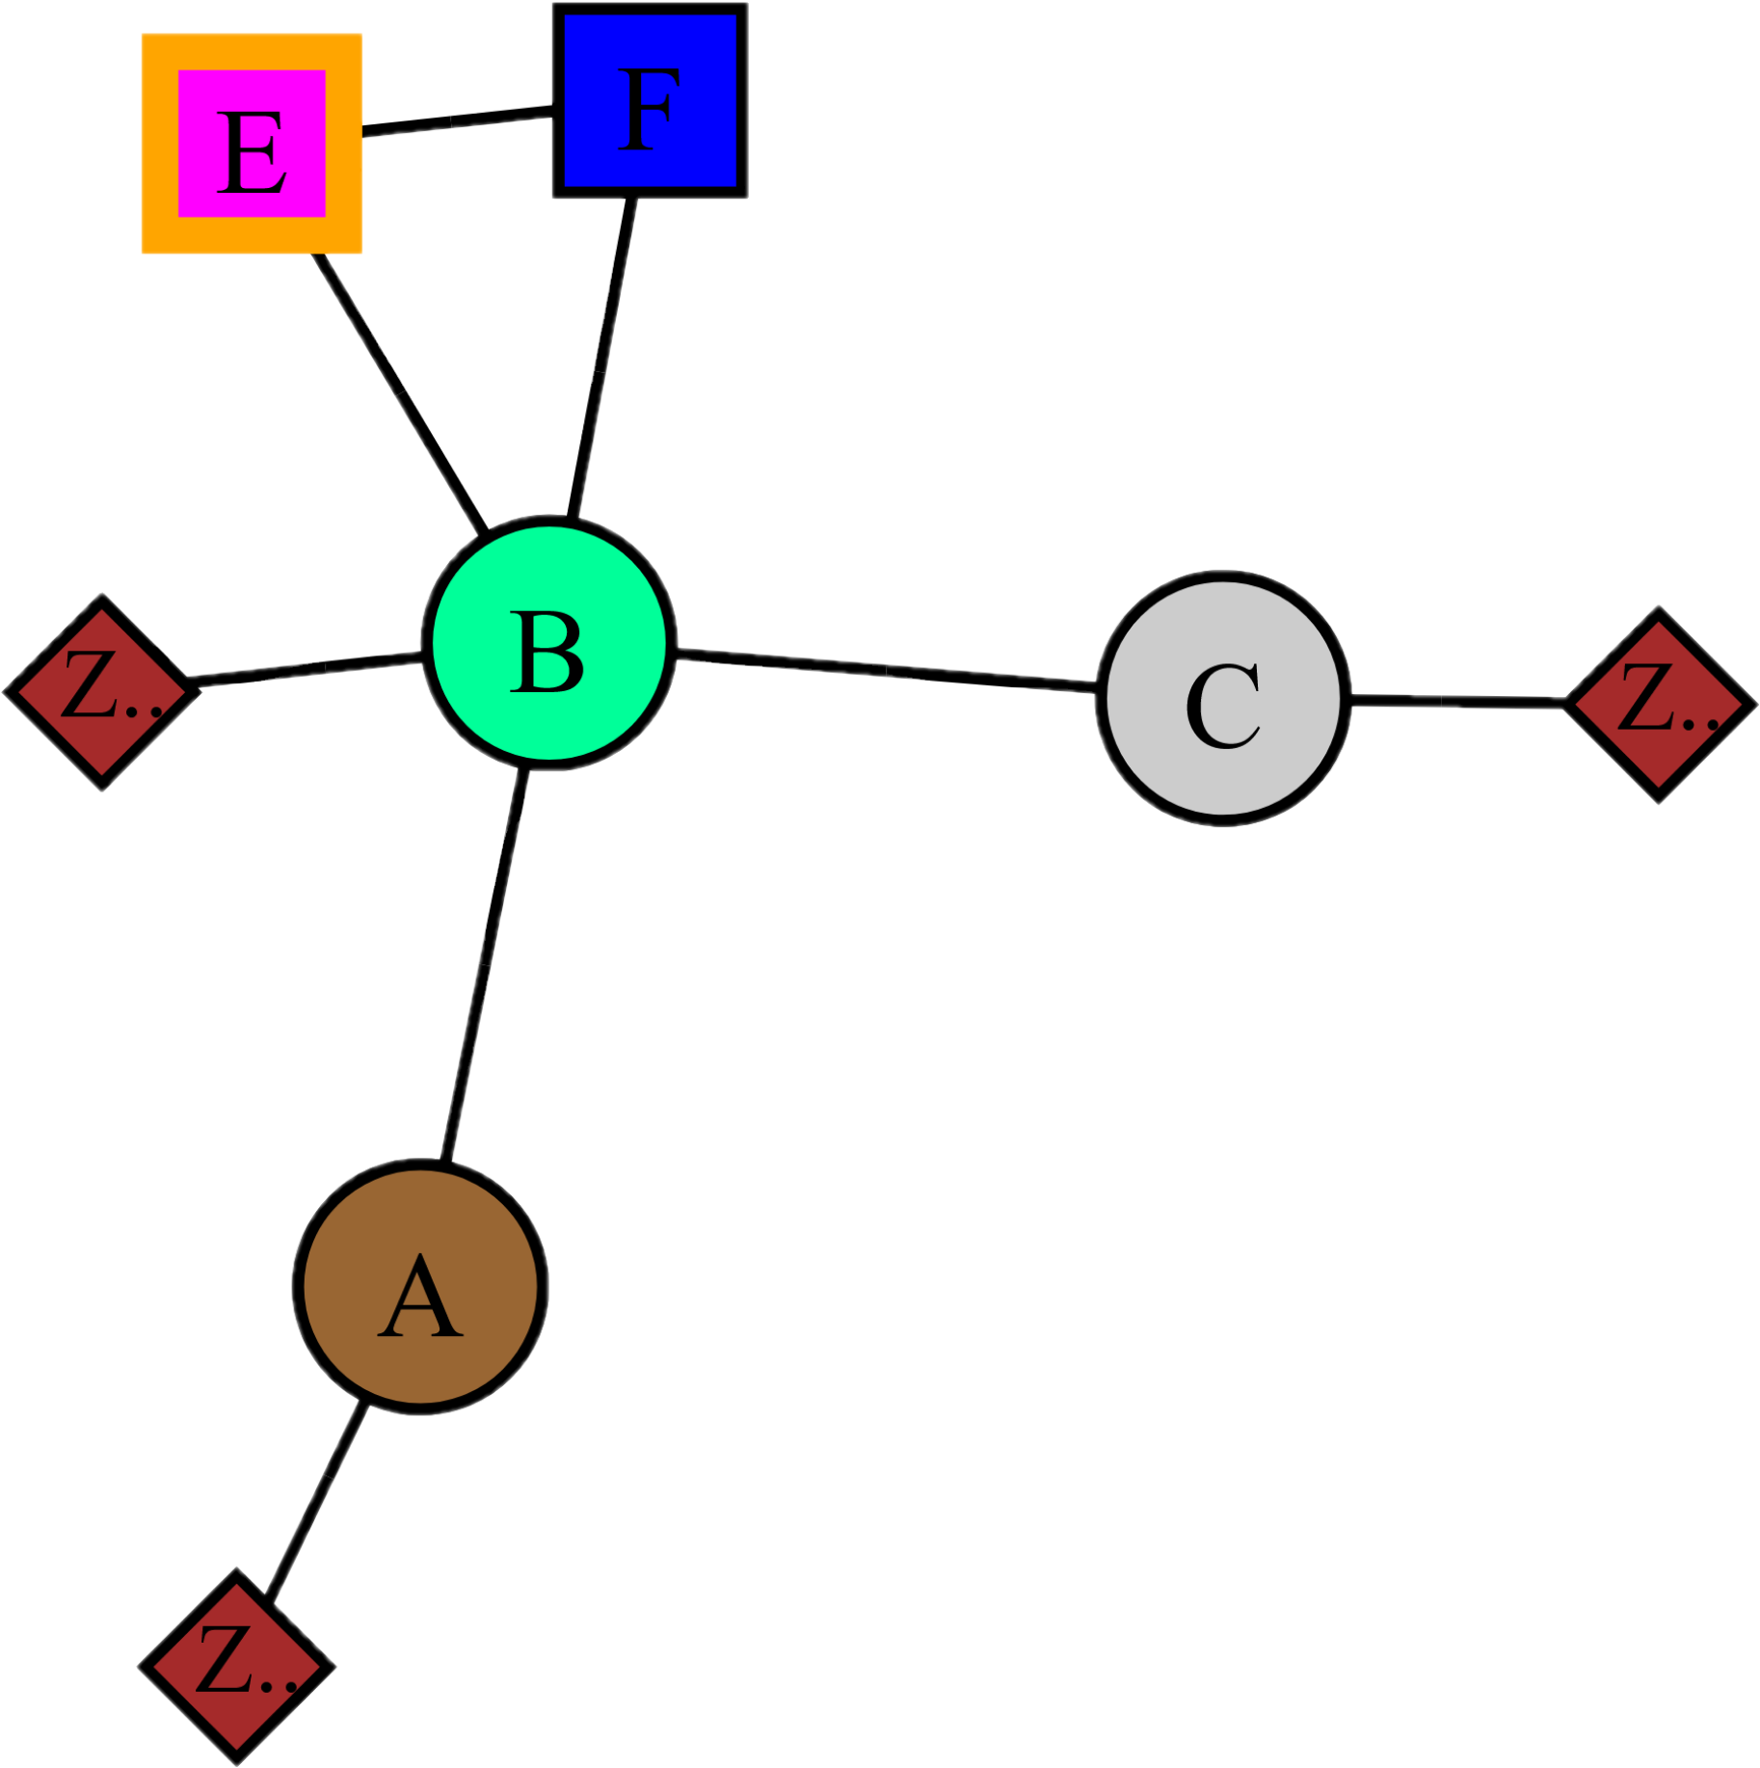
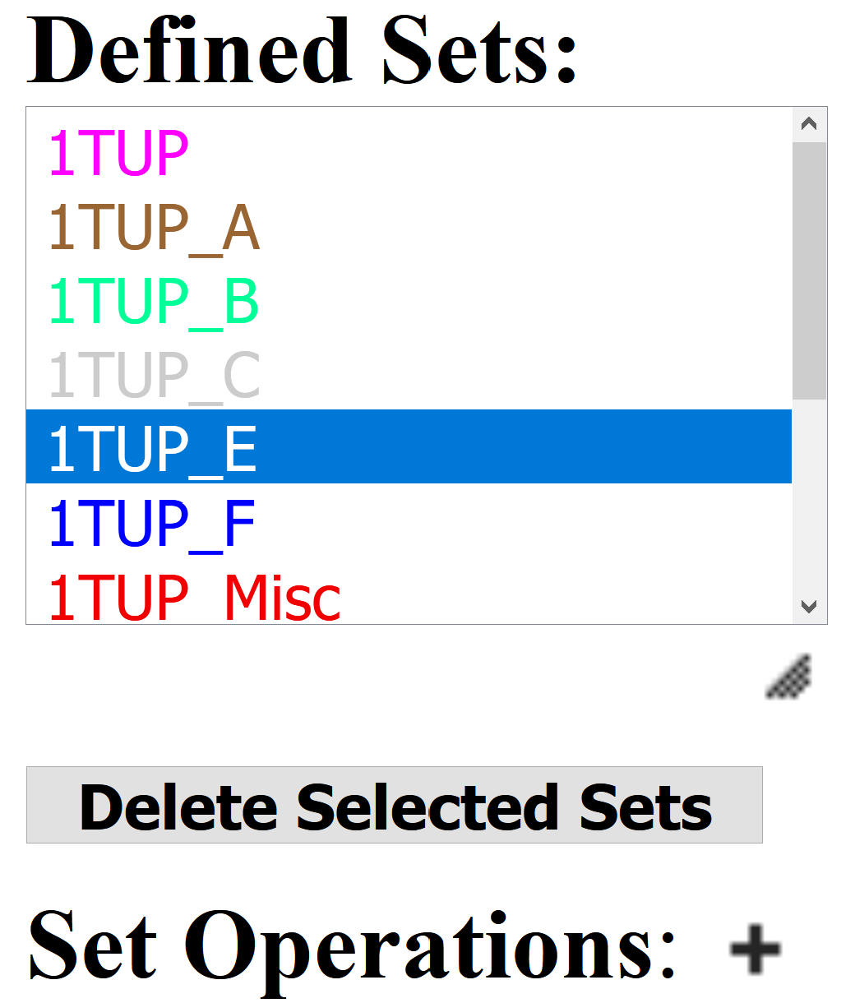
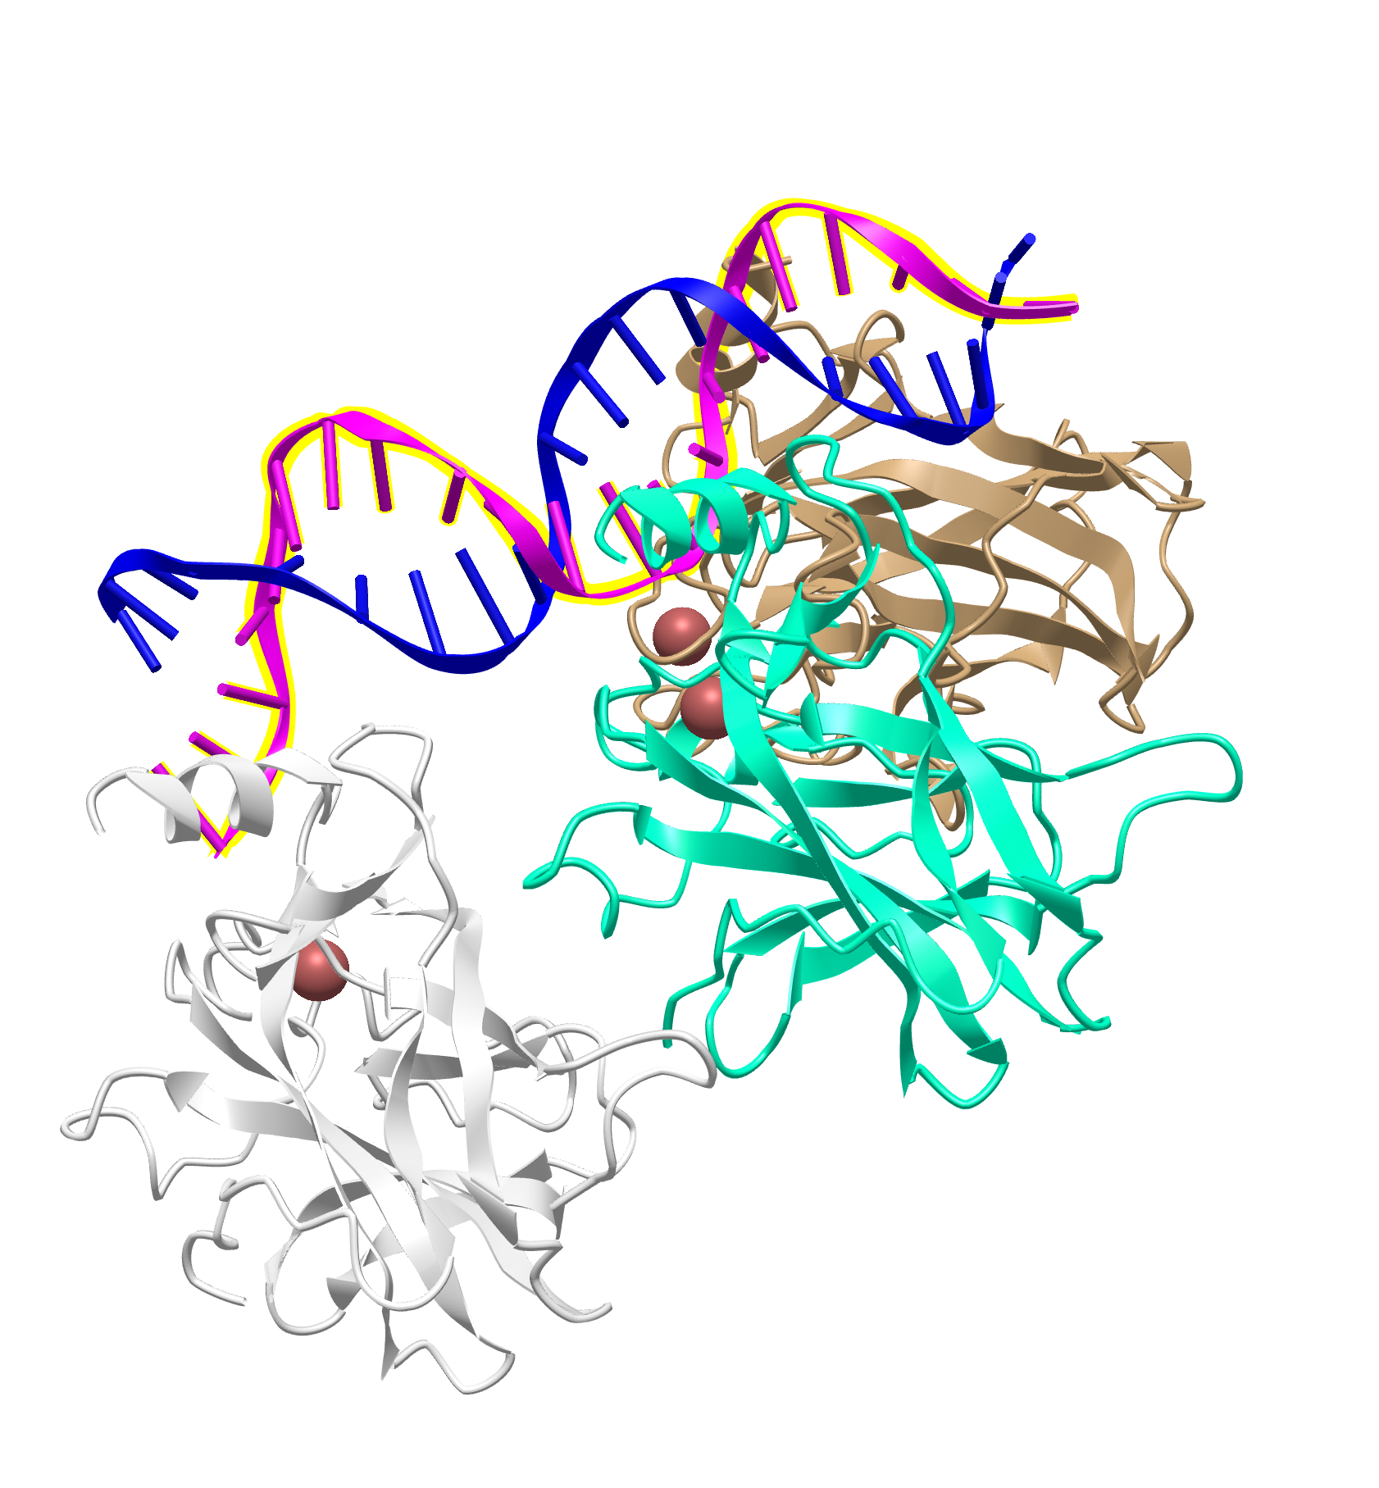

Macromolecular Complex Representations
2D Interactions
Defined Sets
3D Structure
1D Sequences

