Slide 1
Campaign Finance
By Remy Sorensen and Tim Prevo

Slide 2
Introduction

Slide 3
Key Points
Context/Background Information
Research Questions
Data and Plots
Analysis
Conclusion

Slide 4
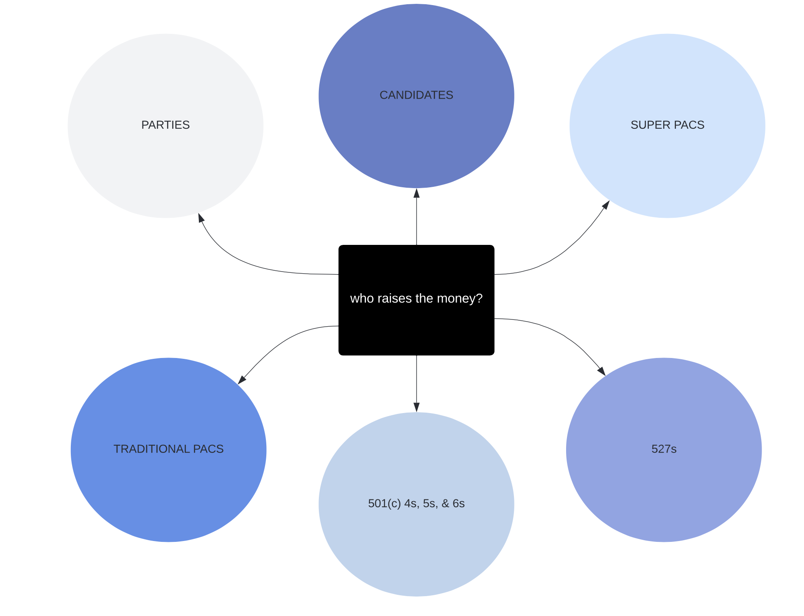

Slide 5
Definitions and Distinctions:
PACS: political action committees–raise money to help elect (or prevent the election) of a candidate or candidates.
501(c)s: tax exempt, nonprofit groups that may engage in political activity and are not required to disclose information about their donors.
527s: tax exempt groups organized to raise money for “political activities”. FEC only requires disclosure reports regarding PACs and political parties.
Campaign Committee: created by a candidate to fund/finance their campaign.

Slide 6
Preliminary Questions:
The questions we began with before formulating our hypotheses and analysis to guide the initial research and data exploration:
Which states have the strictest campaign finance policies, which are the most lenient?
Is there correlation between party ID and donation amount?
What are the stats of donations to each candidate or party by PACs, individuals, etc?
Where are the largest donations from? Who are they too?
Where are the smallest donations from? Who are they too?
Is there correlation between strictness of state policy and party ID?
Are incumbent candidates better funded? To what extent?
Subsequently, is there a correlation between incumbency and donation amounts?
What are the differences between PAC donations by state? or house vs senate?
Do females or males donate more to campaigns? Is gender relevant? Is it influenced by party ID?
How much influence does money wield? How does campaign funding affect success?
What differences will we find between state and federal elections? What are the financial differences in funding?

Slide 7
Research Question and Hypotheses:
Research Questions:
Is there a correlation between greater campaign finances and electoral wins on both a state-by-state basis and federal level?
How is campaign finance impacted by party ID (and state policy), and how does it does it differ state-by-state?
How do PACS, parties, individuals, etc. contribute to/fund campaigns? What does that distribution look like, and how does it vary?
Hypotheses:
It is hypothesized that party ID does not greatly impact fundraising outcomes–republican and democrat candidates receive similar ratios of contributions (i.e from PACs) and similar total donation amounts.
It is hypothesized that candidates that spend more money are more likely to win their election.
Notes:
I replaced the hypothesis, this is better formatted, hope that’s a correct interpretation.
Challengers and incumbents are more likely to win an election when they have higher campaign finances.

Slide 8
Data:
Sources:
FEC: Federal Election Commission
Political MoneyLine
Open Secrets
NCSL: National Conference of State Legislatures
Coalition for Integrity
Follow the Money
Kaggle
Modern data, 2020 & 2022

Slide 9
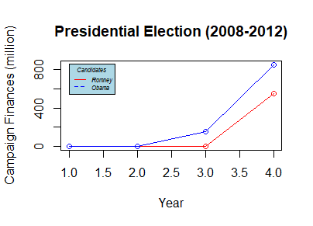
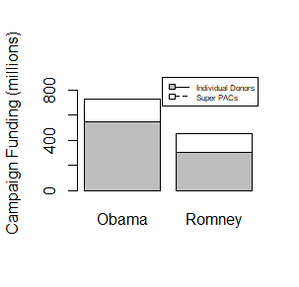
Data Visualization Of Federal Elections (2012)
Barack Obama Total: $847,366,151
Mitt Romney Total: $550,729,150

Slide 10
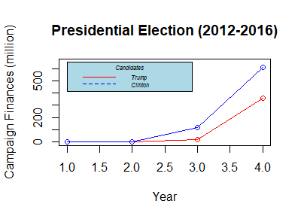
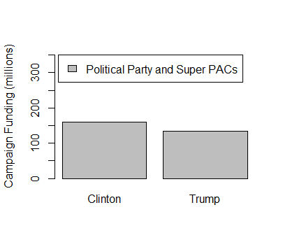
Data Visualization Of Federal Elections (2016)
Hillary Clinton Total: $612,381,250
Donald Trump Total: $358,116,002

Slide 11
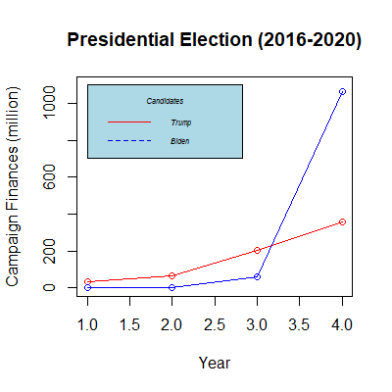
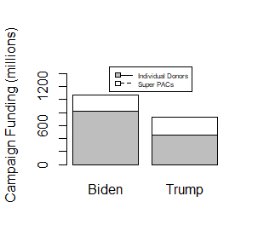
Data Visualization Of Federal Elections (2020)
Joseph Biden Total: $1,074,179,975
Donald Trump Total: $744,350,229

Slide 12
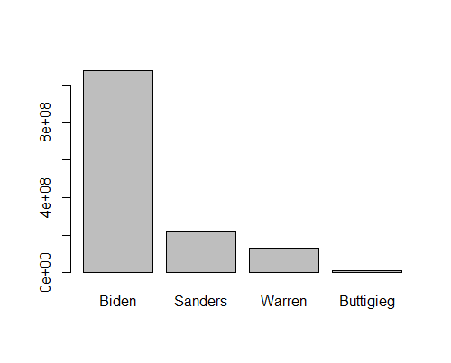
Party Candidate and Campaign Finances(2018-2020)
Joseph Biden: $1,074,179,975
Bernie Sanders: $218,907,026
Elizabeth Warren: $131,368,111
Pete Buttigieg: $102,73,974

Slide 13
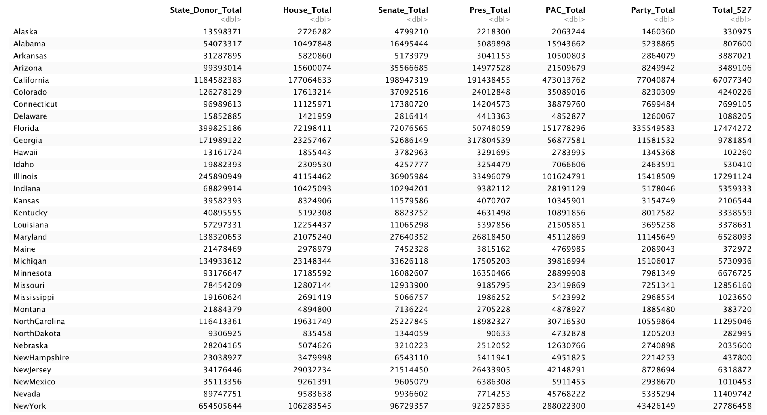
EDA for state-by-state:

Slide 14
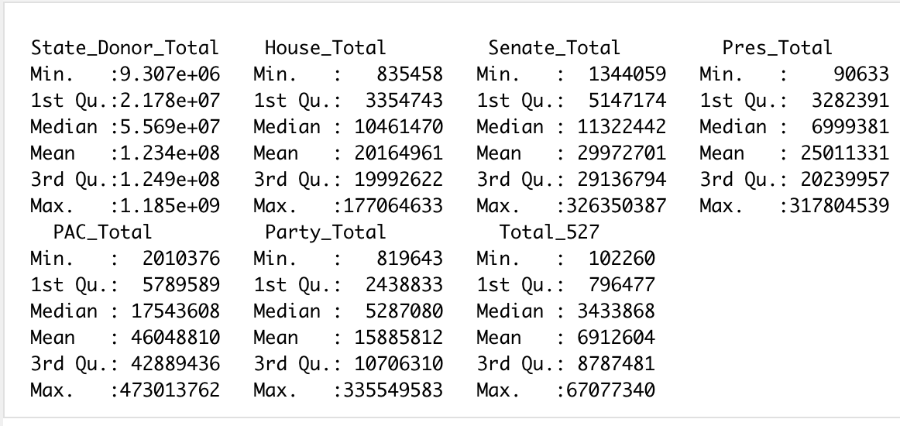
EDA for state-by-state:
Summary of all 50 states

Slide 15
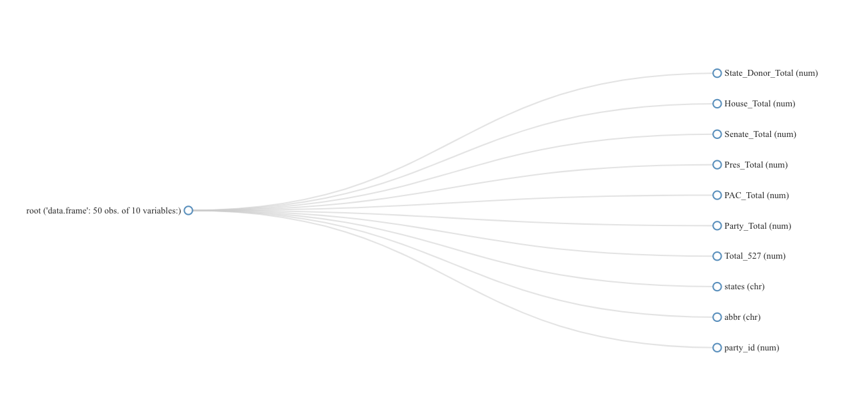

Slide 16
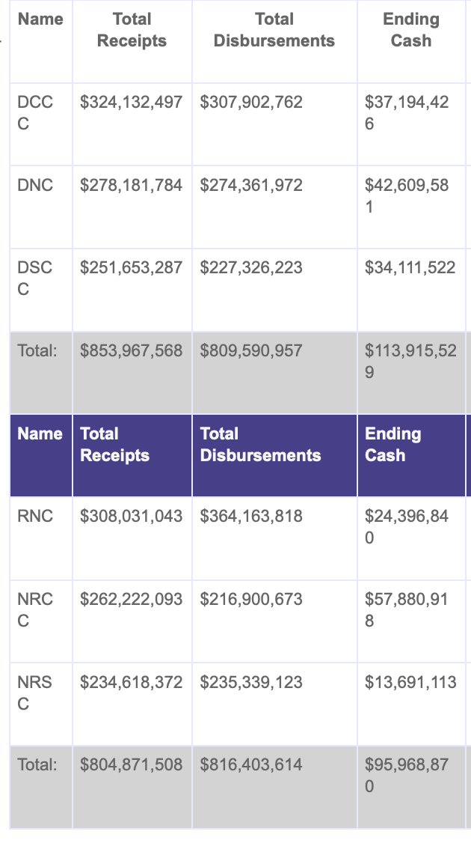
For party id:
I classified each state as red or blue by referencing the 2020 electorate and the 2022 senate, and added a column of 1s and 0s to my df.
1 = red
0 = blue
Political MoneyLine

Slide 17
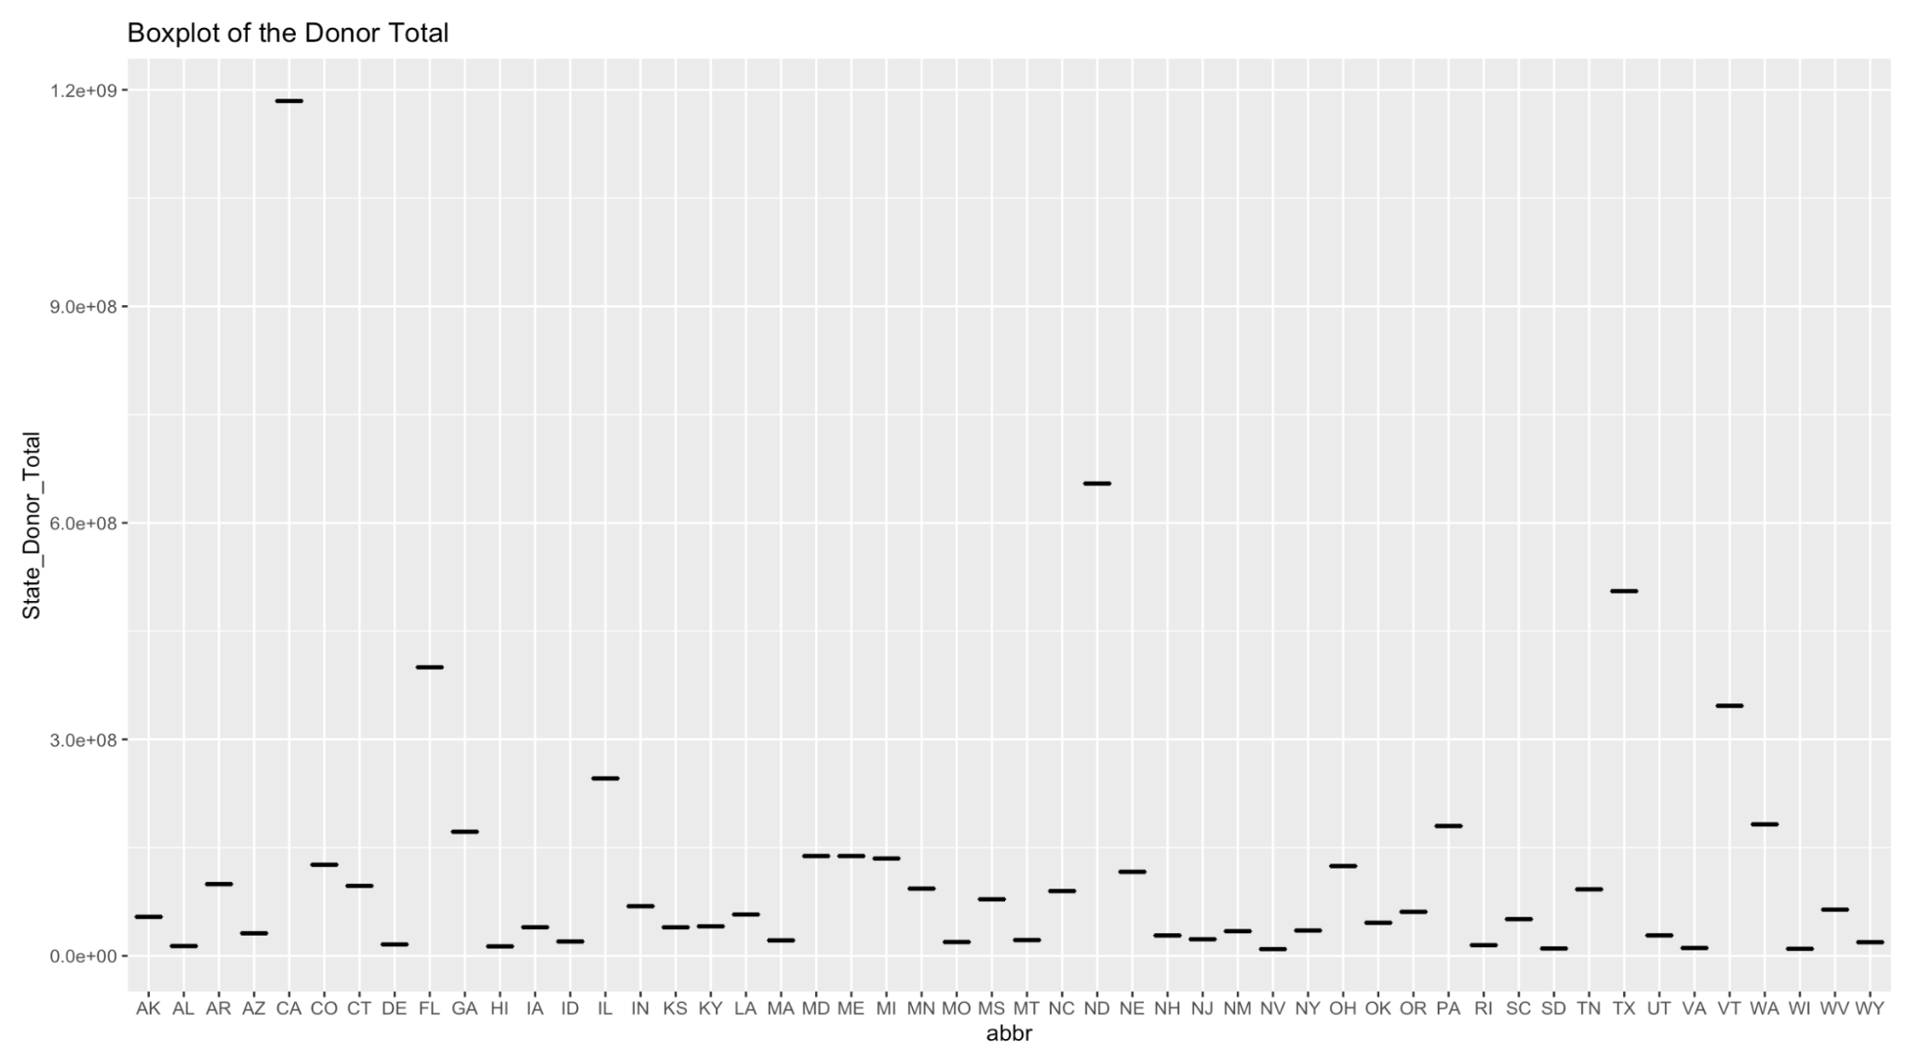

Slide 18
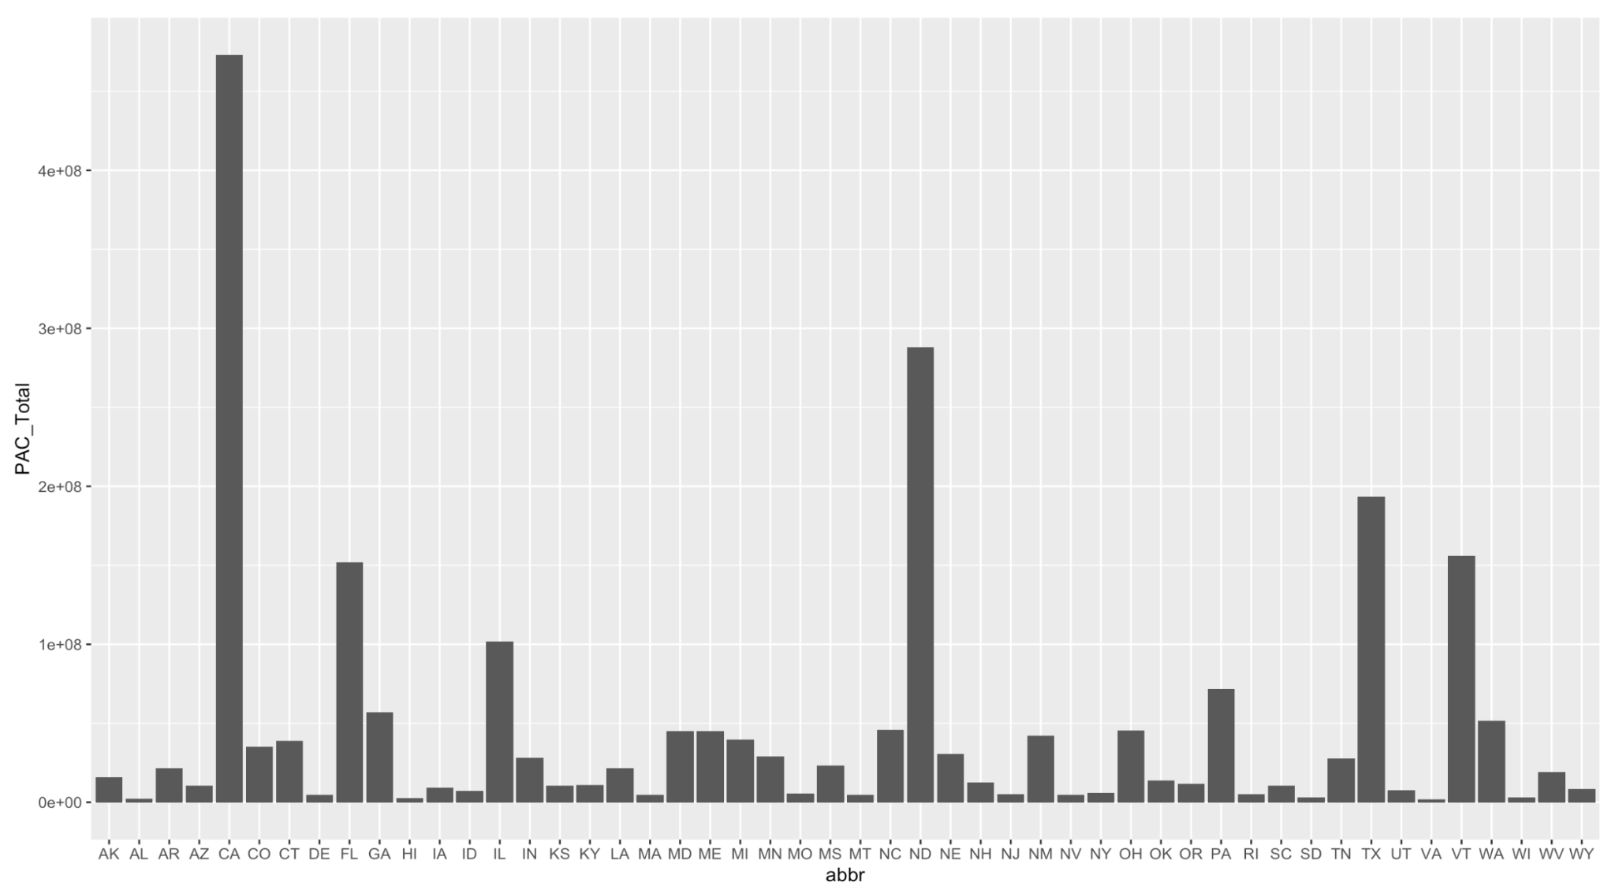

Slide 19
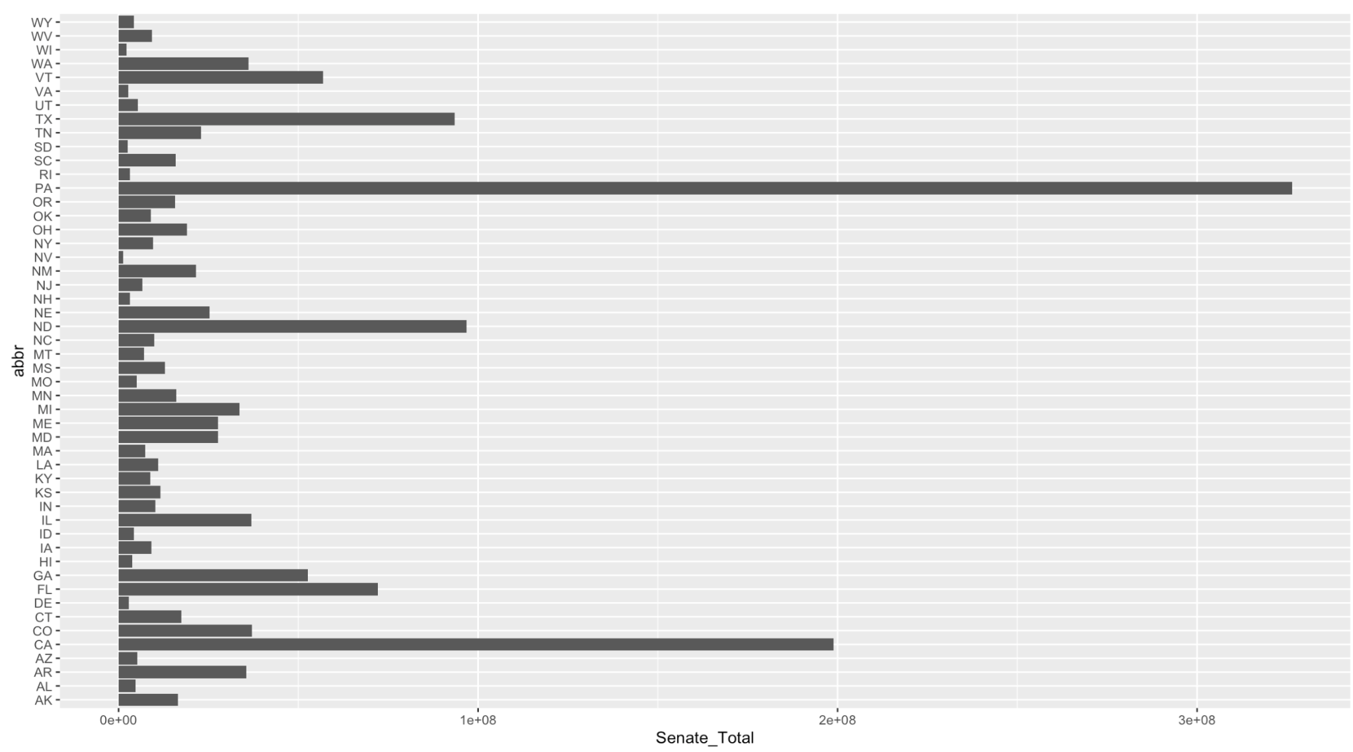

Slide 20
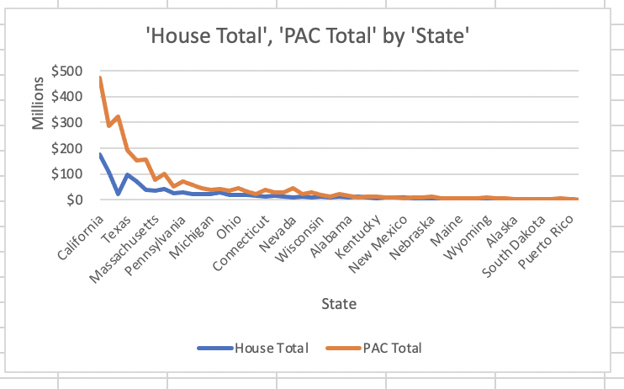

Slide 21
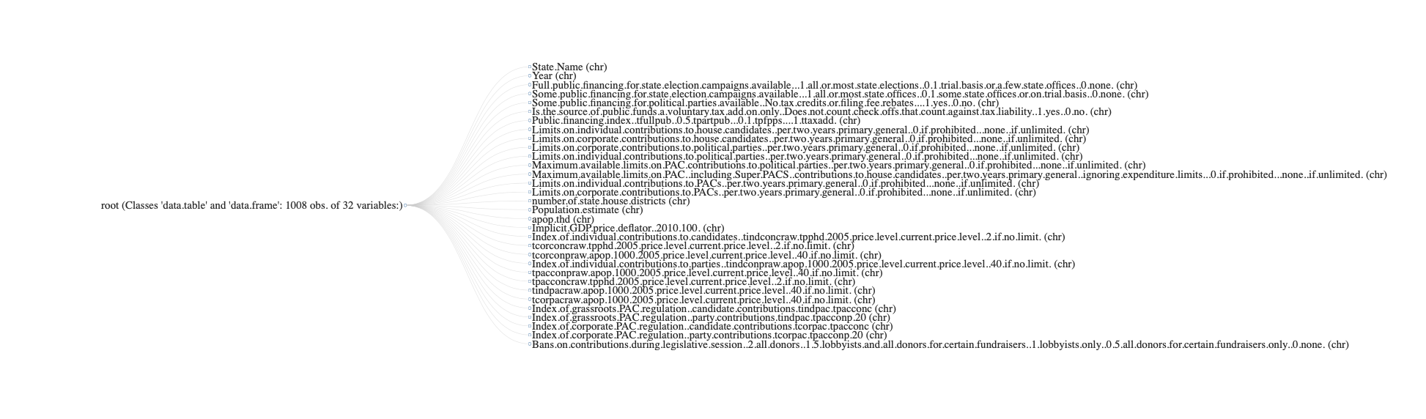

Slide 22
Findings (still in progress):
Federal Level:
During presidential elections there was evidence to support that candidates who had greater spending power, due to higher campaign finances, were more likely to win the election.
Party candidates are more likely to represent a party if they received more donations
State-by-State:
Red states have less restrictive policies, specifically regarding PACs and individual contributions
(so far) blue states steadily have marginally higher total donations—this holds true for both the senate and the house
Overall:
PACs are biggest donors and are the most successful fundraisers in campaign finance (above candidates, parties, individuals, party committees, etc)
There is an incumbency advantage when it comes to fundraising

Slide 23
Conclusion
To Finalize: Modeling, Analyzing Ratios, & Regression
Notes:
For me ^

Slide 24
Sources:
Presidential candidate data summary tables (fec.gov)
https://www.infoworld.com/article/3586147/how-to-create-an-election-map-in-r.html
https://r4ds.had.co.nz/functions.html
https://www.opensecrets.org/resources/learn/glossary.php
https://guides.libraries.emory.edu/c.php?g=944707&p=6810110
https://magicbaltimore.com/3327814/heres-a-list-of-major-corporations-donating-to-support-to-their-political-party/
http://ippsr.msu.edu/public-policy/correlates-state-policy
https://www.fec.gov
https://www.cambridge.org/core/journals/state-politics-and-policy-quarterly
ConCand1_2020_18m.pdf (fec.gov)
ConCand7_2020_18m.pdf (fec.gov)
State Legislative Campaign Finance Research: A Review Essay - Graham P. Ramsden, 2002 (sagepub.com)
https://www.followthemoney.org
https://politicalmoneyline-com.eu1.proxy.openathens.net
https://www.cnn.com/2019/05/14/business/republican-democrat-ceos
https://www.coalitionforintegrity.org/state-campaign-finance/
https://aceproject.org/ace-en/focus/campaign-finance/onePage
https://mathstat.slu.edu/~speegle/_book/RData.html
https://electionlab.mit.edu/data
http://www.ippsr.msu.edu/public-policy/correlates-state-policy
https://www.statepolicyindex.com/data/
https://www.poliscidata.com/pages/statisticalDataCollections.php
https://www.ncsl.org/research/elections-and-campaigns/campaign-finance-regulation-state-comparisons.aspx

