Slide 1
CLINICAL IMPORTANCE OF LIVER FUNCTION TEST
A PRESENTATION BY: AFUKIA TENI RUBBY AND
OPHELIA NKRUMAH

Slide 2
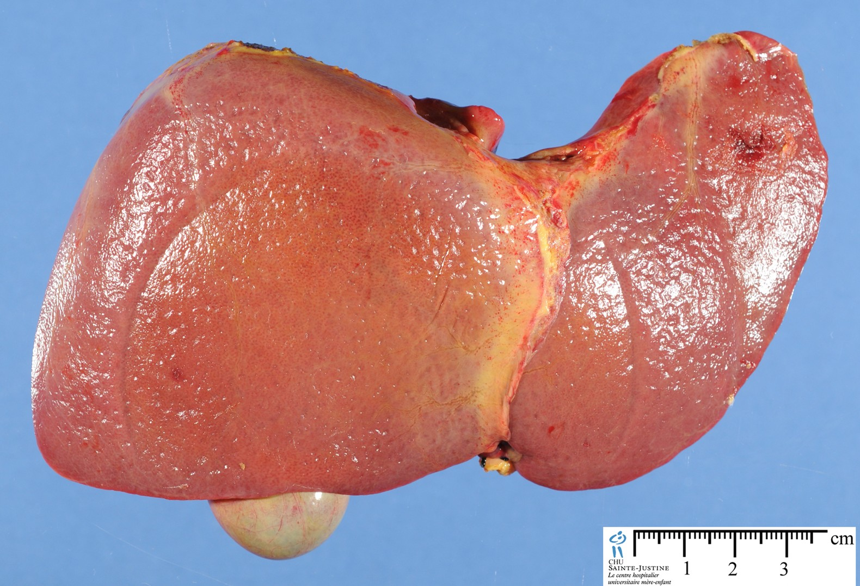

Slide 3
ANATOMY AND PHYSIOLOGY OF LIVER
The liver is the largest and heaviest(1.0-1.5kg) organ in the body and also the only organ in the human body that can regenerate from damage or partial hepatectomy.
The liver is located at the upper right portion of the abdominal cavity, beneath the diaphragm, and on top of the stomach, right kidney, and intestines.
The liver serves functions such as metabolism, storage, detoxification and synthetic.

Slide 4
SYMPTOMS WARRANTING REQUEST OF LFT
Chronic Fatigue
Jaundice
Pain and distention of the abdomen
Dark colored urine
Nausea

Slide 5
CLINICAL IMPORTANCE OF LFT
Screening
Assess Prognosis
Diagnosis
Evaluate Therapy
Determine the severity of a disease

Slide 6
PARAMETERS OF LFT
PROTEINS
LIVER ENZYMES
SERUM BILIRUBIN

Slide 7
MARKERS OF HEPATIC SYNTHETIC CAPACITY OF THE LIVER
PROTHROMBIN TIME- Used mainly to assess how well the liver is performing its synthetic function concerning the production of clotting factors.
ALBUMIN- Increase of albumin is seen in sepsis, burns etc. and a decrease of albumin can be due to malnutrition, cancer, cirrhosis or first few weeks of pregnancy.

Slide 8
MARKERS OF HEPATOCELLULAR NECROSIS
Increased ALT,AST and GGT as a result of their leakage from the damaged hepatocytes, alcohol abuse, obesity, diabetes, drug hepatoxicity.
An elevated amount of ALT and AST means damaged hepatocytes
AST/ALT Ratio is useful in differential diagnosis; ratio = 1 indicates acute viral injury and a ratio > than 2 indicates alcohol hepatitis

Slide 9
FATTY LIVER DISEASE
Symptoms include: abdominal swelling, enlarged blood vessels just beneath the skin’s surface and red palms.
Results as a result of the reduced ability of the liver to breakdown fats leading to its build up on the liver. Intake of excess calories and obesity also contributes to a fatty liver.
ALT is the specific marker that shoots out with a fatty liver.

Slide 10
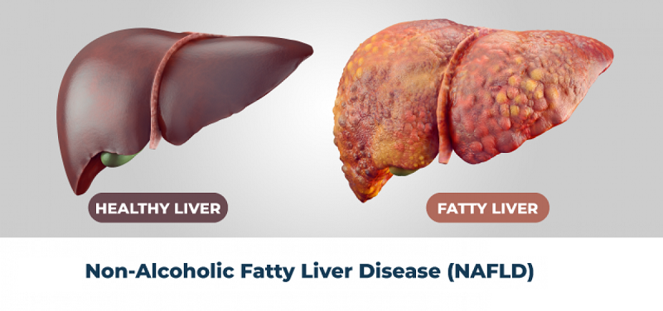

Slide 11
CHOLESTASIS
Condition in which the flow of bile is impeded and can also lead to the build up of bilirubin since bilirubin is the main pigment of bile.
Common symptoms include intense itching, dark urine and jaundice.
Increased serum concentration of conjugated bilirubin is a principal sign of cholestasis.
elevation of ALP and GGT is observed in cholestasis.

Slide 12
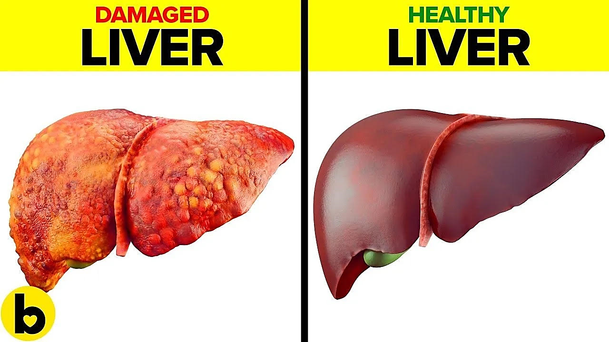

Slide 13
REFERENCES
www.healthline.com
https://slideplayer.com
CHEMICAL PATHOLOGY LECTURE NOTES II PAGES 31 AND 32

Slide 14
THANK YOU

