Slide 1
Value Driven, Hierarchical Approach to Warehouse Design
Design of a forward area

Slide 2
Motivation
Designing a warehouse involves making a lot of decisions, many decision variables, large design space
Variety of models to analyze parts of the warehouse design problem but no framework combining these models
Idea:
Develop a design hierarchy that structures the design space and simplifies searching it
Integrate the separate models into the design hierarchy to make decisions on each level, thereby truncating the design space

Slide 3
Methodology
On each level of the hierarchy a value driven approach is used to choose promising designs to take to the next level of the hierarchy and explore them further
Tradeoff curves on each level provide decision support to an expert on which designs to further investigate
SKU- & order profile of the warehouse, as well as a proxy model are used in order to calculate metrics for trade-offs on each level

Slide 4
Design Hierarchy
Design hierarchy for the forward design problem
Meta-hierarchy:
Structure
Behavior
Control
The design hierarchy developed for the forward design problem here is an instance of this meta hierarchy

Slide 5
Design Hierarchy Forward Design
Structure
Behavior
Control

Slide 6
Implementation
Object-oriented implementation in Matlab
Each of the screening levels of the hierarchy produces a number of different possible designs of the forward area and compares them in trade off curves to support the design decision
Each possible design and information gained by the screening process is saved as a storage department object
Each level of the hierarchy refines the storage department
Metrics are calculated by Monte-Carlo sampling orders and calculating travel times for pick tours / each stop

Slide 7
Implementation
Structure of the object-oriented implementation in Matlab

Slide 8
Proxy Model
Assumptions for proxy model:
Picker to goods
Ladder structure, top and bottom cross aisle, central base
Controller :
SKU assignment by frequency of access
1 SKU per opening
Quantity required to never stock out fits in opening
Dedicated storage policy
Slotting according to most frequent <-> most desirable
Routing: TSP
Batching according to pick equipment capacity
Warehouse Object:
Average order lines = 10
Total number of SKUs = 5000
Orders per year = 250,000
Interest rate = 10%
Amortization horizon = 5 years
Storage Department Object:
Cross aisle width = 10 feet
Shape factor = 1 (square)
Maximum height = 5 levels
Time penalty per stop = 2 seconds
Fleet size = 1 vehicle/picker
Pick Equipment Object:
Required aisle width = 10 feet
Capacity = 3 orders (can be picked at the same time)
Vertical velocity = 65/60 feet per second
Horizontal velocity = 600/60 feet per second
Fixed cost = $39,000
Variable cost = $12 * 1.5
Storage Equipment Object:
Opening width = 3.33 feet
Opening length = 4 feet
Opening height = 4 feet
Fixed cost = $75 * number of openings

Slide 9
Structure Screening – Part 1
Screening for the storage height and percentage of SKUs in the forward area
Metric to support decision: mean travel time per stop and footprint of the forward area
Monte Carlo simulate average travel time per stop (Monte Carlo sample orders and batches based on average number of order lines and proxy model assumptions about the batch size: 3 orders picked at once, calculate distances between storage locations included in tour, calculate travel time for tour, divide by number of stops)

Slide 10
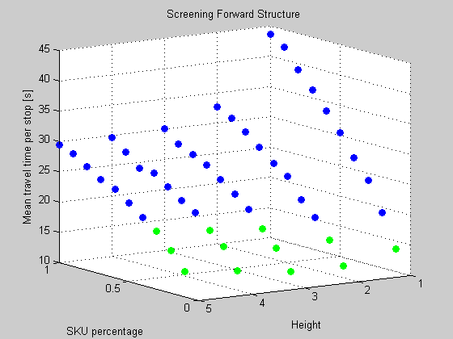
Structure Screening – Part 1
The graph shows the tradeoff between storage height (space utilization), SKU percentage, and travel time per stop
Each point represents a different configuration of the forward area, depending on storage height and SKU percentage
Green points indicate storage departments that fulfill constraints on the mean time per stop and the footprint of the area
For high percentage of SKUs the mean travel time per stop decreases with height
For small percentage of SKUs the mean travel time per stop initially decreases, then increases with height
SKU level of 100 percent represents reserve area
Out of these configurations the one with the lowest travel time per stop is chosen to be taken to the next level of screening → 2 high and 10% of SKUs in the forward area

Slide 11
Structure Screening – Part 2
Screening for the shape parameter of the forward area
Shape factor 1 (square) to 12 (12 times as long as wide) in steps of 0.2
Metric to support decision making: mean travel time per stop
Monte Carlo simulate average travel time per stop
Shows the tradeoff between larger number of aisles and longer aisles

Slide 12
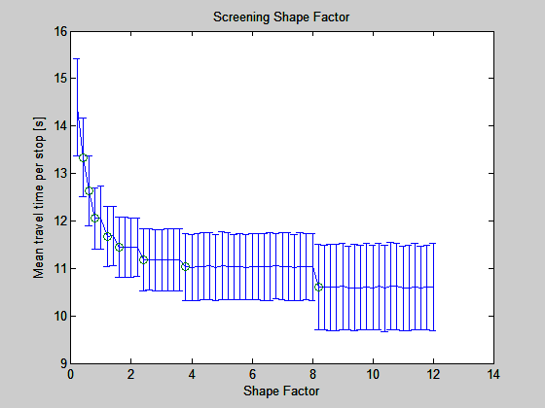
Structure Screening – Part 2
Plot of the mean travel time per stop and its variance, depending on the shape parameter
Circles around the mean indicate that at this shape factor an aisle gets truncated
The forward area with the lowest travel time per stop is chosen to be further explored on the next level of the design hierarchy → 2 high, 10% of SKUs in the forward area, shape factor 8.2

Slide 13
Behavior Screening
Screening for the fleet size (homogeneous fleets), pick equipment capacity, vertical and horizontal speed
Metrics to support decision making: time required to clear out 100 orders (proxy for throughput), average time per tour (proxy for service level), capital cost, and variable cost → 4 dimensional space
Monte Carlo simulate tours for 100 orders (Monte Carlo sample 100 orders and batch them according to the chosen pick equipment capacity, calculate distances between storage locations included in tour, calculate travel time for tour, assign tours to pickers (number of pickers = fleet size))
Variable cost = PV [time it takes to pick all orders over the planning horizon * loaded wage * fleet size]
Capital cost = investment cost in pick- and storage equipment
Two different ways to search the design space and find the points to be evaluated on this level of the hierarchy:
Latin Hypercube Sampling (can be compared to having a catalogue of equipment to choose from) or
Genetic Algorithm (find the “best” equipment and see if you can find a similar one in an equipment catalogue)

Slide 14
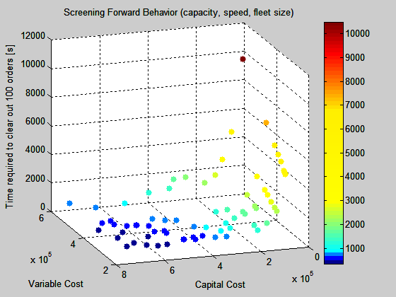
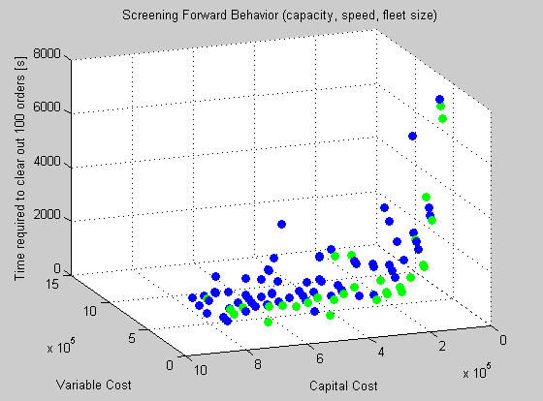
Behavior Screening – Part 1
Trade off between the time required to clear out 100 orders and variable and capital cost generated by a design
Each point represents another design of the forward area
Pareto front found by a Genetic Algorithm
Green points: Pareto front found using Latin Hypercube Sampling

Slide 15
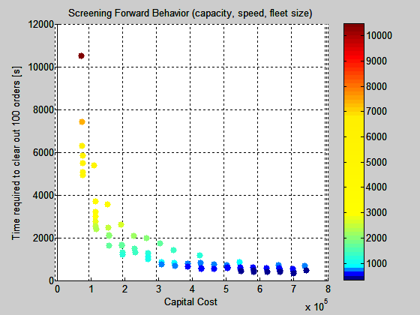
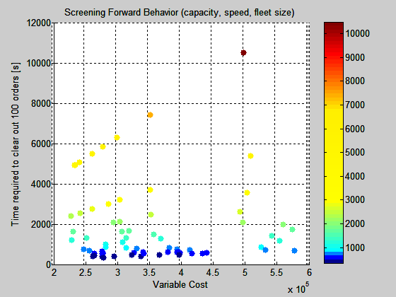
Behavior Screening – Part 1
Time required to clear out 100 orders decreases with increasing investment cost

Slide 16
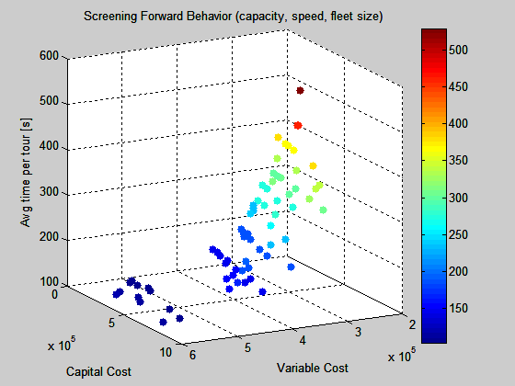
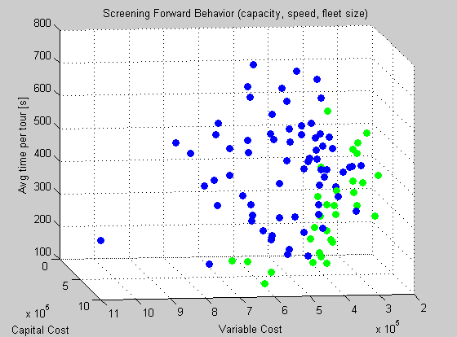
Behavior Screening – Part 2
Trade off between average time per tour and variable and capital cost generated by a design
Pareto front found by Genetic Algorithm
Pareto front found using Latin Hypercube Sampling

Slide 17
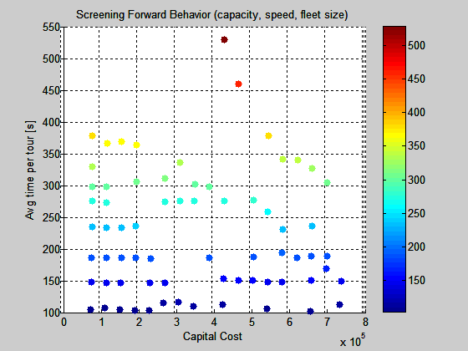
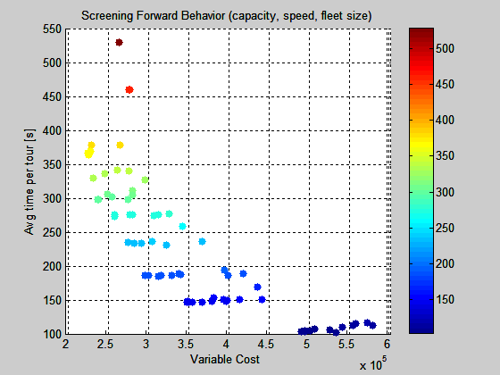
Behavior Screening – Part 2
Average time per tour decreases with increasing variable cost
For each level of investment cost the time per tour can be decreased by using more pickers (increasing variable cost)
Trade-off between service level and efficiency (higher service level <-> shorter, less efficient tours)

Slide 18
Next steps in the Hierarchy
Screening control policies: storage policy, slotting, routing, batching

Slide 19
What’s new to this approach
Hierarchical search method to warehouse design
new to warehouse design
meta-hierarchy Structure/Behavior/Control + Screening
instance of Structure/Behavior/Control for warehouse design + Screening
proxy concept (object oriented)
Computational implementation
Object-oriented
Matlab

