Slide 1
Computer vision
MSK Project 2018-2019

Slide 2
Who?
Bert De Saffel
Timothy Thiecke
Notes:
Wie zijn we

Slide 3
What?
Program/algorithm to localize user in Museum of Fine Arts (MSK) building in Ghent
Segmentation and extraction of images
Feature extraction
Matching
Path tracking

Slide 4
Why?
Introduction to computer vision
Use case
Mobile app
Notes:
Voornaamste case is om het in een mobiele applicatie te steken zodat mensen informatie over het schilderij / ruimte te weten komen

Slide 5
How?
Python 3.7.3
OpenCV libraries
Github

Slide 6
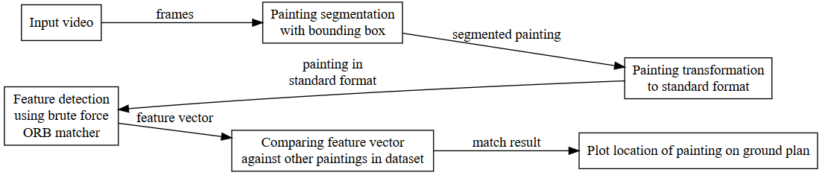
Block diagram

Slide 7
Painting segmentation
Resizing
Canny
Dilatation
Contours
Approximation to quad
Conversion to standard format through homography

Slide 8
Feature detection
ORB
Efficient alternative to SIFT
Feature points and descriptors

Slide 9
matching
Brute Force matcher
Extracted vs database

Slide 10
Database
Feature detection takes a while
Persistency by saving to disk
Metadata, feature points, descriptors

Slide 11
matching
Brute Force matcher
Extracted vs database
Linear lookup per segmented picture
Straightforward
Linear lookup per video
CPU intensive!
Matching procedure started every 50 frames
Realistic
Saves on processing time

Slide 12
Path tracking
Meta data of matched painting
Room number
Expandable (cf. database)
Graph of floor plan
Marking of nodes
Started
Visited
Current/ended
Strict!

Slide 13
DEMO

Slide 14
Quantitative evaluation
Ground truth
Random sample (n = 30) from dataset
1 minute segment of video

Slide 15
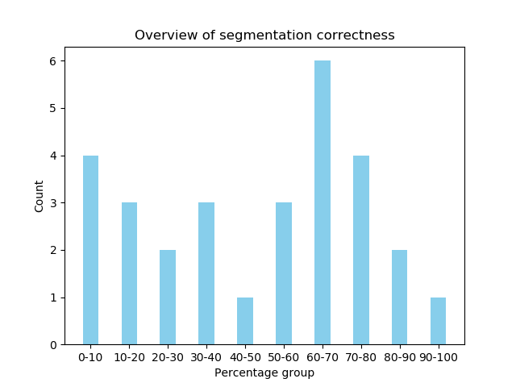
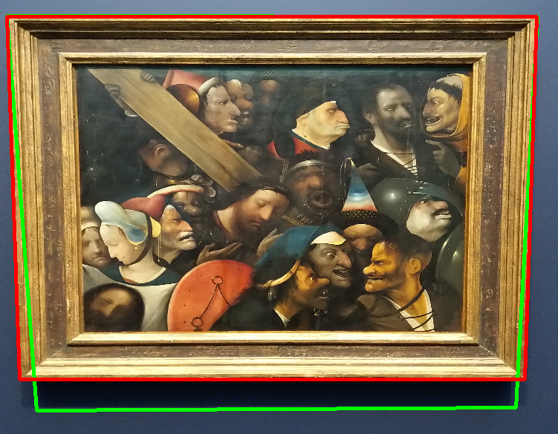
Quantitative evaluation
Segmentation accuracy
Ratio of shared area between two polygons
0.0 = no shared area
1.0 = perfect overlap
88.57% correctness

Slide 16
Quantitative evaluation
Matching accuracy
True or false
Manually evaluated
47.10% correctness

Slide 17
Qualitative evaluation
Strengths
Simple
Too simple?
Relatively fast
But can definitely improve!
Invariant
Resilient without segmentation

Slide 18
Qualitative evaluation
Flaws
Prone to image size
Resize necessary
%25 > x16 less pixels
Potential loss of information
Assumption of correct match
Smallest sum of matches
Descriptor count mismatch!
Segmentation not perfect
Smaller quad detectable but not a valid painting
Matching in linear time
Exhibits O(n²) behaviour
Database of at least 688 x 40 000 elements to compare
Brute force matching

Slide 19
conclusion
Frame segmentation strongest
Generalize polygon approximation
Need focus on matching procedure
Quantitative
And qualitative
Parts of algorithm can be swapped
Different types of objects to be matched
Other location / ground plan
Notes:
Generalize polygon approximation: currently only support extraction of polygons that are quads, problem when polygons with sides > 4 because transforming to standard format is not easy then
Parts of algorithm can be swapped: modularity

