Slide 1
Discovering Causal Relationships Between the Metabolome and DNA Methylation in Type 1 Diabetes Using Bayesian Networks
Tim Vigers

Slide 2
Brief Overview
Type 1 diabetes (T1D) is an auto-immune disease characterized by the destruction of insulin-producing pancreatic β cells.
It currently affects over 30 million people worldwide and the incidence is increasing by 3-4% per year on average for reasons that are not entirely clear.
Genetic predisposition accounts for much of the disease etiology, but recent studies also suggest roles for DNA methylation and the metabolome.
There is also mounting evidence that DNA methylation affects the metabolome and vice versa.
The two have been studied separately in T1D, but the combined nutri-epigenetics are still unexplored.
We will use Bayesian network analysis (BNA) to integrate DNA methylation and metabolomic data to uncover causal relationships between methylation sites, metabolites, and disease state in T1D.

Slide 3
DNA Methylation
DNA and histone modifications that impact gene expression without altering the base pair sequence are collectively referred to as “epigenetics.”
These changes can be caused by environmental exposures and are often inherited along with the raw genetic information.
DNA cytosine methylation plays an active role in repression of gene transcription.
60% of human gene promoters are near a CpG island and as high as 22% of transcription factors are sensitive to methylation at these sites.
Methylation can also change heterochromatin structure through recruitment of DNA-methyltransferase (DNMT) proteins and chromatin remodelers

Slide 4
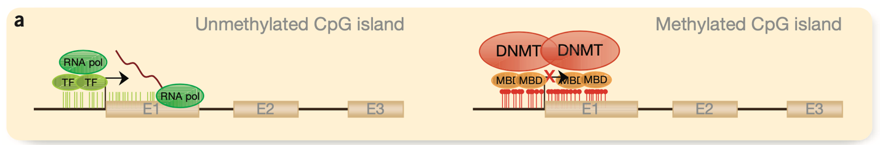

Slide 5
Metabolomics
Metabolites are small molecule products of metabolism and are involved in many vital cellular processes.
They are involved in energy storage, cellular signaling and apoptosis, post-translational protein modification and transport, and maintenance of homeostasis in the cellular milieu.
Analysis of the metabolome can therefore quantify the integrated response to endogenous and exogenous disease factors.
Nutrition and metabolism also directly affect DNA methylation.

Slide 6
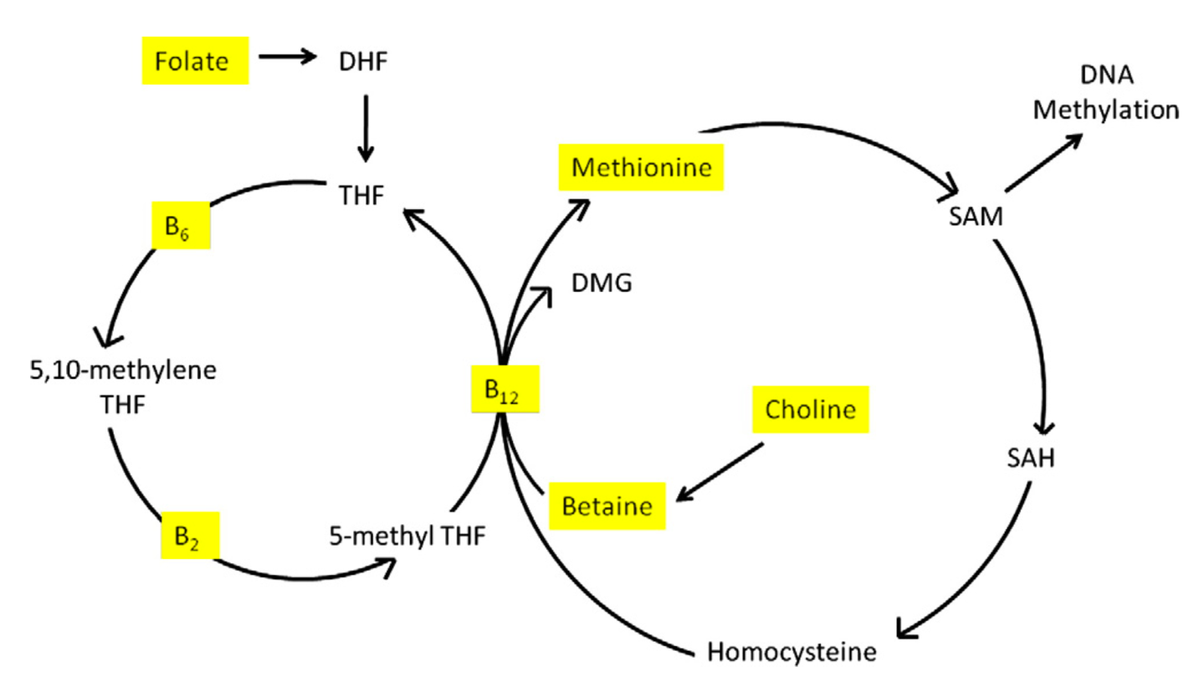
Substrates obtained via diet are highlighted in yellow.

Slide 7
Type 1 Diabetes
Genetic predisposition accounts for some of the etiology of T1D (sibling relative risk has been estimated at 15).
However, monozygotic (MZ) twin concordance is low (approximately 50%).
Epigenome-wide association studies (EWAS) in discordant and concordant twin pairs found that methylation profiles were more similar among participants with T1D than to unaffected twins.
Norris group has found that T1D cases had different longitudinal methylation patterns compared to controls prior to diagnosis.
The metabolome has also been linked with islet autoimmunity and T1D etiology.
Although the effects of the metabolome and DNA methylation have been studied separately in T1D, the combined nutri-epigenetics of T1D remain unclear.

Slide 8
Bayesian Network Analysis
Integration of epigenetic and metabolomics data requires statistical methods capable of evaluating associations between many different variables in complex multilevel networks.
BNA can be used to generate intuitive graphical models, which represent probabilistic dependence between multiple variables.
Probabilistic dependence relationships can be interpreted as causal pathways, which clarifies the biological interpretation of results.

Slide 9
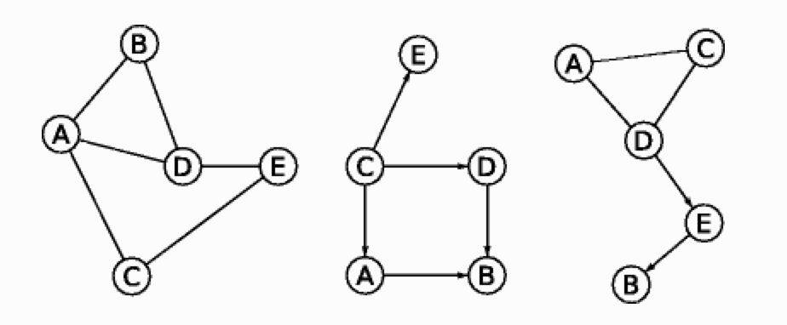
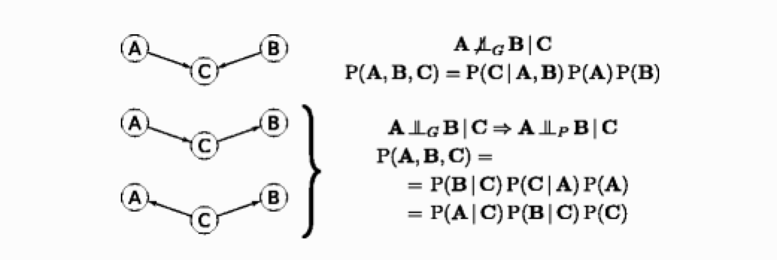
Bayesian Network Analysis

Slide 10
Cohort
A total of 174 participants (87 T1D cases and 87 frequency-matched controls) were chosen from the DAISY study for measurement of DNA methylation.
Participants with both methylation and metabolomic measures at seroconversion were selected for these analyses.
Seroconversion is defined as the second consecutive visit at which a confirmed auto-antibody to insulin, GAD65, IA-2, or ZnT8 was detected.

Slide 11
Methylation
One group of 84 participants was measured ﻿using the Infinium HumanMethylation450K Beadchip (“450 K”) and the remaining 90 participants were measured using ﻿the Infinium MethylationEPIC Beadchip (“EPIC”).
199,243 probes covering 68.6% of autosomal genes passed rigorous pre-processing procedures, which included normalization, quality control, and filtering using the SeSAMe pipeline.
Batch effects were adjusted for using ComBat.

Slide 12
Metabolomics
Metabolites and complex lipids at seroconversion were quantified using gas chromatography/time-of-flight mass spectrometry (GC-TOF MS), charged surface hybrid mass spectrometry (CSH-QTOF MS).
A total 2,541 metabolites were available for testing.

Slide 13
Methods

Slide 14
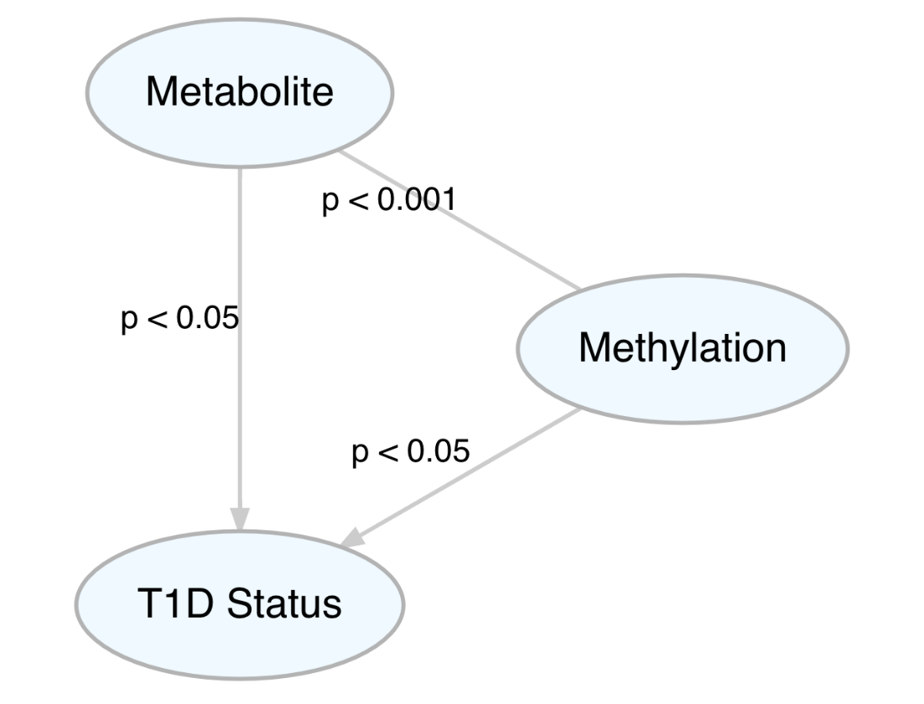
Feature Reduction Step 1: Linear Models

Slide 15
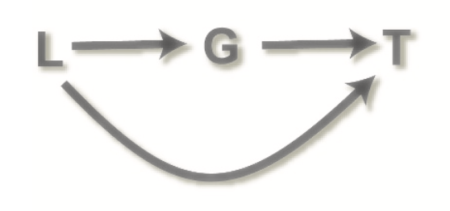
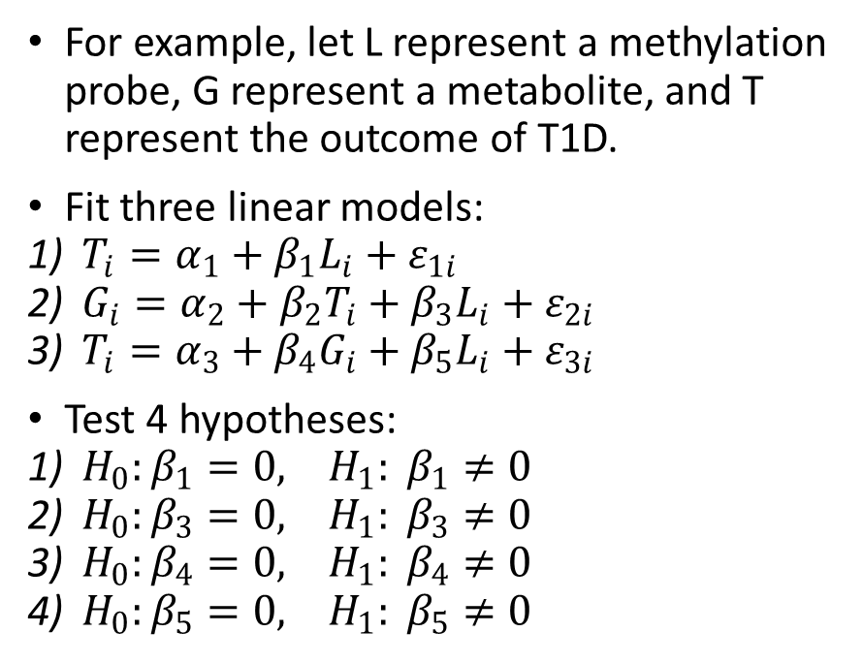
Feature Reduction Step 2: Causal Inference
For example, let L represent a methylation probe, G represent a metabolite, and T represent the outcome of T1D.
Fit three linear models:
$T_{i}=α_{1}+β_{1}L_{i}+ε_{1i}$
$G_{i}=α_{2}+β_{2}T_{i}+β_{3}L_{i}+ε_{2i}$
$T_{i}=α_{3}+β_{4}G_{i}+β_{5}L_{i}+ε_{3i}$
Test 4 hypotheses:
$H_{0}:β_{1}=0, H_{1}: β_{1}≠0$
$H_{0}:β_{3}=0, H_{1}: β_{3}≠0$
$H_{0}:β_{4}=0, H_{1}: β_{4}≠0$
$H_{0}:β_{5}=0, H_{1}: β_{5}≠0$

Slide 16
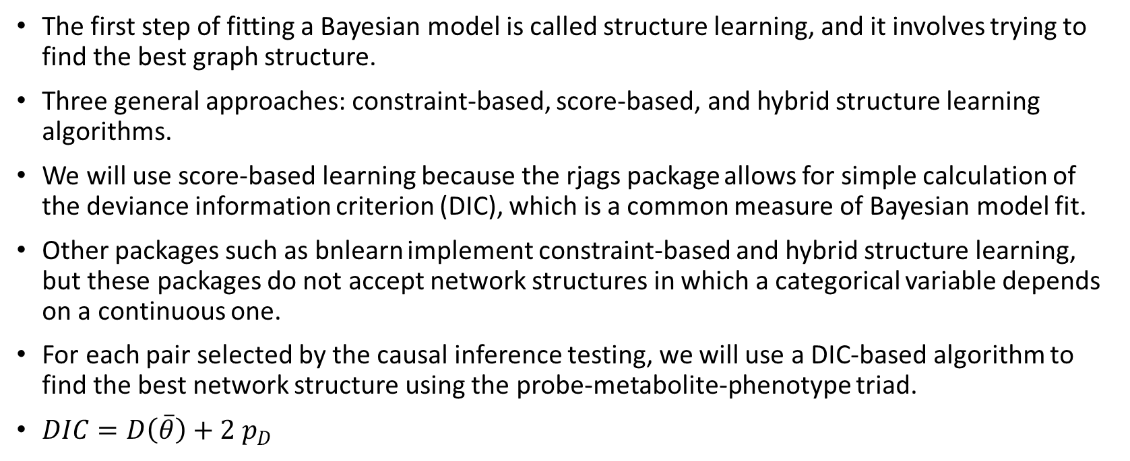
Learning the Bayesian Network
The first step of fitting a Bayesian model is called structure learning, and it involves trying to find the best graph structure.
Three general approaches: constraint-based, score-based, and hybrid structure learning algorithms.
We will use score-based learning because the rjags package allows for simple calculation of the deviance information criterion (DIC), which is a common measure of Bayesian model fit.
Other packages such as bnlearn implement constraint-based and hybrid structure learning, but these packages do not accept network structures in which a categorical variable depends on a continuous one.
For each pair selected by the causal inference testing, we will use a DIC-based algorithm to find the best network structure using the probe-metabolite-phenotype triad.
$DIC=D\left(\overline{θ}\right)+{2 p}_{D}$

Slide 17
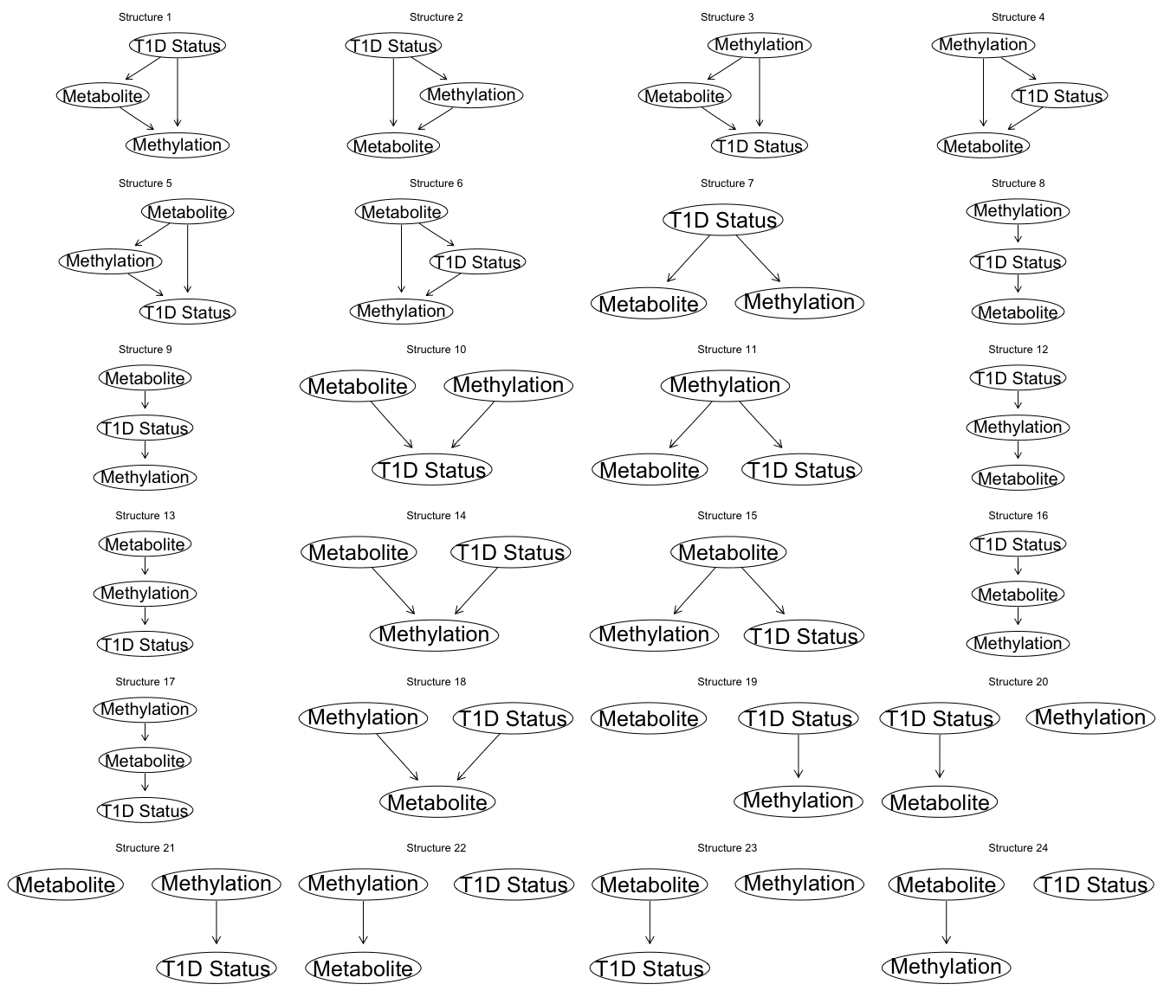

Slide 18
Preliminary Results
7,157 unique methylation and metabolite pairs (out of a total of 506,276,463 possible combinations) were chosen to move on to the causal inference testing phase of feature reduction.
139 unique pairs with an omnibus p value < 0.05 continued from causal inference to the next step.
For each triad we fit a Bayesian graphical model for each network structure using the package rjags with uninformative priors.
Unfortunately it appears that DIC is not able to distinguish the direction of arcs in a graph, so we are currently evaluating other score-based approaches (WAIC) under the same framework.
We may need to discretize the continuous variables and use the automated learning packages, but this will be a last resort.

Slide 19
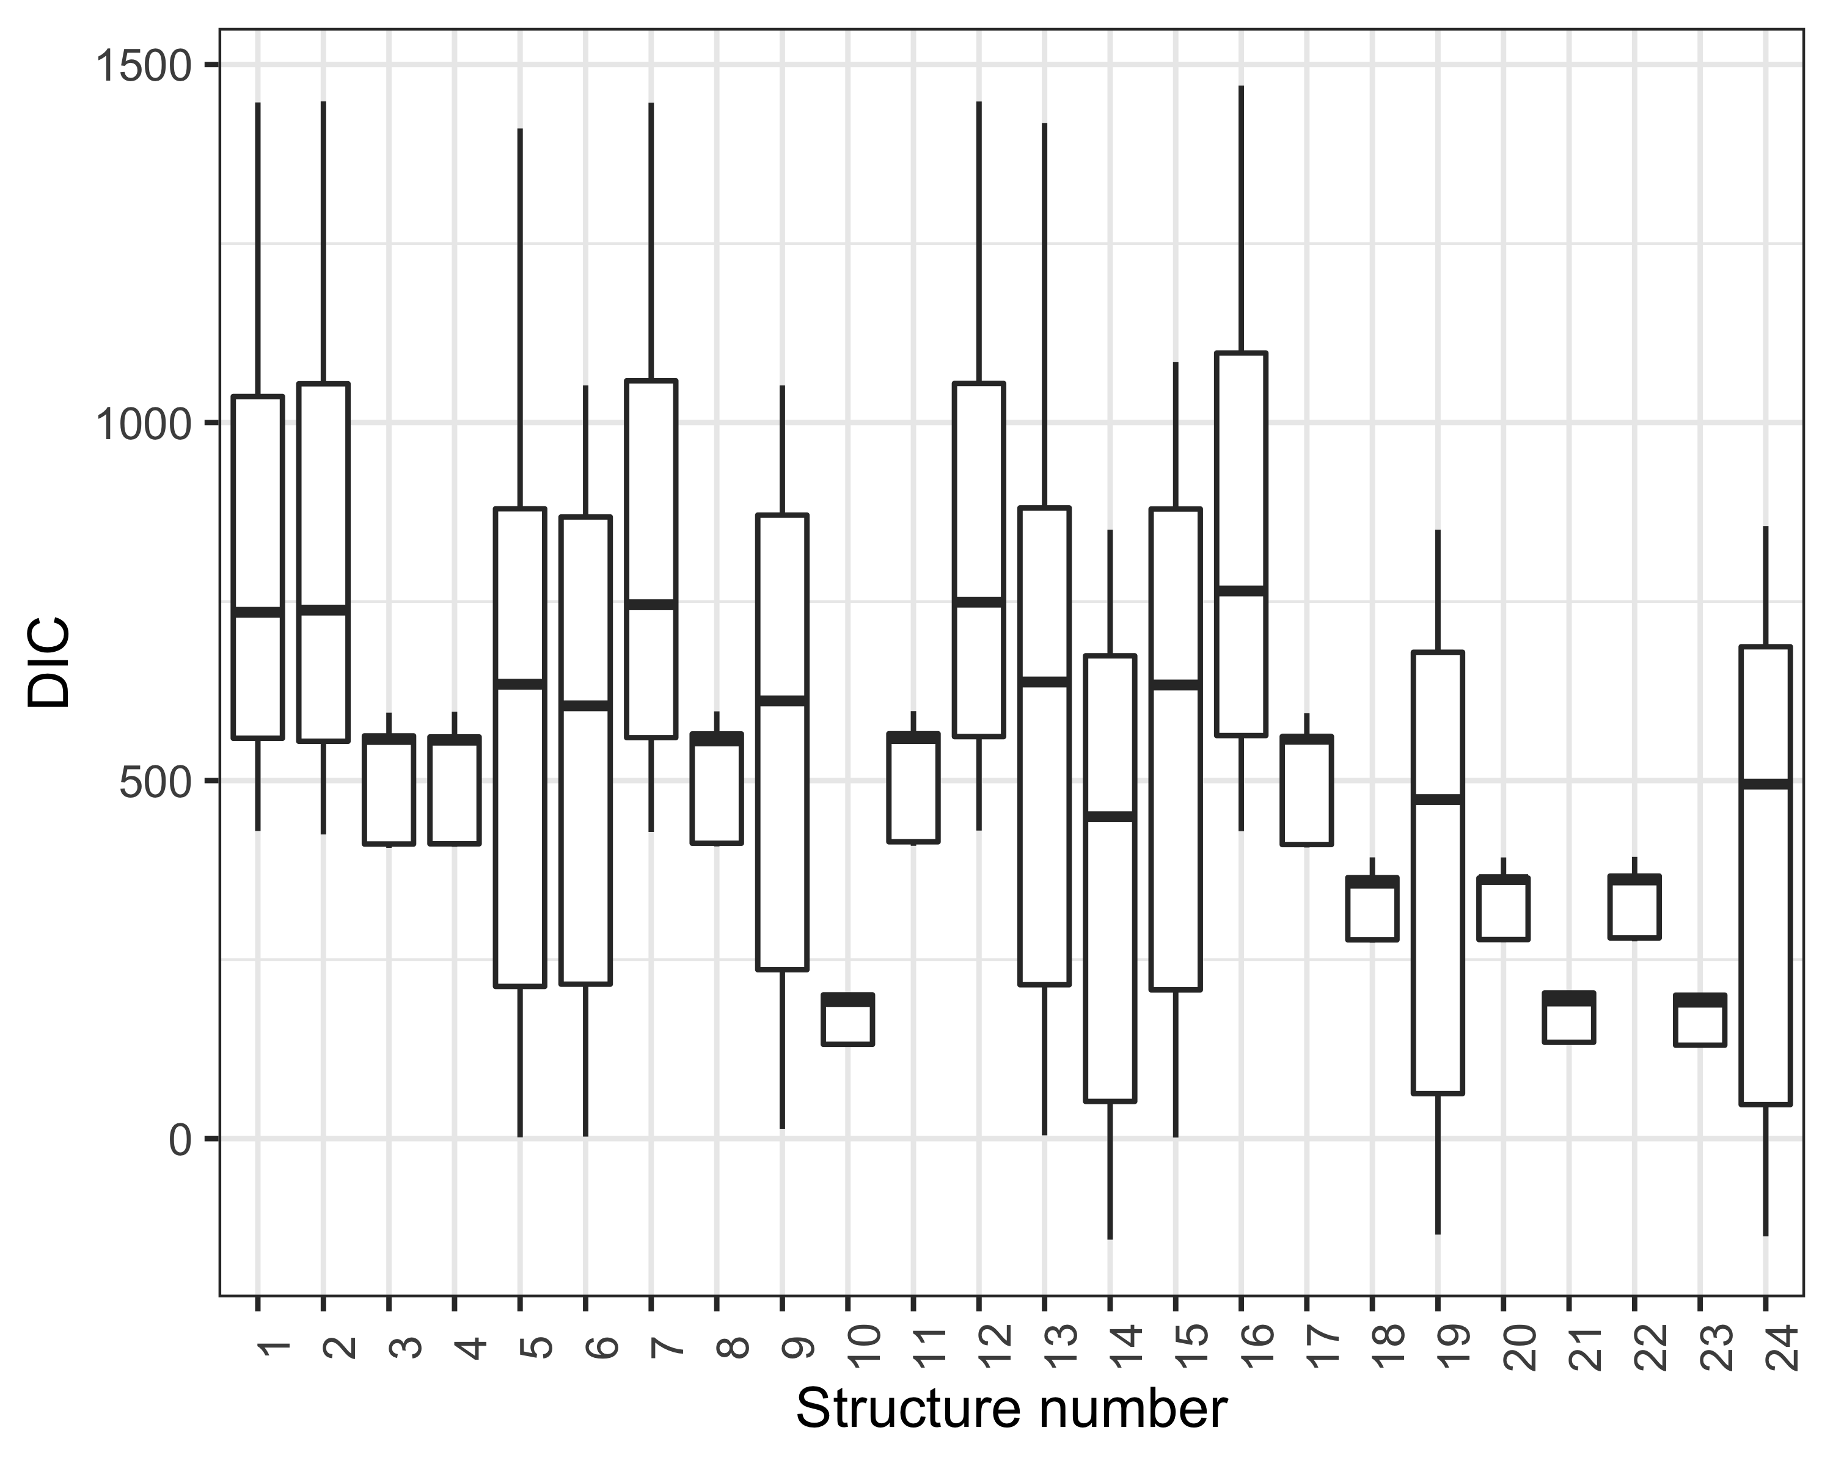
Preliminary Results
Structure Number | Frequency
6 | 1
10 | 27
14 | 19
19 | 2
23 | 60
24 | 30

Slide 20
References
1. Tuomilehto J. The Emerging Global Epidemic of Type 1 Diabetes. Curr Diab Rep. 2013;13(6):795-804. doi:10.1007/s11892-013-0433-5
2. Johnson RK, Vanderlinden L, DeFelice BC, et al. Metabolite-related dietary patterns and the development of islet autoimmunity. Sci Rep. 2019;9(1):14819. doi:10.1038/s41598-019-51251-4
3. Johnson RK, Vanderlinden LA, DeFelice BC, et al. Metabolomics-related nutrient patterns at seroconversion and risk of progression to type 1 diabetes. Pediatr Diabetes. n/a(n/a). doi:10.1111/pedi.13085
4. Johnson RK, Vanderlinden LA, Dong F, et al. Longitudinal DNA methylation differences precede type 1 diabetes. Sci Rep. 2020;10(1):3721. doi:10.1038/s41598-020-60758-0
5. Guasch-Ferré M, Hruby A, Toledo E, et al. Metabolomics in Prediabetes and Diabetes: A Systematic Review and Meta-analysis. Diabetes Care. 2016;39(5):833-846. doi:10.2337/dc15-2251
6. Stefan M, Zhang W, Concepcion E, Yi Z, Tomer Y. DNA methylation profiles in type 1 diabetes twins point to strong epigenetic effects on etiology. J Autoimmun. 2014;50:33-37. doi:10.1016/j.jaut.2013.10.001/journal.pgen.1002300

Slide 21
References
7. Rakyan VK, Beyan H, Down TA, et al. Identification of Type 1 Diabetes–Associated DNA Methylation Variable Positions That Precede Disease Diagnosis. PLOS Genet. 2011;7(9):e1002300. doi:10.1371/journal.pgen.1002300
8. Frohnert BI, Rewers MJ. Metabolomics in childhood diabetes. Pediatr Diabetes. 2016;17(1):3-14. doi:10.1111/pedi.12323
9. Anderson OS, Sant KE, Dolinoy DC. Nutrition and epigenetics: an interplay of dietary methyl donors, one-carbon metabolism and DNA methylation. J Nutr Biochem. 2012;23(8):853-859. doi:10.1016/j.jnutbio.2012.03.003
10. Wellen KE, Hatzivassiliou G, Sachdeva UM, Bui TV, Cross JR, Thompson CB. ATP-Citrate Lyase Links Cellular Metabolism to Histone Acetylation. Science. 2009;324(5930):1076-1080. doi:10.1126/science.1164097
11. Mentch SJ, Mehrmohamadi M, Huang L, et al. Histone Methylation Dynamics and Gene Regulation Occur through the Sensing of One-Carbon Metabolism. Cell Metab. 2015;22(5):861-873. doi:10.1016/j.cmet.2015.08.024
12. Alakwaa FM, Savelieff MG. Bioinformatics Analysis of Metabolomics Data Unveils Association of Metabolic Signatures with Methylation in Breast Cancer. J Proteome Res. 2020;19(7):2879-2889. doi:10.1021/acs.jproteome.9b00755

Slide 22
References
13. Chiacchiera F, Piunti A, Pasini D. Epigenetic methylations and their connections with metabolism. Cell Mol Life Sci. 2013;70(9):1495-1508. doi:10.1007/s00018-013-1293-5
14. Weller M, Wick W, Deimling A von. Isocitrate dehydrogenase mutations: A challenge to traditional views on the genesis and malignant progression of gliomas. Glia. 2011;59(8):1200-1204. doi:10.1002/glia.21130
15. Putluri N, Shojaie A, Vasu VT, et al. Metabolomic Profiling Reveals a Role for Androgen in Activating Amino Acid Metabolism and Methylation in Prostate Cancer Cells. PLOS ONE. 2011;6(7):e21417. doi:10.1371/journal.pone.0021417
16. Huang Y, Hui Q, Walker DI, et al. Untargeted metabolomics reveals multiple metabolites influencing smoking-related DNA methylation. Epigenomics. 2018;10(4):379-393. doi:10.2217/epi-2017-0101
17. Wang Zeneng, Tang W. H. Wilson, Cho Leslie, Brennan Danielle M., Hazen Stanley L. Targeted Metabolomic Evaluation of Arginine Methylation and Cardiovascular Risks. Arterioscler Thromb Vasc Biol. 2009;29(9):1383-1391. doi:10.1161/ATVBAHA.109.185645
18. Wang Q, Ye J, Fang D, et al. Multi-omic profiling reveals associations between the gut mucosal microbiome, the metabolome, and host DNA methylation associated gene expression in patients with colorectal cancer. BMC Microbiol. 2020;20(S1):83. doi:10.1186/s12866-020-01762-2

Slide 23
References
19. Zaghlool SB, Mook-Kanamori DO, Kader S, et al. Deep molecular phenotypes link complex disorders and physiological insult to CpG methylation. Hum Mol Genet. 2018;27(6):1106-1121. doi:10.1093/hmg/ddy006
20. Portela A, Esteller M. Epigenetic modifications and human disease. Nat Biotechnol. 2010;28(10):1057-1068. doi:10.1038/nbt.1685
21. Gardiner-Garden M, Frommer M. CpG Islands in vertebrate genomes. J Mol Biol. 1987;196(2):261-282. doi:10.1016/0022-2836(87)90689-9
22. Greenberg MVC, Bourc’his D. The diverse roles of DNA methylation in mammalian development and disease. Nat Rev Mol Cell Biol. 2019;20(10):590-607. doi:10.1038/s41580-019-0159-6
23. Johnson CH, Ivanisevic J, Siuzdak G. Metabolomics: Beyond biomarkers and towards mechanisms. Nat Rev Mol Cell Biol. 2016;17(7):451-459. doi:10.1038/nrm.2016.25
24. Frohnert BI, Rewers MJ. Metabolomics in childhood diabetes. Pediatr Diabetes. 2016;17(1):3-14. doi:10.1111/pedi.12323
25. Anderson OS, Sant KE, Dolinoy DC. Nutrition and epigenetics: An interplay of dietary methyl donors, one-carbon metabolism and DNA methylation. J Nutr Biochem. 2012;23(8):853-859. doi:10.1016/j.jnutbio.2012.03.003

Slide 24
References
26. Atkinson MA, Eisenbarth GS, Michels AW. Type 1 diabetes. The Lancet. 2014;383(9911):69-82. doi:10.1016/S0140-6736(13)60591-7
27. Rakyan VK, Beyan H, Down TA, et al. Identification of type 1 Diabetes-associated DNA methylation variable positions that precede disease diagnosis. PLoS Genet. 2011;7(9):1-9. doi:10.1371/journal.pgen.1002300
28. Tuomilehto J. The emerging global epidemic of type 1 diabetes. Curr Diab Rep. 2013;13(6):795-804. doi:10.1007/s11892-013-0433-5
29. Polychronakos C, Li Q. Understanding type 1 diabetes through genetics: advances and prospects. Nat Rev Genet. 2011;12(11):781-792. doi:10.1038/nrg3069
30. Johnson RK, Vanderlinden LA, Dong F, et al. Longitudinal DNA methylation differences precede type 1 diabetes. Sci Rep. 2020;10(1):1-13. doi:10.1038/s41598-020-60758-0
31. Orešič M, Simell S, Sysi-Aho M, et al. Dysregulation of lipid and amino acid metabolism precedes islet autoimmunity in children who later progress to type 1 diabetes. J Exp Med. 2008;205(13):2975-2984. doi:10.1084/jem.20081800
32. Shaddox E, Stingo FC, Peterson CB, et al. A Bayesian Approach for Learning Gene Networks Underlying Disease Severity in COPD. Stat Biosci. 2018;10(1):59-85. doi:10.1007/s12561-016-9176-6

Slide 25
References
33. Sachs K, Perez O, Pe’er D, Lauffenburger DA, Nolan GP. Causal Protein-Signaling Networks Derived from Multiparameter Single-Cell Data. Science. 2005;308(5721):523-529. doi:10.1126/science.1105809
34. Rudra P, Shi WJ, Russell P, et al. Predictive modeling of miRNA-mediated predisposition to alcohol-related phenotypes in mouse. BMC Genomics. 2018;19(1):639. doi:10.1186/s12864-018-5004-3
35. Wright ML, Dozmorov MG, Wolen AR, et al. Establishing an analytic pipeline for genome-wide DNA methylation. Clin Epigenetics. 2016;8(1):45. doi:10.1186/s13148-016-0212-7
36. Zhou W, Triche TJ, Laird PW, Shen H. SeSAMe: reducing artifactual detection of DNA methylation by Infinium BeadChips in genomic deletions. Nucleic Acids Res. 2018;46(20):e123-e123. doi:10.1093/nar/gky691
37. Leek JT, Johnson WE, Parker HS, Jaffe AE, Storey JD. The sva package for removing batch effects and other unwanted variation in high-throughput experiments. Bioinformatics. 2012;28(6):882-883. doi:10.1093/bioinformatics/bts034
38. Conneely KN, Boehnke M. So Many Correlated Tests, So Little Time! Rapid Adjustment of P Values for Multiple Correlated Tests. Am J Hum Genet. 2007;81(6):1158-1168. doi:10.1086/522036
39. Millstein J, Chen GK, Breton CV. cit: hypothesis testing software for mediation analysis in genomic applications. Bioinformatics. 2016;32(15):2364-2365. doi:10.1093/bioinformatics/btw135

Slide 26
References
40. Millstein J, Zhang B, Zhu J, Schadt EE. Disentangling molecular relationships with a causal inference test. BMC Genet. 2009;10(1):23. doi:10.1186/1471-2156-10-23
41. Nagarajan R, Scutari M, Lèbre S. Bayesian Networks in R.; 2013. doi:10.1007/978-1-4614-6446-4
42. Scutari M, Denis J-B. Bayesian Networks: With Examples in R. 0 ed. Chapman and Hall/CRC; 2014. doi:10.1201/b17065
43. Nagarajan R, Scutari M, Lèbre S. Bayesian Networks in R. Springer New York; 2013. doi:10.1007/978-1-4614-6446-4
44. Spiegelhalter DJ, Best NG, Carlin BP, Van Der Linde A. Bayesian measures of model complexity and fit. J R Stat Soc Ser B Stat Methodol. 2002;64(4):583-616. doi:10.1111/1467-9868.00353
45. Plummer M. rjags: Bayesian graphical models using MCMC. R Package Version. 2016;4(6).
46. Spiegelhalter DJ, Best NG, Carlin BP, Linde AVD. Bayesian measures of model complexity and fit. J R Stat Soc Ser B Stat Methodol. 2002;64(4):583-639. doi:10.1111/1467-9868.00353
47. Scutari M. Learning Bayesian Networks with the bnlearn R Package. ArXiv09083817 Stat. Published online July 10, 2010. Accessed August 9, 2020. http://arxiv.org/abs/0908.3817

