Slide 1
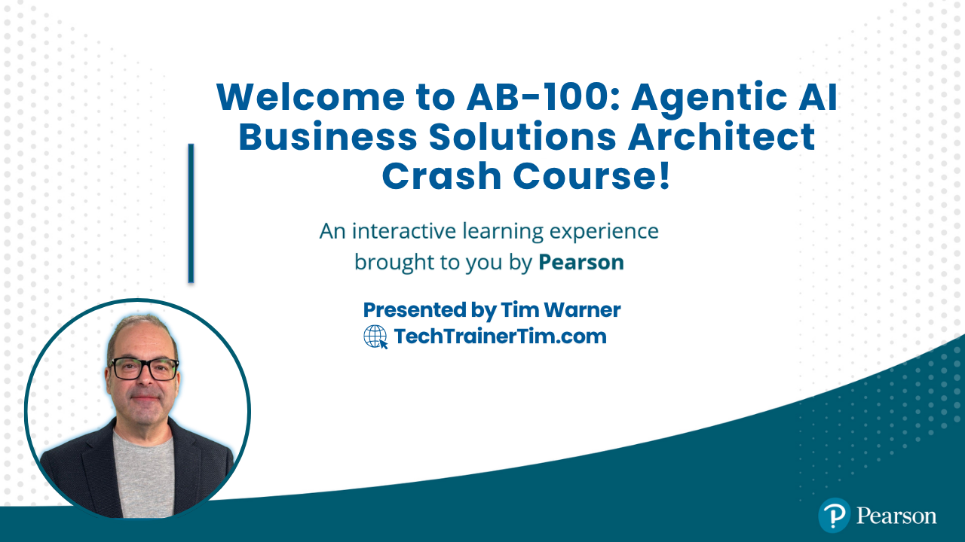
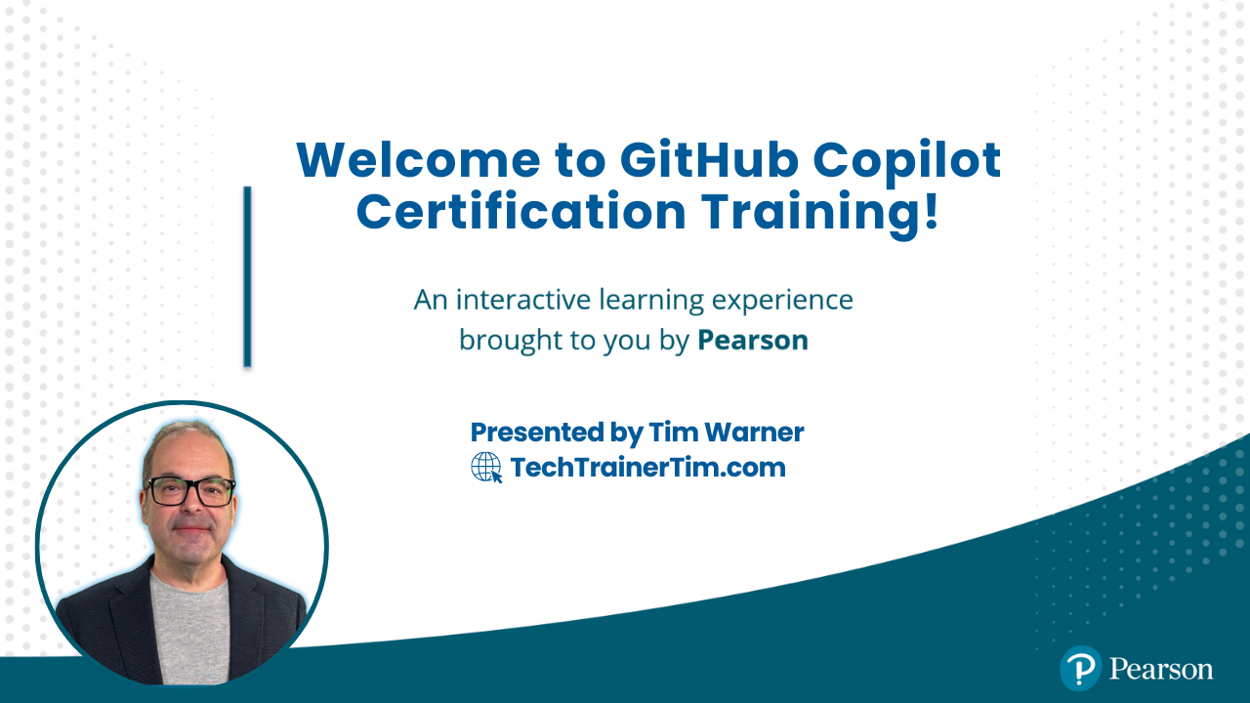




GitHub Copilot for Almost Everyone
Tim Warner
timw.info/linkedin
Notes:
How much flexibility am I allowed with these slide layouts? If you right-click a slide, you can play with layouts, but otherwise, not much flexibility.
Am I free to add my own graphics, providing MSFT attribution where necessary? When it comes to MS graphics, we're not allowed to use those, so please do not add in graphics unless they are created FROM SCRATCH by you.
Can I make the font a bit smaller? Some of the objectives are verbose and I don’t want to crowd the skills? Yes, I do this, too, when I review the slides because sometimes the default size just won't work.
Do the bullet points here need to be word-for-word from the outline or can I condense? We prefer word-for-word, but some of the sub-lesson titles are super long. Use your discretion, and we can address case-by-case during the review of each lesson's slides.

Slide 2


Tim Warner
Based in Nashville, TN, US
29-year Microsoft Certified Trainer (MCT)
8-year Microsoft MVP in Azure AI
Contact: TechTrainerTim.com

Slide 3
Course Flow (Central Time Zone)
09:00 am - Start - Segment 1 [Plan AI Solutions]
10:00 am - 10-minute break - Segment 2 [Design AI Solutions]
11:00 am - 10-minute break - Segment 3 [Deploy AI Solutions]
12:00 pm - 10-minute break - Segment 4 [RAI, Gov, Exam Prep]
01:00 pm - Finish

Slide 4
Course materials
github.com/timothywarner-org/ ab100

Slide 5
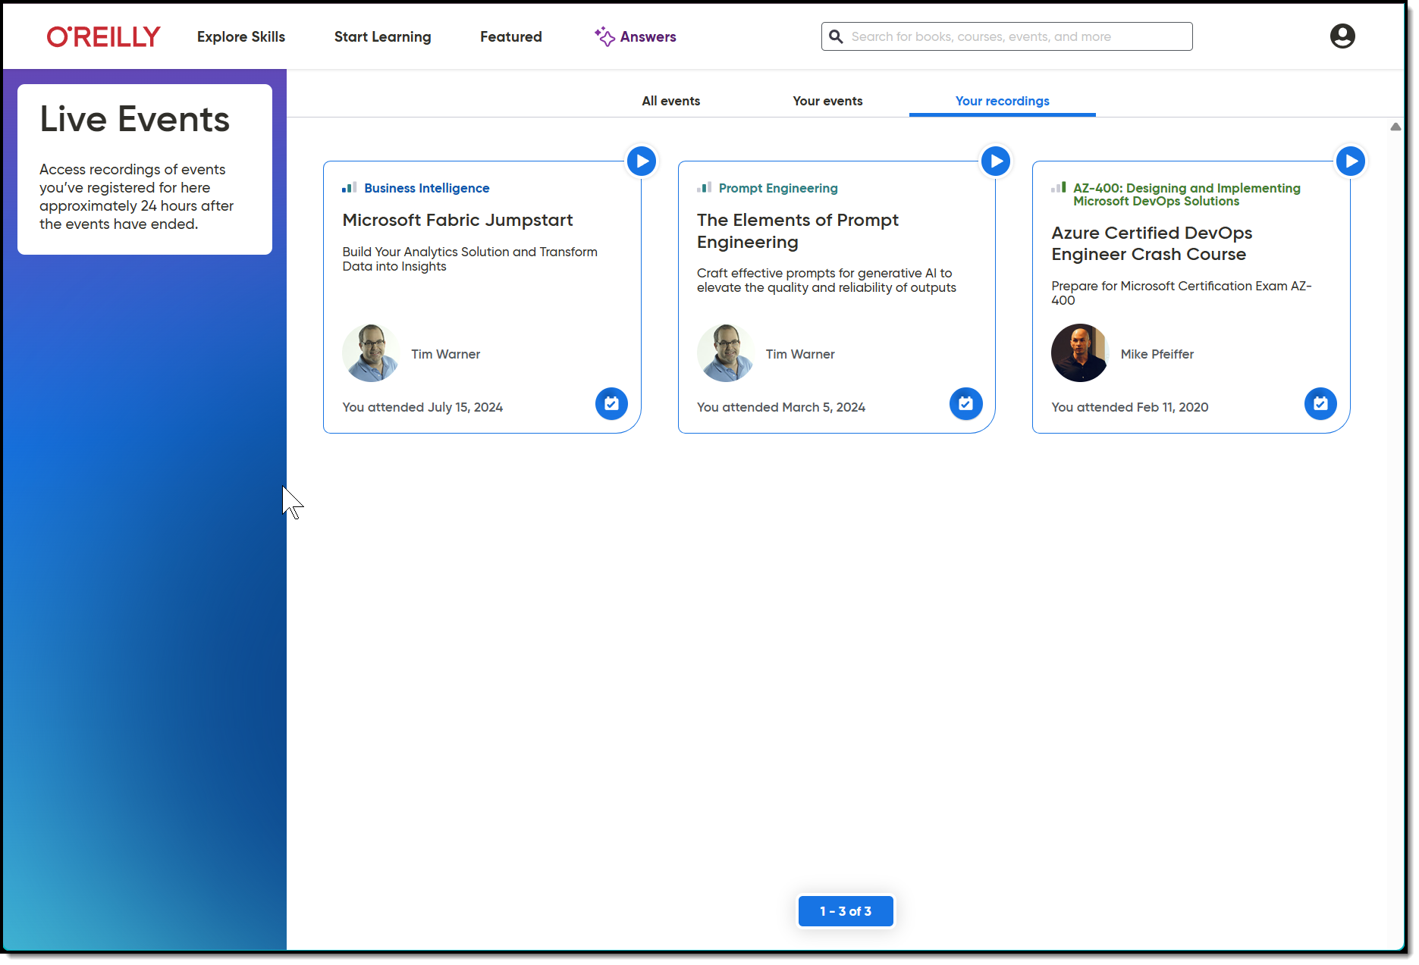
Session Recording + Badge

Slide 6
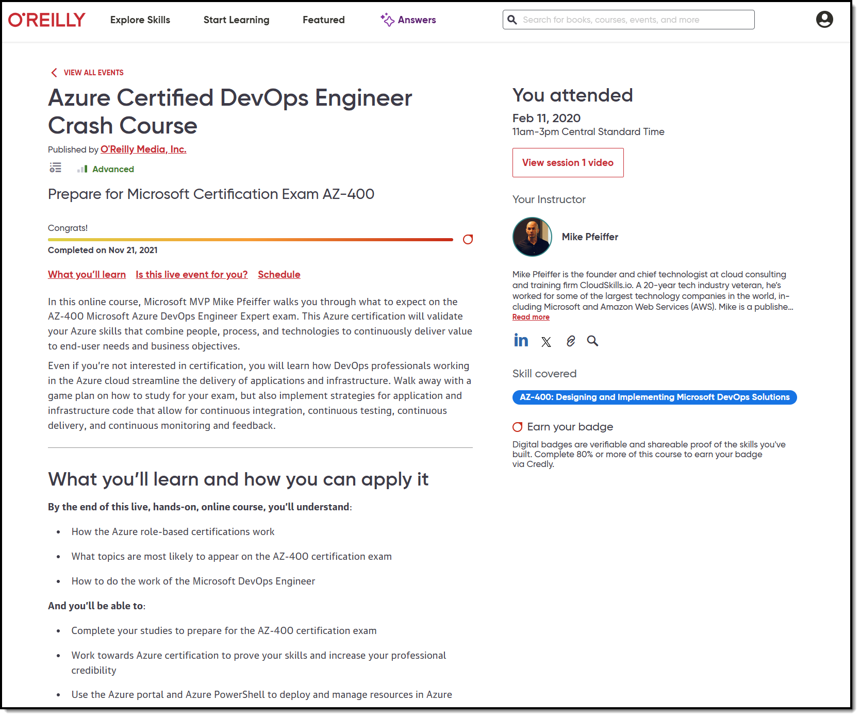
Session Recording + Badge

Slide 7
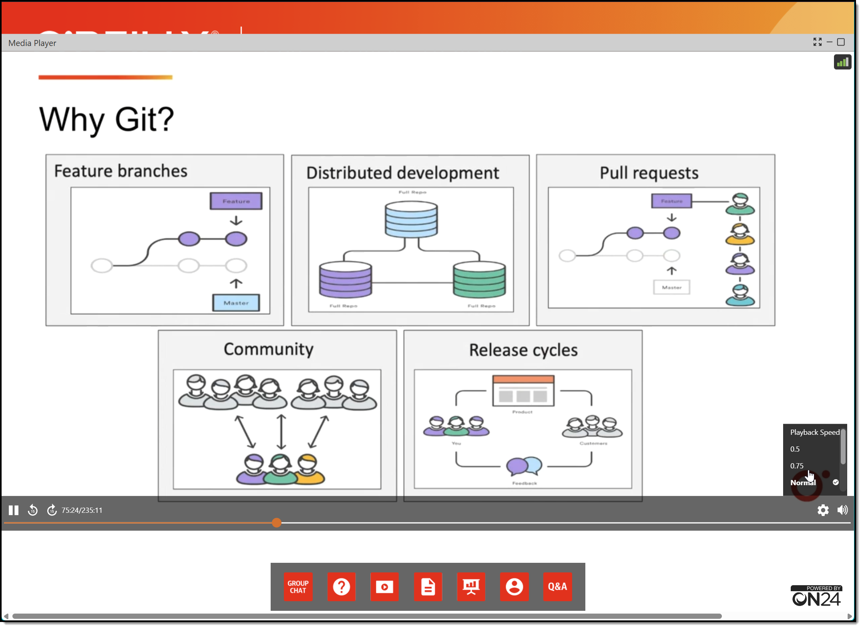
Session Recording + Badge

Slide 8
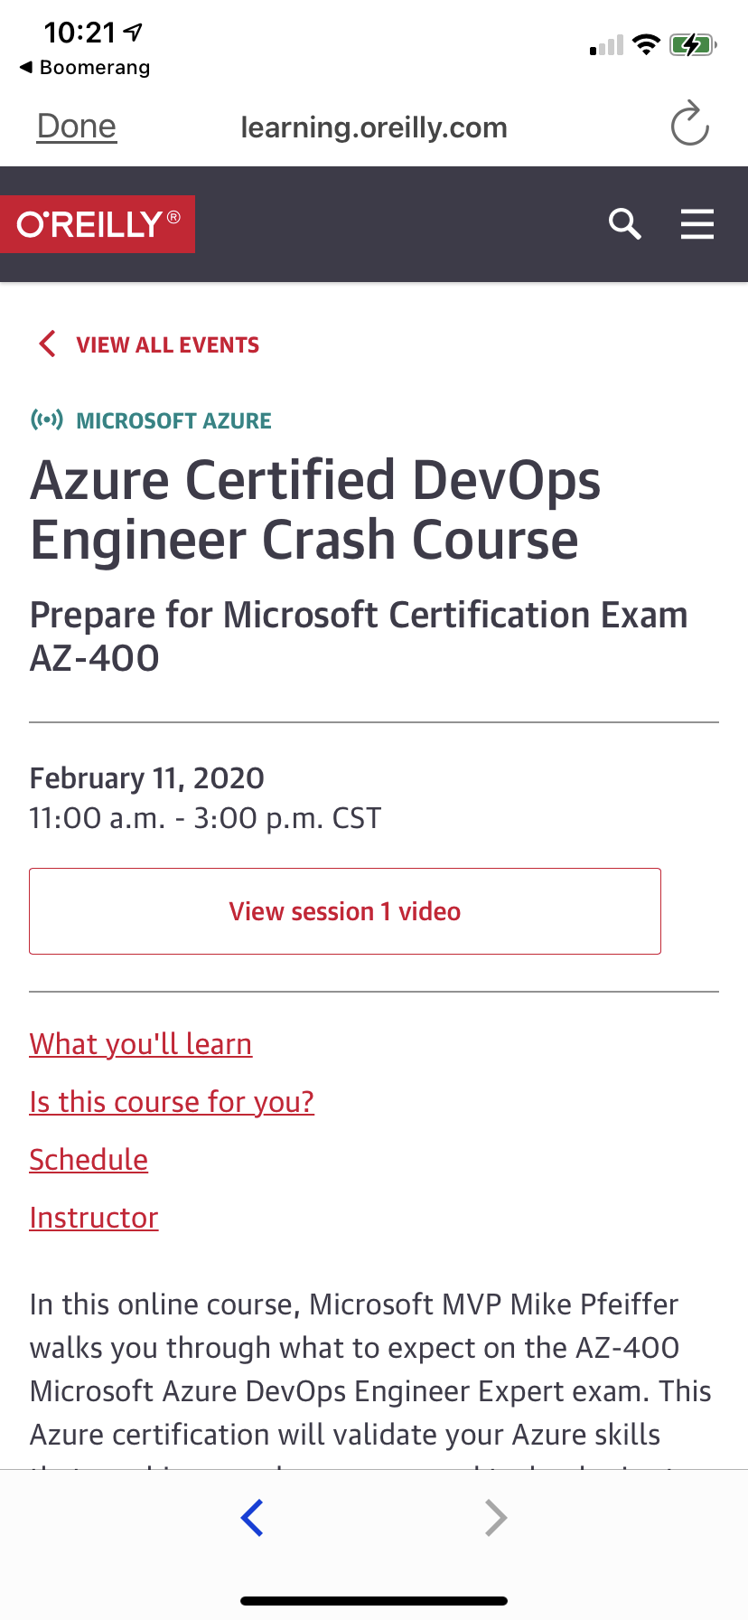
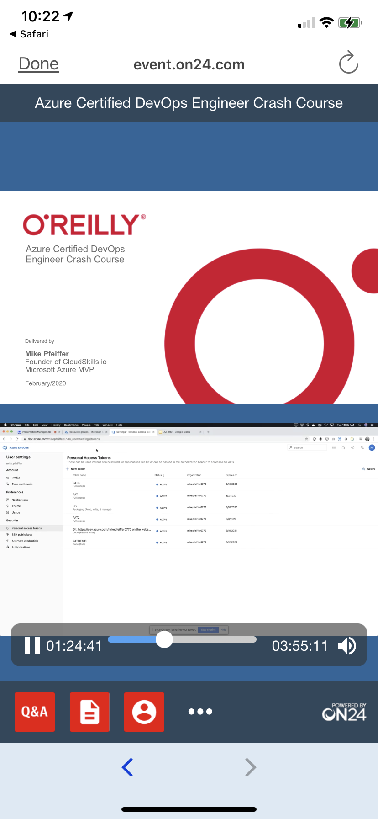
Mobile Browser: learning.oreilly.com

Slide 9
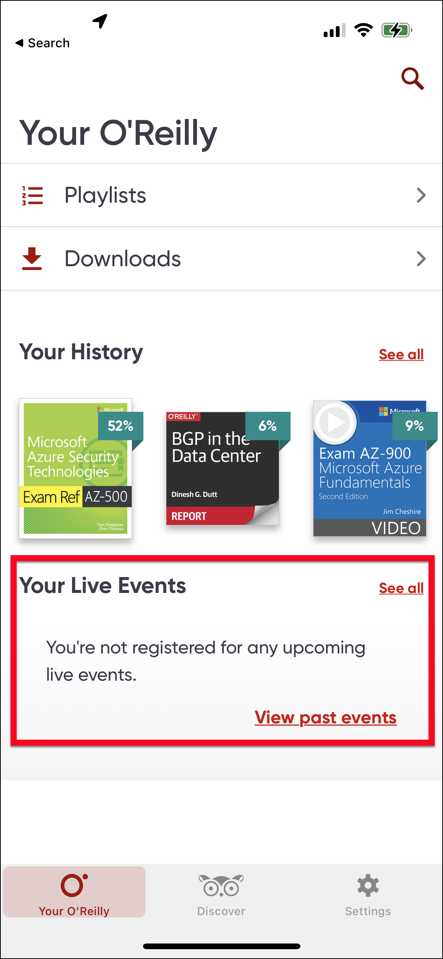
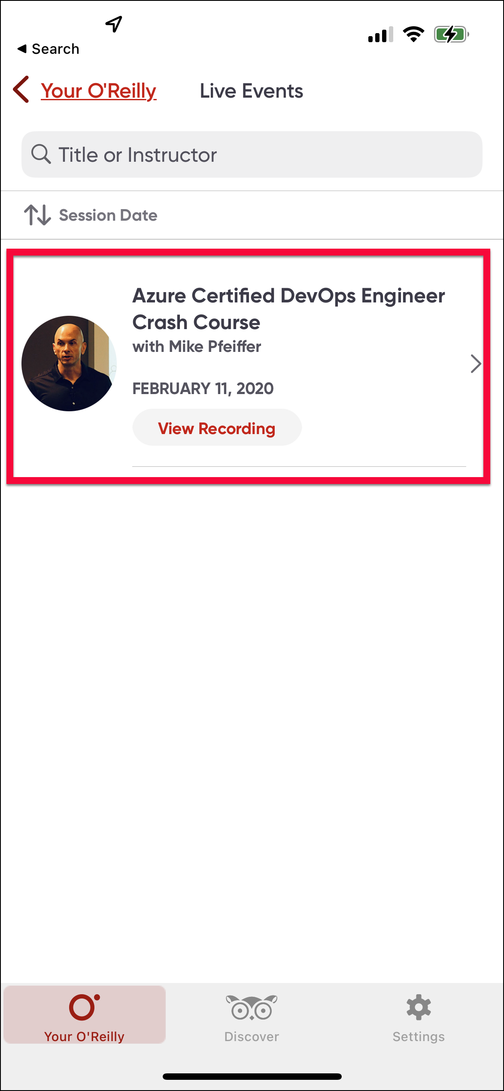
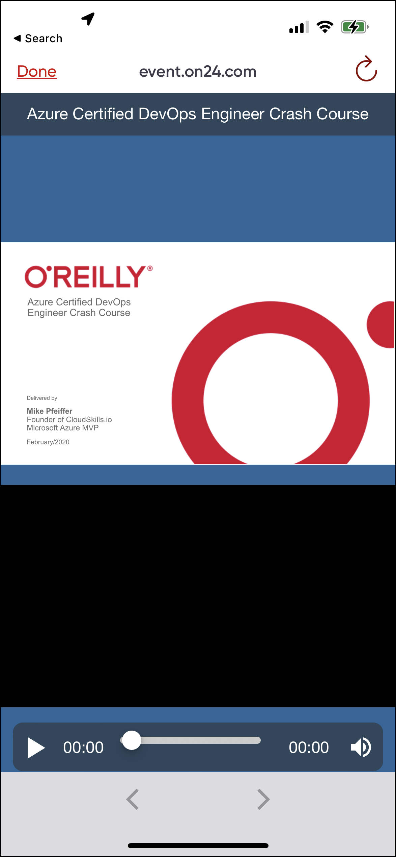
O'Reilly Mobile App

Slide 10
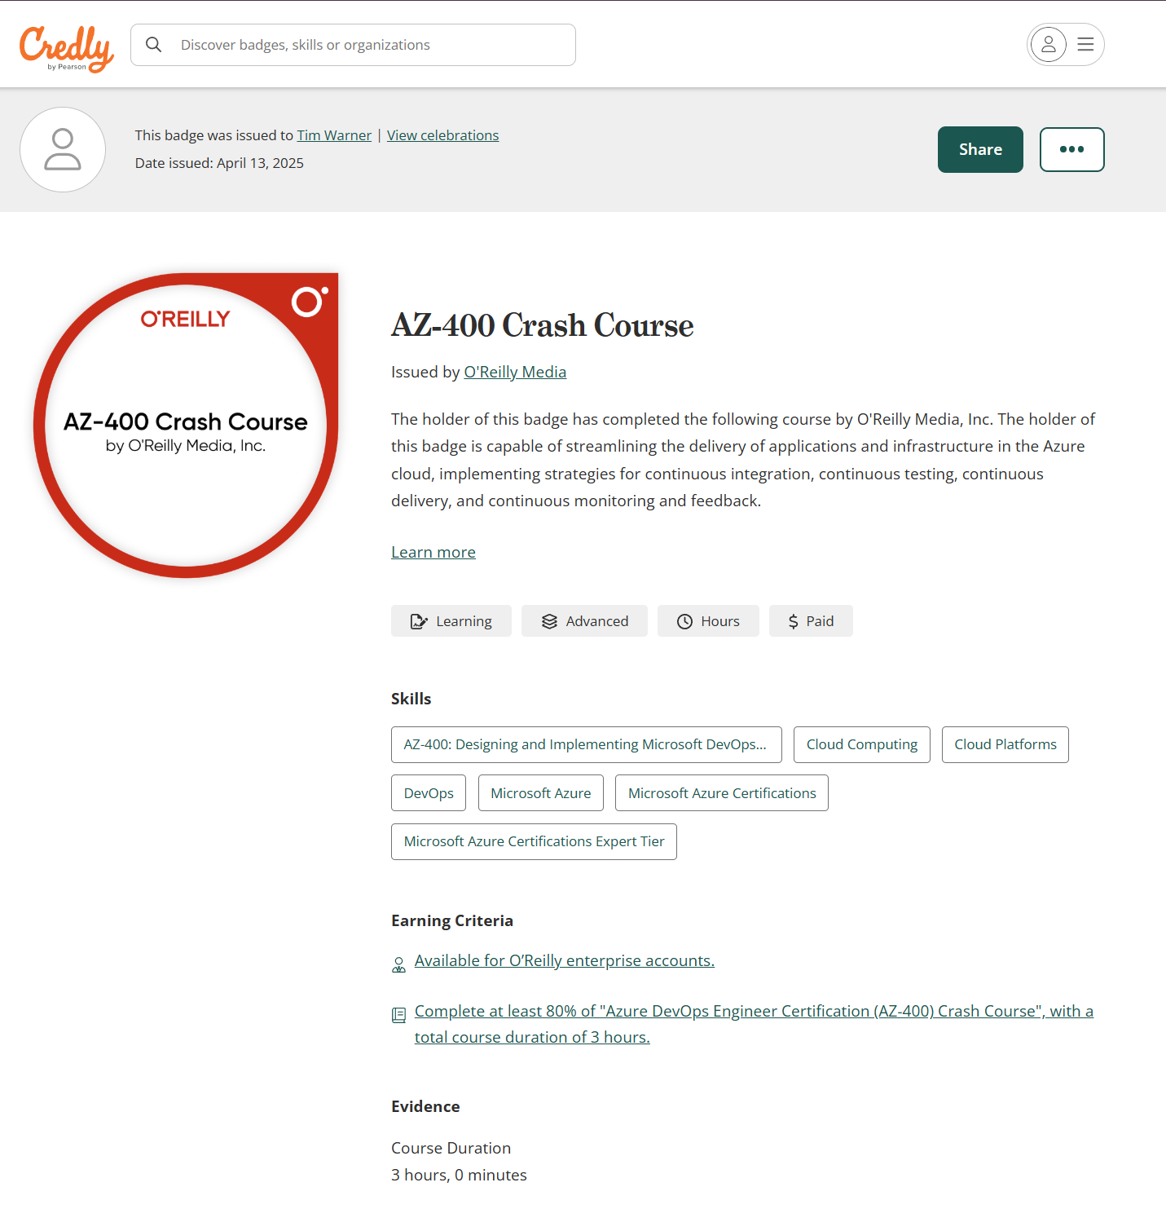
Session Recording + Badge

Slide 11
Questions?
Please add questions to the Q&A window so I don’t miss them
Only O’Reilly folks and I can read them
Your name shows up as initials with no company name
Let us know in the Q&A if my audio and/or video gets “crispy”

Slide 12
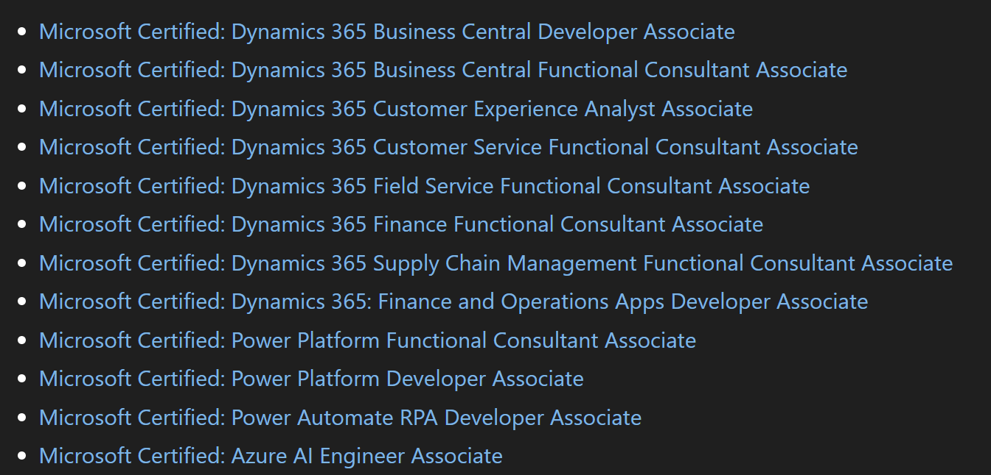

Prerequisites

Slide 13
Azure AI Engineer Associate
Exam AI-102: Designing and Implementing a Microsoft Azure AI Solution
Exam AI-103: Developing AI Apps and Agents on Azure

Slide 14
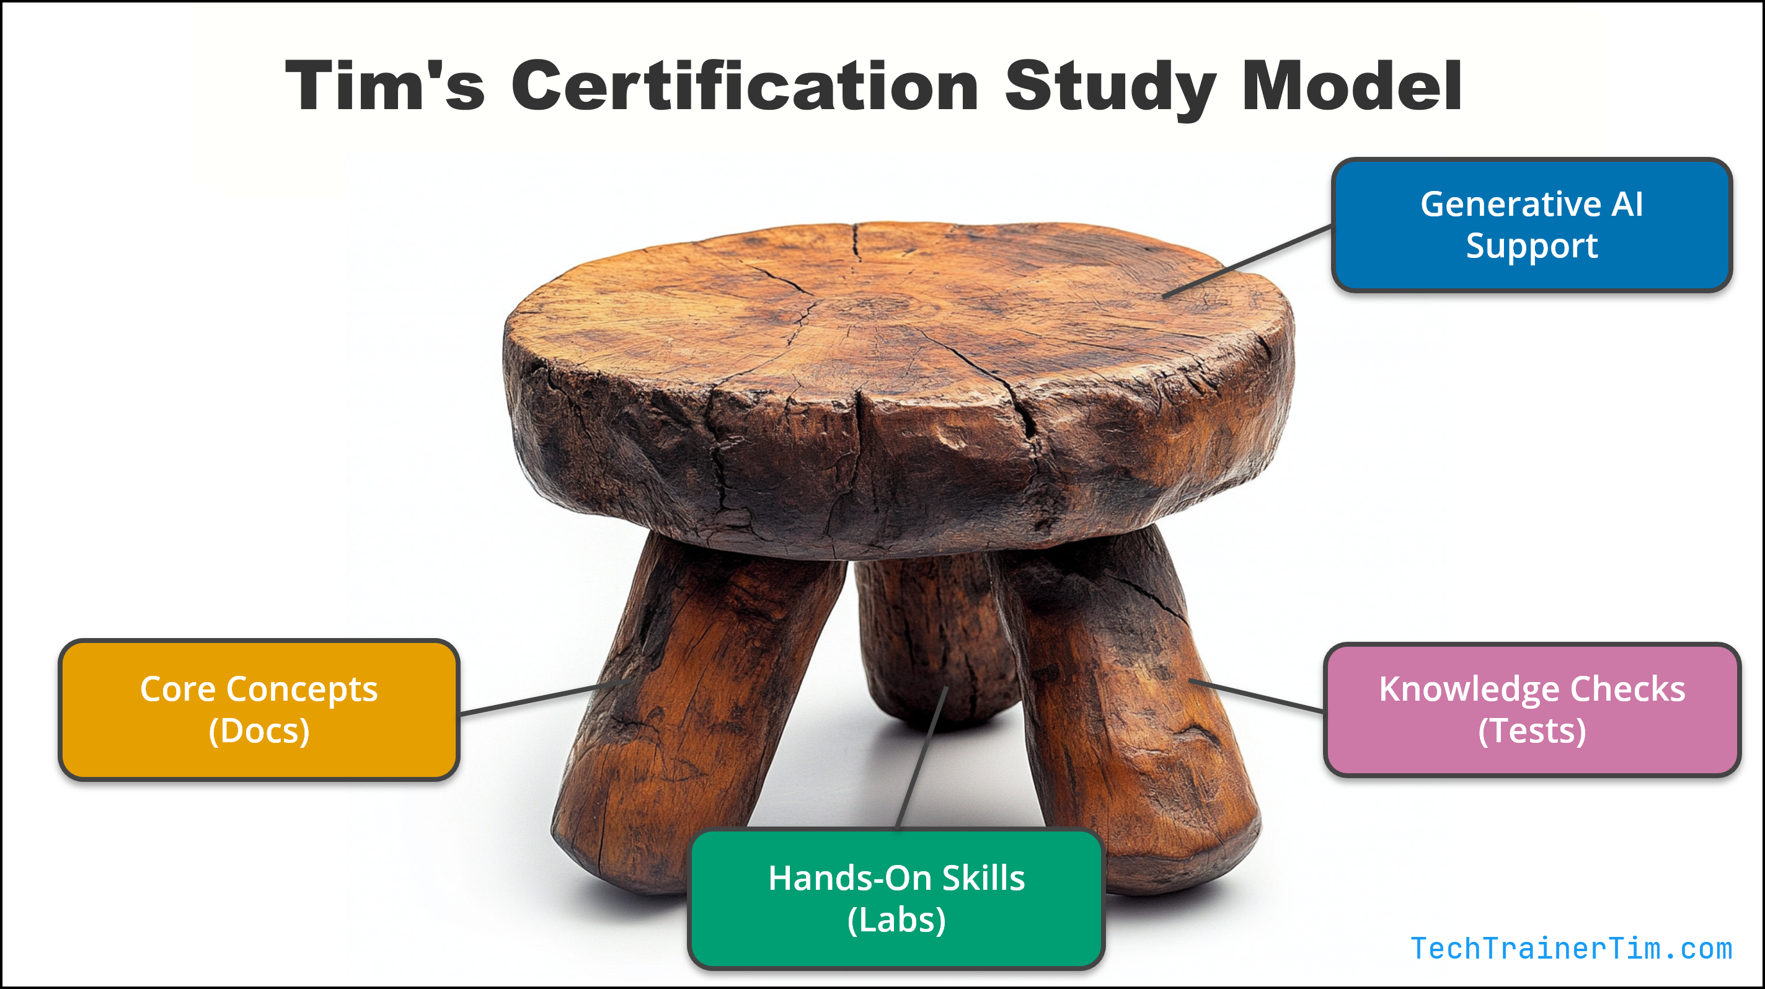

Tim's IT Certification Study Model

Slide 15
Thank you!
Course materials: github.com/timothywarner-org/ab100
Contact: TechTrainerTim.com

Slide 16
MICROSOFT AB-100 EXAM PREP
Agentic AI Business Solutions Architect
Plan, design, and deploy AI-powered business solutions in 4 hours
Tim Warner
O'Reilly Live Learning -- 4 hours, four 50-minute segments

Slide 17
WHAT YOU WILL LEARN
Course agenda -- four 50-minute segments
1
2
3
4
PLAN -- 25-30%
DESIGN -- 25-30%
DEPLOY OPS -- ~20-25%
DEPLOY SEC -- ~20-25%
Plan AI Solutions
Design AI Solutions
Deploy: Ops, Test, ALM
Security and Exam Mastery
Requirements, grounding data, CAF AI adoption, platform choice, ROI and TCO, build vs buy vs extend.
Agent typology, Copilot Studio topics and flows, Foundry Tools, MCP and A2A, prebuilt orchestration.
Monitoring and telemetry, agent testing, ALM across data, agents, custom models, and Dynamics 365.
Agent and model security, governance, prompt manipulation, residency, audit, exam-day plan.
Source: Microsoft Learn -- Exam AB-100 study guide (synced 2026-04-21). Companion: Microsoft Learn path -- Architect AI solutions for business productivity (11 modules).

Slide 18
DOMAIN WEIGHT 25-30%
SEGMENT
Plan AI-powered business solutions
1
Analyze requirements and grounding data
Design overall AI strategy on the Cloud Adoption Framework
Evaluate cost, ROI, build vs buy vs extend, and model router
0:00 -- 0:50
STUDY BETWEEN SESSIONS -- MICROSOFT LEARN
01. Introduction to agentic AI
02. Analyze requirements
03. Design overall AI strategy
04. Evaluate costs and benefits

Slide 19
SUBDOMAIN 1.1
Analyze requirements and grounding data
Where do agents fit?
Architect lens
Task automation -- bounded, repeatable
Data analytics -- summarize and surface insight
Decision-making -- recommend, route, escalate
Score data before you score the model
Map sources to channels and identities
Plan organization-wide data architecture
Five grounding data tests
Exam tip. Bad grounding data is the most common reason an agent fails review. Always evaluate the source first.
Accuracy and relevance
Timeliness and cleanliness
Availability for downstream AI systems
Source: Microsoft Learn -- AB-100 study guide; Cloud Adoption Framework AI agent adoption.

Slide 20
SUBDOMAIN 1.2
Design overall AI strategy on CAF
STEP 1
STEP 2
STEP 3
STEP 4
STEP 5
STEP 6
AI Strategy
AI Plan
AI Ready
Govern AI
Manage AI
Secure AI
Platform decision tree
CENTER OF EXCELLENCE INPUTS
Extend Microsoft 365 Copilot for in-flow productivity
Build a Copilot Studio agent for business workflow
Build in Microsoft Foundry for custom models or A2A
Use prebuilt agents in Dynamics 365 when possible
Prompt library and engineering guidelines
Rules and constraints for Foundry Tools
Multi-agent solution patterns
Small language model use cases
Source: Microsoft Learn -- Cloud Adoption Framework AI adoption; AB-100 Subdomain 1.2.

Slide 21
SUBDOMAIN 1.2 -- AGENT TECHNOLOGY PLAN
SaaS first, then low-code, then pro-code
STEP 1
STEP 2
STEP 3
SaaS
Low code
Pro code
Microsoft 365 Copilot, prebuilt Dynamics 365 agents
Microsoft Copilot Studio agents and agent flows
Microsoft Foundry, custom models, A2A
When to drop a tier
FIVE ORCHESTRATION PATTERNS
SaaS does not meet the requirement out of the box
Low code cannot model the workflow or scale path
Custom model, custom protocol, or A2A is required
Default to SaaS when the cost case is unclear
Sequential -- linear handoff
Concurrent -- parallel work, then merge
Group chat -- shared context
Handoff -- routed to a specialist
Magentic -- planner directs workers
Concepts informed by Microsoft AB-100T00 official courseware; AB-100 Subdomain 1.2.

Slide 22
SUBDOMAIN 1.3
Cost, benefit, and the model router
ROI and total cost of ownership
Build vs buy vs extend
Capacity, licensing, and Copilot Credits
Build, run, and improve costs over 12 months
Time saved, deflection rate, conversion lift
Risk and compliance reduction value
BUILD
BUY
EXTEND
Custom Foundry agent or model
Prebuilt Dynamics 365 or M365 agent
Copilot Studio agent atop Microsoft 365 Copilot
Model router pattern. Send each request to the most suitable model -- balance latency, cost, and quality.
Choose the cheapest path that meets the requirement
Default to extend, then buy, then build
Reserve build for differentiated capability
Source: Microsoft Learn -- AB-100 Subdomain 1.3; Foundry model router guidance.

Slide 23
SUBDOMAIN 1.3 -- BUILD VS BUY VS EXTEND
TCO across five cost drivers
SCORING WEIGHTS (1-5)
Strategic fit -- Build wins
Time to value -- Buy wins
TCO -- compare across years
Customization need -- Build wins
Maintainability -- Extend balanced
SENSITIVITY BANDS
Optimistic / expected / conservative
Vary adoption, time saved, labor mix
Concepts informed by Microsoft AB-100T00 official courseware; AB-100 Subdomain 1.3.

Slide 24
DOMAIN WEIGHT 25-30%
SEGMENT
Design AI-powered business solutions
2
Design AI and agents -- topics, flows, agent types
Design extensibility with custom models, MCP, and Computer Use
Orchestrate prebuilt AI features across Dynamics 365 and M365
1:00 -- 1:50
STUDY BETWEEN SESSIONS -- MICROSOFT LEARN
05. Design AI agents
06. Design extensibility
07. Orchestrate prebuilt agents

Slide 25
SUBDOMAIN 2.1
Three agent types in Copilot Studio
PROMPT AND RESPONSE
TASK
AUTONOMOUS
Conversational
Workflow runner
Event-driven
Topic-driven dialog with NLU, fallback, and generative orchestration. Best for FAQ, lookup, and guided flows.
Calls tools and connectors to complete a defined task -- create a record, send a message, kick off a flow.
Triggers on events such as new email or record change. Runs in the background within scoped permissions.
Topics: classic, generative answers, fallback. Choose NLP, CLU, or generative orchestration.
Agent flows: orchestrate multi-step actions. Prompt actions: structured AI calls.
Source: Microsoft Learn -- Copilot Studio agent types, autonomous agents, generative orchestration.

Slide 26
SUBDOMAIN 2.1 -- NLP DECISION LANE
Pick standard NLP, CLU, or generative orchestration
Standard NLP
Azure CLU
Generative orchestration
Deterministic, rule-locked
Trainable, varied phrasing
Regulated and audited flows
Fixed intent set
Reproducible outcomes
Known topics, many ways to ask
Slot filling and entity extraction
Trained models per language
Open-ended, knowledge-grounded
Multi-turn conversation
Reasoning across knowledge
Topic + agent flow + prompt action
VERB: rigid, prescribed
VERB: varied, trainable
VERB: open-ended, grounded
Concepts informed by Microsoft AB-100T00 official courseware; AB-100 Subdomain 2.1.

Slide 27
SUBDOMAIN 2.2
Extensibility -- MCP, A2A, custom models
Open protocols
Behavior and reach
MCP
A2A
Custom models in Microsoft Foundry
Agents in Microsoft 365 Copilot
Computer Use -- automate apps and websites
Reasoning and voice mode behaviors
Optimize across Teams and SharePoint
Foundry Tools: Web search, Code Interpreter, File Search, AI Search, Functions
Model Context Protocol -- tools and resources
Agent2Agent -- cross-agent calls
OpenAPI
Toolbox
HTTP API tools
Bundled MCP endpoint
MCP requires generative orchestration. Connect once on the server, reuse across agents and runtimes.
Source: Microsoft Learn -- Foundry Agent Service tool catalog; Copilot Studio MCP extensibility.

Slide 28
SUBDOMAIN 2.2 -- AGENT BEHAVIOR TRIGGERS
Reasoning, voice, and Computer Use
Standard reasoning
Voice mode
USE WHEN
DESIGN RULES
Summaries, lookups, greetings
Single-step retrieval
Latency budget is tight
Short phrasing, confirm before action
Confidence checks, graceful backtrack
Interruption handling required
Deep reasoning
COMPUTER USE -- LAST RESORT
USE WHEN
Use only when no API or connector exists
Legacy desktop, vendor portals, dynamic UI
Reasoning over visible elements
If an API exists, do not pick Computer Use
Multi-step validation chains
Constraint and policy evaluation
Finance, compliance, engineering
Concepts informed by Microsoft AB-100T00 official courseware; AB-100 Subdomain 2.2.

Slide 29
SUBDOMAIN 2.3
Orchestrate prebuilt agents and apps
Dynamics 365 customer experience and service
Microsoft 365 Copilot for Sales and Service
Copilot for Sales and Service, business terms, connectors, Contact Center channel agents.
Configure CRM grounding, agent surfaces, and Sales-specific actions across email and Teams.
Dynamics 365 finance and supply chain
Power Platform AI hub
Catalog of AI prompts, models, and AI Builder features that intelligent canvas apps can call.
F and O agent chats with extra knowledge sources, in-app help and guidance, AI features.
Propose M365 agents for business scenarios
Apply Power Platform Well-Architected to intelligent workloads
Source: Microsoft Learn -- AB-100 Subdomain 2.3; Microsoft 365 agents deployment checklist.

Slide 30
DEPLOY DOMAIN -- OPS, TEST, ALM (~20-25%)
SEGMENT
3
Deploy: monitor, test, and ALM
Analyze, monitor, and tune AI-powered solutions
Manage testing of agents and custom AI models
Design ALM across data, agents, and Dynamics 365 AI
2:00 -- 2:50
STUDY BETWEEN SESSIONS -- MICROSOFT LEARN
08. Monitor, analyze, and tune agents
09. Manage testing
10. Design ALM process
Note: Microsoft groups Deploy as one 40-45 percent domain. Tim splits it across segments 3 and 4 for pacing.

Slide 31
SUBDOMAIN 3.1
Monitor agents and tune from telemetry
BUCKET 1
BUCKET 2
BUCKET 3
Operational
Quality and reasoning
User-centered
Latency and throughput
Error rate
Resource utilization
Response accuracy
Knowledge coverage
Action effectiveness
Task completion rate
Satisfaction (CSAT)
Abandonment rate
Monitor
>
Detect
>
Correlate
>
Root cause
>
Tune
>
Validate
Task completion rate is the user-success metric. Sudden drop in output relevancy is the strongest model-drift signal. Tune from patterns, not isolated events.
Concepts informed by Microsoft AB-100T00 official courseware; AB-100 Subdomain 3.1.

Slide 32
SUBDOMAINS 3.2 AND 3.3
Test strategy and ALM golden rules
Test strategy (3.2)
Three-environment pipeline
Process and metrics to test agents
Validation criteria for custom AI models
Validate Copilot prompt best practices
End-to-end tests across multiple Dynamics 365 apps
Generate test cases by using Copilot
DEV
>
TEST
>
PROD
ALM golden rules
Never customize outside dev
Always work in solutions
Use environment variables for settings
Deploy managed solutions to test and prod
Automate with Power Platform pipelines
What ALM covers (3.3)
Data used in AI models and agents
Copilot Studio agents, connectors, actions
Microsoft Foundry agents and custom models
AI in Dynamics 365 finance, supply chain, and CES
Watch out: some Copilot Studio settings are not solution-aware -- App Insights, channels, sharing.
Source: Microsoft Learn -- ALM strategy for Copilot Studio; Power Platform pipelines for agents.

Slide 33
SUBDOMAIN 3.3 -- ENVIRONMENT STRATEGY
Dev to Test to Pre-Prod to Prod
STAGE 1
STAGE 2
STAGE 3 -- CANARY
STAGE 4
Dev
Test
Pre-Prod
Prod
Red is mutable, gold is frozen. Only frozen, evaluation-passed datasets cross into Prod. Promotion is a control plane decision, not a deployment step.
Concepts informed by Microsoft AB-100T00 official courseware; AB-100 Subdomain 3.3.

Slide 34
DEPLOY DOMAIN -- SEC AND GOV (~20-25%)
SEGMENT
4
Security, governance, and exam mastery
3:00 -- 3:50
Design security and governance for agents and models
Defend against prompt manipulation and indirect injection
Validate residency, access controls, and audit trails
Walk in confident -- AB-100 exam-day plan
STUDY BETWEEN SESSIONS -- MICROSOFT LEARN
11. Responsible AI security and governance

Slide 35
SUBDOMAIN 3.4
Security, governance, and responsible AI
Defense in depth for agents
Governance and compliance checklist
Identity
Data
Design security and governance for agents
Design model security and tuning controls
Analyze AI vulnerabilities and mitigations
Review against responsible AI principles
Validate data residency and movement
Access controls on grounding and tuning
Audit trails for model and data changes
Purview and Sentinel for end-user activity
Entra ID, RBAC, least privilege
Knowledge ACLs, DLP, residency
Prompt shields
Spotlighting
Direct and indirect injection
Mark untrusted content
Critic agents
Human in loop
Audit inputs and outputs
Verify risky actions
Indirect prompt injection hides instructions in documents the agent reads. Layer probabilistic and deterministic mitigations.
Source: Microsoft Learn -- Defend against indirect prompt injection (Zero Trust SFI); Copilot Studio responsible AI.

Slide 36
SUBDOMAIN 3.4 -- AI VULNERABILITY TAXONOMY
Five buckets, five primary mitigations
Concepts informed by Microsoft AB-100T00 official courseware; AB-100 Subdomain 3.4.

Slide 37
SUBDOMAIN 3.4 -- RESPONSIBLE AI
Six lenses for the architect review
Pressure-test every model, agent, workflow, and UX choice against all six. Each lens is a question the architect must answer.
LENS 1
LENS 2
LENS 3
Fairness
Reliability and safety
Privacy and security
Did the training data and grounding sources represent every user group the agent will serve?
Does the agent fail predictably and safely on edge cases, with content filters and rollback?
Are knowledge sources, prompts, and outputs scoped to the user, with DLP and residency enforced?
LENS 4
LENS 5
LENS 6
Inclusiveness
Transparency
Accountability
Does the experience work across language, accessibility, and modality (text, voice, screen reader)?
Can users tell they are interacting with an agent and see the basis for its answer?
Is there a named owner, an agent registry entry, and an audit trail of changes and decisions?
Microsoft Responsible AI Standard v2; concepts informed by AB-100T00 official courseware; AB-100 Subdomain 3.4.

Slide 38
EXAM MASTERY
Walk in confident on exam day
AB-100 AT A GLANCE
FINAL-WEEK PLAN
Exam: AB-100 -- Agentic AI Business Solutions Architect
Your 5-step closer:
Re-read docs/ab100-exam-objectives.md word for word
Run the AB-100 Cert Buddy: questions and labs
Drill Subdomain 3.4 -- highest-yield section
Watch Exam Readiness Zone for AB-100
Sleep, hydrate, register early at Pearson VUE
Level: Advanced (Expert) -- Solution Architect
Passing score: 700 / 1000
Renewal: 12 months -- free Microsoft Learn assessment
Prerequisite: one qualifying associate certification
Domains: Plan 25-30, Design 25-30, Deploy 40-45
Next steps: /ab100-practice-question :: /ab100-practice-lab :: /ab100-study-planner

