Slide 2


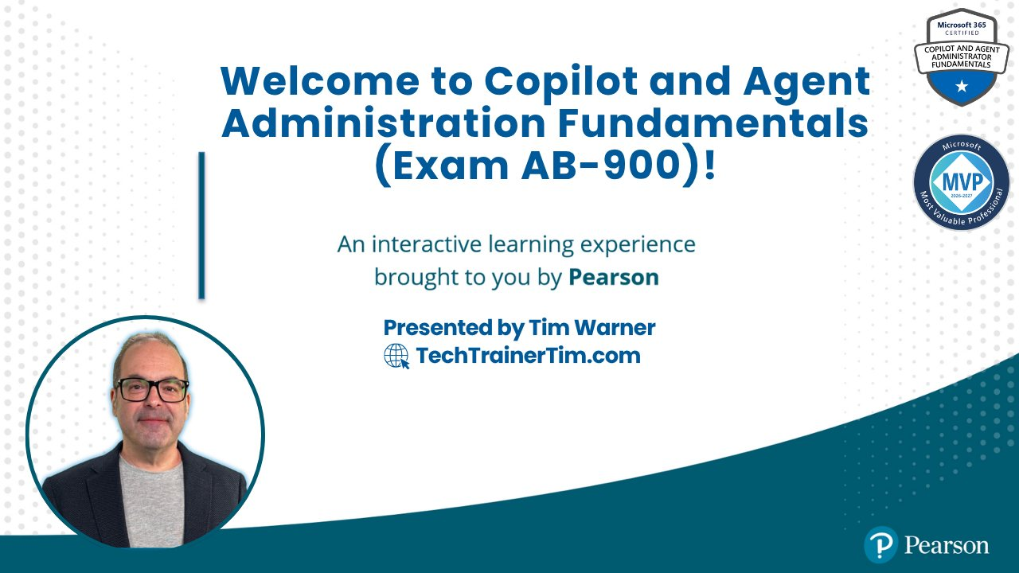




GitHub Copilot for Almost Everyone
Tim Warner
timw.info/linkedin
Notes:
How much flexibility am I allowed with these slide layouts? If you right-click a slide, you can play with layouts, but otherwise, not much flexibility.
Am I free to add my own graphics, providing MSFT attribution where necessary? When it comes to MS graphics, we're not allowed to use those, so please do not add in graphics unless they are created FROM SCRATCH by you.
Can I make the font a bit smaller? Some of the objectives are verbose and I don’t want to crowd the skills? Yes, I do this, too, when I review the slides because sometimes the default size just won't work.
Do the bullet points here need to be word-for-word from the outline or can I condense? We prefer word-for-word, but some of the sub-lesson titles are super long. Use your discretion, and we can address case-by-case during the review of each lesson's slides.

Slide 3


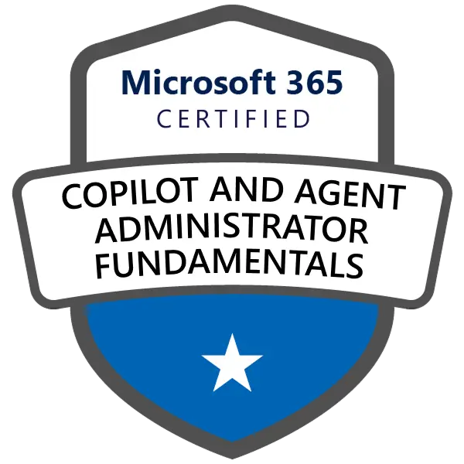
Tim Warner
Based in Nashville, TN, US
29-year Microsoft Certified Trainer (MCT)
8-year Microsoft MVP in M365 Copilot and Cloud/Datacenter Management
Contact: TechTrainerTim.com

Slide 4
Course Flow (Central Time Zone)
09:00 am - Start - Segment 1 [Core M365 Services]
10:00 am - 10-minute break - Segment 2 [Data Prot. & Gov.]
11:00 am - 10-minute break - Segment 3 [Copilot Admin]
12:00 pm - 10-minute break - Segment 4 [Agent Admin & Exam Prep]
01:00 pm - Finish

Slide 5
Course materials
github.com/timothywarner-org/ ab900

Slide 6
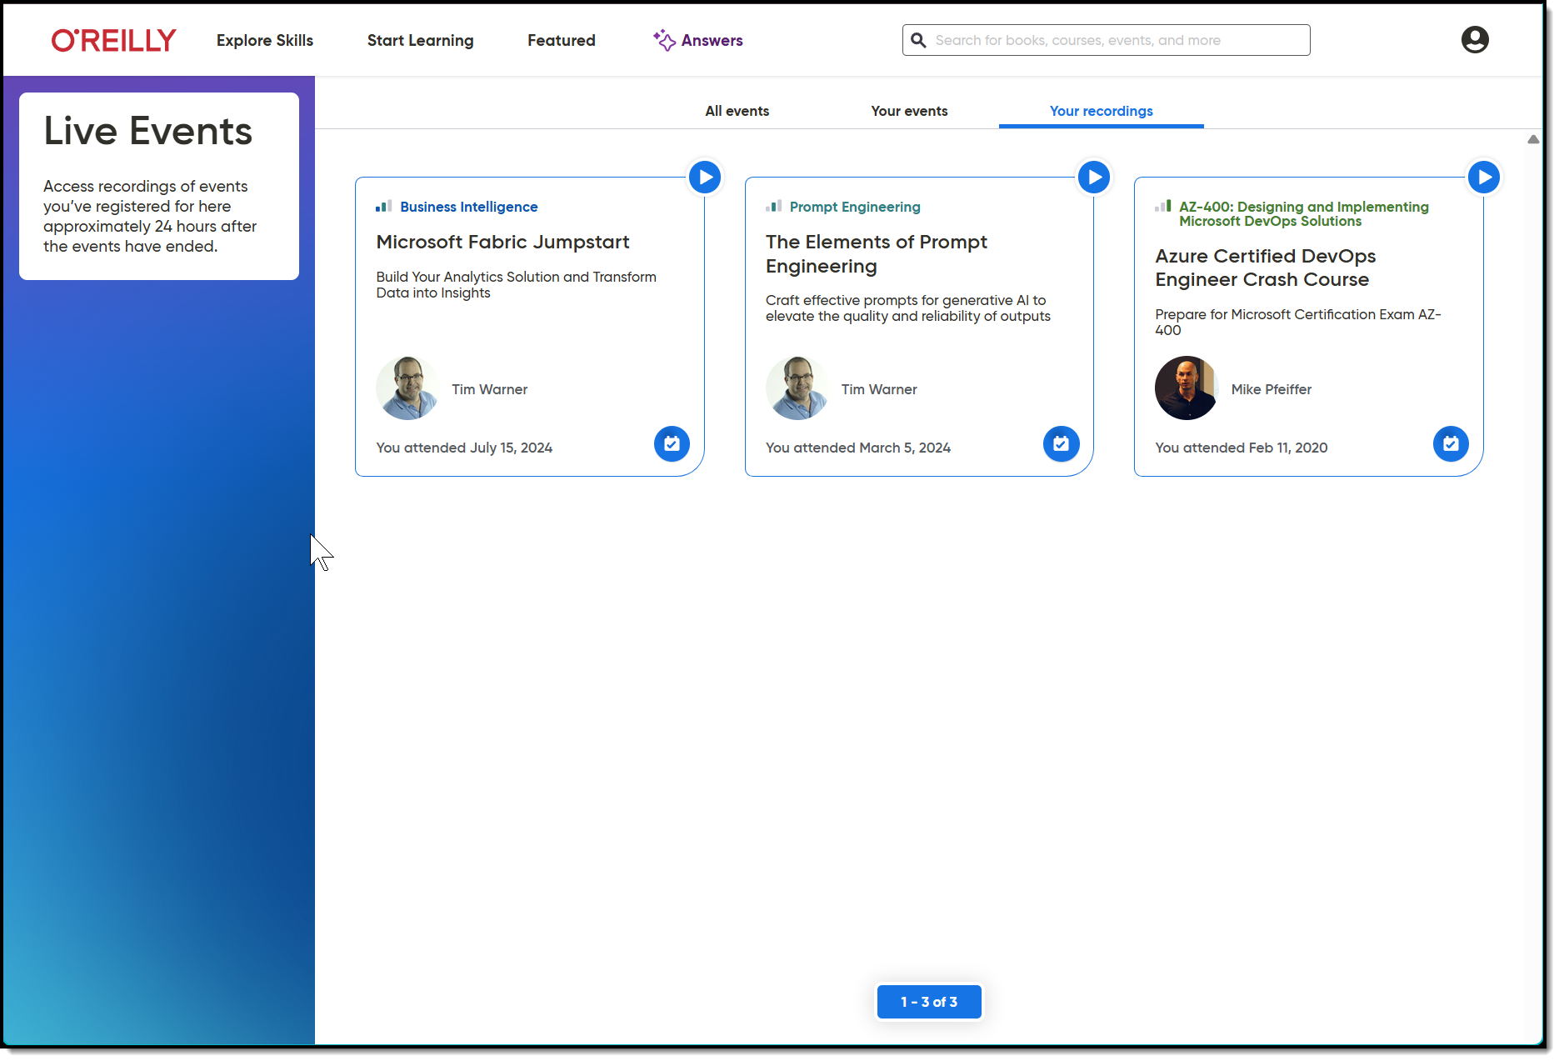
Session Recording + Badge

Slide 7
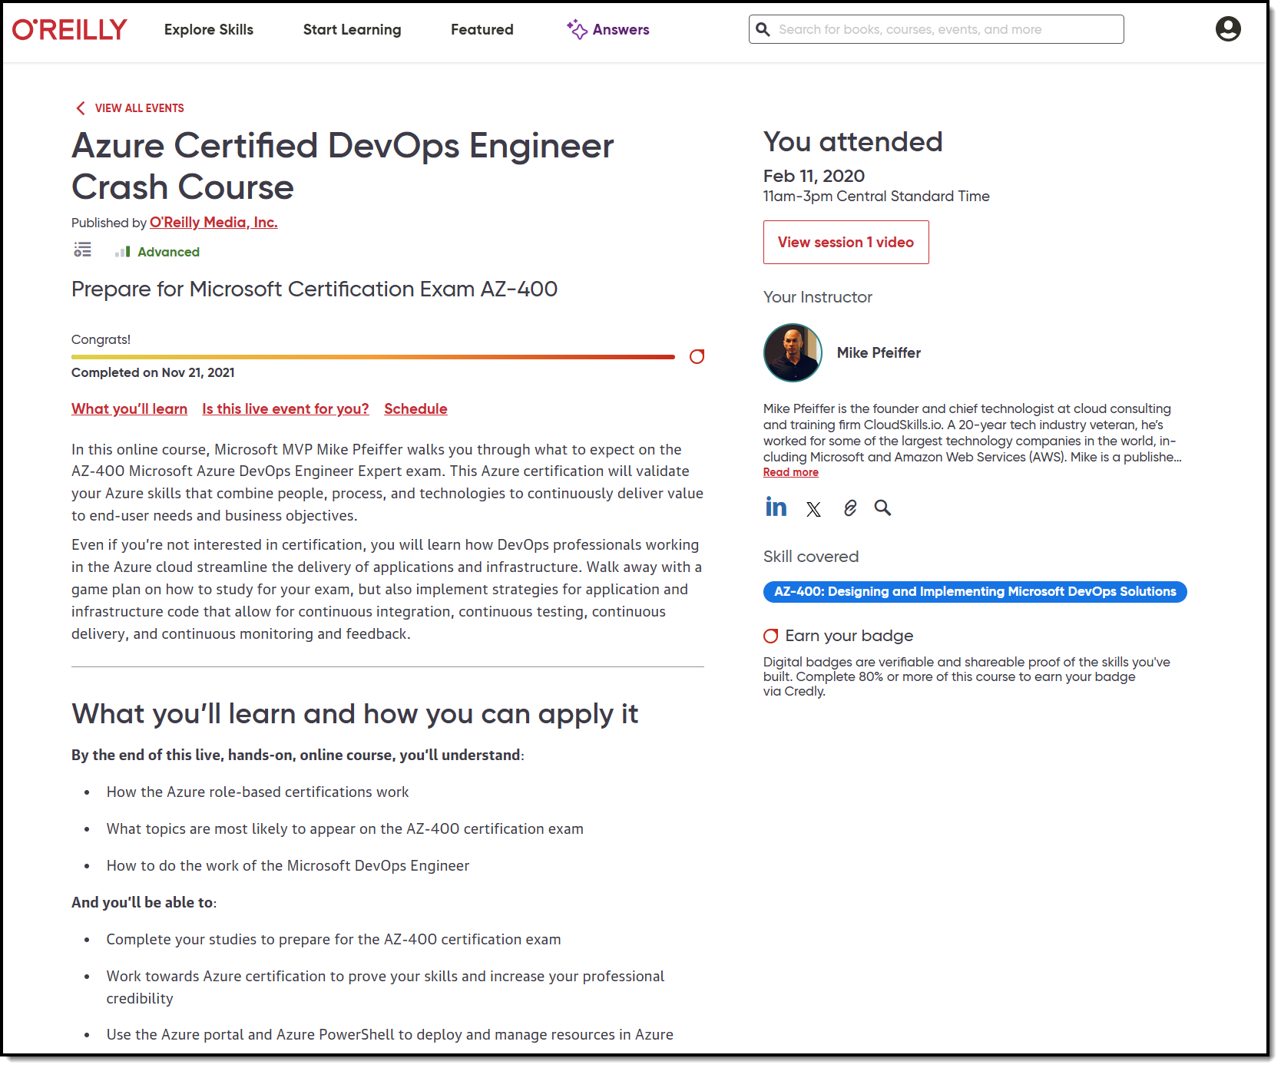
Session Recording + Badge

Slide 8
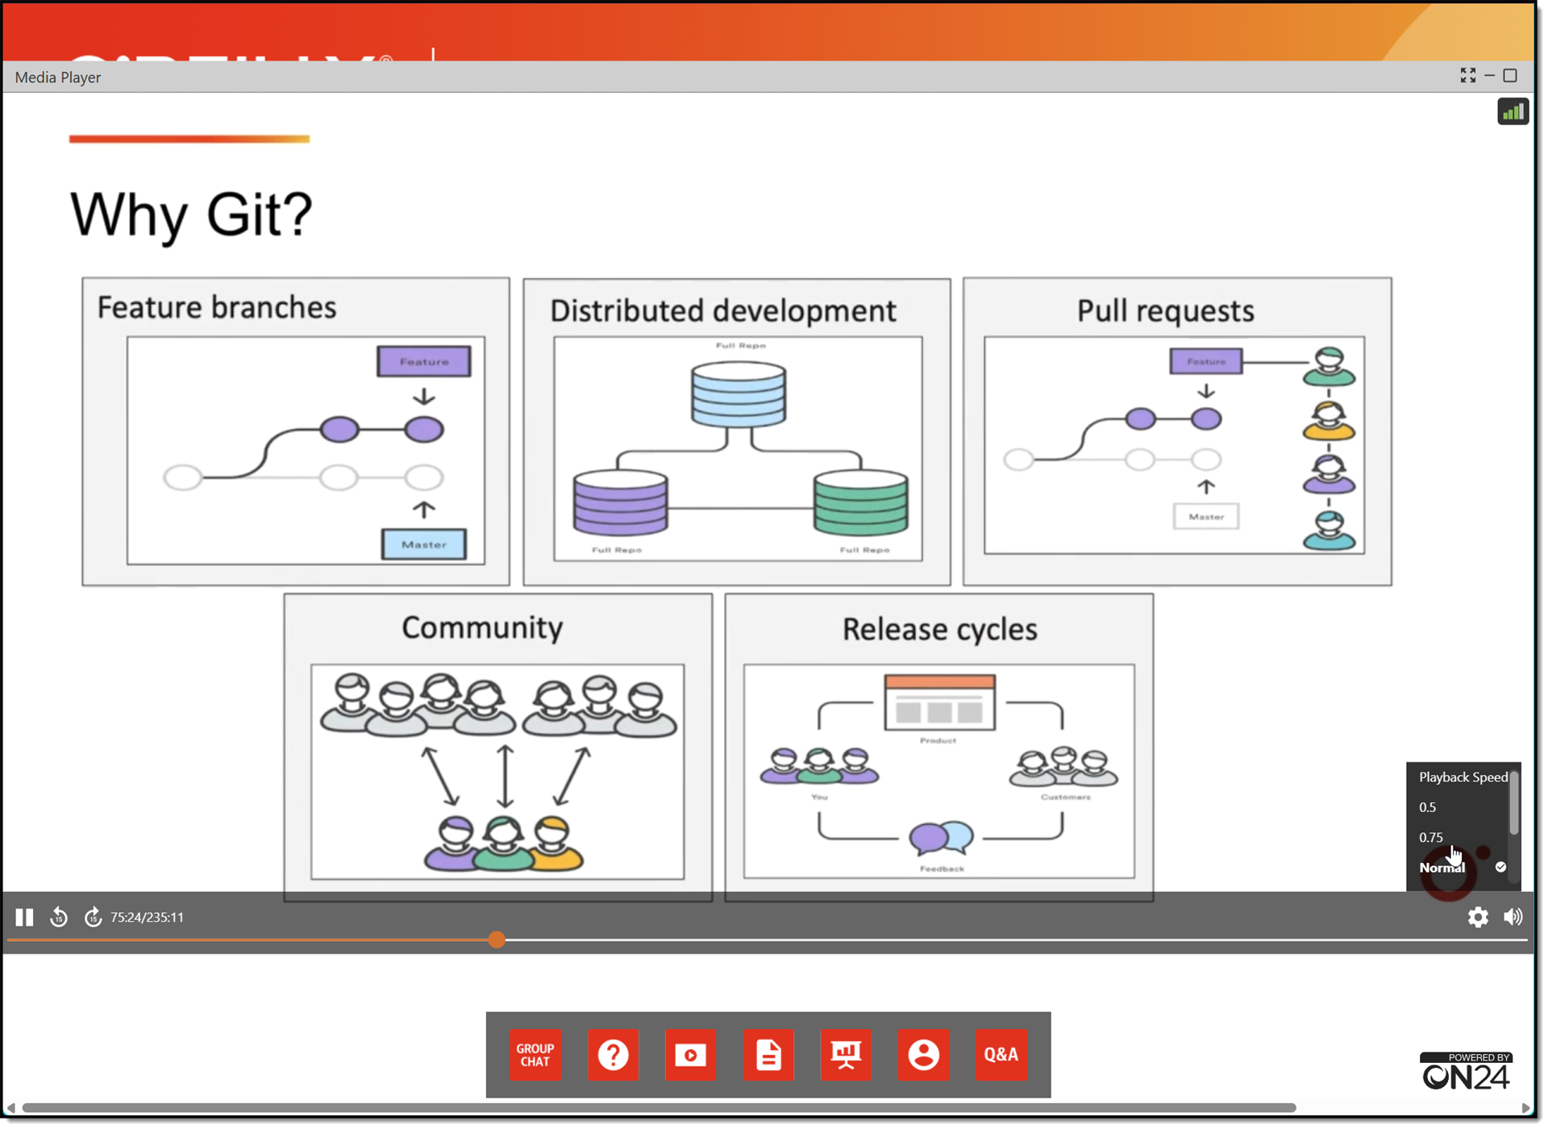
Session Recording + Badge

Slide 9
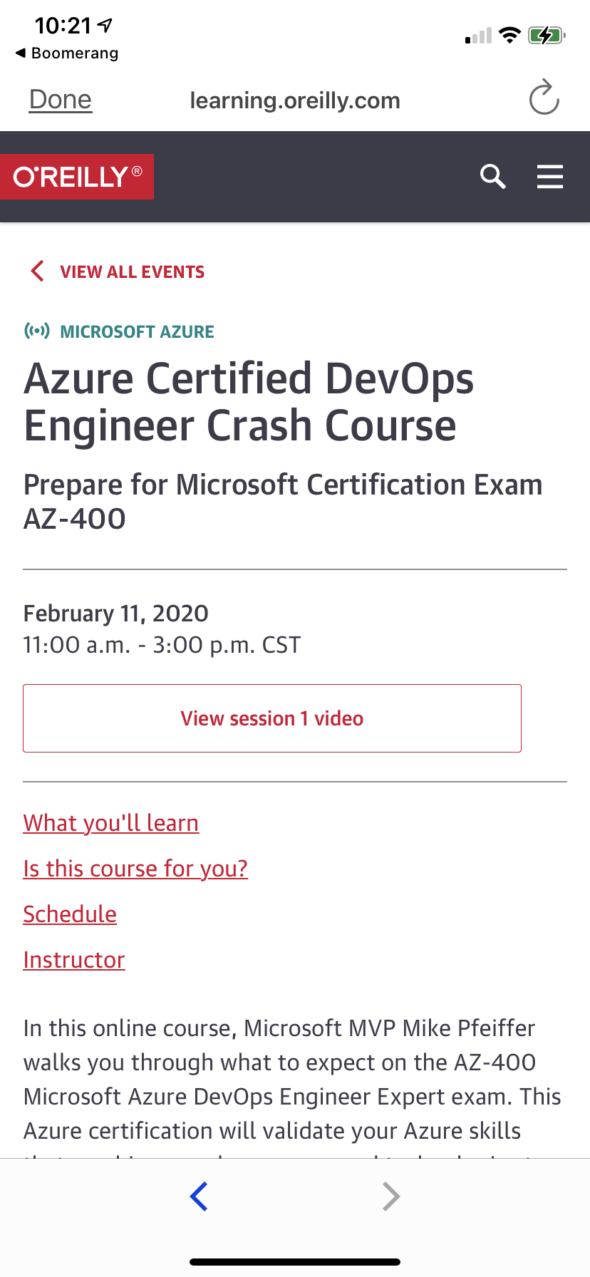
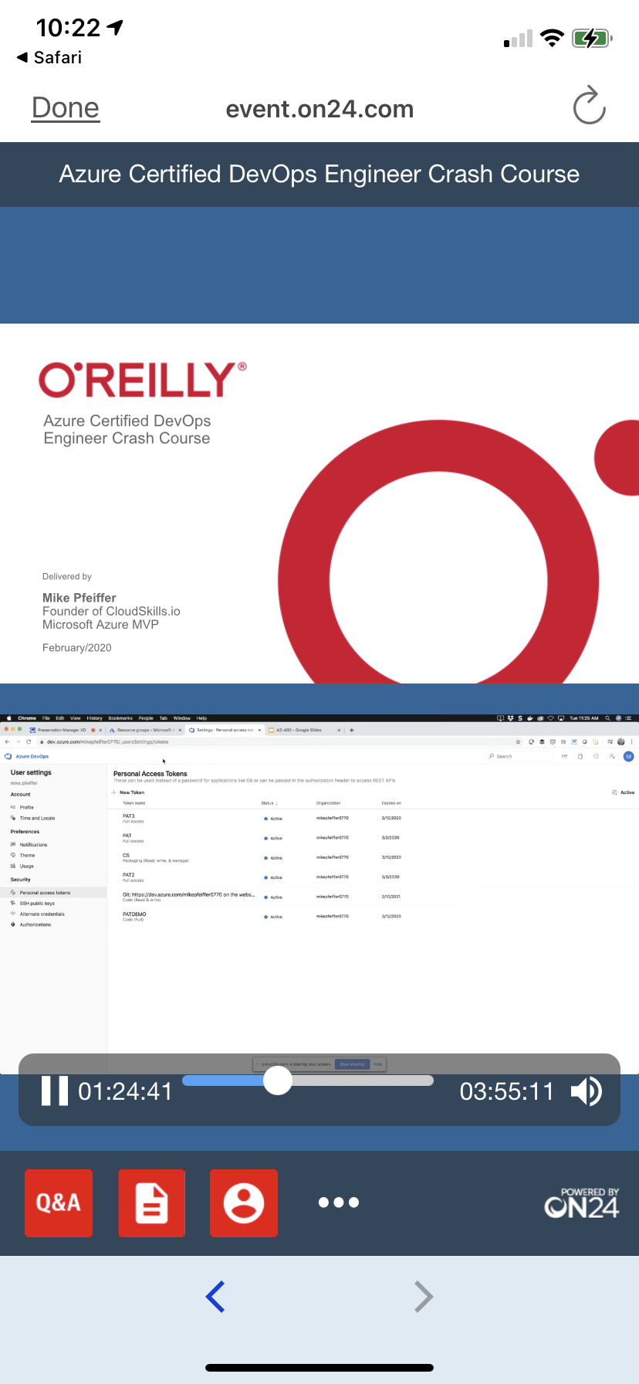
Mobile Browser: learning.oreilly.com

Slide 10
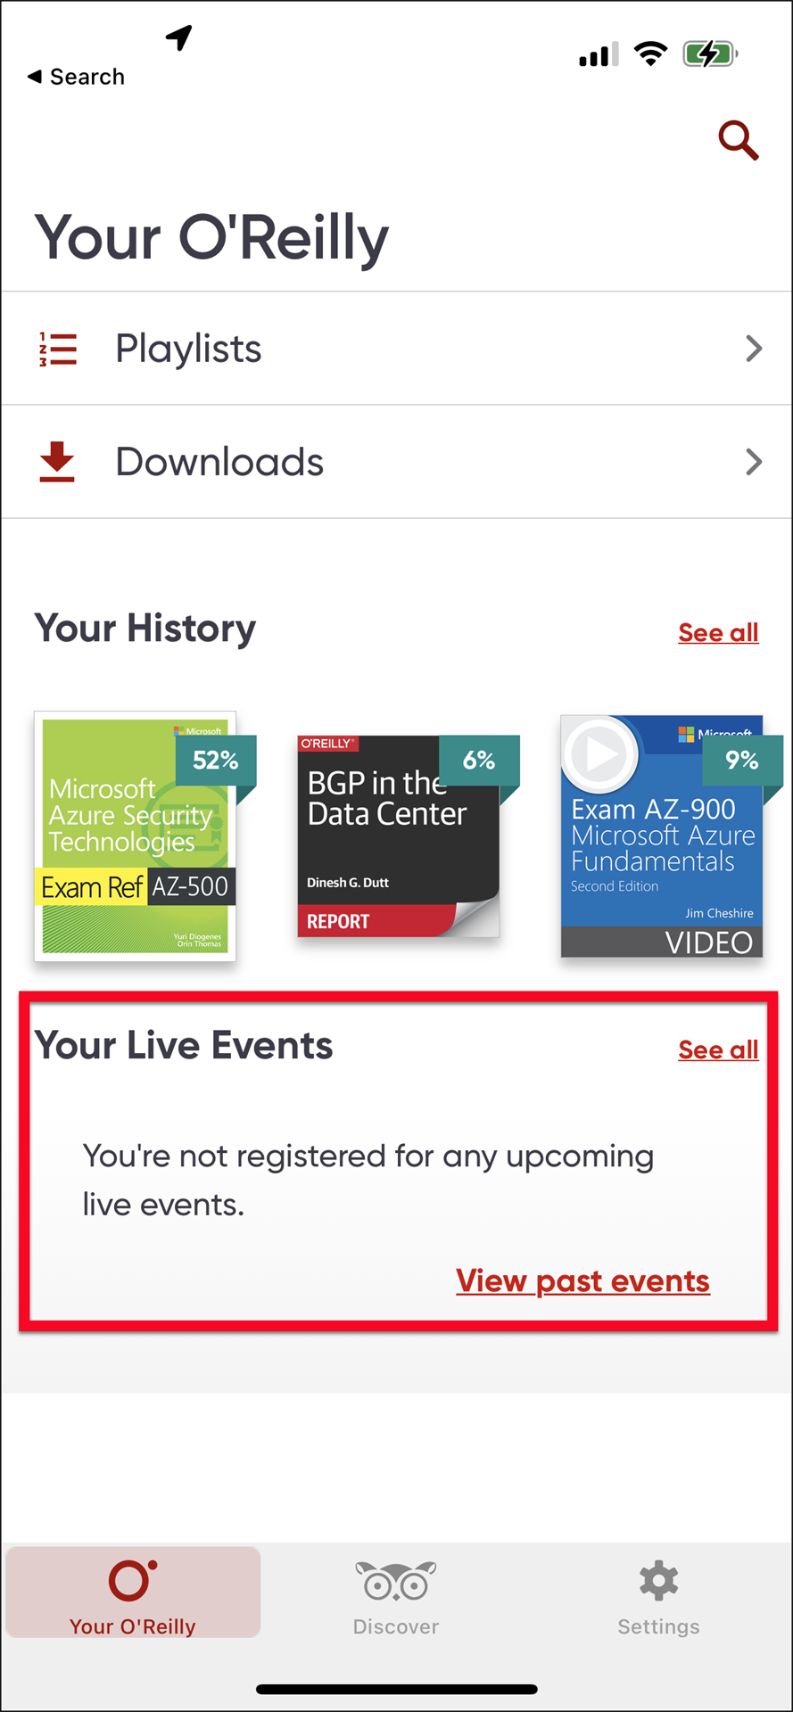
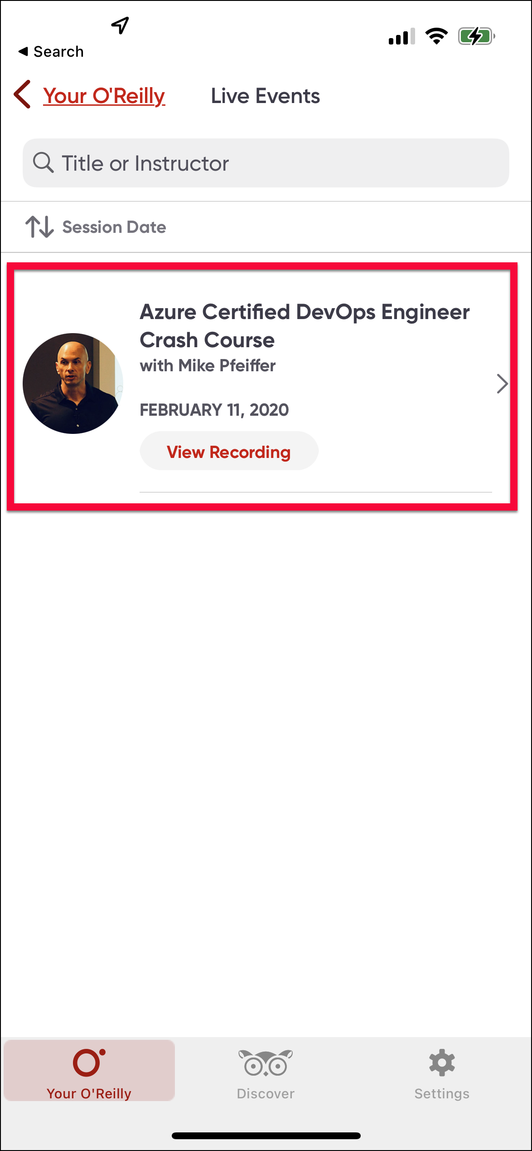
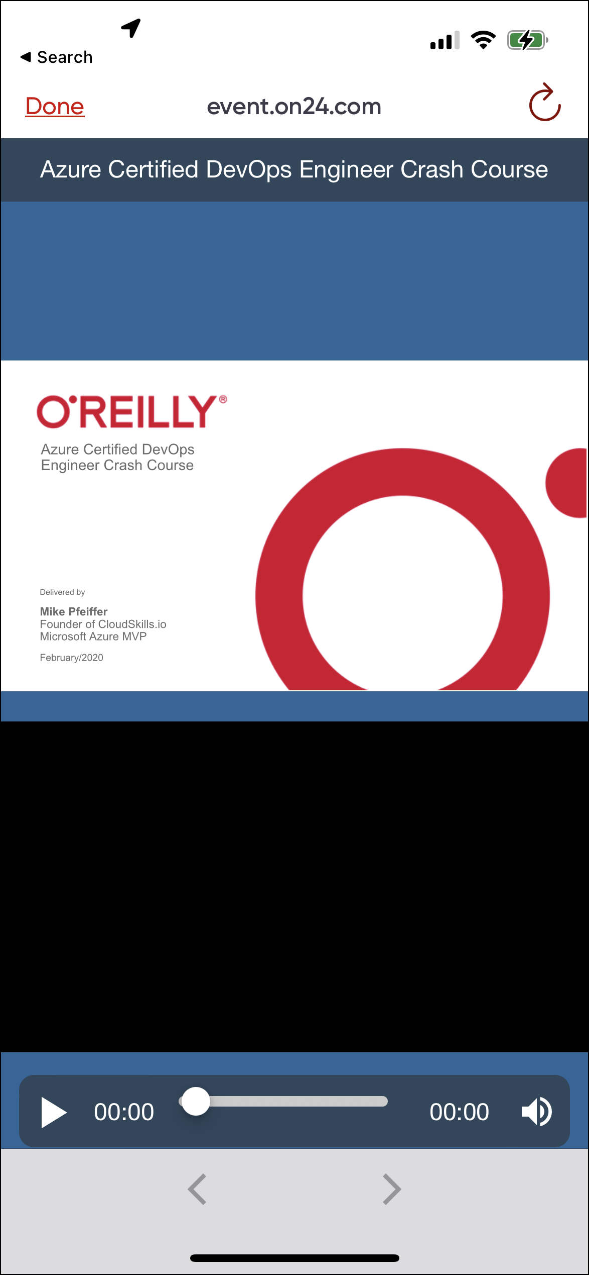
O'Reilly Mobile App

Slide 11
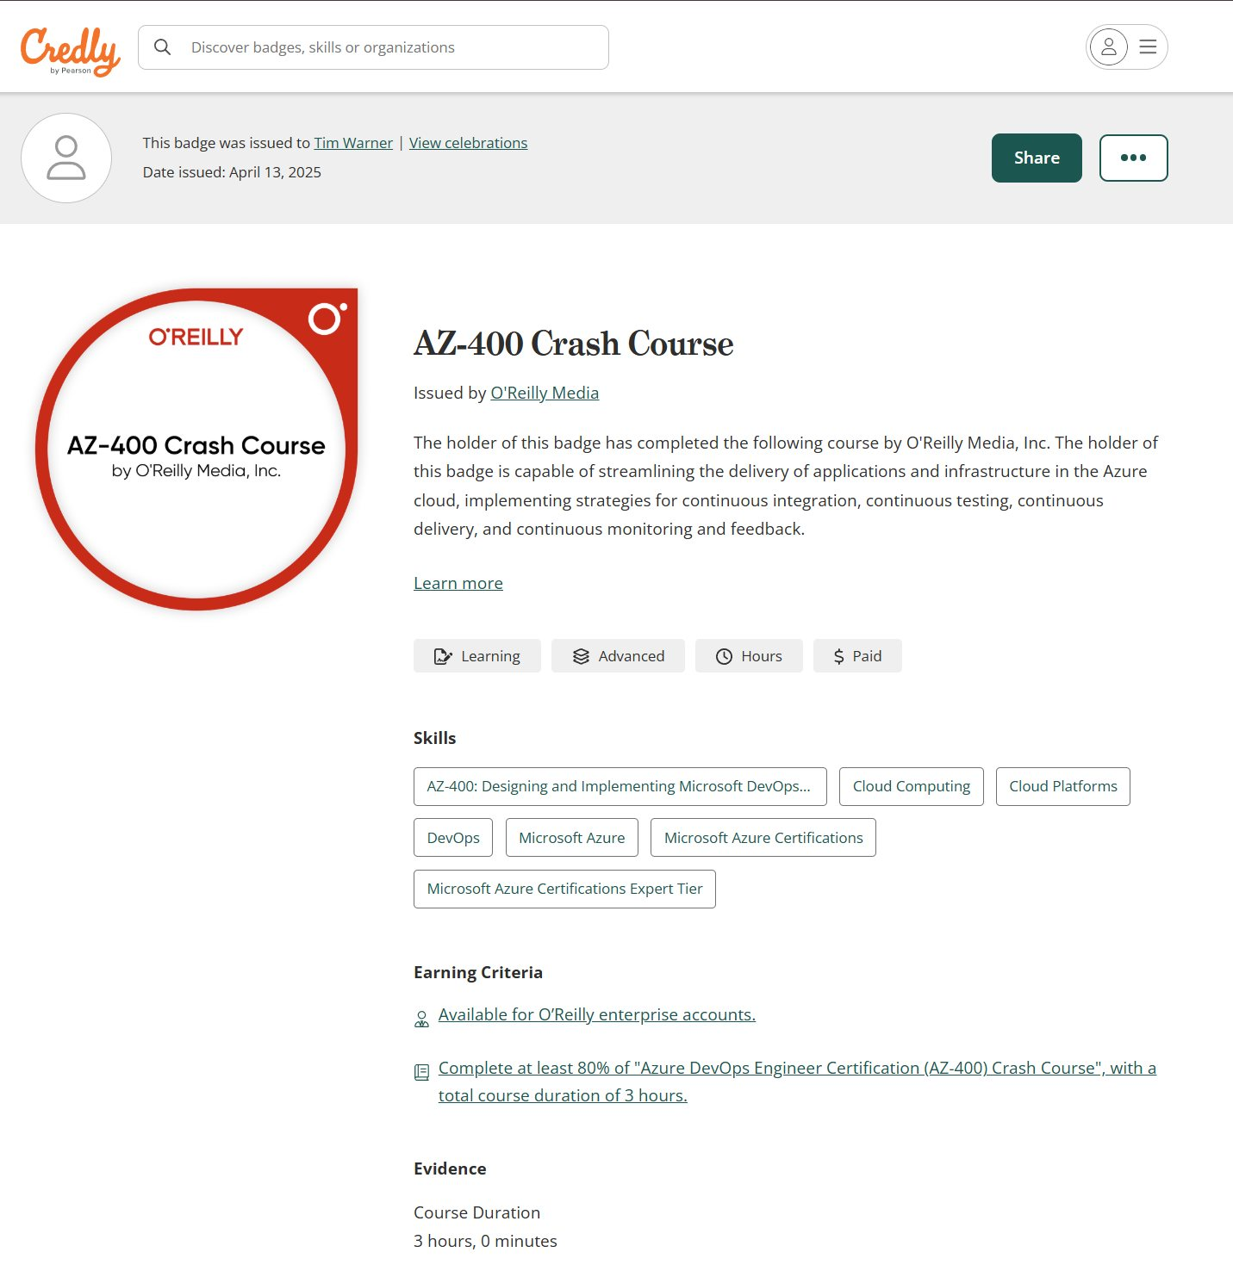
Session Recording + Badge

Slide 12
Questions?
Please add questions to the Q&A window so I don’t miss them
Only O’Reilly folks and I can read them
Your name shows up as initials with no company name
Let us know in the Q&A if my audio and/or video gets “crispy”

Slide 13
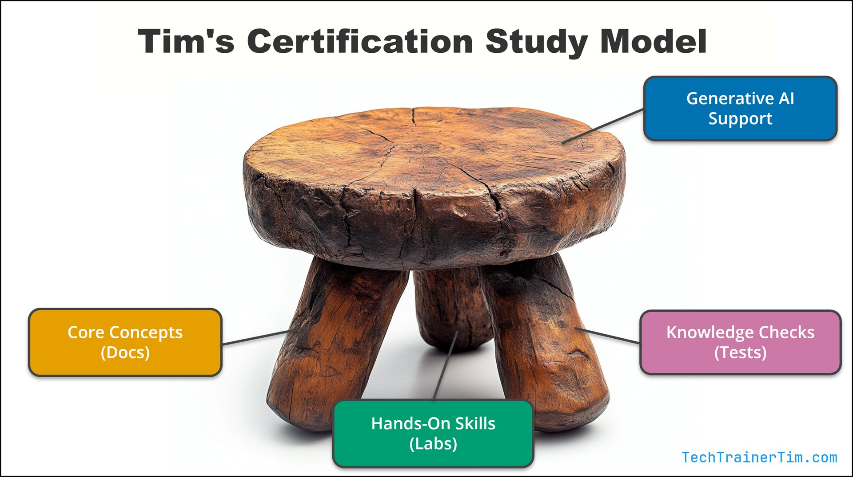

Tim's IT Certification Study Model

Slide 14
Thank you!
Course materials: github.com/timothywarner-org/ab900
Contact: TechTrainerTim.com

Slide 15

AB-900: Microsoft 365 Copilot and
Agent Administration Fundamentals
O'Reilly Live Learning | Tim Warner | TechTrainerTim.com
Exam: AB-900 | 45 min | 700/1000 to pass | Beginner level

Slide 16
AB-900 Exam Domains
Domain | Weight | Focus
1: Core features and objects of M365 services | 30-35% | Identity, admin centers, core services
2: Data protection and governance | 35-40% | HEAVIEST -- Purview, DLP, DSPM for AI
3: Basic admin tasks for Copilot and agents | 25-30% | Licensing, agents, Copilot Studio

Slide 17
Session Roadmap
Segment 1: Microsoft 365 Copilot -- What it is, how it works, licensing
Segment 2: Copilot Agents + Copilot Studio -- Build and manage agents
Segment 3: Data Protection and Governance -- Purview, DLP, DSPM for AI
Segment 4: M365 Admin, Identity, Security + Exam Prep
Each segment: 50 minutes + 10-minute break
Demos throughout -- follow along if you have a tenant

Slide 18

SEGMENT 1
Microsoft 365 Copilot
50 minutes | Domain 3 (25-30%)

Slide 19
What is Microsoft 365 Copilot?
NOT a standalone app -- it is embedded in Word, Excel, PowerPoint, Outlook, and Teams
AI assistant powered by large language models (Azure OpenAI Service)
Grounded in YOUR organizational data via Microsoft Graph
Key principle: Copilot can only see what the user can already see
Data never leaves the tenant and is never used to retrain public models
User always sees source references -- full transparency

Slide 20
Copilot Architecture: Four Components
Microsoft Graph -- unified data layer (emails, files, meetings, chats)
Work IQ -- intelligence layer that CONTAINS Graph and the semantic index
Large Language Models -- multi-provider foundation models, enterprise-tuned
Tenant-isolated; data never shared across organizations
Orchestration Service -- manages prompts, data, and LLM interactions
5 steps: prompt intake > evaluation > enrichment > execution > formatting
Semantic Index -- meaning-based retrieval, not keyword matching
"Project kickoff" finds docs about "launch meetings" or "initial planning"

Slide 21
Copilot Across Microsoft 365 Apps
Word
Draft documents, summarize, rewrite
Excel
Formulas, charts, what-if via natural language
PowerPoint
Outline to full slide deck with visuals
Outlook
Thread summaries, draft responses
Teams
Meeting recaps, action items, chat summaries
Copilot Chat
Cross-app search, tenant-wide queries via Graph

Slide 22
Responsible AI Principles
Data minimization
Fetches only data needed for the specific request
Transparency
Every answer includes source references users can verify
Content filtering
Blocks harmful, offensive, or unverified content
Auditability
All interactions logged in Microsoft Purview and M365 audit logs
No fabrication by design -- "No data found" rather than hallucinating

Slide 23
Copilot Licensing Models
Plan | For | Key Difference
Copilot Chat (Free) | Anyone | Web-grounded only -- NO org data
M365 Copilot Business | 300-seat MAXIMUM | Graph grounding + core security
M365 Copilot Enterprise | E3/E5 orgs | Full Purview compliance + governance
Copilot Studio | Business/Enterprise | Build custom agents + connectors

Slide 24
Monthly Per-User vs. Pay-as-You-Go
Subscription
Consumption
Monthly Per-User License
Fixed monthly fee regardless of usage
Predictable budgeting
Risk: over-licensing inactive users
Best for: consistent daily users
Pay-as-You-Go (Consumption)
Charged based on actual usage (Azure)
Metered against Azure subscription
Risk: unexpected cost spikes
Best for: pilots, seasonal, fluctuating demand

Slide 25
DEMO
Copilot in Action
1. Open Word -- use Copilot to draft a project summary from a SharePoint doc2. Open Excel -- ask Copilot to create a chart from raw data3. Open Teams -- review a meeting recap with action items4. Open Copilot Chat -- cross-app search ("What did the team discuss last week?")5. Show source references and Graph grounding in each response

Slide 26

10-MINUTE BREAK
Segment 2 starts shortly
Stretch, grab a drink, and post questions in chat!

Slide 27
SEGMENT 2
Copilot Agents + Copilot Studio
50 minutes | Domain 3 (25-30%)

Slide 28
What Are Agents?
Intelligent software that automates tasks, answers questions, and acts on user intent
Unlike Copilot (reactive assistant), agents can be tailored for specific expertise
Agents can retrieve information, perform actions, and operate independently
Four types of agents:
1. Prebuilt (Microsoft): Researcher, Analyst, Writing Coach, Prompt Coach
2. Ready-made SharePoint site agents: auto-created, scoped to site content
3. Everyday user agents: no-code, built in Copilot Chat or SharePoint
4. Advanced agents: Copilot Studio full experience or VS Code, 1000+ connectors

Slide 29
Prebuilt Agents: Researcher and Analyst
Researcher Agent
AI-powered research assistant -- gathers, analyzes, synthesizes into structured reports
Semantic search across SharePoint, Teams, incident logs
Analyst Agent
Virtual data scientist -- transforms raw data into insights using Python
Works with Excel, Power BI datasets
EXAM TRAP: Researcher and Analyst require a SEPARATE admin block.
They are NOT governed by the general agent on/off toggle!

Slide 30
Copilot vs. Agents: Key Differences
Criteria | Copilot | Agents
Interaction | Real-time, conversational in apps | Schedule/trigger-based, behind scenes
Data access | User permissions only | Service accounts, managed identities
Customization | Org-level config | Fully customizable per agent
Security | User-level audit logs | Approval process, credential mgmt
Best for | Quick one-off tasks | Repetitive, automated workflows

Slide 31
Agent Builder vs. Copilot Studio
No-Code (Exam Focus)
Pro-Code
Agent Builder (Testable!)
For everyday business users
No coding required
Describe tab: plain language creation
Configure tab: manual step-by-step
Both tabs sync automatically
Templates: preconfigured starting points
Copilot Studio (Full)
For developers and IT pros
Advanced customization
Multi-step workflows
Custom connectors and APIs
1000+ data connectors
Lifecycle management and security

Slide 32
Creating an Agent in Agent Builder
Describe Tab (plain language):
Select a template (optional) -- provides preconfigured starting point
WARNING: Changing template on Configure tab resets ALL customizations
Enter description in natural language; Agent Builder refines via follow-up questions
Configure Tab (manual):
Knowledge sources (up to 20): files, SharePoint, web, Copilot connectors
Capabilities (ON by default): Code interpreter, Image generator
Starter prompts: no documented minimum or maximum
Test draft before creating -- verify instructions and knowledge sources

Slide 33
Creating a SharePoint Agent
Four entry points:
Site homepage (+New > Agent), Library command bar, File context menu, Chat pane
Three tabs:
Overview: name, description, icon (.png, max 1 MB)
Sources: "Entire site" or pick specific libraries/folders/files (up to 20)
Behavior: welcome message, starter prompts (max 3), instructions
Key differences from Copilot Chat agents:
Has welcome message, max 3 starter prompts, NO Code Interpreter, NO Image Generator

Slide 34
Agent Approval and Lifecycle
Three-stage approval process:
1. Submission -- user/developer provides purpose, audience, permissions
2. Review -- admins + compliance officers assess
3. Decision -- approve, reject, or send back for revisions
Portal path: admin.microsoft.com > Agents > All agents > Requests
Lifecycle: Create > Approve > Deploy > Maintain > Block/Remove
Communicate retirement 30 days in advance
Monitor via Power Platform admin center and M365 admin center
Licensing: Free (declarative) | Licensed (Copilot Studio) | Consumption (PAYG)

Slide 35
DEMO
Create Two Agents Side by Side
1. Create a Copilot Chat agent using the Describe tab -- enter plain language description2. Switch to Configure tab -- add SharePoint knowledge source, enable Code Interpreter3. Add 3 starter prompts and test the draft agent4. Create a SharePoint agent from a document library -- pick specific files as sources5. Compare: welcome message, starter prompt limits, capabilities6. Show the agent approval queue at admin.microsoft.com > Agents > All agents > Requests

Slide 36
10-MINUTE BREAK
Segment 3 starts shortly
Stretch, grab a drink, and post questions in chat!

Slide 37
SEGMENT 3
Data Protection and Governance
50 minutes | Domain 2 (35-40%) -- HEAVIEST

Slide 38
Microsoft Purview: The Unified Portal
purview.microsoft.com -- NOT compliance.microsoft.com (retired)
Three pillars:
Data Security: sensitivity labels, DLP, encryption
Data Governance: lifecycle management, retention, archiving
Risk and Compliance: Insider Risk, Communication Compliance, eDiscovery
Key exam concept: Purview protects data that Copilot accesses
Sensitivity labels + DLP are enforced on Copilot responses

Slide 39
Sensitivity Labels
Classify and protect data -- labels TRAVEL with the data
Label components:
Encryption -- restrict who can open, edit, print, copy
Content markings -- headers, footers, watermarks
Access restrictions -- block external sharing
Application: manual, automatic (content detection), recommended, or mandatory
Justification required to downgrade a label
Portal: purview.microsoft.com > Solutions > Information protection > Labels

Slide 40
Data Loss Prevention (DLP)
Prevents accidental or intentional sharing of sensitive data
Scans content for patterns: credit card numbers, SSNs, health records
Actions: block, warn with policy tip, require business justification, alert admin
Enforced across: email, chat, SharePoint, OneDrive, Copilot interactions
Data classification methods:
Sensitive Information Types (SITs) -- regex + checksums + confidence scoring
Trainable classifiers -- ML models (50+ document samples)
Exact Data Match -- precise matching against uploaded data lists

Slide 41
Insider Risk and Communication Compliance
Insider Risk Management
Behavioral analytics + HR signals
Mass file downloads, personal email sharing
Unusual hours, unfamiliar locations
Integrates resignation/role change data
Elevates risk score with combined signals
Communication Compliance
Monitors email, Teams, Yammer, Copilot prompts
Detects harassment, data leaks, insider trading
Pattern-based detection + ML classifiers
Reviewer dashboard for investigation
Dismiss, notify, or escalate to HR/Legal

Slide 42
DSPM for AI (Data Security Posture Management)
Portal: purview.microsoft.com > Solutions > DSPM for AI (classic)
What it does:
Discovers and monitors how AI interacts with sensitive data
Detects shadow AI -- unsanctioned AI tools used without IT approval
Tracks AI-generated content: where stored, who has access
Oversharing assessments -- identifies data exposure risks
EXAM TRAP: Use DSPM for AI (not Data Explorer) for AI-specific data risk
Data Explorer finds sensitive data. DSPM for AI monitors AI interactions.

Slide 43
Compliance Manager, eDiscovery, and Retention
Compliance Manager:
Compliance score -- quantifies regulatory readiness (GDPR, HIPAA, ISO 27001)
Improvement actions -- specific steps to close gaps
eDiscovery:
ONE unified eDiscovery -- classic Standard/Premium retired Aug 2025
Premium FEATURES (by subscription): analytics, redaction, review sets
Retention:
Labels (per-item) vs. policies (location-wide)
Auto-apply rules based on SITs, keywords, or classifiers

Slide 44
How Copilot Accesses Data Through Graph
Copilot can only see what the user can already see
Queries Graph using the user OAuth token (same permissions as user)
Semantic index ranks results by context, recency, and activity
Sensitivity labels enforced -- "Confidential - Finance Only" excluded for non-Finance users
DLP rules apply to Copilot responses (block, warn, log)
"Anyone with the link" -- if link is active, Copilot can access it; revoke = Copilot loses access
All Copilot interactions are logged and auditable via Purview

Slide 45
SharePoint Oversharing
Common oversharing scenarios:
"Everyone" or "Anyone with the link" used too broadly
Edit access when View-only is sufficient
External guests with full site access instead of specific documents
Tools to detect and fix:
DAG reports (SharePoint admin center) -- identify high-risk sites
SharePoint Advanced Management (SAM) -- add-on for restricted access control (RAC)
DSPM for AI oversharing reports -- AI-specific oversharing

Slide 46
DEMO
Purview Portal Walkthrough
1. Navigate to purview.microsoft.com -- show the unified portal2. Solutions > Information protection > Labels -- view/create sensitivity labels3. Solutions > Data loss prevention > Policies -- review a DLP policy and alerts4. Solutions > DSPM for AI (classic) -- show oversharing reports and AI activity5. Show how a "Confidential" label restricts Copilot from surfacing a document

Slide 47
10-MINUTE BREAK
Segment 4 starts shortly
Stretch, grab a drink, and post questions in chat!

Slide 48
SEGMENT 4
M365 Admin, Identity, Security
+ Exam Prep
50 minutes | Domain 1 (30-35%) + Wrap-up

Slide 49
Microsoft 365 Admin Center
admin.microsoft.com -- the central hub
Dashboard: user activity, license usage, service health, recommendations
Users: create, assign licenses, reset passwords, configure MFA
Groups: Security, M365, Mail-enabled Security, Distribution, Dynamic
Billing: subscriptions, license allocation, PAYG policies
Reports: usage across Exchange, Teams, SharePoint, OneDrive, Copilot
Service health: real-time status, incidents, advisories, Message Center

Slide 50
Core Services at a Glance
Exchange Online
User, shared, and resource mailboxes
Transport rules (mail flow)
Retention policies, litigation hold
SharePoint Online
Team sites vs. communication sites
Document libraries, permissions, sharing
Permission inheritance model
Microsoft Teams
Channels: standard, private, shared
Meeting/messaging/app policies
Built on M365 Groups + SharePoint
OneDrive for Business
1 TB per user, Known Folder Move
Sharing controls with expiration

Slide 51
Copilot Admin Tasks
License assignment:
Individual: admin.microsoft.com > Users > Active users > Licenses and apps
Group-based: admin.microsoft.com > Groups > Active groups > Licenses
Pay-as-you-go billing (2-step process):
Step 1: Create billing policy at admin.microsoft.com > Copilot > Billing & usage
Step 2: Connect policy to a Copilot service -- if skipped, PAYG stays disabled!
Monitor usage:
Reports > Usage > Microsoft 365 Copilot (quick triage)
Copilot Analytics via Viva Insights Dashboard (deeper adoption analysis)
Prompt governance: save, share, schedule, delete prompts

Slide 52
Zero Trust Security Model
Three core principles:
Verify explicitly -- every request authenticated with all signals (identity, device, location)
Least privilege -- minimum access needed; PIM for just-in-time elevation
Assume breach -- segment, monitor, respond; Defender XDR + Sentinel
Six pillars: Identity, Endpoints, Apps, Data, Infrastructure, Network
Microsoft Secure Score measures your security posture
Identity Secure Score measures identity-specific posture

Slide 53
Identity and Authentication
Microsoft Entra ID -- the central identity platform
Authentication methods:
MFA, passwordless (FIDO2, Windows Hello, Authenticator), SSPR
Hybrid auth:
Password Hash Sync (most common) | Pass-through Auth | Federation (AD FS)
SSO:
Authenticate once, access all M365 + approved third-party apps
Conditional Access: signals > decision > enforcement
Signals: user risk, device compliance, location, app sensitivity
"What If" tool to simulate policies before deployment

Slide 54
PIM and Microsoft Defender XDR
Privileged Identity Management (PIM)
Just-in-time admin role activation
Time-bound access -- auto-revokes
Requires MFA + justification at activation
Approval workflows for sensitive roles
All activations logged and auditable
Microsoft Defender XDR
Unified threat detection and response
Defender for Office 365 (email/phishing)
Defender for Endpoint (devices)
Defender for Identity (AD signals)
Defender for Cloud Apps (shadow IT)

Slide 55
App Registrations and Enterprise Apps
App Registrations:
Define how an app connects to M365 and what it can access
Specify account types and required permissions (read profiles, send email, etc.)
Secured with client secrets or certificates -- rotate regularly
Enterprise Applications:
Service principals instantiated in a tenant
Represent the actual app instance users interact with
User consent management:
Review and limit which apps users can approve
Regularly audit permissions -- enforce least privilege for apps

Slide 56
Role-Based Access Control (RBAC)
Principle of least privilege -- do NOT use Global Admin for everything
Key built-in roles:
Global Administrator: full access (use sparingly)
Exchange Administrator, Teams Administrator, SharePoint Administrator
Helpdesk Administrator: password resets only
Compliance Administrator: audit logs, DLP policies
User Administrator: account management
Custom roles available in Microsoft Entra ID for fine-tuned access
Use group-based role assignment for scalability

Slide 57
DEMO
Admin Center Tour
1. admin.microsoft.com -- show dashboard, user list, license management2. Assign a Copilot license to a user (Users > Active users > Licenses and apps)3. Copilot > Billing & usage -- show PAYG billing policy setup4. entra.microsoft.com -- show Conditional Access policy and "What If" tool5. Health > Service health -- review active advisories

Slide 58
Key Portal Paths (Memorize These!)
Task | Portal Path
DSPM for AI | purview.microsoft.com > Solutions > DSPM for AI (classic)
Copilot PAYG billing | admin.microsoft.com > Copilot > Billing & usage
Agent approval queue | admin.microsoft.com > Agents > All agents > Requests
Sensitivity labels | purview.microsoft.com > Solutions > Information protection > Labels
Conditional Access | entra.microsoft.com > Protection > Conditional Access > Policies
PIM role activation | entra.microsoft.com > Identity governance > PIM
Copilot license | admin.microsoft.com > Users > Active users > Licenses and apps

Slide 59
Exam Tips and Final Reminders
Domain 2 (Purview/data protection) is 35-40% -- study it most
Know the portal paths -- wrong portal is the #1 distractor pattern
Copilot = reactive assistant | Agents = autonomous, customizable
Researcher and Analyst need a separate admin block (not the general toggle)
PAYG billing is a 2-step process -- both steps required or PAYG stays disabled
Copilot license activation has a 24-hour delay -- NOT immediate
PAYG usage is metered in Copilot Credits (not "per message")
DSPM for AI for AI-specific risk; Data Explorer for general sensitive data
Copilot can only see what the user can see -- Graph enforces permissions
Passing score: 700/1000 | 45 minutes | Exam sandbox: aka.ms/examdemo

Slide 60

Thank You!
Tim Warner | TechTrainerTim.com | github.com/timothywarner
Good luck on the AB-900 exam!
Resources: github.com/timothywarner-org/ab900

