Slide 1


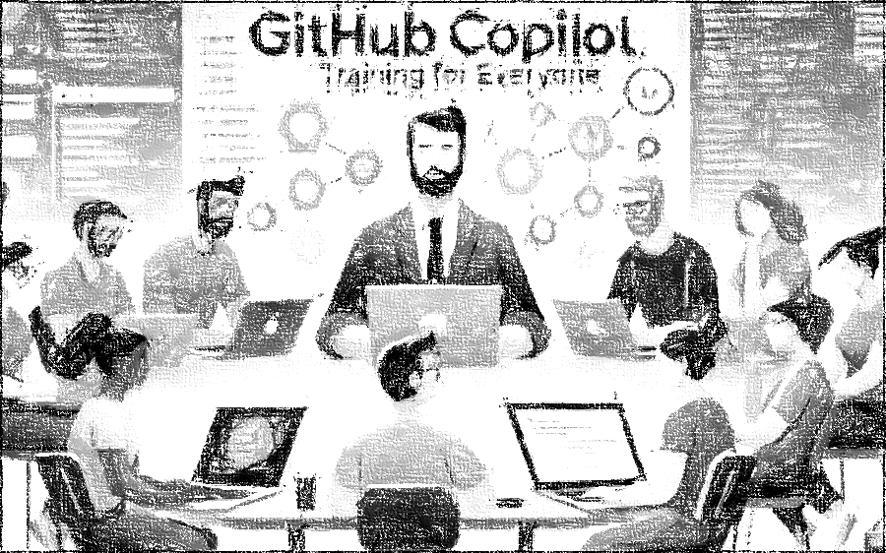


GitHub Copilot for Almost Everyone
Tim Warner
timw.info/linkedin
Notes:
How much flexibility am I allowed with these slide layouts? If you right-click a slide, you can play with layouts, but otherwise, not much flexibility.
Am I free to add my own graphics, providing MSFT attribution where necessary? When it comes to MS graphics, we're not allowed to use those, so please do not add in graphics unless they are created FROM SCRATCH by you.
Can I make the font a bit smaller? Some of the objectives are verbose and I don’t want to crowd the skills? Yes, I do this, too, when I review the slides because sometimes the default size just won't work.
Do the bullet points here need to be word-for-word from the outline or can I condense? We prefer word-for-word, but some of the sub-lesson titles are super long. Use your discretion, and we can address case-by-case during the review of each lesson's slides.

Slide 2

Tim Warner
Based in Nashville, TN, US
28-year Microsoft Certified Trainer (MCT)
6-year Microsoft MVP in Azure AI
Contact: TechTrainerTim.com

Slide 3




Learning Goals
Achieve your GitHub Copilot certification
Enhance your development efficiency

Slide 4
Course Flow (Central Time Zone)
09:00 am - Start - Segment 1 [Responsible AI & CLI]
10:00 am - 10-minute break - Segment 2 [Data, Prompts & Agents]
11:00 am - 10-minute break - Segment 3 [Productivity & Org Policy]
12:00 pm - 10-minute break - Segment 4 [Privacy & Safeguards]
01:00 pm - 10-minute break - Segment 5 [Exam Prep & What's Next]
02:00 pm - Finish

Slide 5
Course materials
timw.info/copilotcert

Slide 6
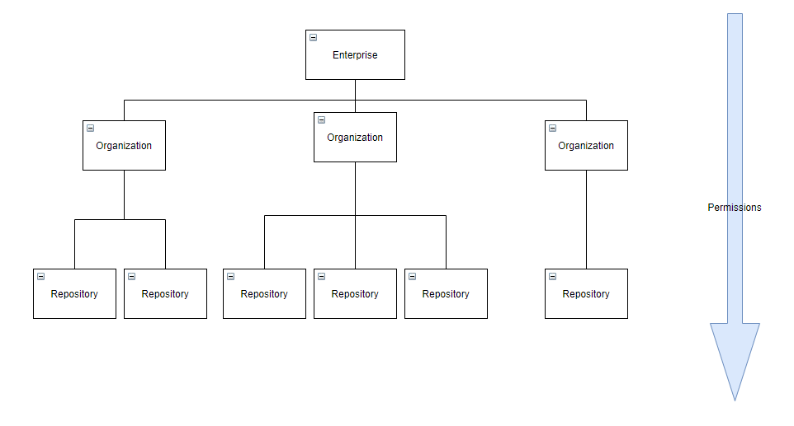
GitHub Enterprise Cloud (GHEC)
Reference: https://github.com/dduzgun-security/github-enterprise-cloud-configuration

Slide 7
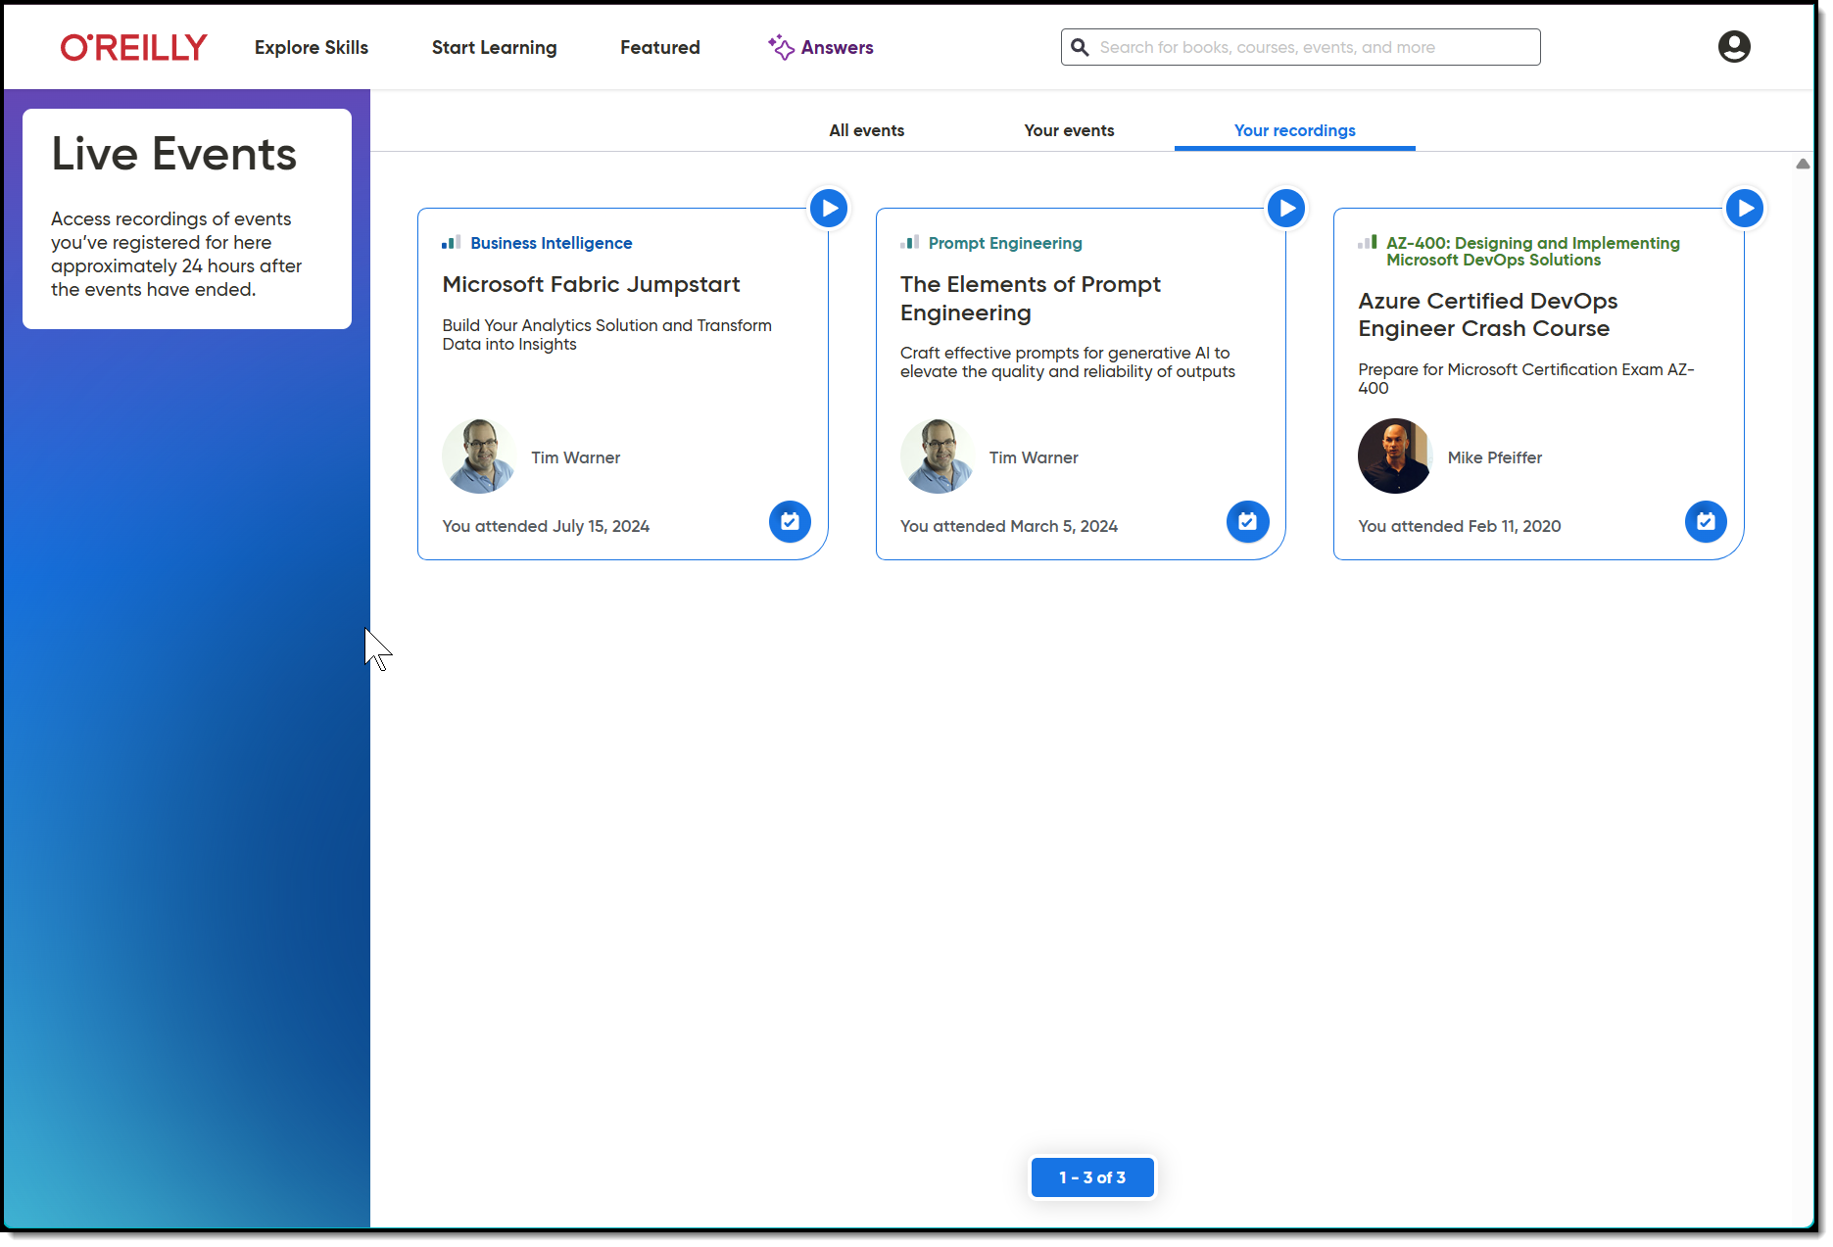
Session Recording + Badge

Slide 8
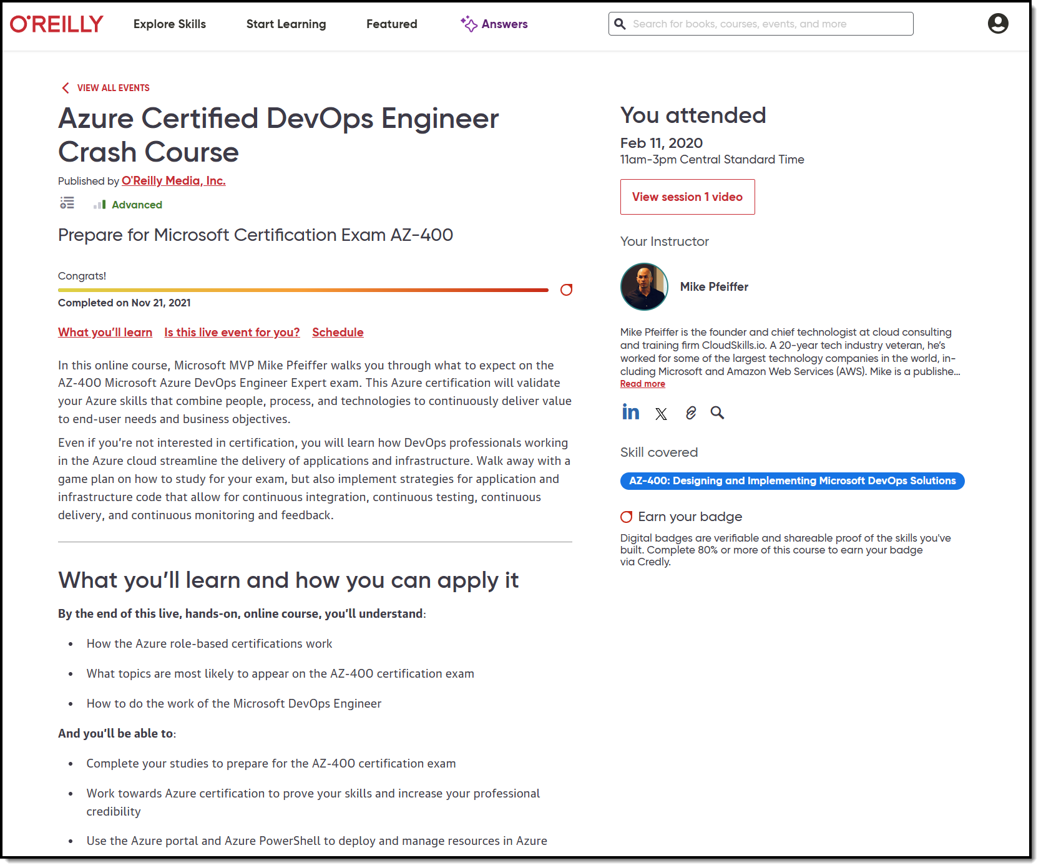
Session Recording + Badge

Slide 9
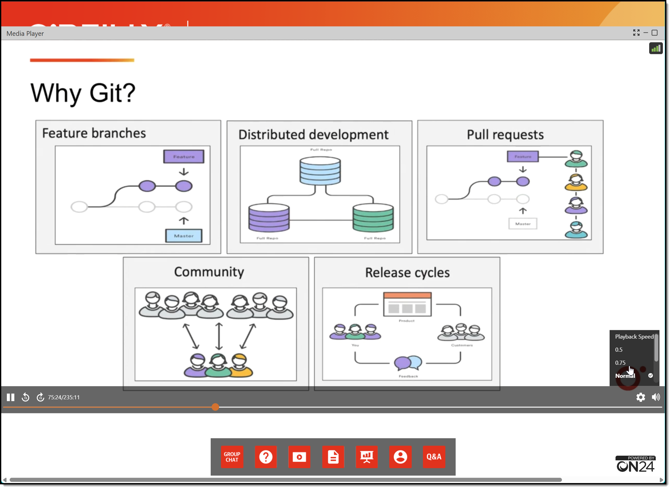
Session Recording + Badge

Slide 10
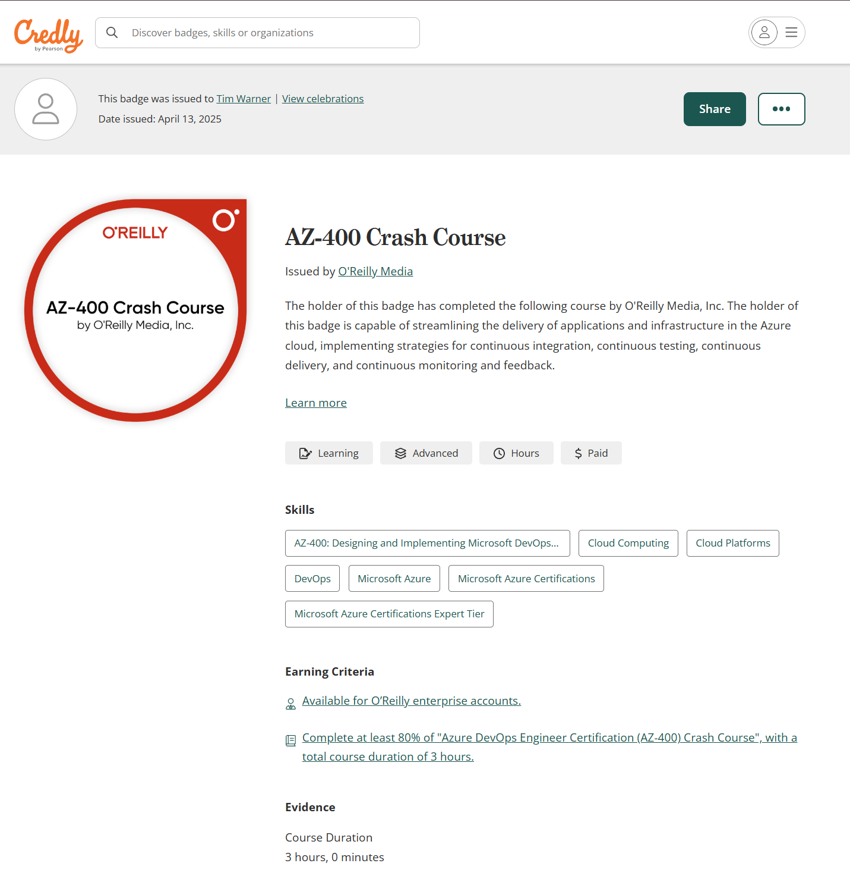
Session Recording + Badge

Slide 11
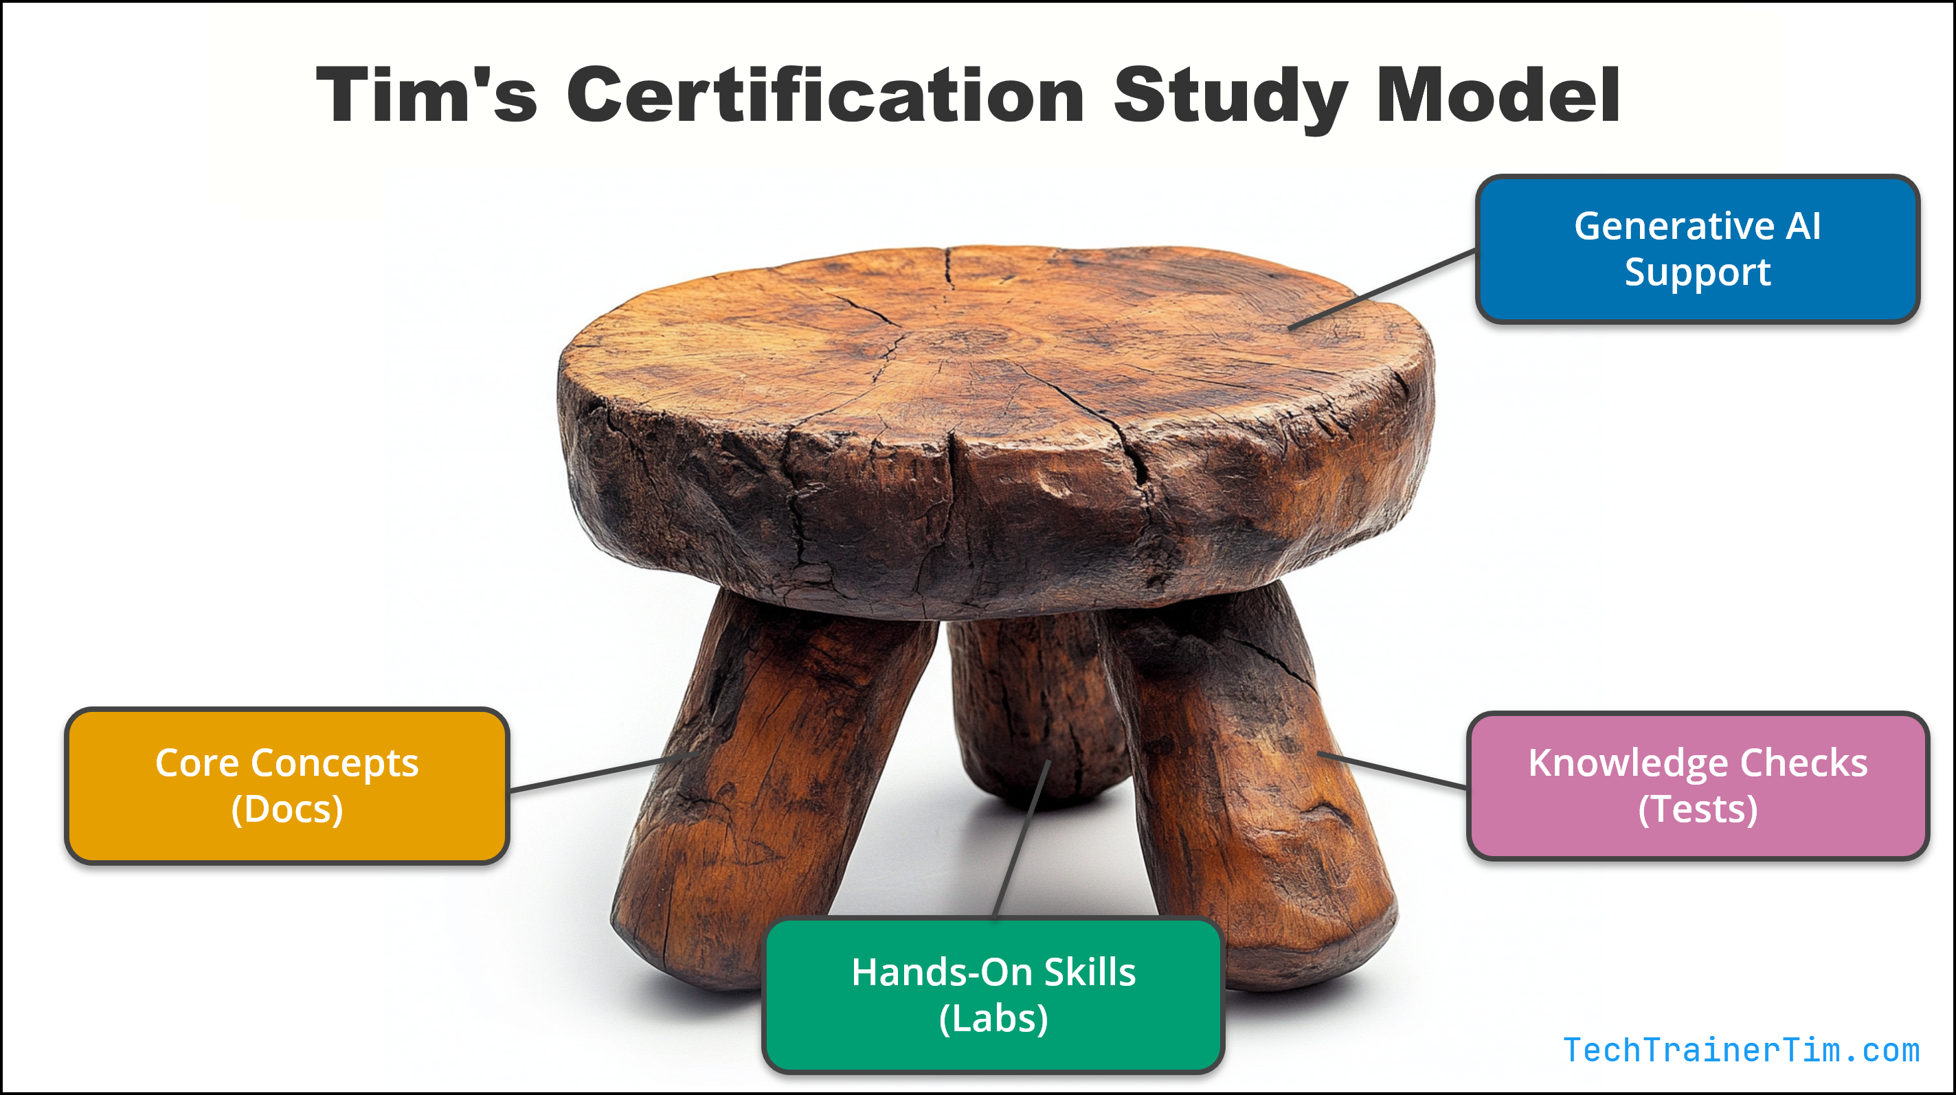

Tim's IT Certification Study Model

Slide 12

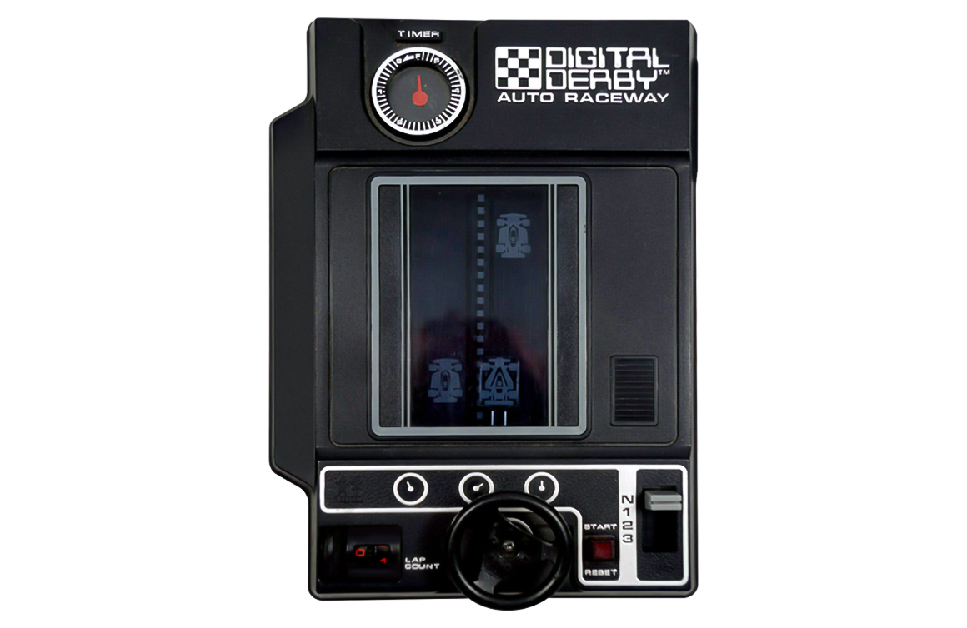
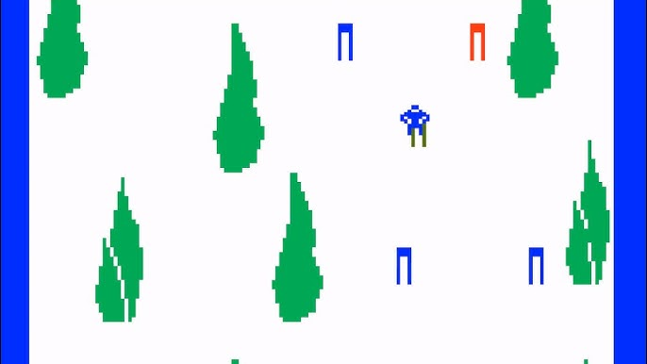
Keeping an LLM on task be like…

Slide 13
Custom Instructions Scopes
Repo: .github/copilot-instructions.md
Workspace: .github/instructions/*.instructions.md
YAML directive
---
applyTo: "src/**/*.js"
---
Org: In GitHub web UI
MCP: Agent mode gear icon

Slide 14
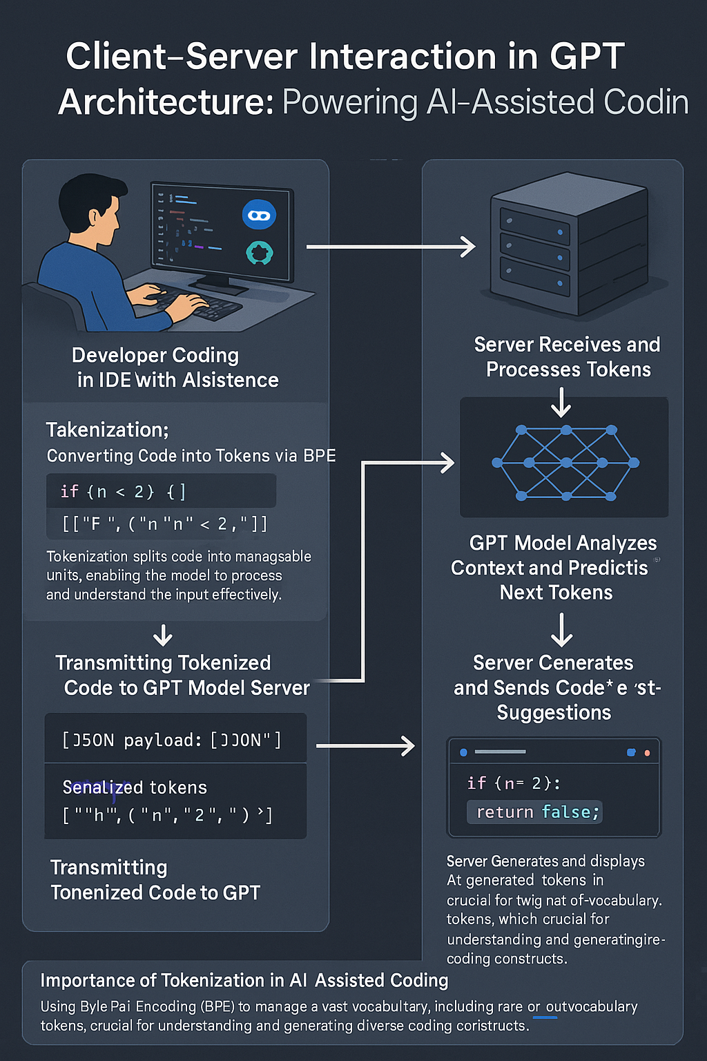
GPT Basic Architecture
OpenAI GPT 4o Image Generation
Multimodal generative AI
Two ways to improve model:
Fine tuning
Retrieval Augmented Generation (RAG)

Slide 15

Neural Network
go.techtrainertim.com/cloud

Slide 16

Context Length

Slide 17
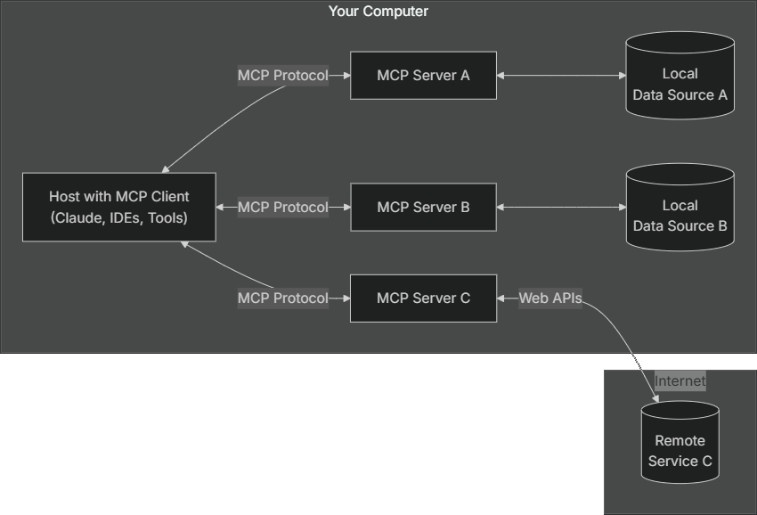
Model Context Protocol (MCP) by Anthropic
modelcontextprotocol.io

Slide 18
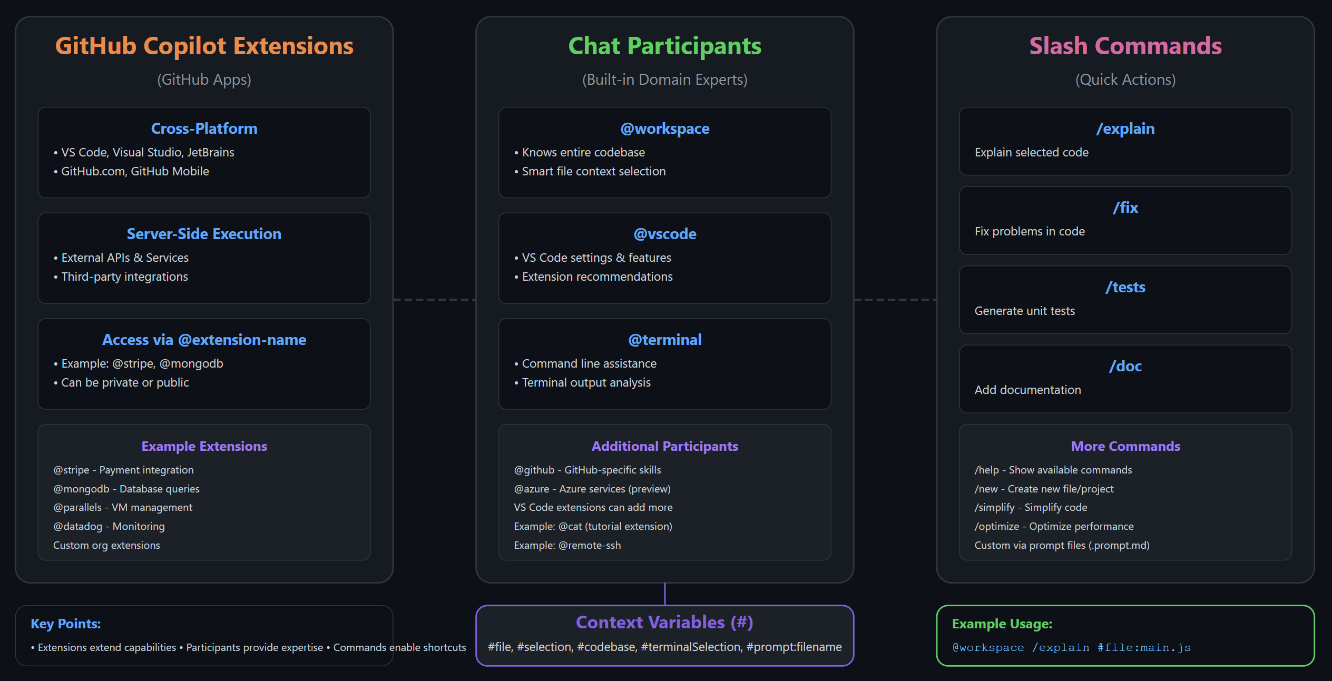
Extending GitHub Copilot

Slide 19

Thank you!
Course materials: go.techtrainertim.com/copilotcert
Contact: TechTrainerTim.com

