Slide 1

Databricks Certified Data Engineer Associate Crash Course
Tim Warner

Slide 2

Tim Warner
Principal Author, Pluralsight
Based in Nashville, TN, US
26-year Microsoft Certified Trainer (MCT)
6-year Microsoft MVP in Azure AI
Email: tim-warner@pluralsight.com
Badge: TechTrainerTim.com

Slide 3
Agenda
Introduction
Design identity, governance, and monitoring solutions (25–30%)
Design data storage solutions (20–25%)
Design business continuity solutions (15–20%)
Design infrastructure solutions (30–35%)Exam AZ-305 strategy

Slide 4
Course Materials
timw.info/databricks

Slide 5
Level Setting
We'll learn by doing – majority demo
Visual, case study approach
This is an expert certification, so we move quickly and assume intermediate-level Azure skills
I’m here to answer your questions – take advantage of this!
Please use the Q&A panel for questions and feedback

Slide 6
Break Schedule (CT, Nashville, TN)
07:00am - Start (Identity & Governance)
08:00am - 8-min break (Data storage)
09:00am - 8-min Break (Business Continuity)
10:00am - 8-min Break (Infrastructure)
11:00am - 8-min Break (Loose ends + cert focus)
12:00pm - Finish

Slide 7
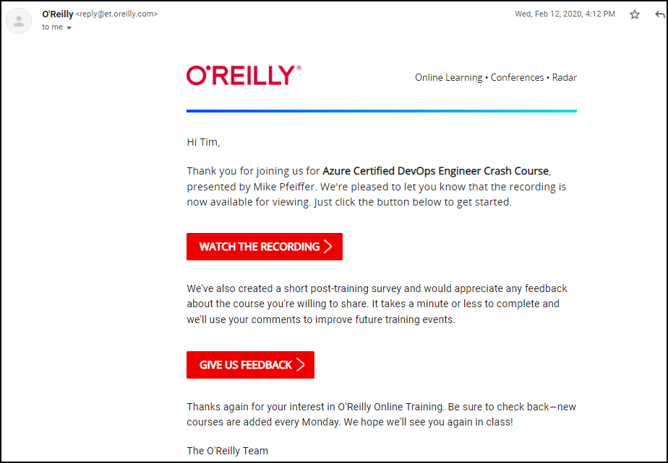
Session Recordings

Slide 8
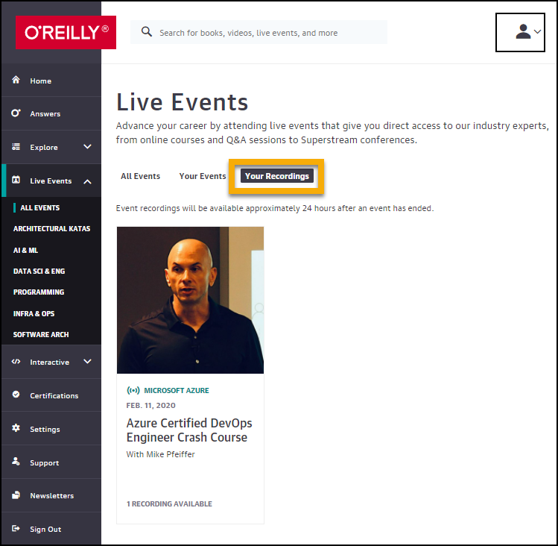
Session Recordings

Slide 9
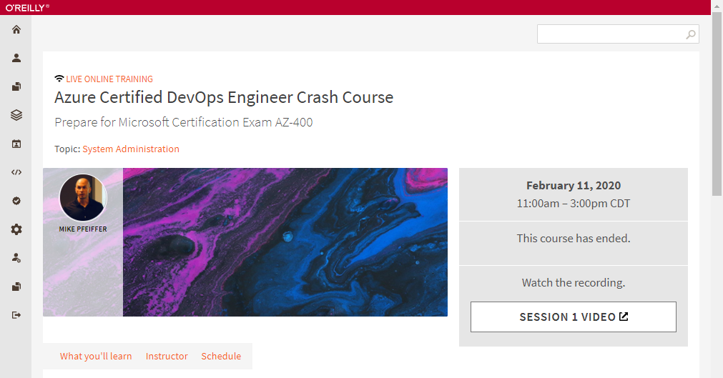
Session Recordings

Slide 10
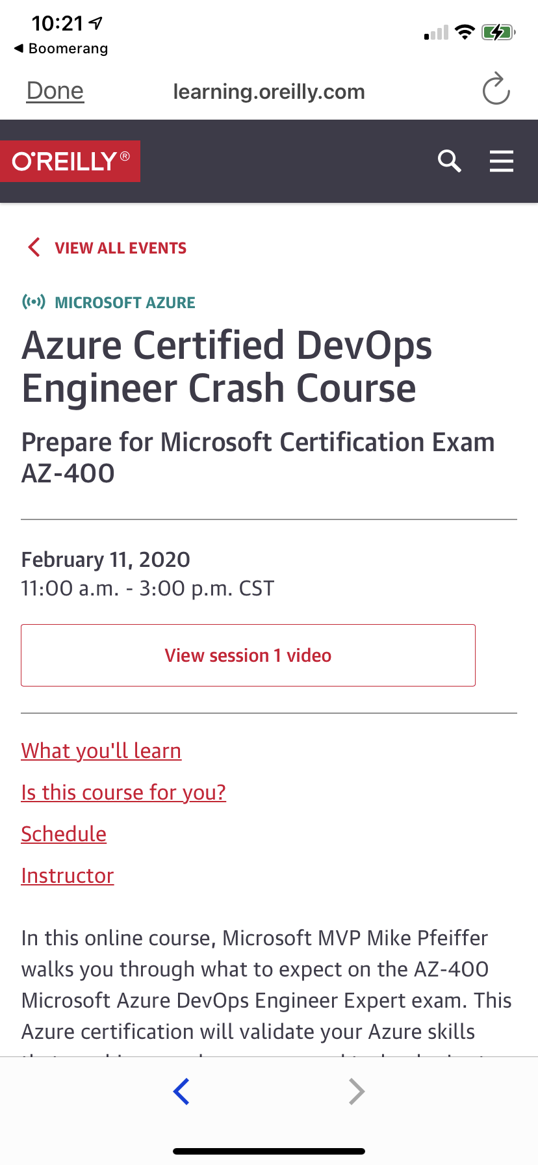
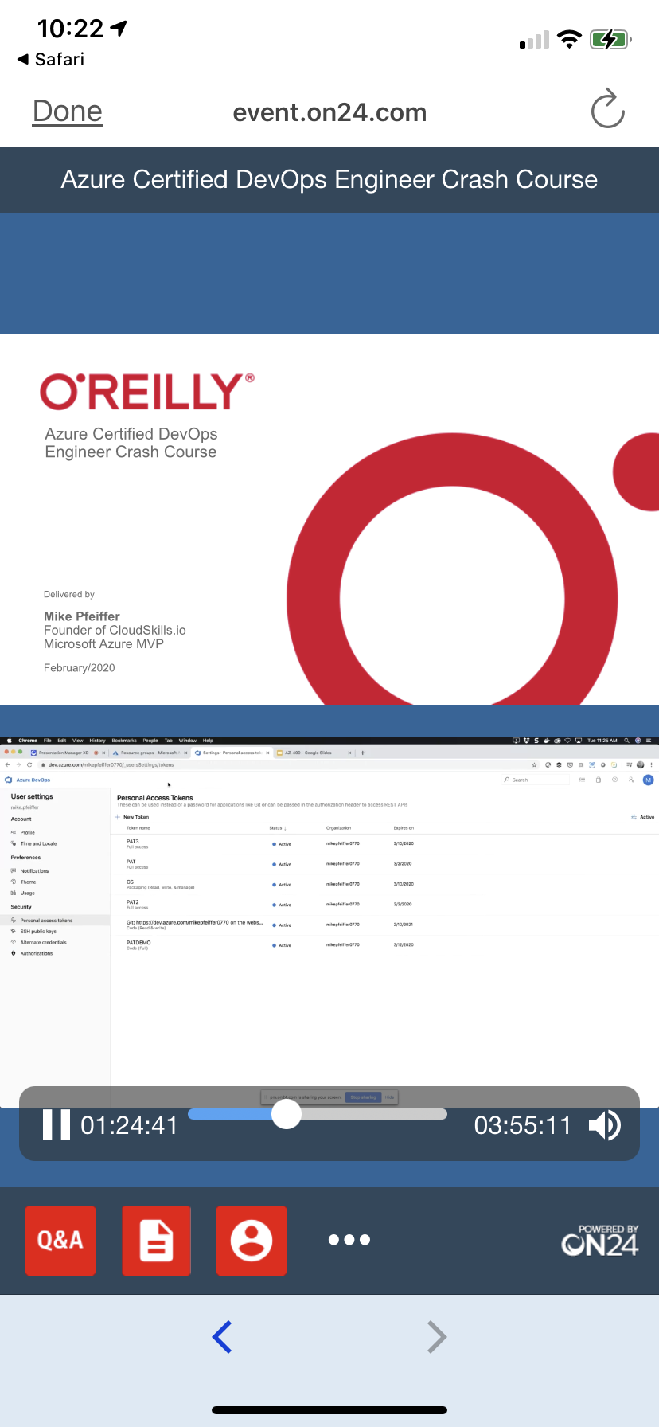
Mobile Browser: learning.oreilly.com

Slide 11
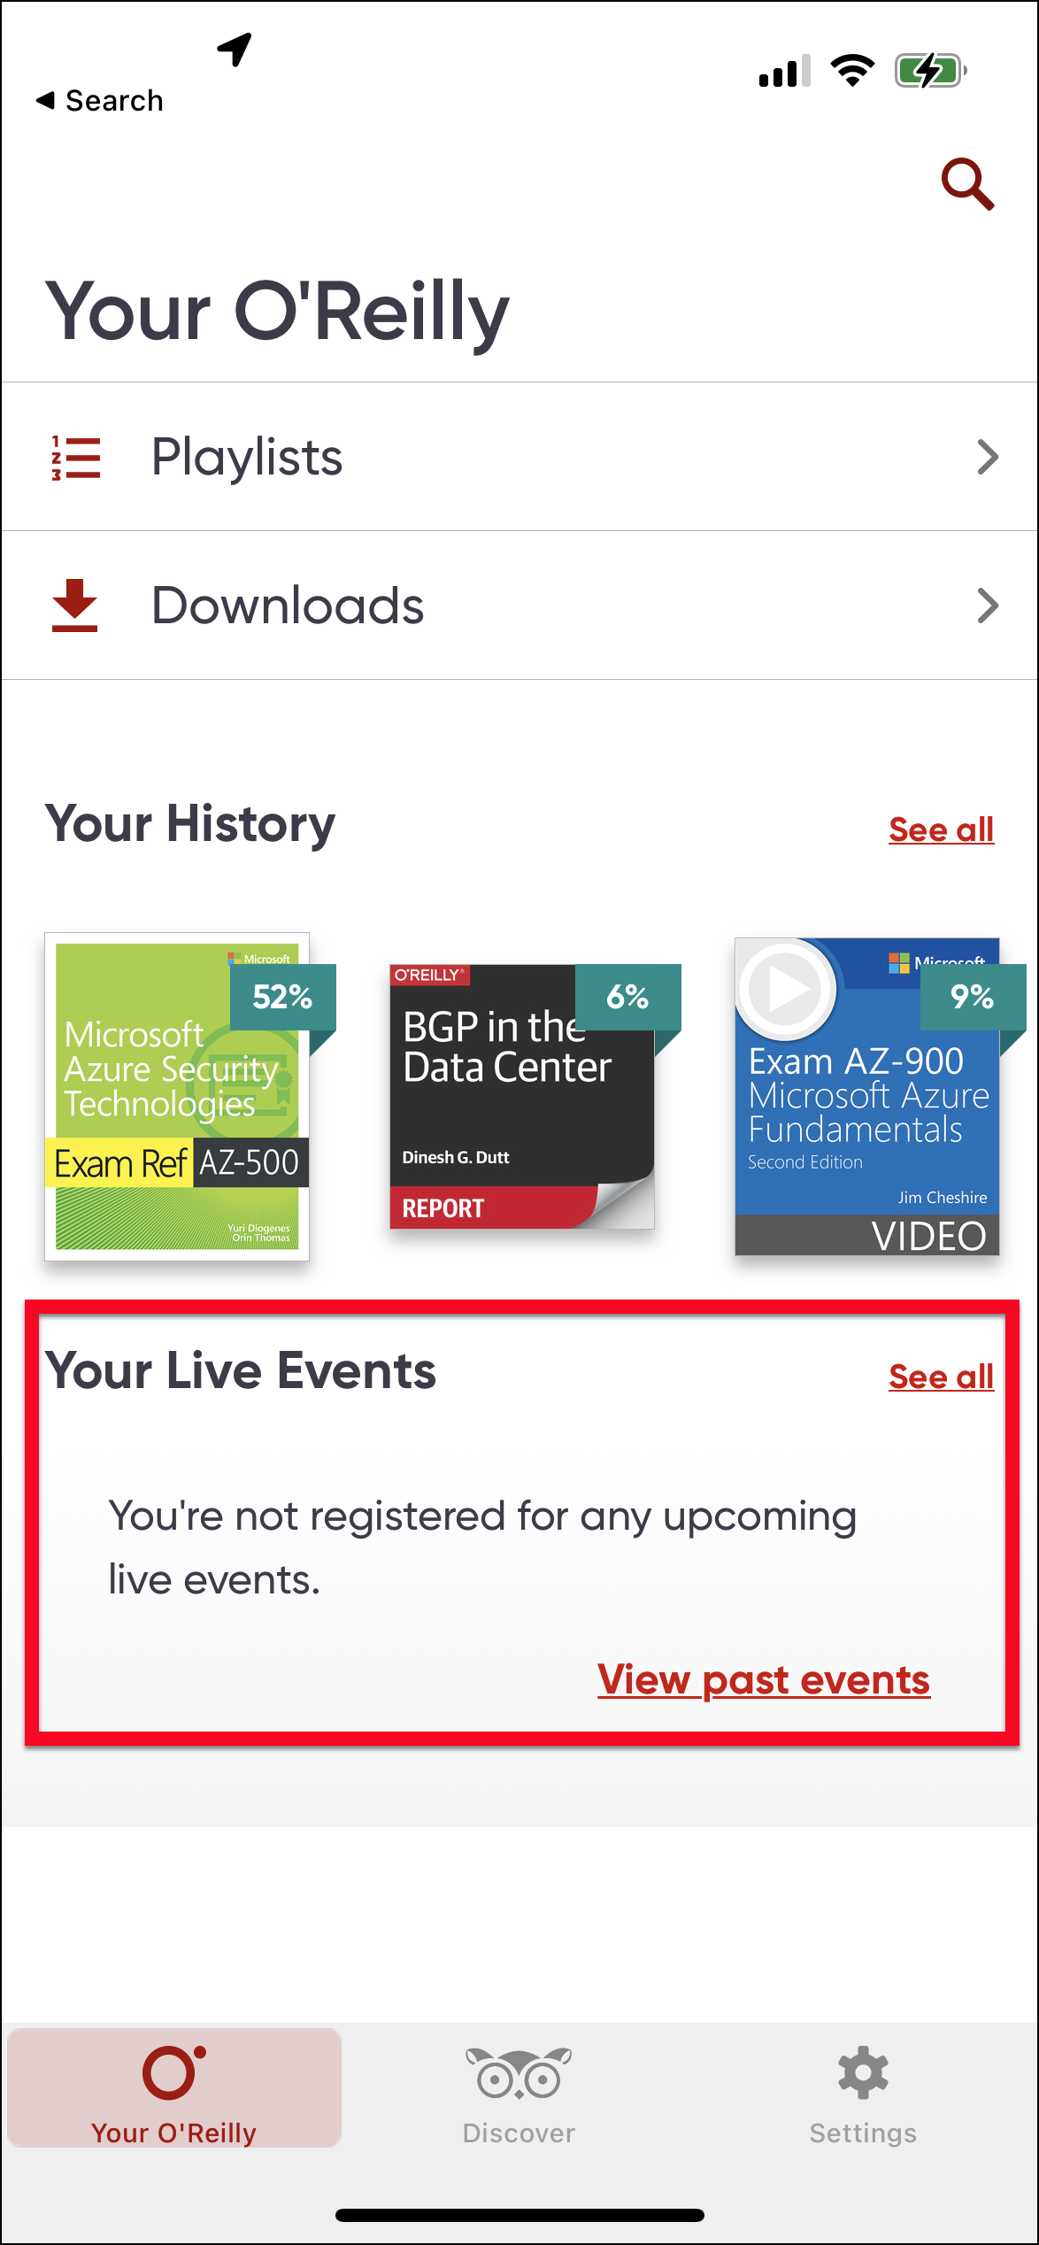
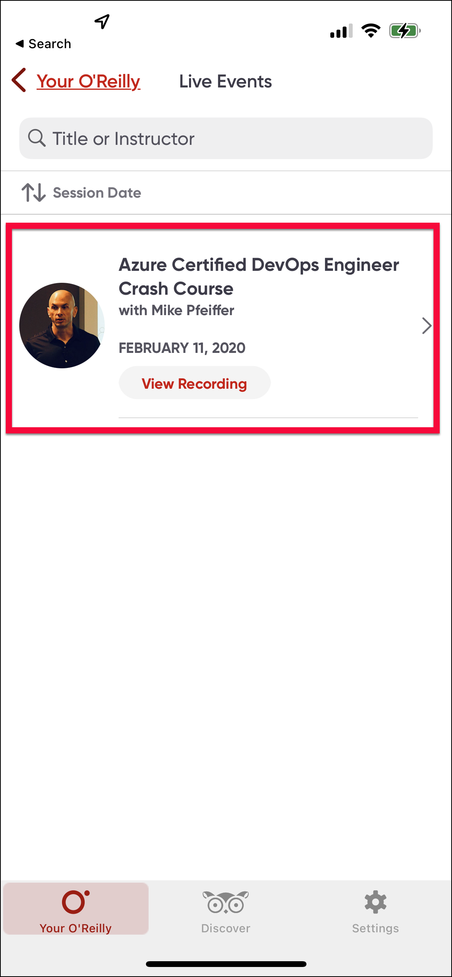
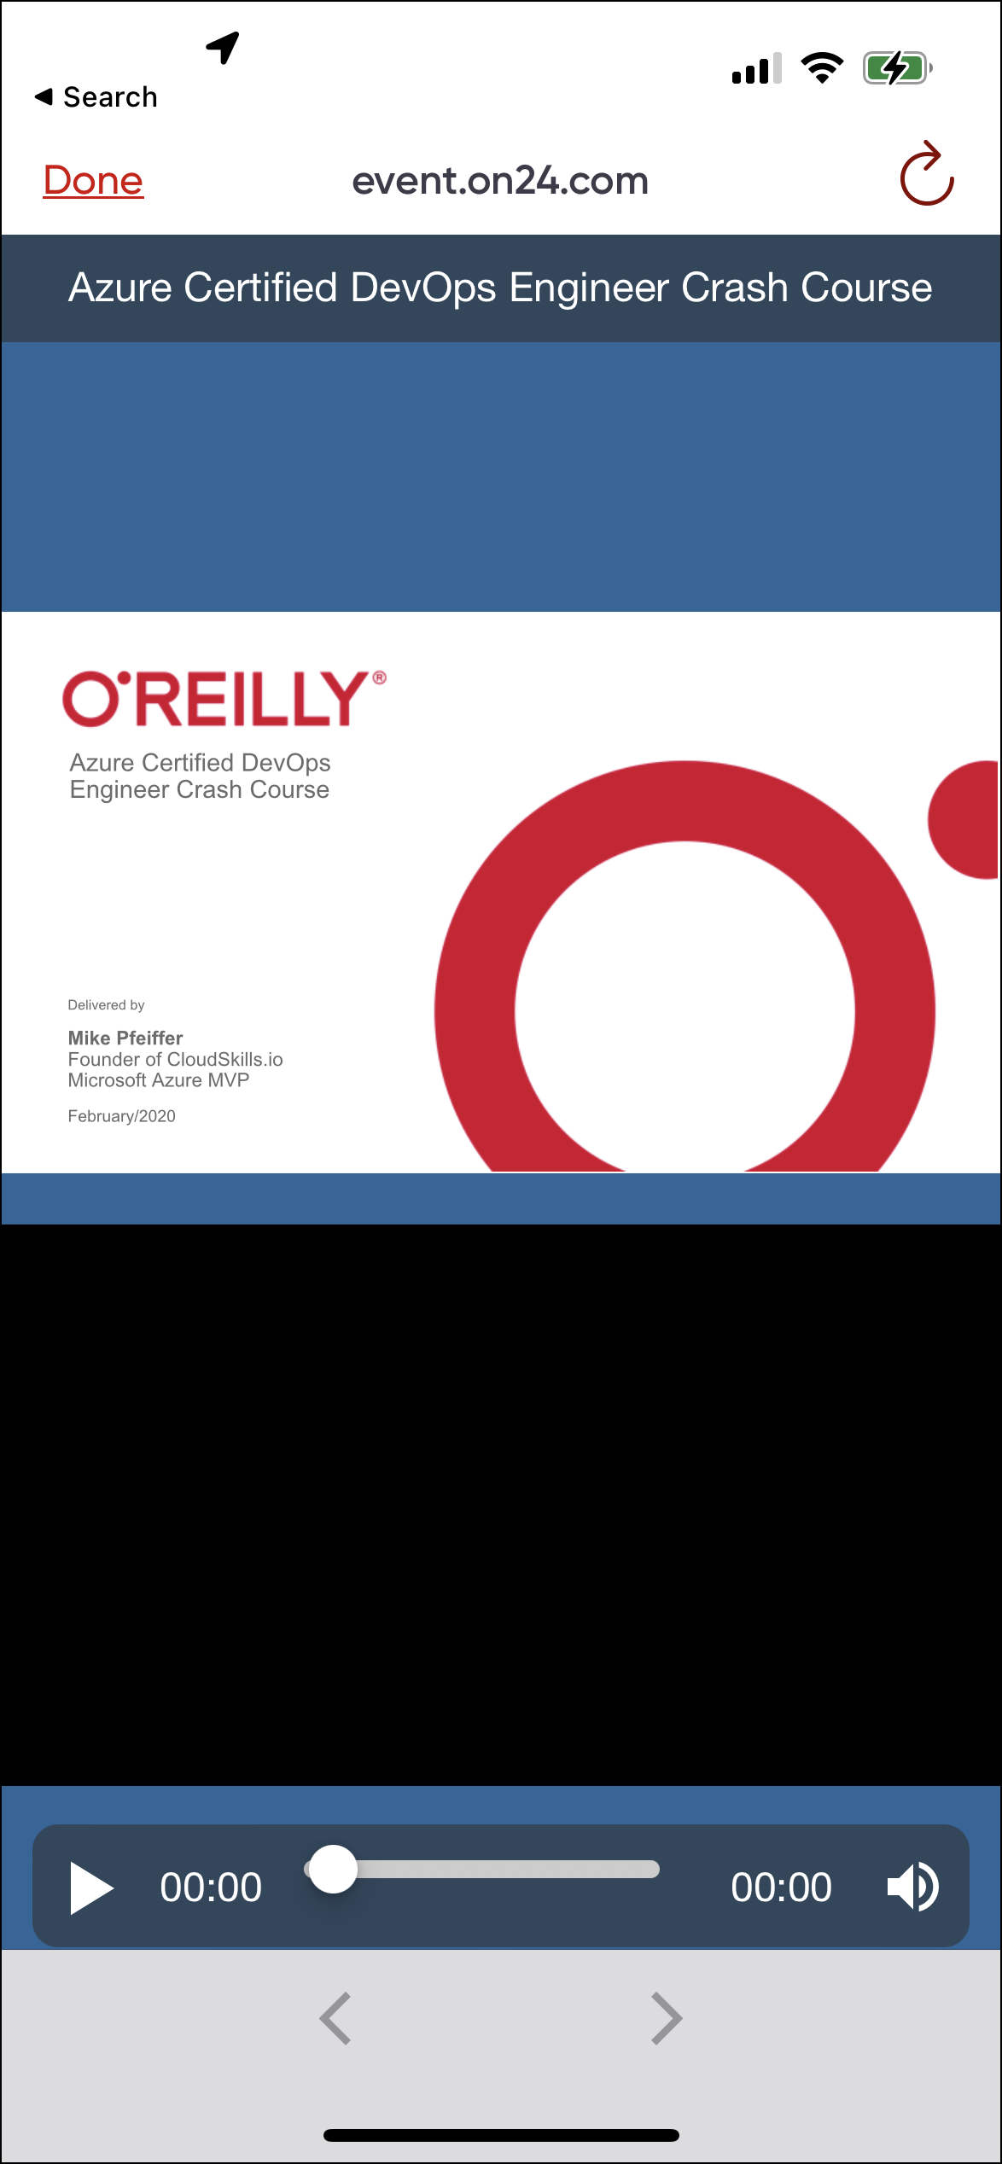
O'Reilly Mobile App

Slide 12
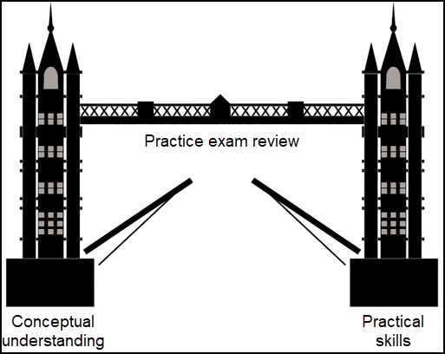
Tim's Certification Study Model

Slide 13
Thank you!
Course materials: timw.info/databricks
Email: tim-warner@pluralsight.com
Pluralsight courses: timw.info/ps
LinkedIn: timw.info/li

