Slide 1

Databricks Certified Data Engineer Associate Crash Course
Tim Warner

Slide 2

Tim Warner
Based in Nashville, TN, US
26-year Microsoft Certified Trainer (MCT)
6-year Microsoft Most Valuable Professional (MVP) in Azure AI and Cloud & Datacenter Management
Connect: timw.info/li

Slide 3
Agenda
Introduction
Design identity, governance, and monitoring solutions (25–30%)
Design data storage solutions (20–25%)
Design business continuity solutions (15–20%)
Design infrastructure solutions (30–35%)Exam AZ-305 strategy

Slide 4
Course Materials
timw.info/databricks

Slide 5
Level Setting
We'll learn by doing – majority demo
Visual, case study approach
This is an expert certification, so we move quickly and assume intermediate-level Azure skills
I’m here to answer your questions – take advantage of this!
Please use the Q&A panel for questions and feedback

Slide 6
Break Schedule (EDT)
07:00am - Start
08:00am - 8-min break
09:00am - 8-min Break
10:00am - 8-min Break
11:00am - 8-min Break
12:00pm - Finish

Slide 7
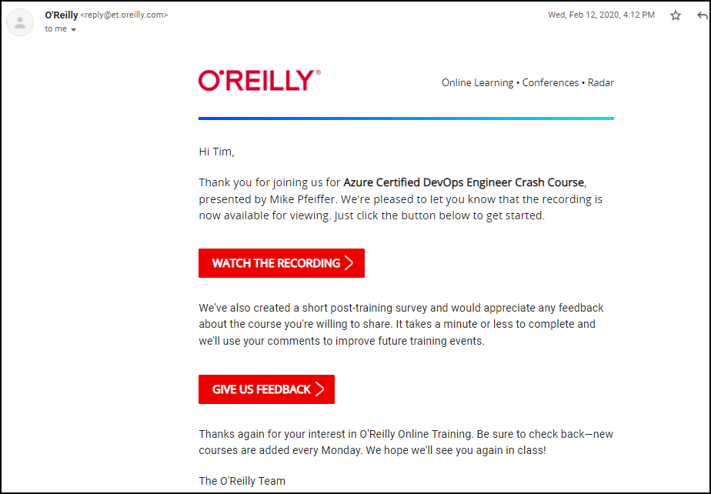
Session Recordings

Slide 8
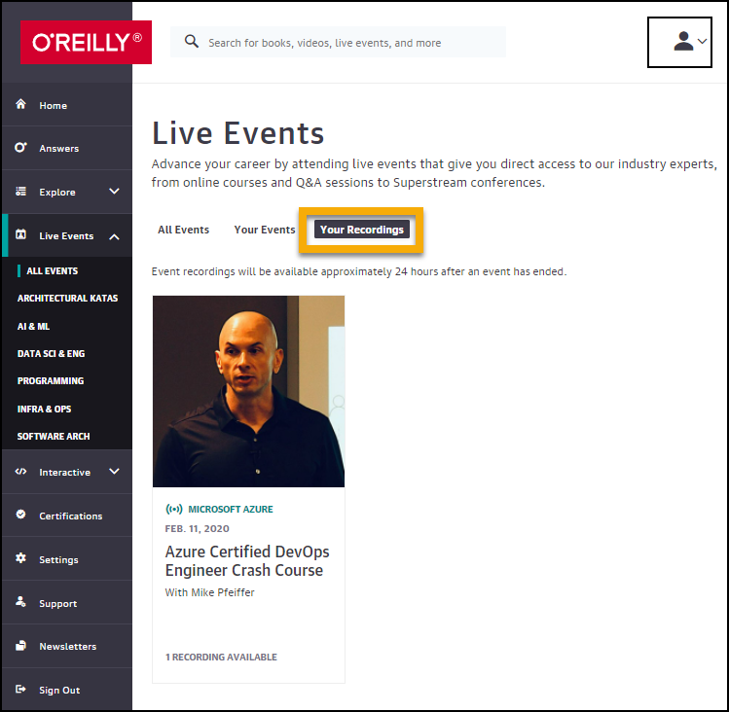
Session Recordings

Slide 9

Session Recordings

Slide 10
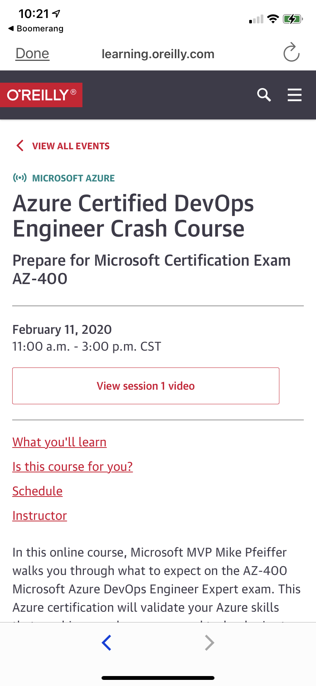
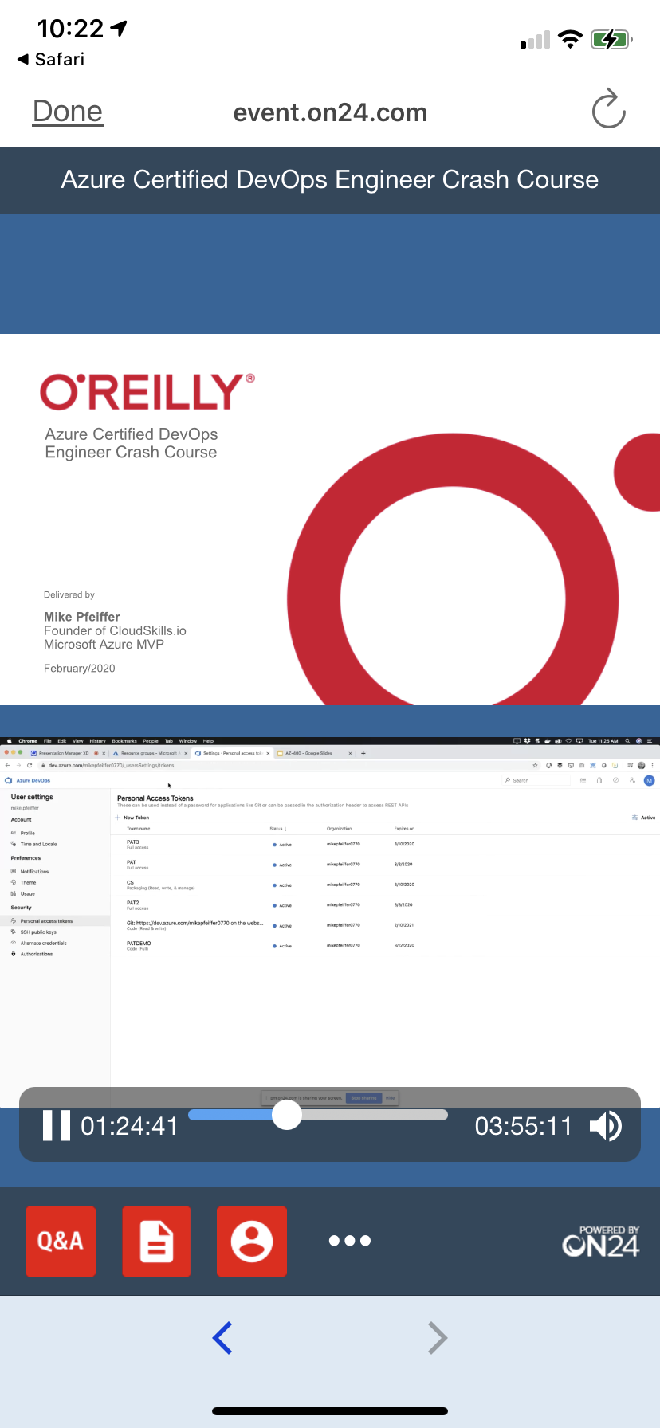
Mobile Browser: learning.oreilly.com

Slide 11



O'Reilly Mobile App

Slide 12
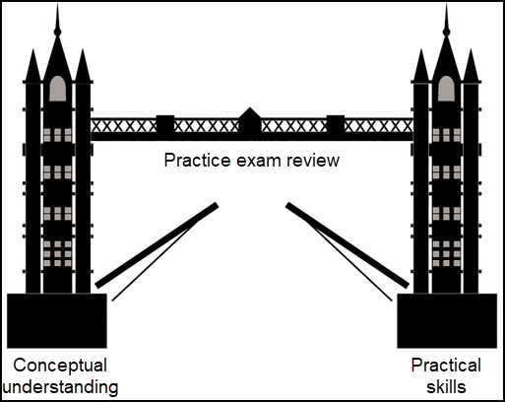
Tim's Certification Study Model

Slide 13
Thank you!
Course materials: timw.info/databricks
Email: tim-warner@pluralsight.com
Pluralsight courses: timw.info/ps
LinkedIn: timw.info/li

Slide 14
About the Exam

Slide 15
Databricks CLI
# Install the CLI
pip install databricks-cli
# Authenticate to Databricks host
databricks configure --token
# List available clusters
databricks clusters list
# Create a new cluster
databricks clusters create --json-file=create-cluster.json
# List available jobs
databricks jobs list
# Run a job
databricks jobs run-now --job-id <job-id>
# Upload a file to DBFS (Databricks File System)
databricks fs cp local-file-path dbfs:/destination-path

Slide 16
PySpark
# PySpark is the Python API for Apache Spark
# Write Spark apps in Python

Slide 17
Databricks SQL
# PySpark is the Python API for Apache Spark
# Write Spark apps in Python

Slide 18
Databricks Notebook Magic Commands
# PySpark is the Python API for Apache Spark
# Write Spark apps in Python

Slide 19
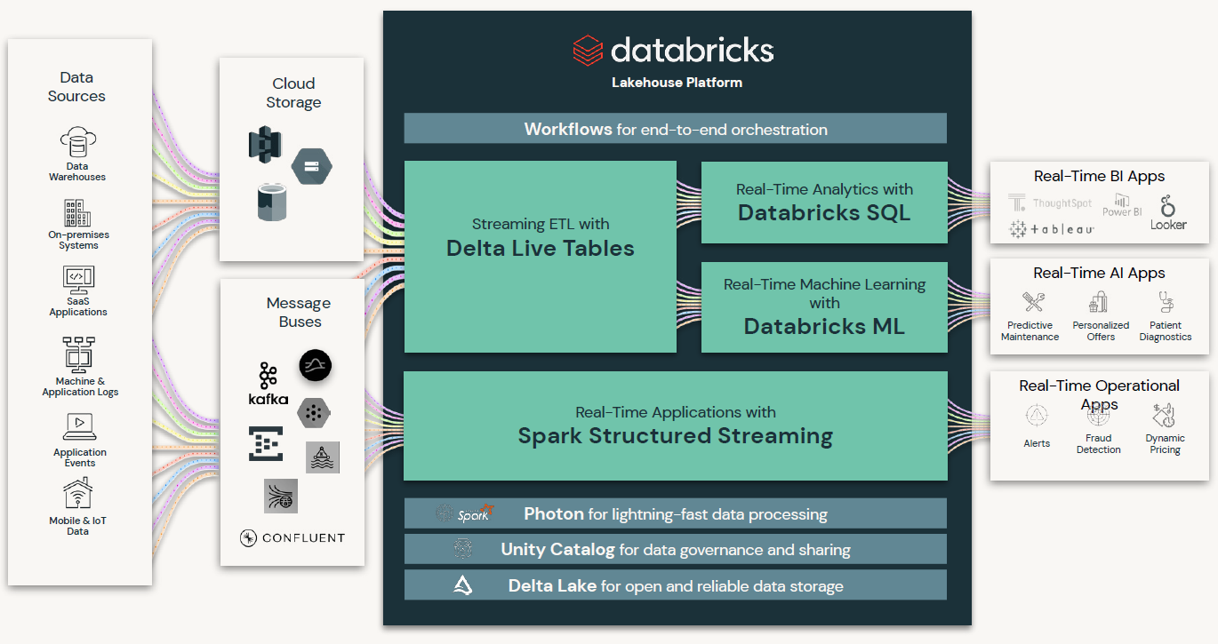
Databricks Integration

Slide 20
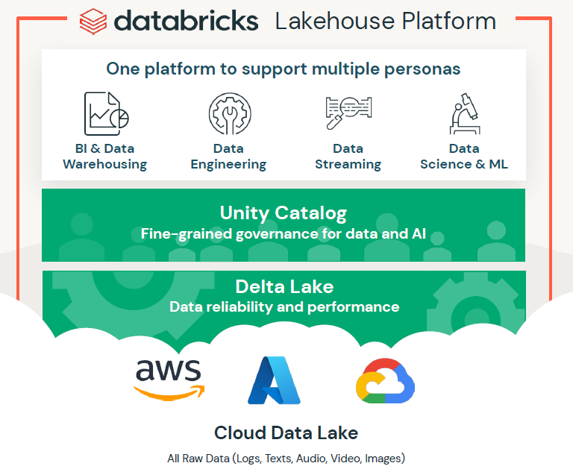
Databricks Marketing Pitch

Slide 21
Delta Lake
Enhances Spark with ACID transactions, schema enforcement, and the ability to handle massive datasets, making it ideal for large-scale data warehousing needs.

Slide 22
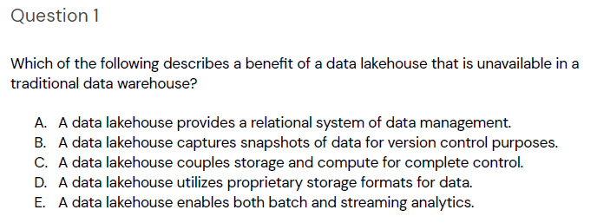
Practice Question #1
Source: academy.databricks.com
Correct answer: E. A data lakehouse enables both batch and streaming analytics. Unlike traditional data warehouses, a data lakehouse supports real-time data processing alongside batch processing, allowing for more flexible and timely data analytics.

Slide 23
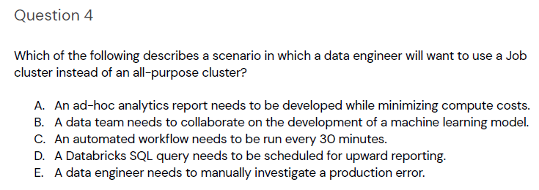
Practice Question #2
Source: academy.databricks.com
Correct answer: C. A Job cluster is ideal for scenarios where compute resources are required only for the duration of the job, as it helps minimize costs by spinning up clusters specifically for scheduled or recurring tasks. This makes Job clusters particularly suitable for automated workflows that run at regular intervals, such as every 30 minutes.

Slide 24
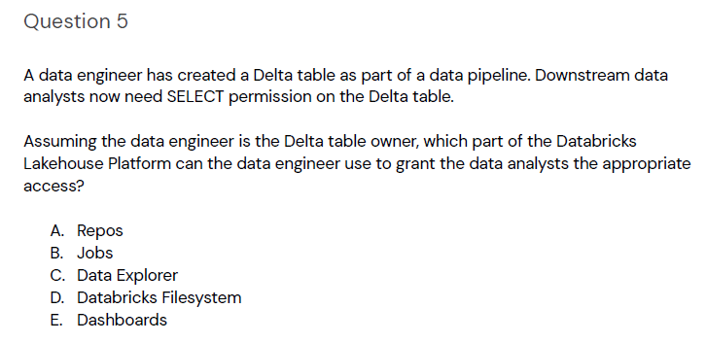
Practice Question #3
Source: academy.databricks.com
Correct answer: C. Data Explorer in Databricks allows the table owner to manage permissions, enabling the data engineer to grant SELECT permissions to downstream data analysts on the Delta table.

Slide 25
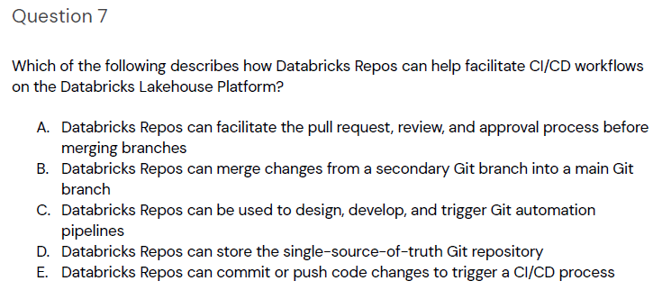
Practice Question #4
Source: academy.databricks.com
Correct answer is C. Databricks Repos integrate with Git to facilitate the continuous integration and continuous delivery (CI/CD) process, allowing users to design, develop, and automate the deployment of code changes through Git workflows.

Slide 26
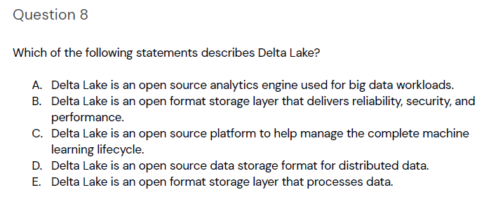
Practice Question #5
Source: academy.databricks.com
The correct choice is B. Delta Lake is an open format storage layer that delivers reliability, security, and performance.Delta Lake enhances the capabilities of data lakes by providing a robust storage layer that ensures data integrity and high performance through features like ACID transactions, schema enforcement, and support for large-scale data processing.

Slide 27
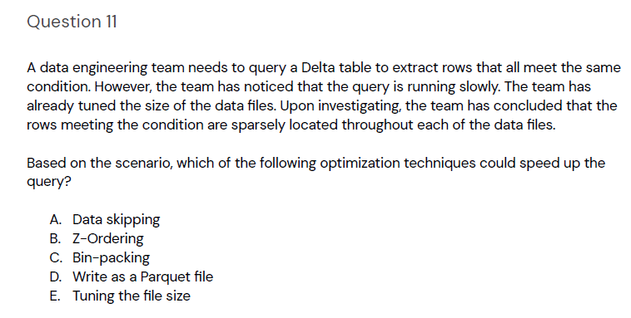
Practice Question #6
Source: academy.databricks.com
Correct answer is B. Z-Ordering improves query performance by co-locating related rows in the same file, which helps reduce the amount of data scanned during query execution. This is especially useful when the rows meeting the condition are sparsely located, as it ensures they are organized more efficiently on disk.

Slide 28
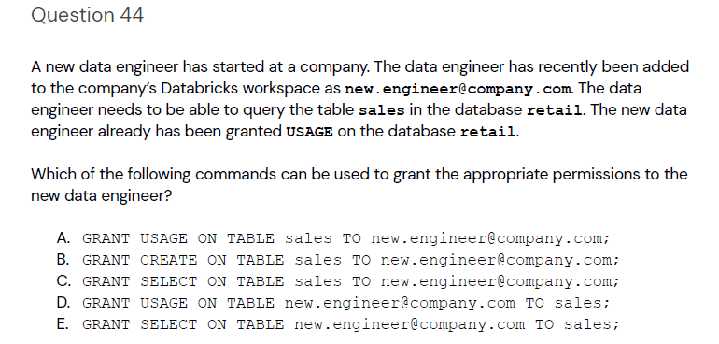
Practice Question #7
Source: academy.databricks.com
Correct answer is C. The GRANT SELECT command provides read access to the specified table, which is necessary for the data engineer to query it. This permission allows the user to execute SELECT statements on the sales table within the retail database, aligning with the required query capabilities.

Slide 29
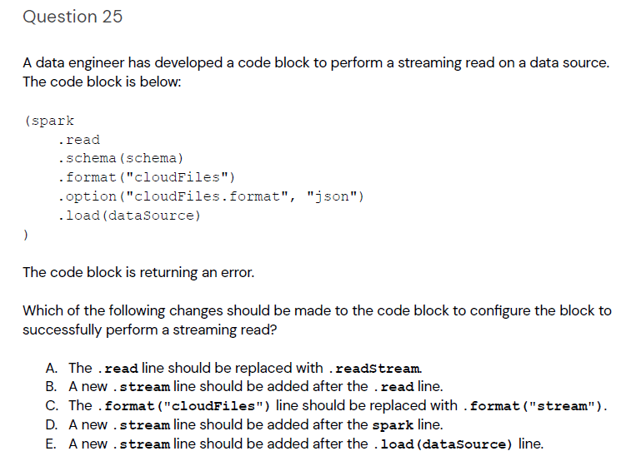
Practice Question #8
Source: academy.databricks.com
Correct answer is A. The `.read` method is used for static data reads, whereas `.readStream` is required for streaming reads to handle continuous data input. Replacing `.read` with `.readStream` will enable the code block to process streaming data as intended.

Slide 30
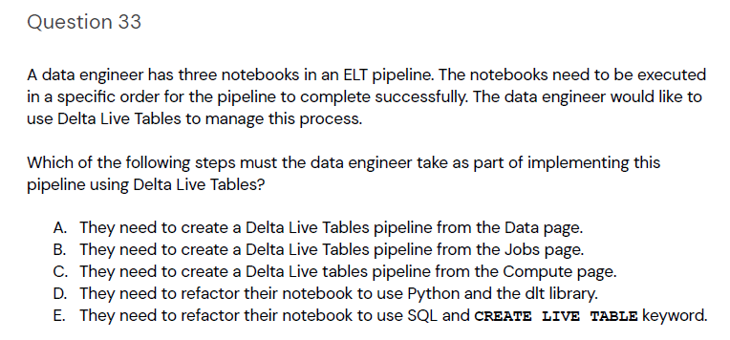
Practice Question #9
Source: academy.databricks.com
Correct answer is B. Creating a Delta Live Tables pipeline from the Jobs page allows the data engineer to schedule and manage the execution of notebooks in a specific order. This is essential for ensuring that the ELT pipeline runs as intended and maintains the correct data processing sequence.

Slide 31
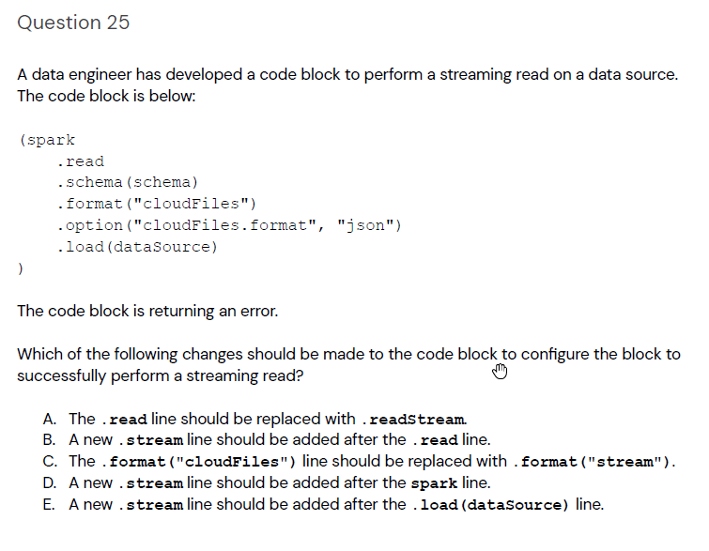
Practice Question #10
Source: academy.databricks.com
Correct answer is A. The `.read` method is intended for static data sources, while `.readStream` is designed for continuous data streams. Replacing `.read` with `.readStream` allows the code block to handle streaming data efficiently, which is necessary for real-time data processing in this context.

Slide 32
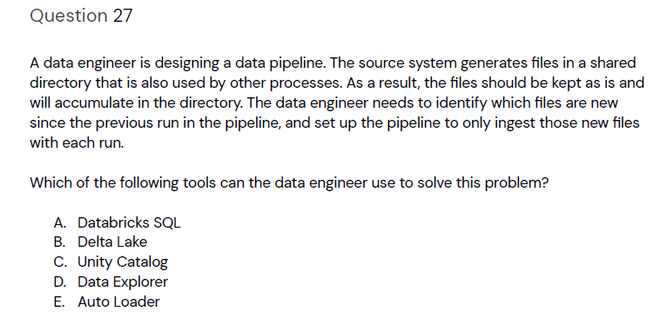
Practice Question #11
Source: academy.databricks.com
Correct answer is E. Auto Loader in Databricks is designed to efficiently load new data as it arrives in a directory, automatically tracking which files have been processed. This allows the pipeline to continuously ingest only new files, simplifying data management and ensuring that no duplicate data is processed.

Slide 33
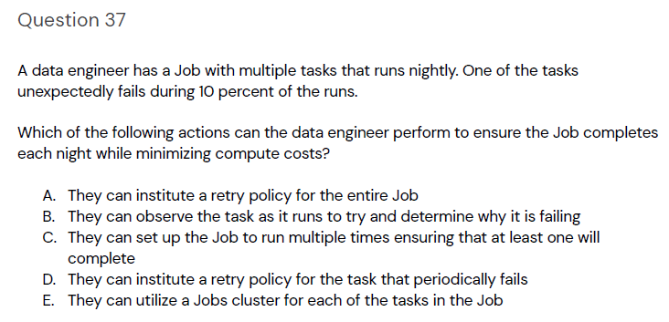
Practice Question #12
Correct answer is D. Instituting a retry policy specifically for the task that periodically fails minimizes compute costs by not redundantly retrying tasks that are already successful. This approach targets the failing task directly, ensuring the job completes while efficiently using compute resources.
Source: academy.databricks.com
Correct answer is D. Instituting a retry policy specifically for the task that periodically fails minimizes compute costs by not redundantly retrying tasks that are already successful. This approach targets the failing task directly, ensuring the job completes while efficiently using compute resources.

Slide 34
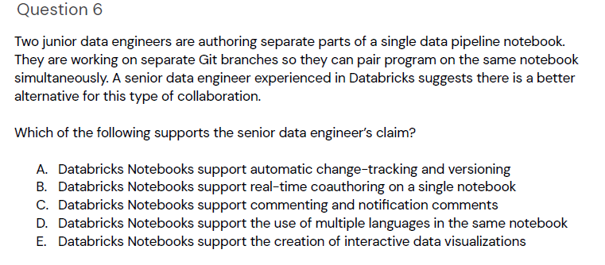
Practice Question #X
Source: academy.databricks.com
Correct answer is B. Databricks Notebooks support real-time coauthoring, allowing multiple users to edit the same notebook simultaneously. This feature facilitates effective collaboration and eliminates the need for separate Git branches for simultaneous work, improving workflow and efficiency.

Slide 35
Practice Question #X
Source: academy.databricks.com
Correct answer is X.

Slide 36
Practice Question #X
Source: academy.databricks.com
Correct answer is X.

Slide 37
Practice Question #X
Source: academy.databricks.com
Correct answer is X.

Slide 38
Practice Question #X
Source: academy.databricks.com
Correct answer is X.

Slide 39
Practice Question #X
Source: academy.databricks.com
Correct answer is X.

Slide 40
Practice Question #X
Source: academy.databricks.com
Correct answer is X.

Slide 41
Practice Question #X
Source: academy.databricks.com
Correct answer is X.

