Slide 1

Databricks Certified Data Engineer Associate Crash Course
Tim Warner

Slide 2

Tim Warner
Based in Nashville, TN, US
26-year Microsoft Certified Trainer (MCT)
6-year Microsoft Most Valuable Professional (MVP) in Azure AI and Cloud & Datacenter Management
Connect: timw.info/li

Slide 3
Agenda
Introduction
Design identity, governance, and monitoring solutions (25–30%)
Design data storage solutions (20–25%)
Design business continuity solutions (15–20%)
Design infrastructure solutions (30–35%)Exam AZ-305 strategy

Slide 4
Course Materials
timw.info/databricks

Slide 5
Level Setting
We'll learn by doing – majority demo
Visual, case study approach
This is an expert certification, so we move quickly and assume intermediate-level Azure skills
I’m here to answer your questions – take advantage of this!
Please use the Q&A panel for questions and feedback

Slide 6
Break Schedule (EDT)
07:00am - Start
08:00am - 8-min break
09:00am - 8-min Break
10:00am - 8-min Break
11:00am - 8-min Break
12:00pm - Finish

Slide 7
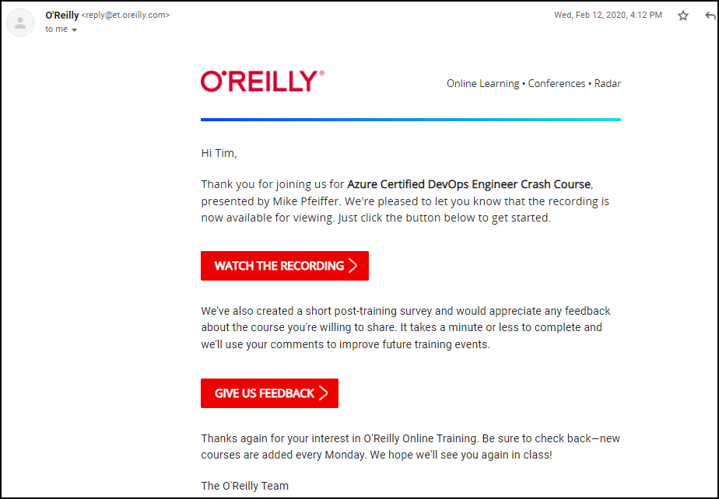
Session Recordings

Slide 8
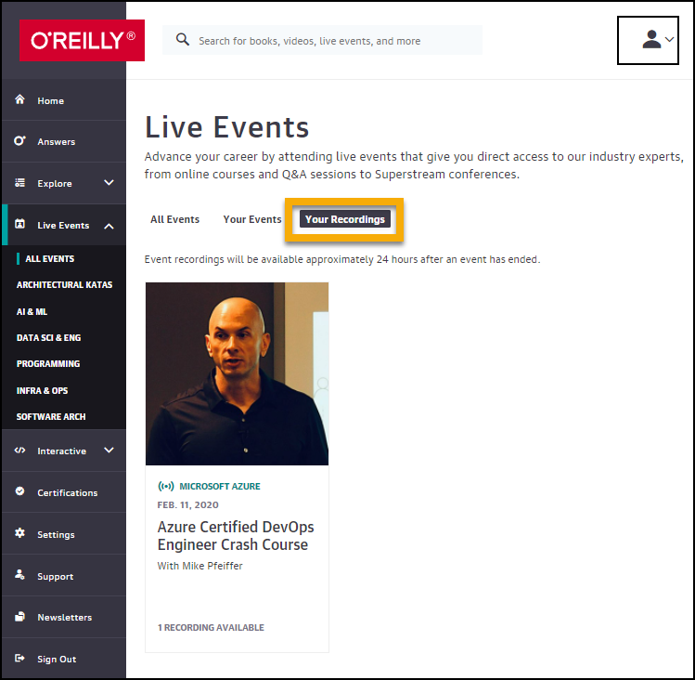
Session Recordings

Slide 9
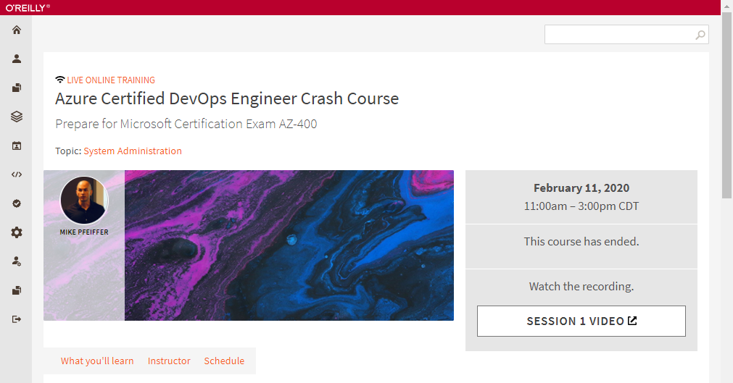
Session Recordings

Slide 10
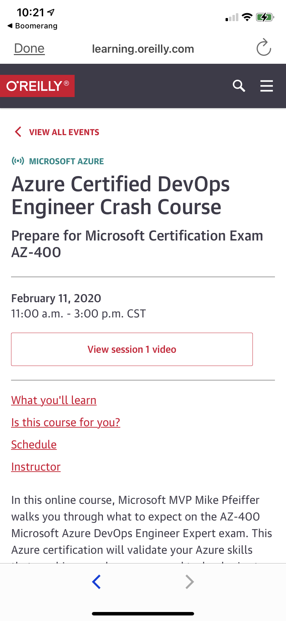
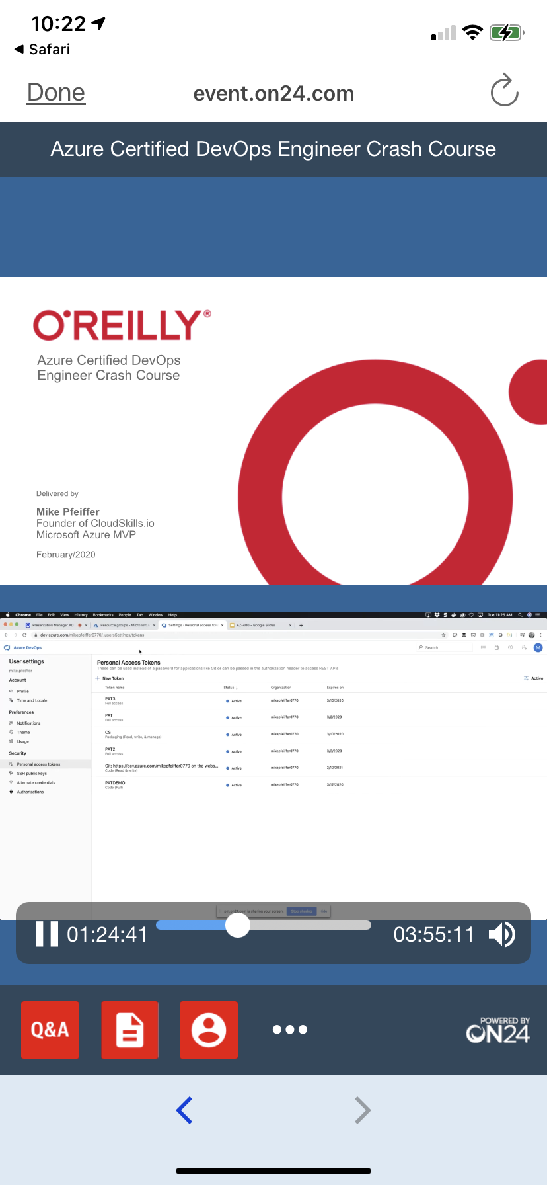
Mobile Browser: learning.oreilly.com

Slide 11
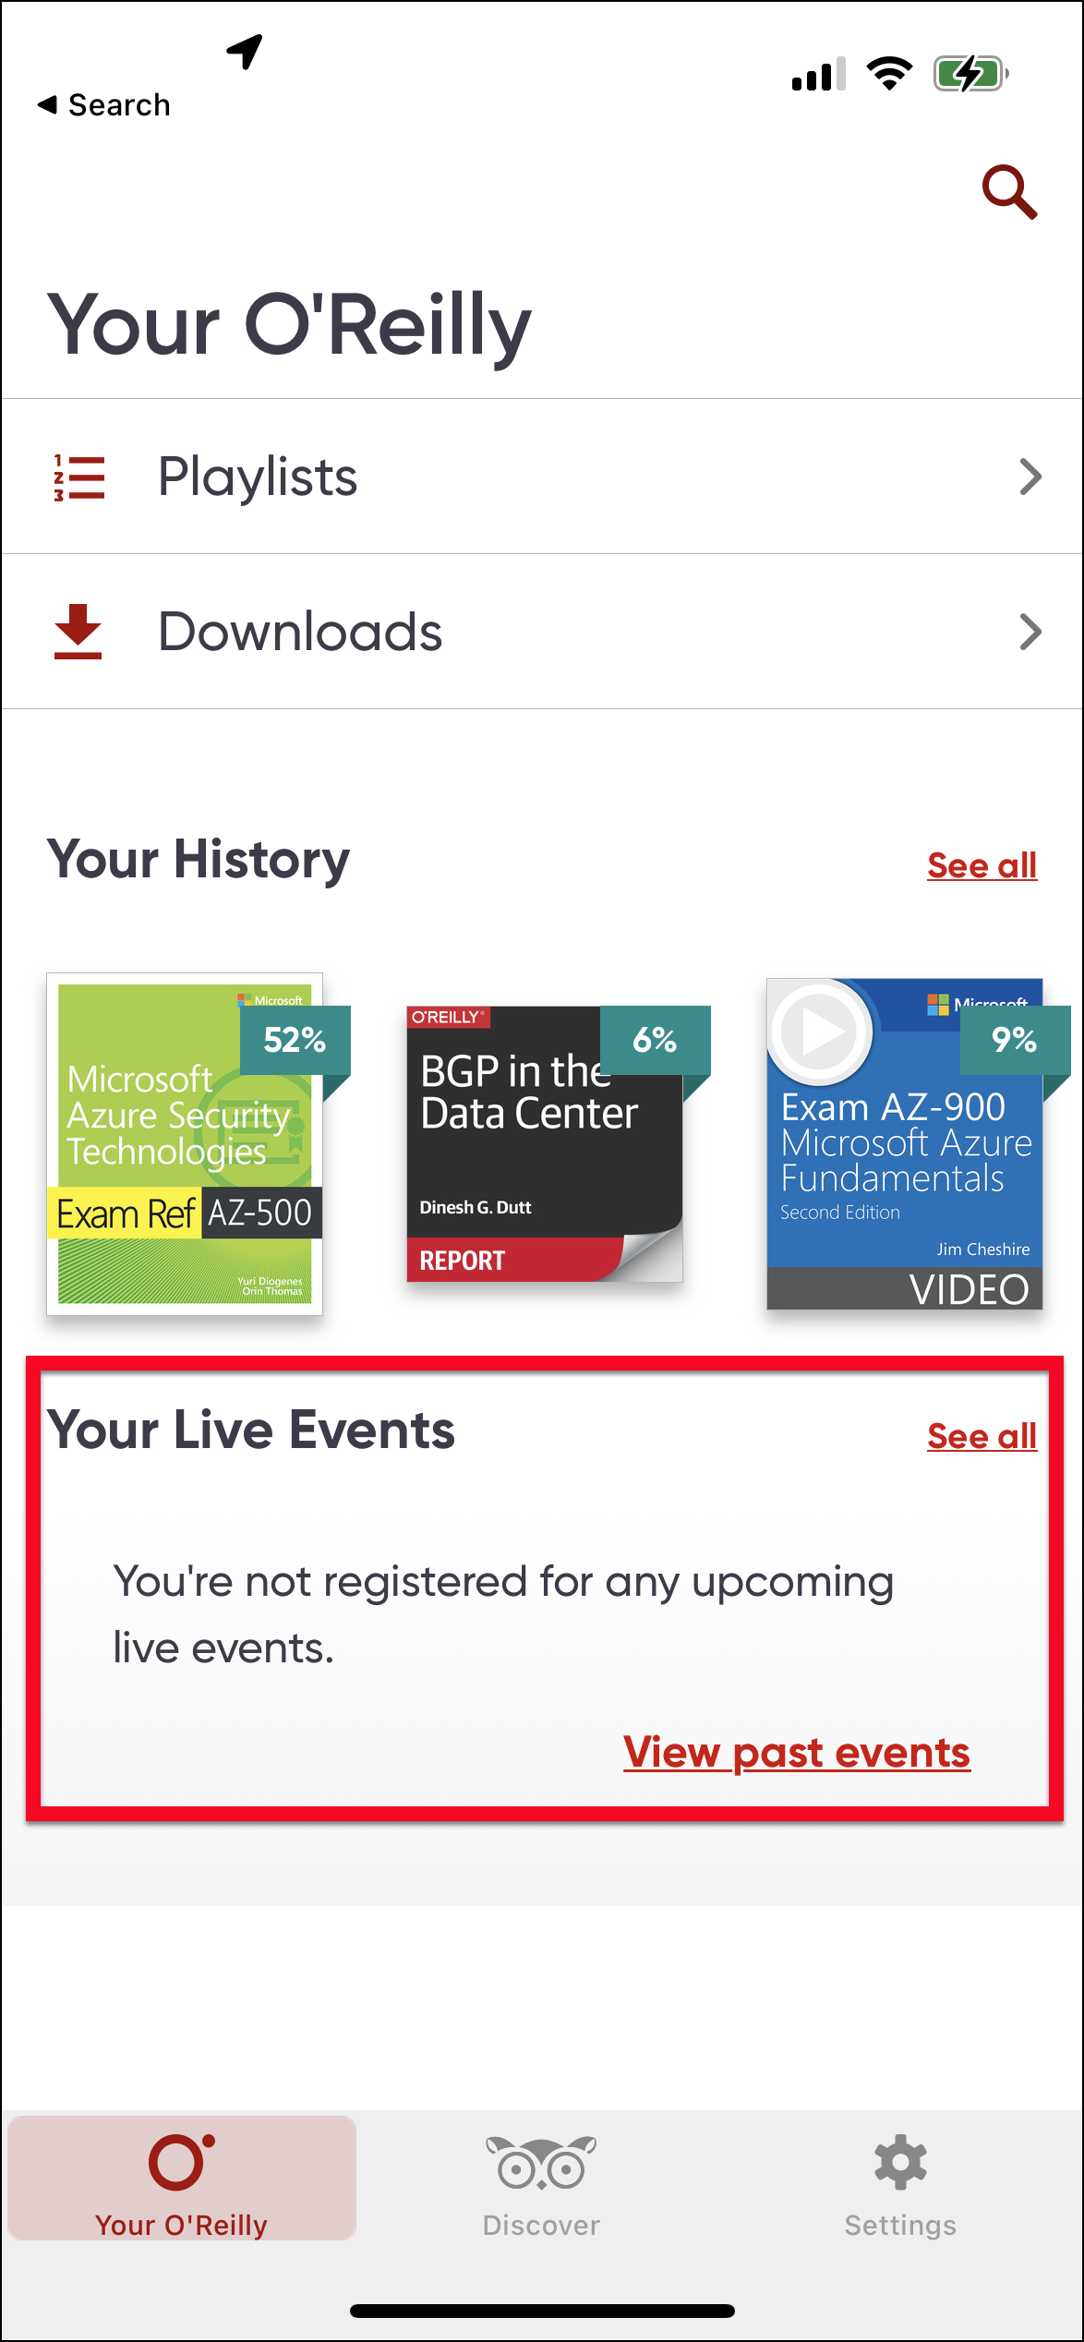
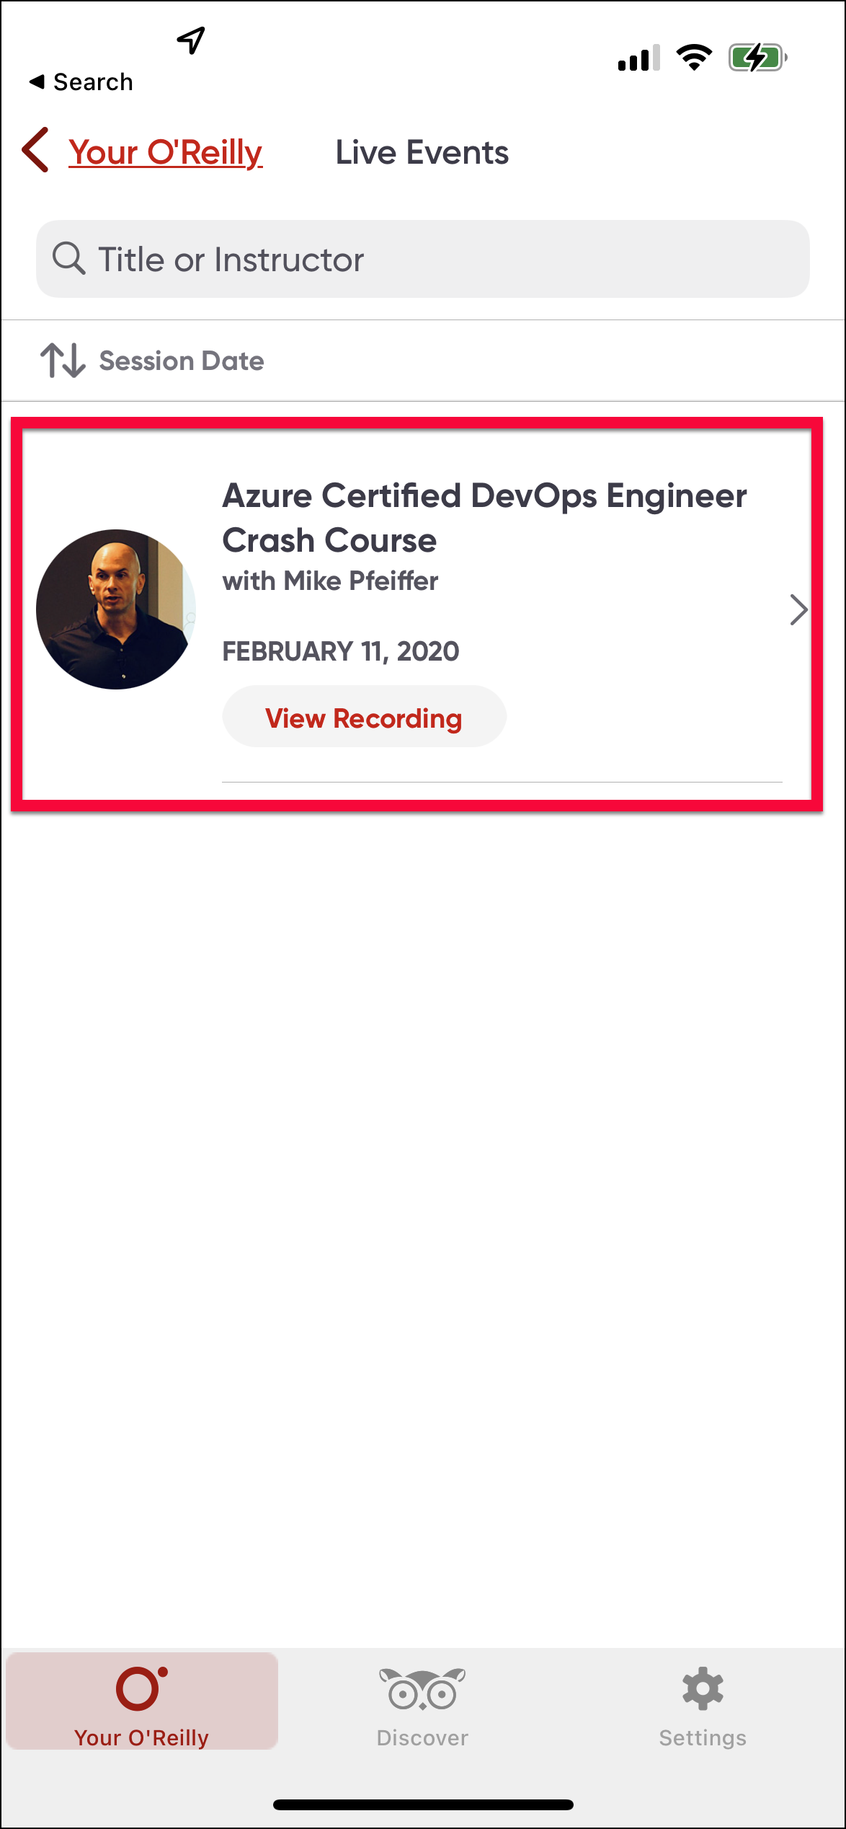
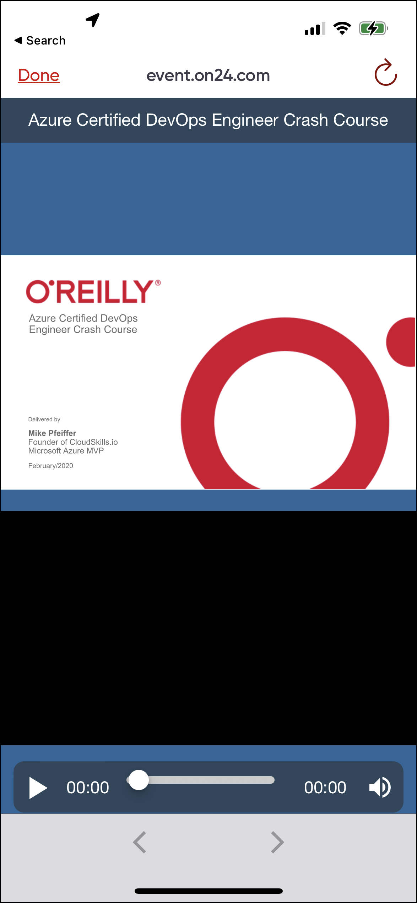
O'Reilly Mobile App

Slide 12
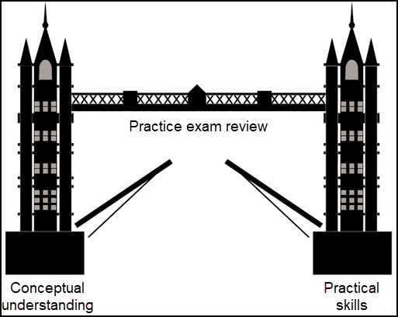
Tim's Certification Study Model

Slide 13
Databricks CLI
# Install the CLI
pip install databricks-cli
# Authenticate to Databricks host
databricks configure --token
# List available clusters
databricks clusters list
# Create a new cluster
databricks clusters create --json-file=create-cluster.json
# List available jobs
databricks jobs list
# Run a job
databricks jobs run-now --job-id <job-id>
# Upload a file to DBFS (Databricks File System)
databricks fs cp local-file-path dbfs:/destination-path

Slide 14
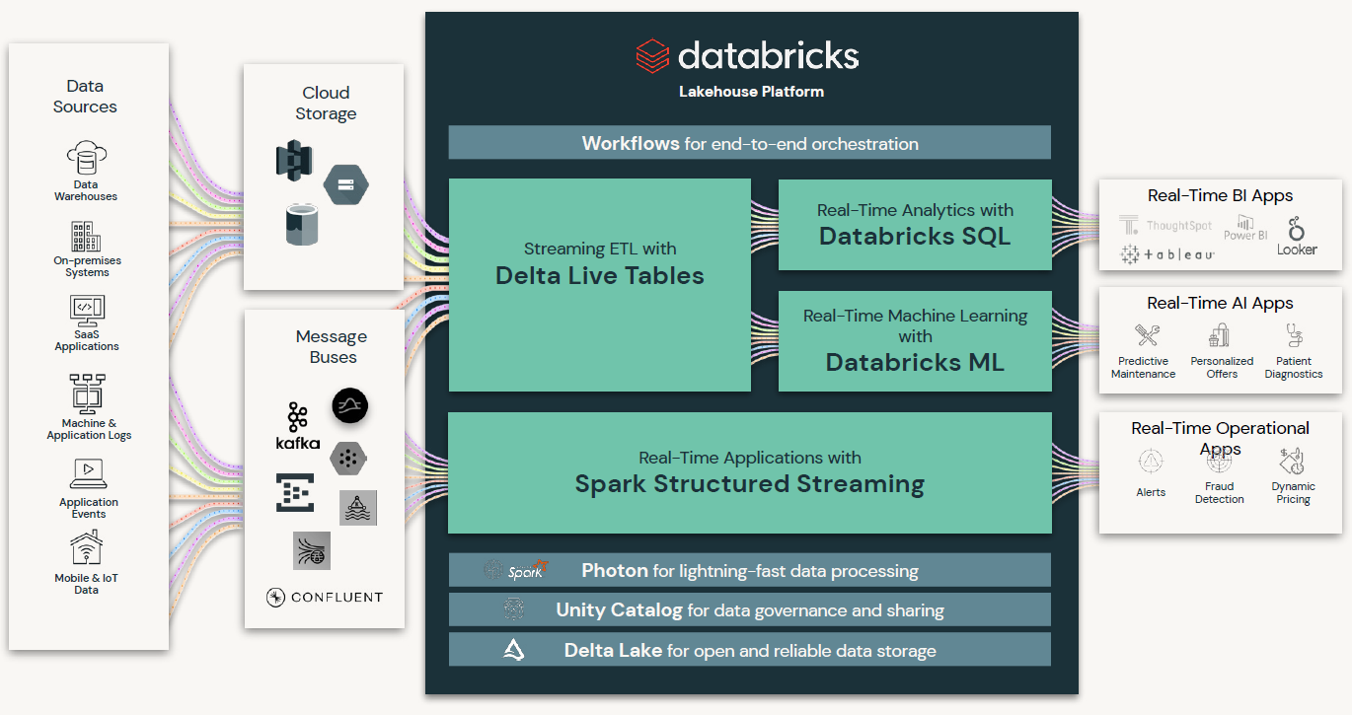
Databricks Intregration

Slide 15
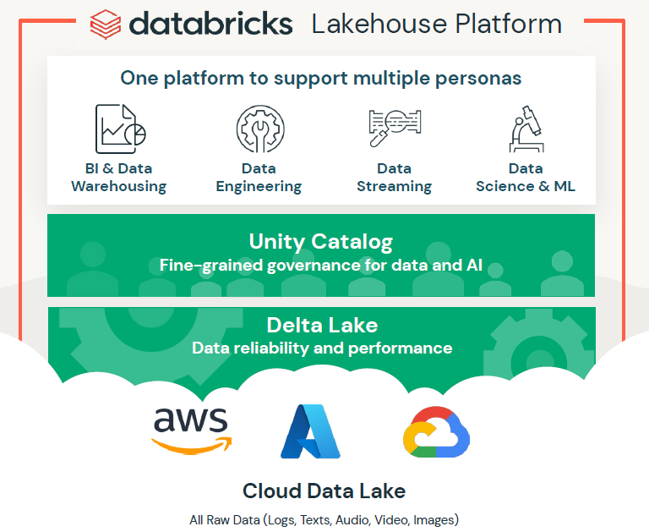
Databricks Marketing Pitch

Slide 16
Thank you!
Course materials: timw.info/databricks
Email: tim-warner@pluralsight.com
Pluralsight courses: timw.info/ps
LinkedIn: timw.info/li

