Slide 1

Microsoft Azure OpenAI for DevOps
Tim Warner

Slide 2
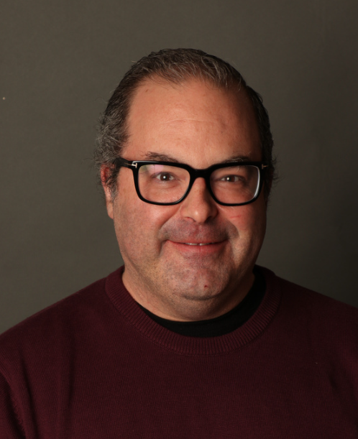

Tim Warner
Senior Content Developer w/ Microsoft
Based in Nashville, TN, US
MCT, Former MVP
Twitter: @TechTrainerTim
Badge: TechTrainerTim.com

Slide 3
Course Agenda
Introduction
tbd

Slide 4
Course Materials
timw.info/aoai

Slide 5
Level-Setting
We'll learn by doing – majority demo
Visual, case study approach
This is an expert certification, so we move quickly and assume intermediate-level Azure skills
10-minute break at midpoint
I’m here to answer your questions – take advantage of this!
Use the Q&A panel

Slide 6
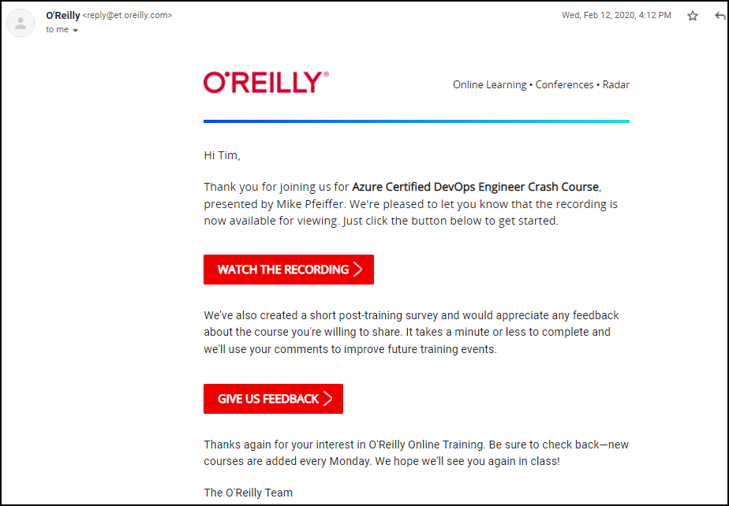
Session Recordings

Slide 7
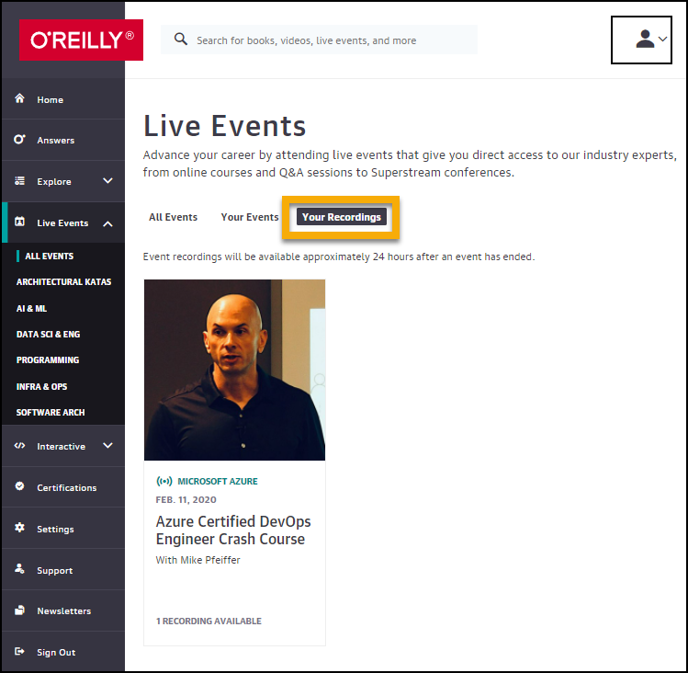
Session Recordings

Slide 8
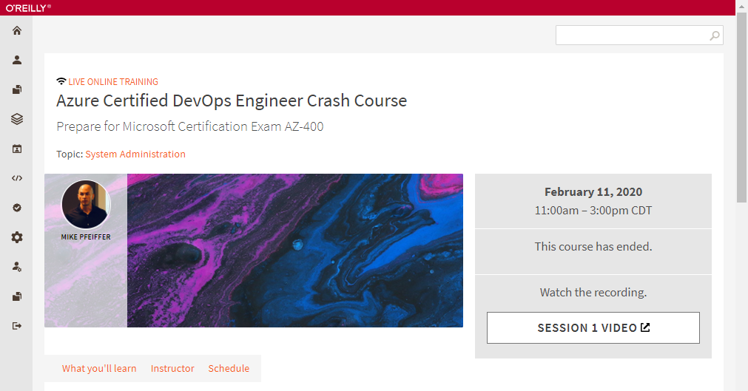
Session Recordings

Slide 9
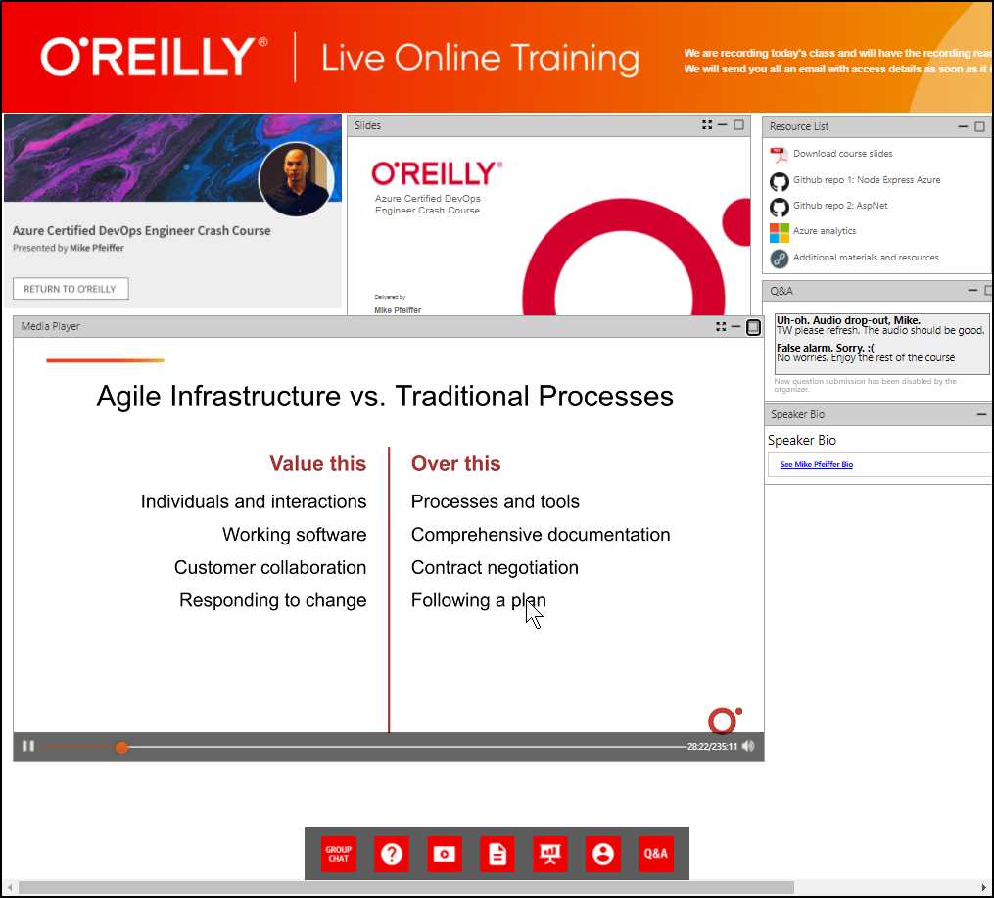
Session Recordings

Slide 10
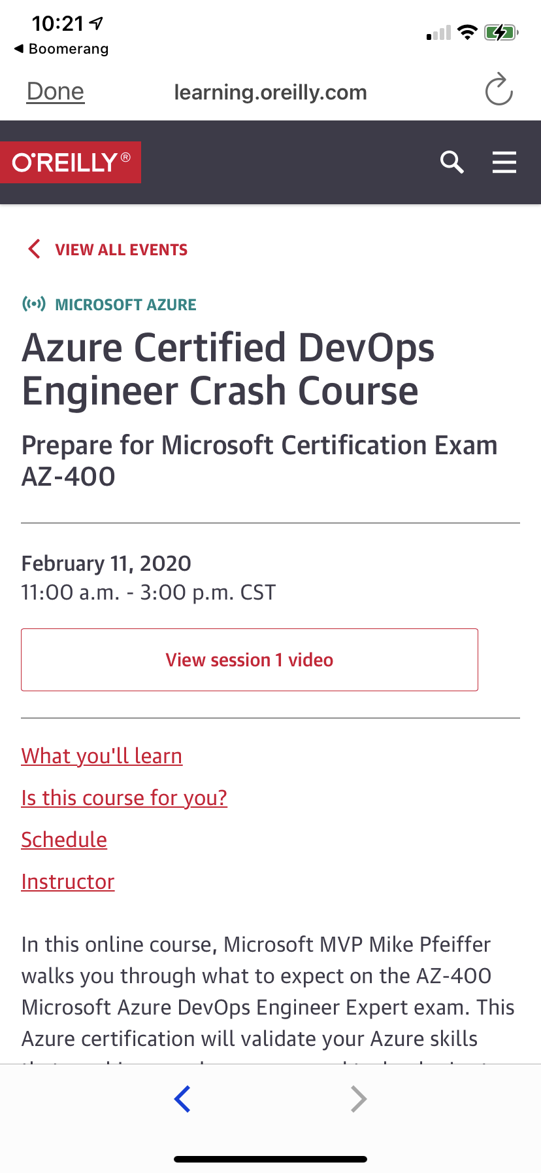
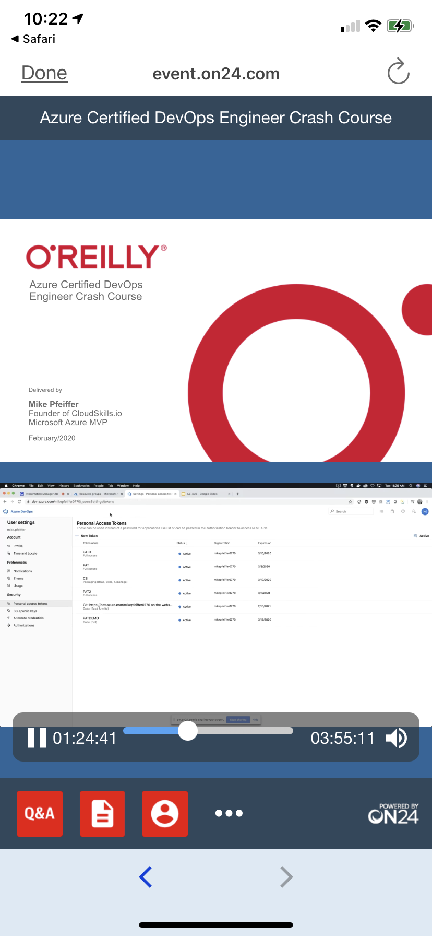
Mobile Browser: learning.oreilly.com

Slide 11
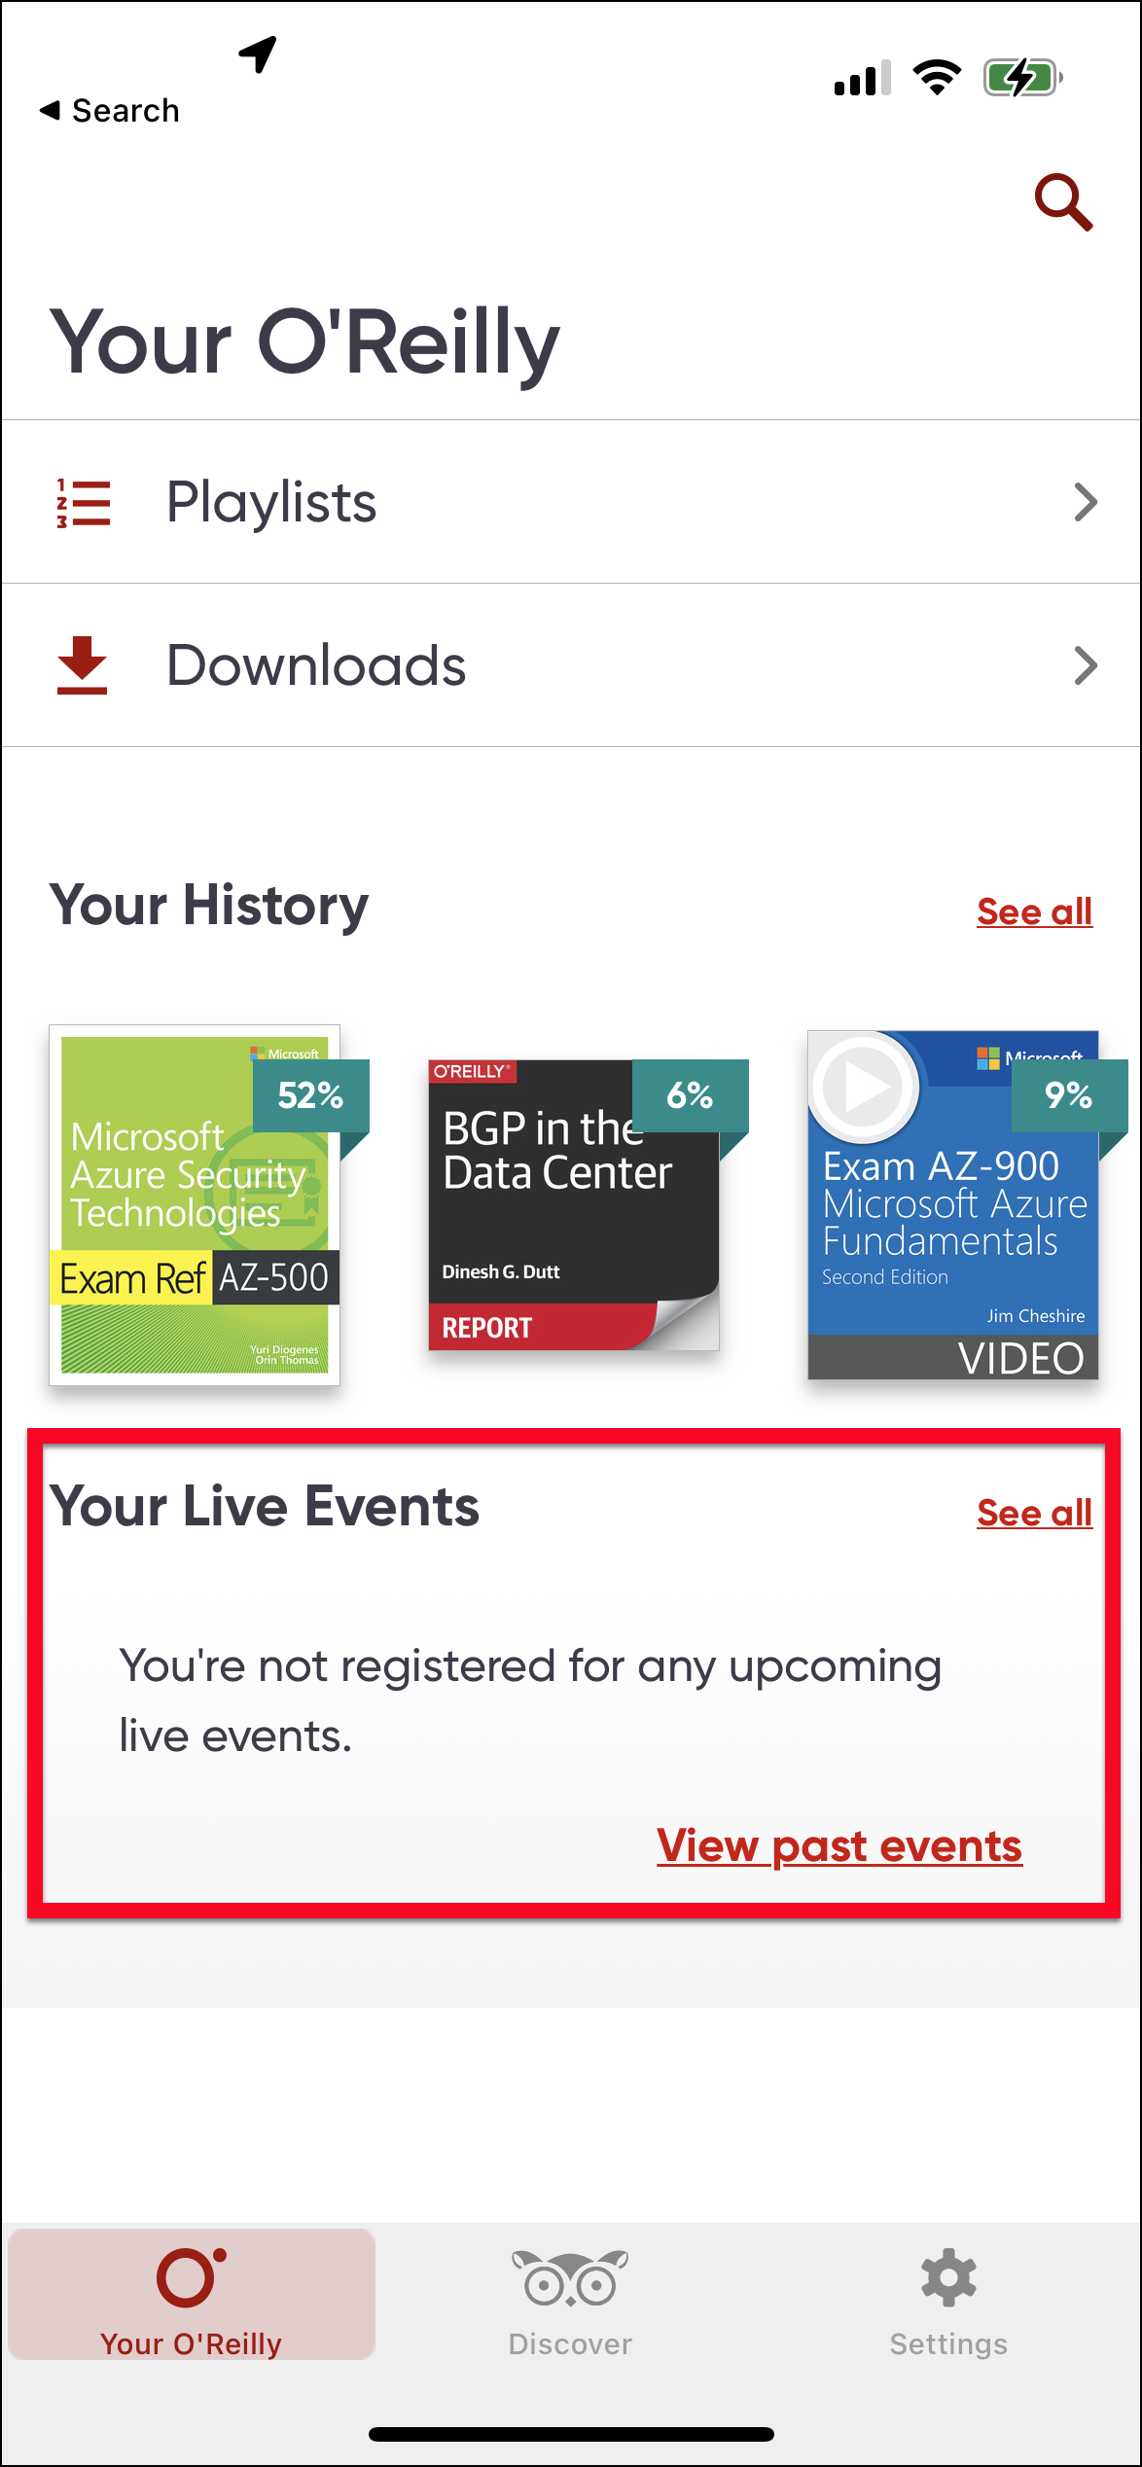
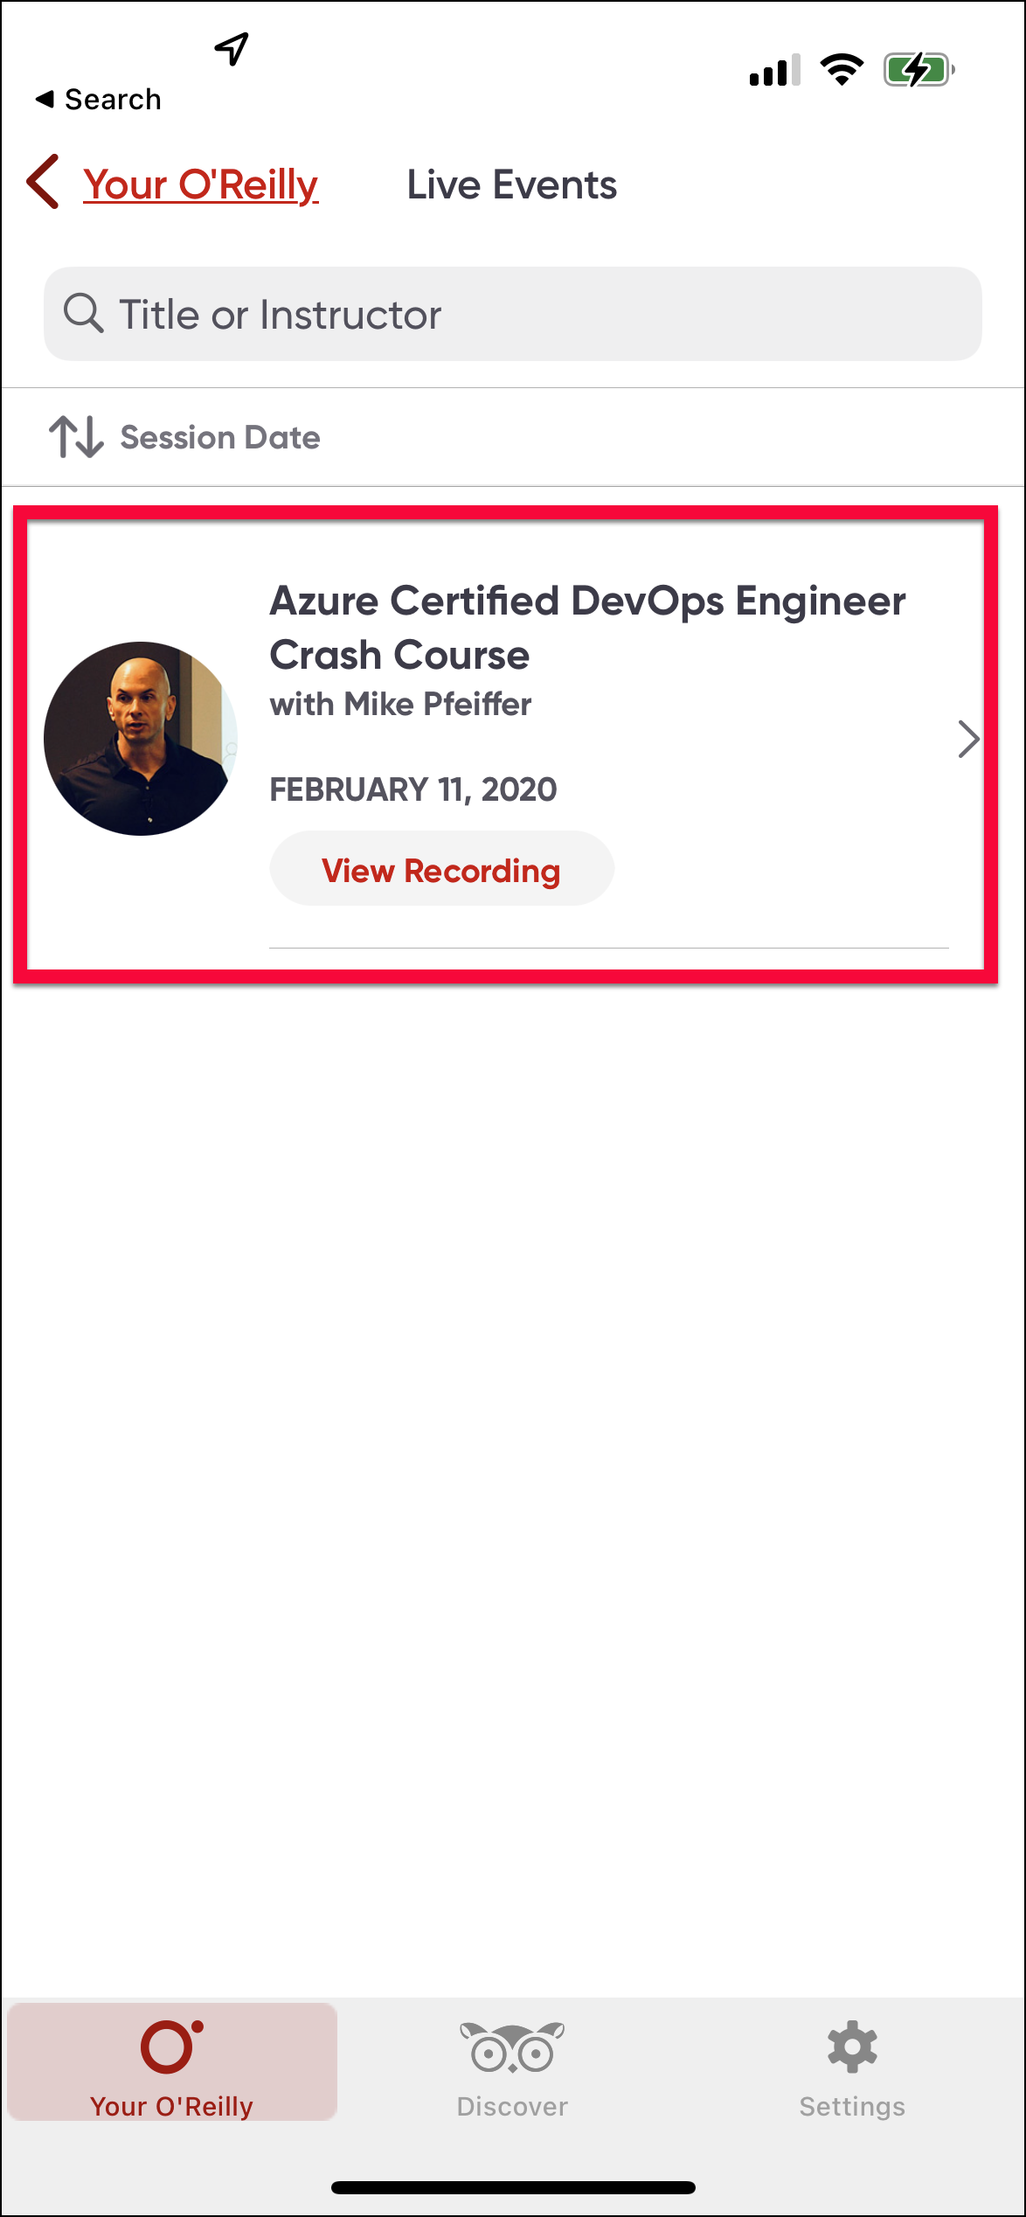
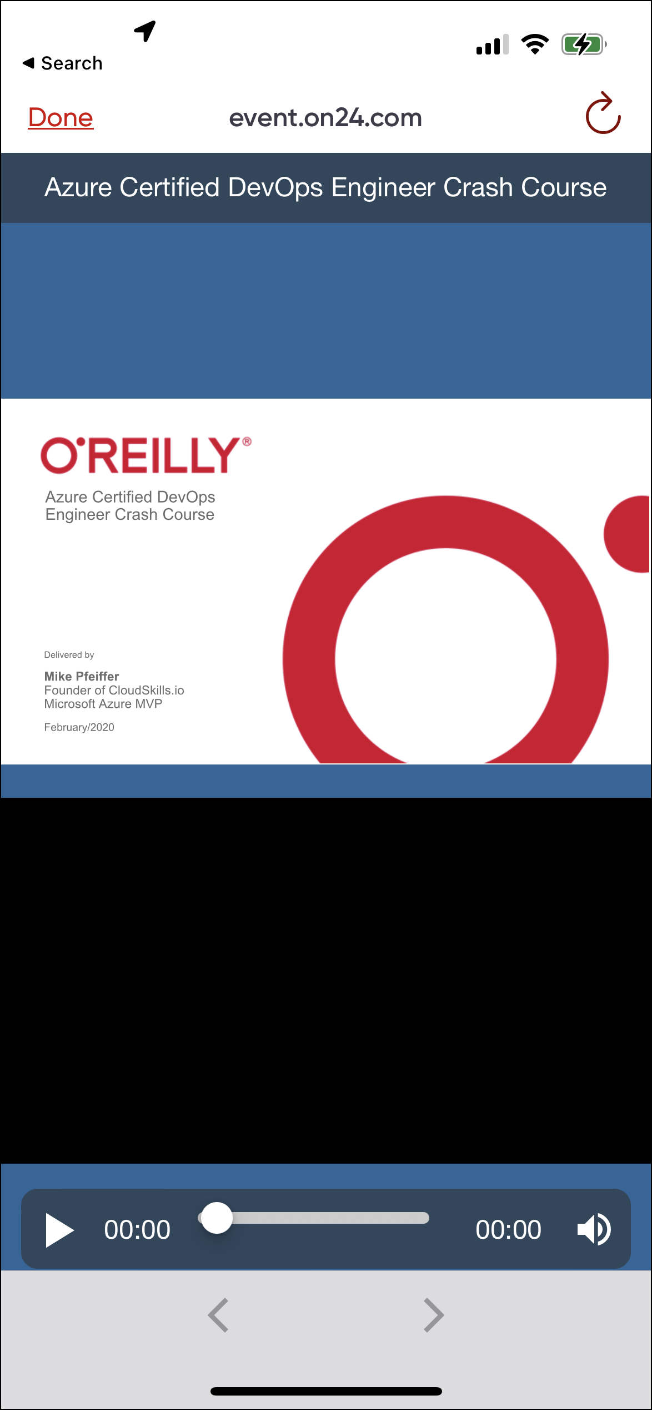
O'Reilly Mobile App

Slide 12
Thank you!
Course materials: timw.info/aoai
Twitter: @TechTrainerTim
Work: timw.info/ps
Web: TechTrainerTim.com

