Slide 1
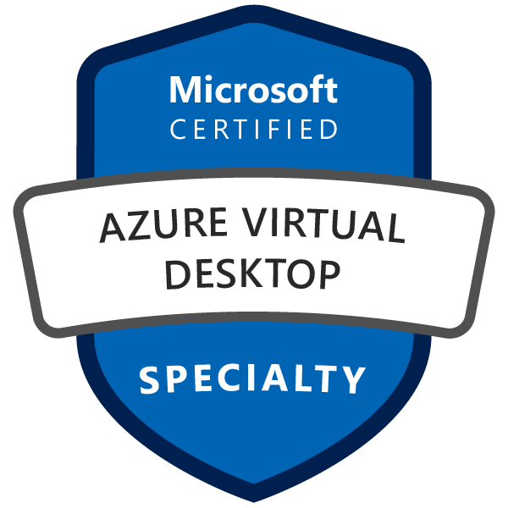
Exam AZ-140: Configuring and Operating Microsoft Azure Virtual Desktop Crash Course
Tim Warner

Slide 2
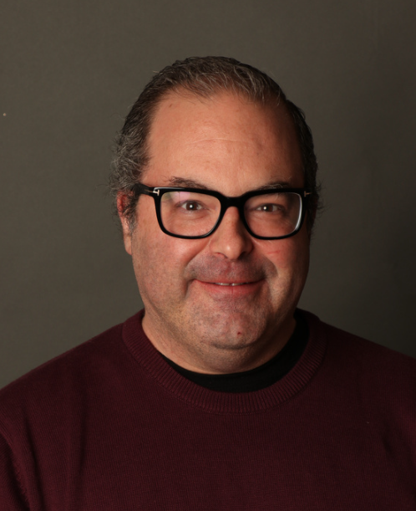

Tim Warner
Senior Content Developer w/ Microsoft
Based in Nashville, TN, US
MCT, Former MVP
Twitter: @TechTrainerTim
Badge: TechTrainerTim.com

Slide 3
Day 1 of 2 Agenda
Introduction
Plan and implement an Azure Virtual Desktop infrastructure (40–45%)
Monitor and maintain an Azure Virtual Desktop infrastructure (10–15%)

Slide 4
Day 2 of 2 Agenda
Content catch-up
Plan and implement identity and security (15–20%)
Plan and implement user environments and apps (20–25%)
Exam AZ-140 strategy

Slide 5
Course Materials
timw.info/az140

Slide 6
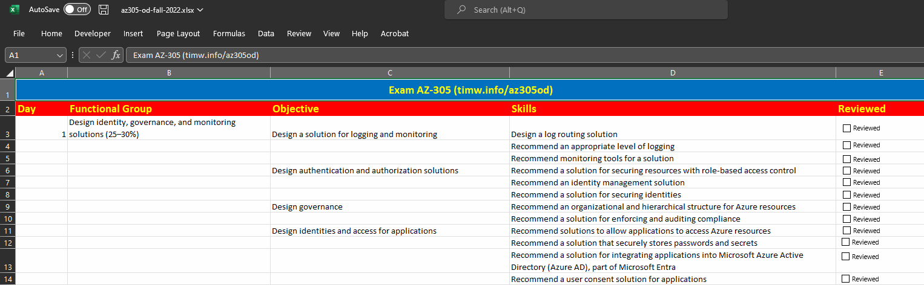
Exam AZ-140 Study Checklist
timw.info/az140sg

Slide 7
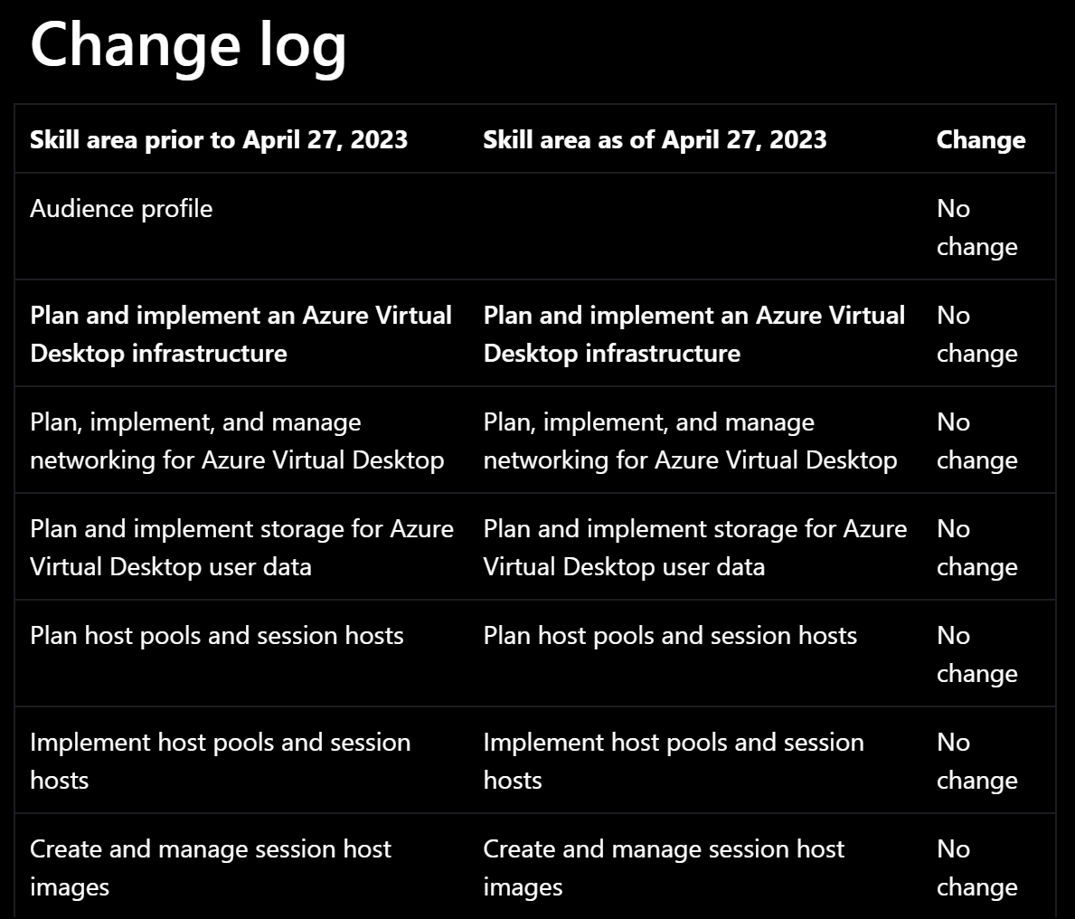
Exam AZ-140 Latest Changes

Slide 8
Level-Setting
This is a “Specialty” certification, so we move quickly and assume intermediate-level Azure skills
10-minute break at midpoint
I’m here to answer your questions – take advantage of this!
Use the Q&A panel

Slide 9
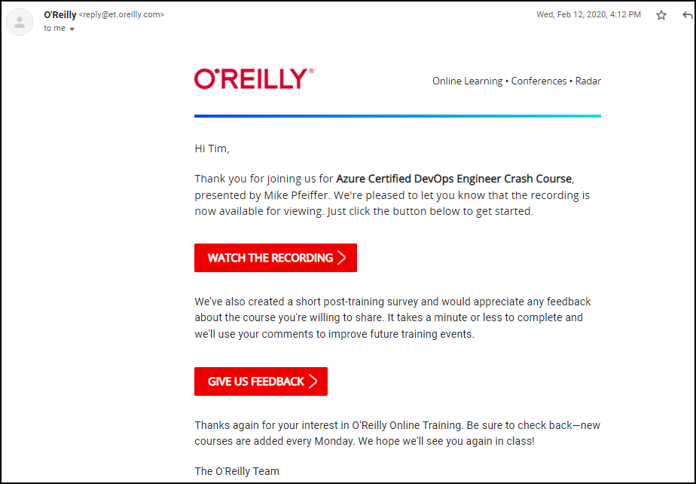
Session Recordings

Slide 10
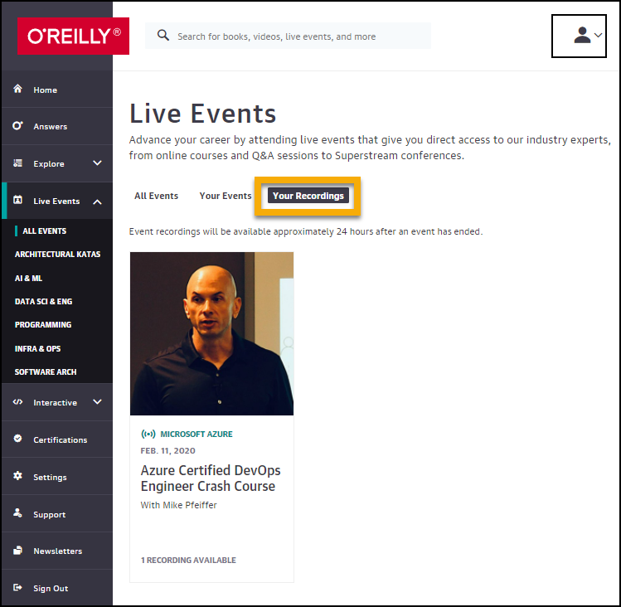
Session Recordings

Slide 11
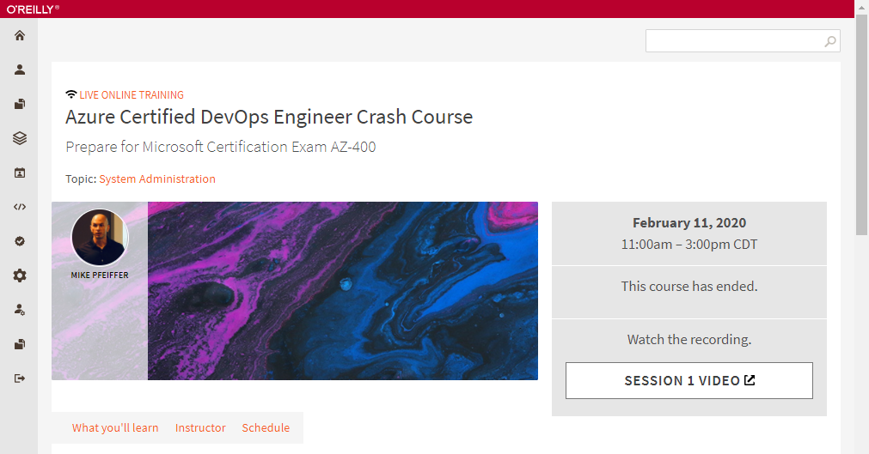
Session Recordings

Slide 12
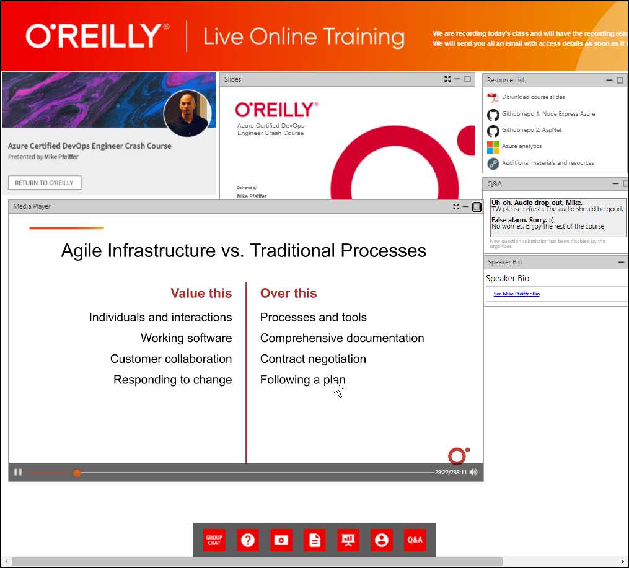
Session Recordings

Slide 13
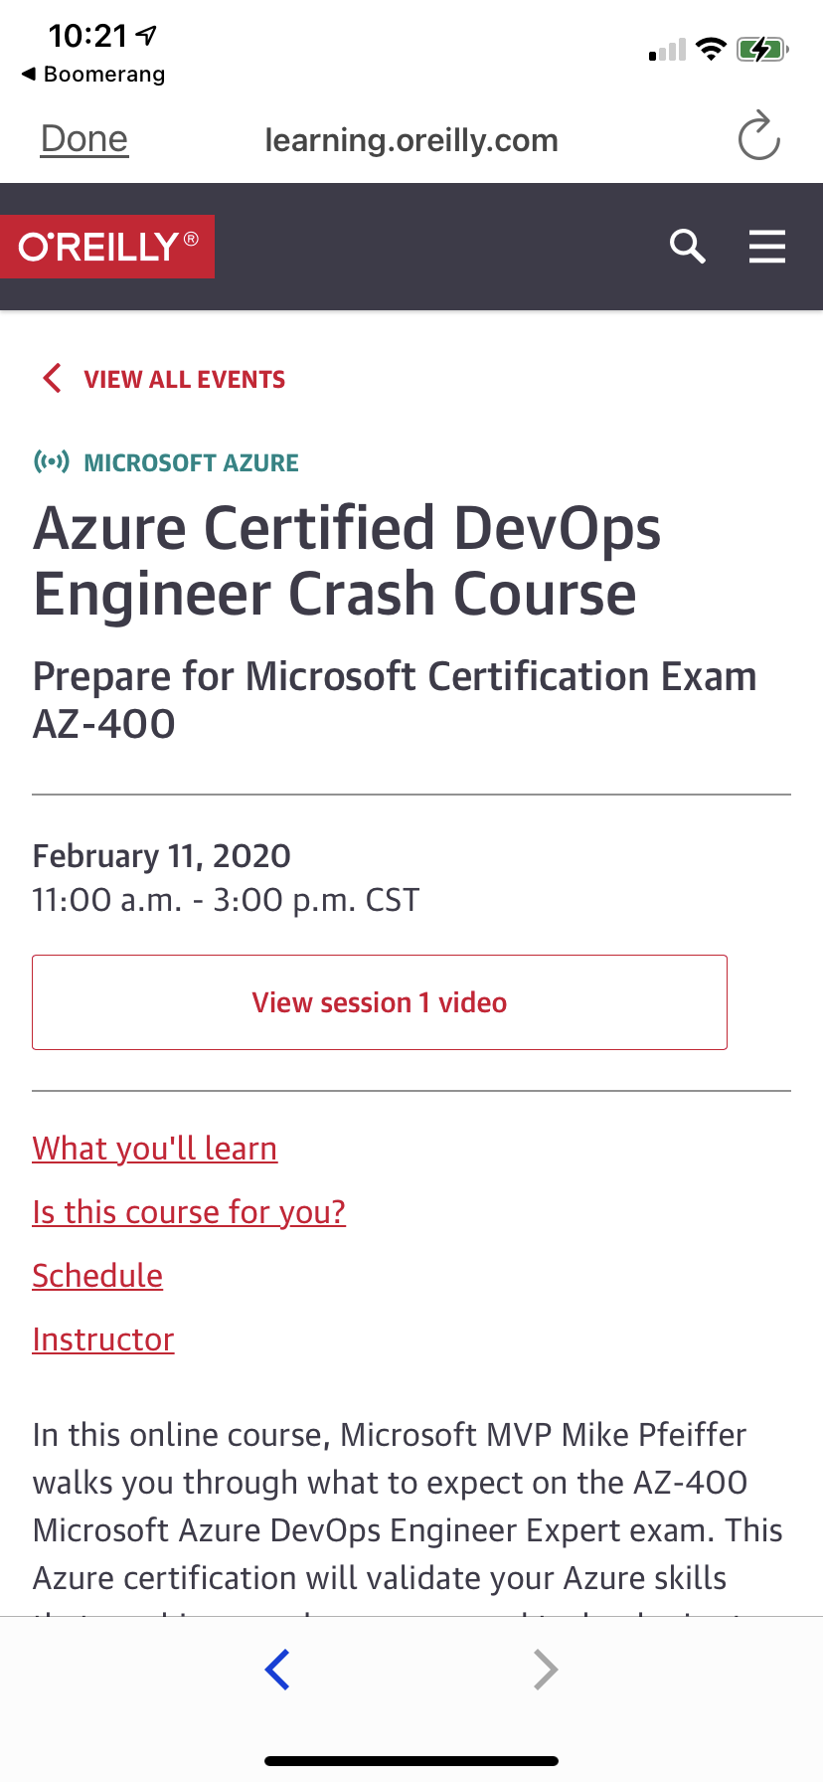
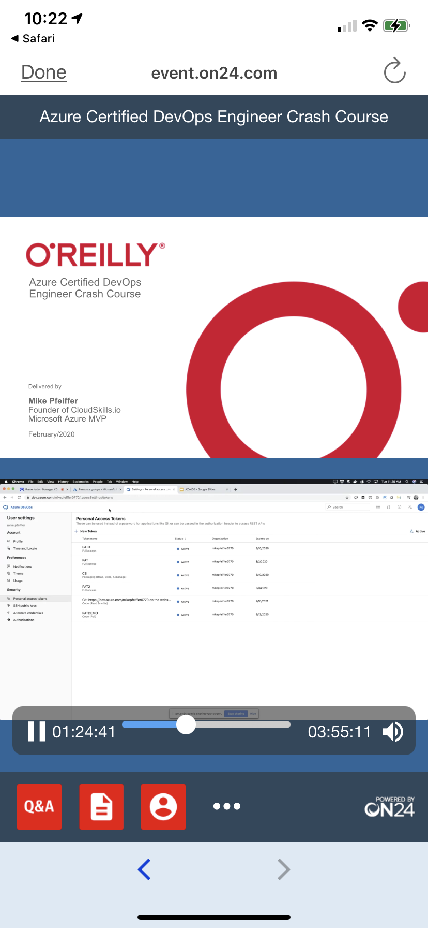
Mobile Browser: learning.oreilly.com

Slide 14
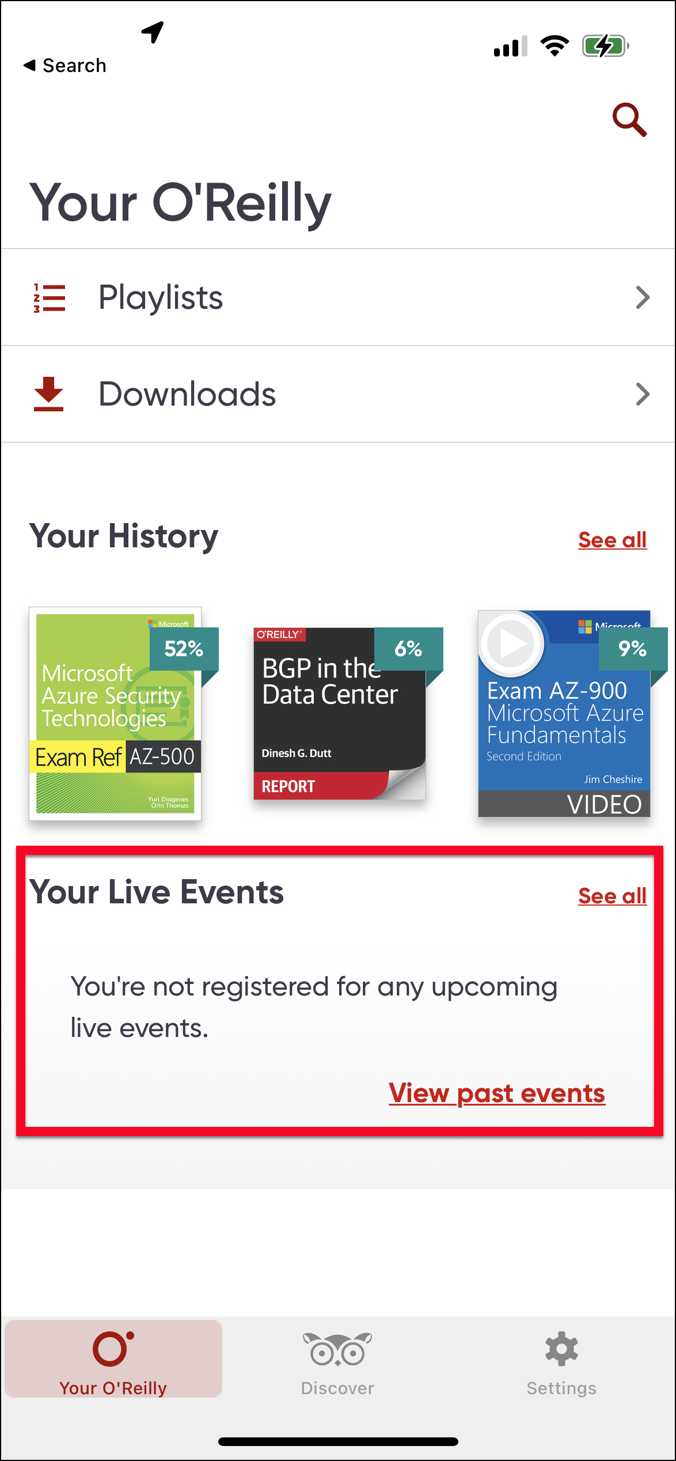
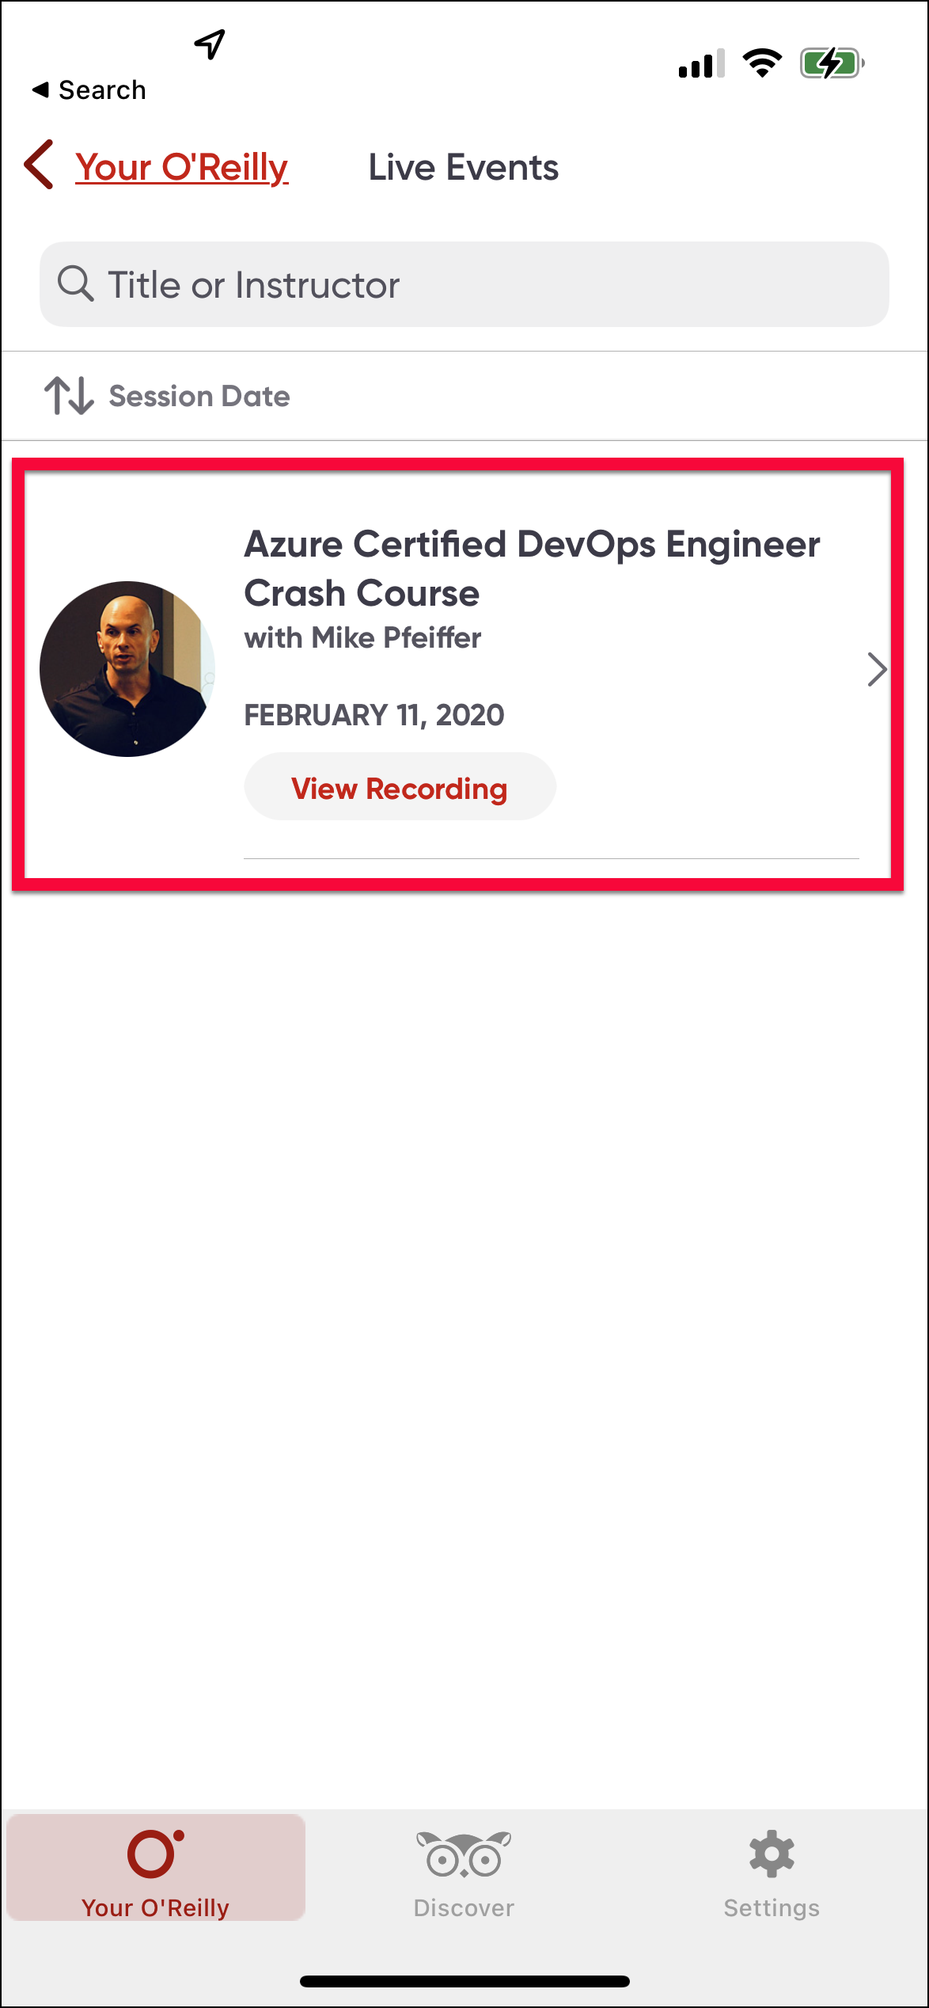
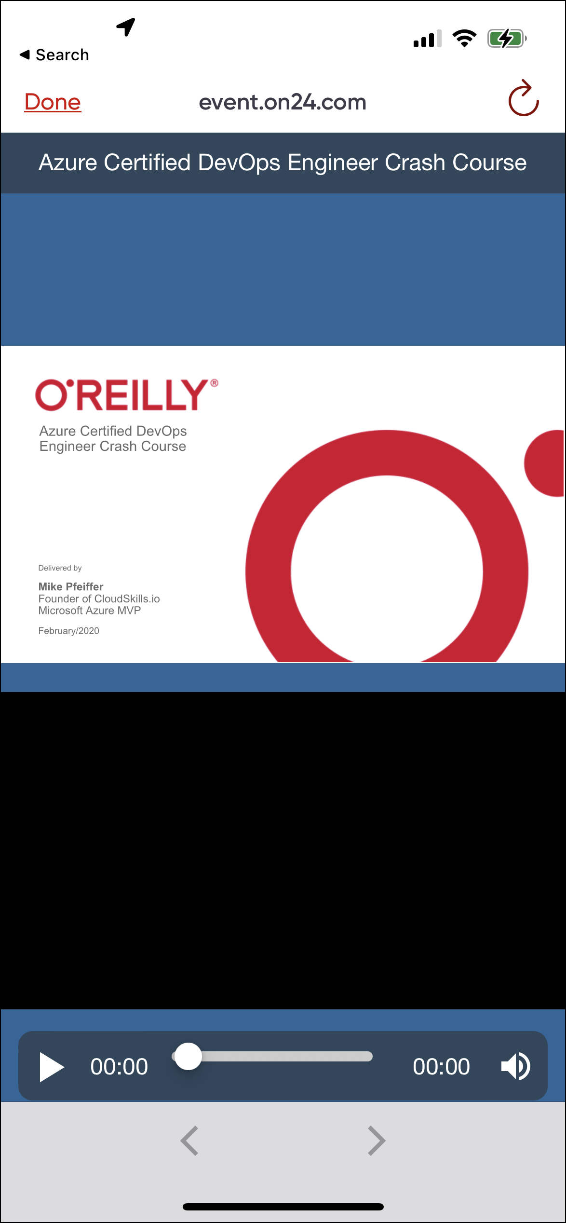
O'Reilly Mobile App

Slide 15
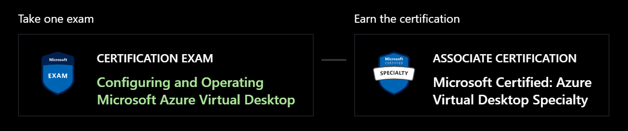
Azure Virtual Desktop Specialty
AZ-140
One-year validity

Slide 16
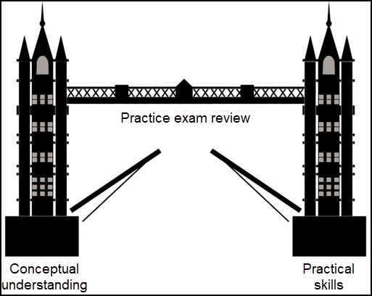
Tim's Certification Study Model

Slide 17
Thank you!
Course materials: timw.info/az140
Twitter: @TechTrainerTim
Work: timw.info/ps
Web: TechTrainerTim.com

