Slide 1
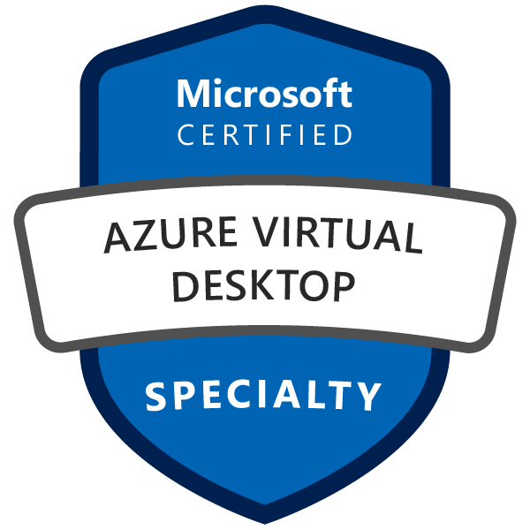
Exam AZ-140: Configuring and Operating Microsoft Azure Virtual Desktop Crash Course
Tim Warner

Slide 2
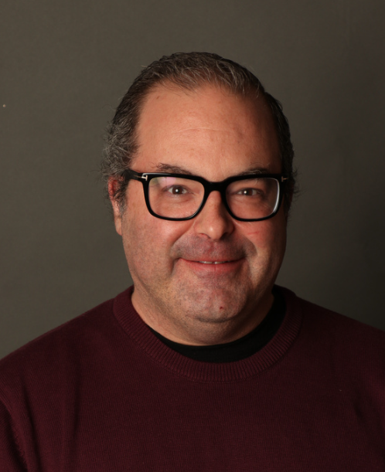

Tim Warner
Senior Content Developer w/ Microsoft
Based in Nashville, TN, US
MCT, Former MVP
Twitter: @TechTrainerTim
Badge: TechTrainerTim.com

Slide 3
Day 1 of 2 Agenda
Introduction
Design identity, governance, and monitoring solutions (25-30%)
Design data storage solutions (25-30%)

Slide 4
Day 2 of 2 Agenda
Content catch-up
Design infrastructure solutions (25-30%)
VMs
Container
App Service
Design business continuity solutions (10-15%)
Migration
Exam AZ-305 strategy

Slide 5
Course Materials
timw.info/az140

Slide 6
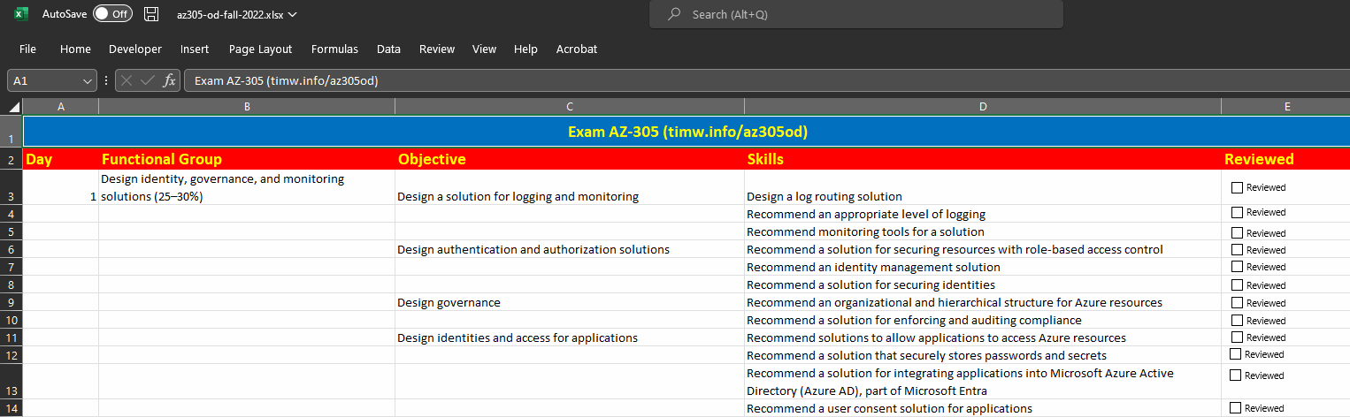
Exam AZ-140 Study Checklist
timw.info/az140sg

Slide 7
Exam AZ-140 Latest OD Changes

Slide 8
Level-Setting
We'll learn by doing – majority demo
Visual, case study approach
This is an expert certification, so we move quickly and assume intermediate-level Azure skills
10-minute break at midpoint
I’m here to answer your questions – take advantage of this!
Use the Q&A panel

Slide 9
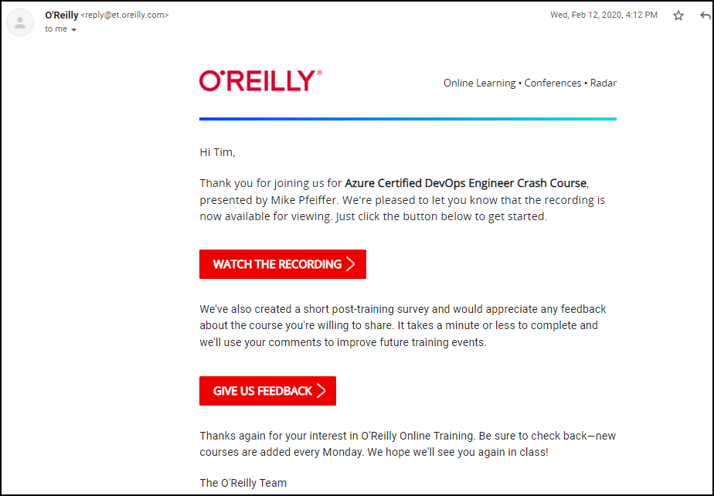
Session Recordings

Slide 10
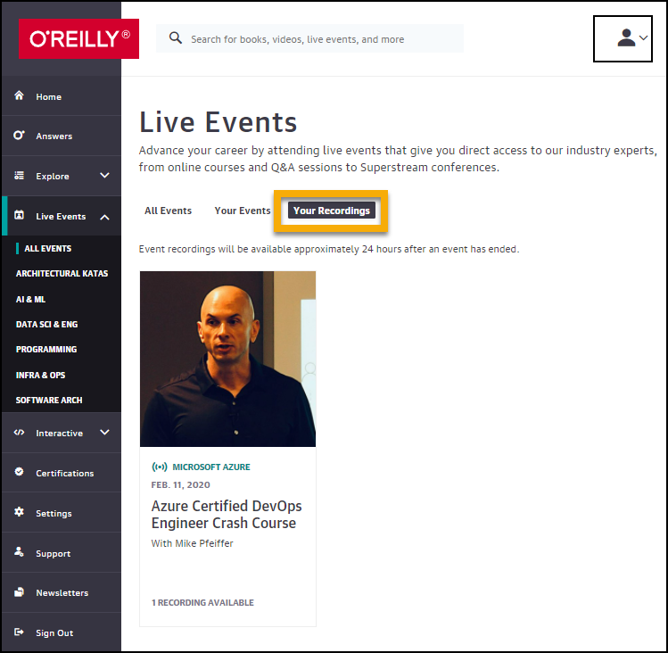
Session Recordings

Slide 11
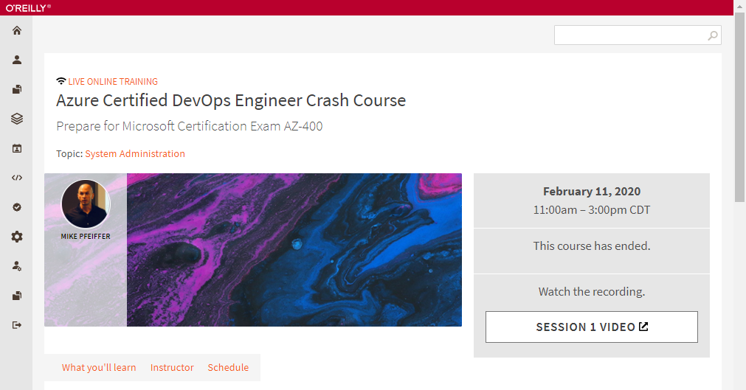
Session Recordings

Slide 12
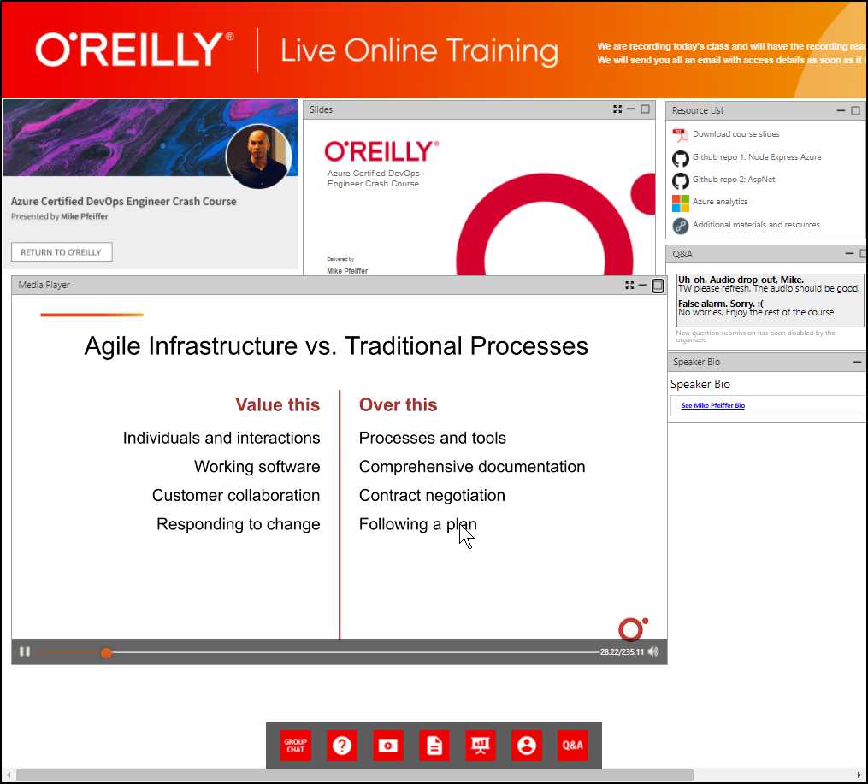
Session Recordings

Slide 13
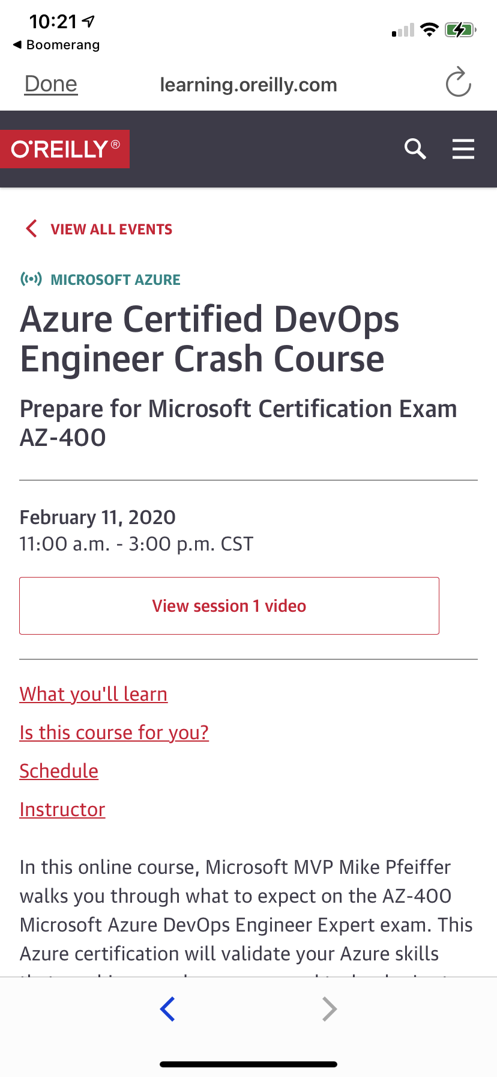
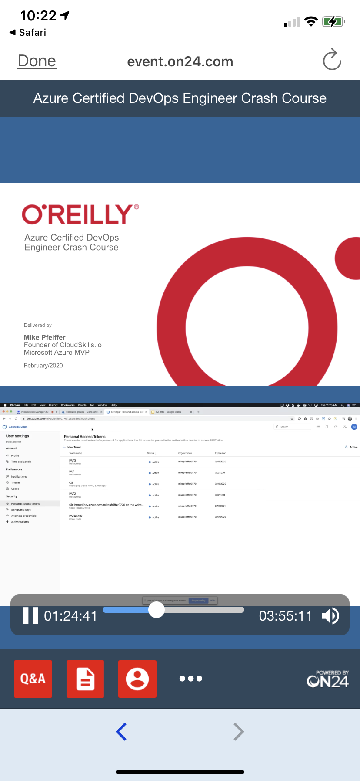
Mobile Browser: learning.oreilly.com

Slide 14
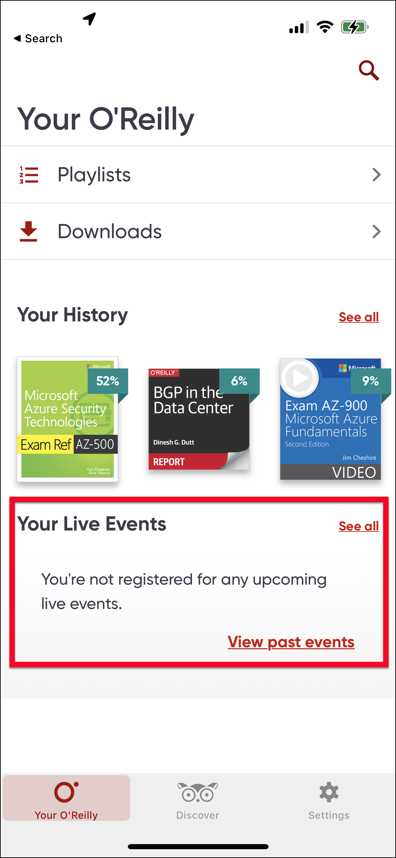
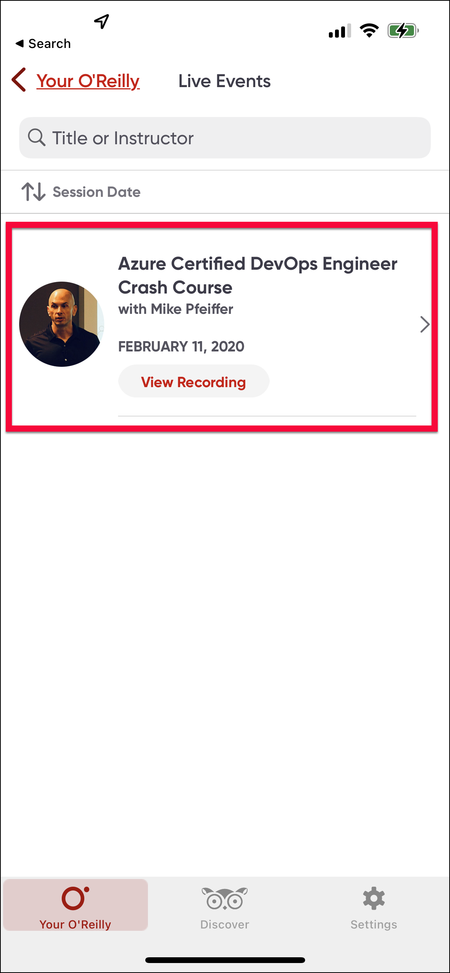
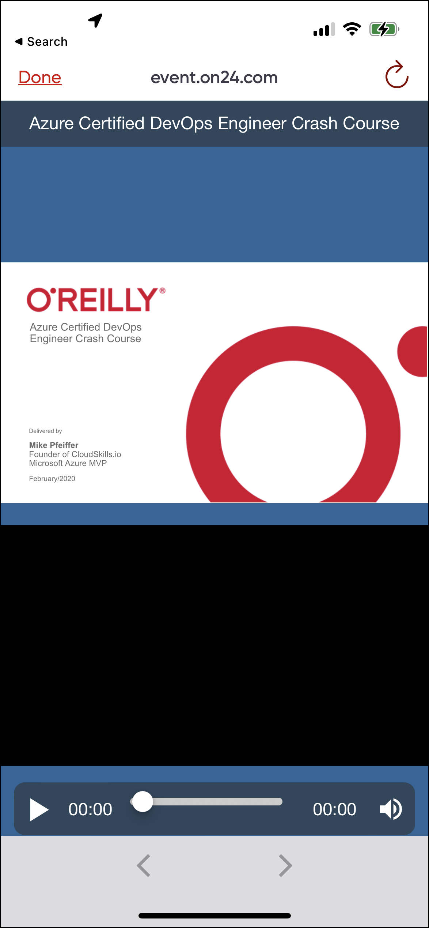
O'Reilly Mobile App

Slide 15
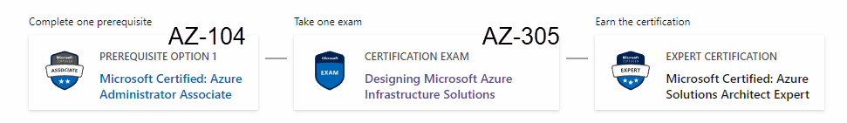
Azure Solutions Architect Expert
AZ-303
AZ-304
One-year validity

Slide 16
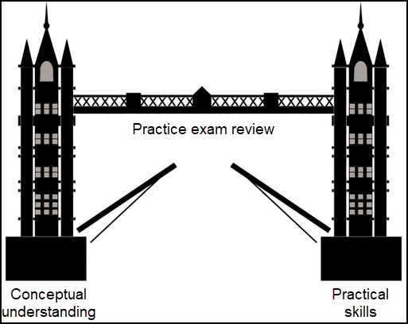
Tim's Certification Study Model

Slide 17
Thank you!
Course materials: timw.info/az140
Twitter: @TechTrainerTim
Work: timw.info/ps
Web: TechTrainerTim.com

