Slide 1


Exam AZ-801: Configuring Windows Server Hybrid Advanced Services, 2nd Ed
Tim Warner
Microsoft Certified Trainer and Microsoft MVP

Slide 2

Lesson 4: Configure Advanced Domain Security
4.1. Configure authentication policy silos
4.2. Restrict access to domain controllers
4.3. Configure security options for user accounts
4.4. Configure security options for built-in administrative groups
4.5. Manage AD delegation
4.6 Implement Just Enough Administration (JEA) and Just-In-Time (JIT) privileged access
n
Notes:
Image credit: Tim + ChatGPT Image Generation

Slide 3
4.1 Configure authentication policy silos

Slide 4
Bridging our learning thus far
Server motherboard-level security hygiene
Local account security and password hygiene
Privileged account protection and branch office security hardening
Notes:
In Lessons 1 through 3, we laid the groundwork for domain security.
Lesson 1: We hardened the operating system itself — exploit protection, Credential Guard, secured-core features. That’s all about strengthening the box.
Lesson 2: We tackled local accounts and password hygiene — Windows LAPS, fine-grained password policies, and Entra Password Protection. That ensured every account starts with a strong foundation.
Lesson 3: We protected high-value users and branch deployments — using the Protected Users group and Read-Only Domain Controllers to contain credential exposure.
Now, in Lesson 4, we move from these tactical protections to the strategic plane: enterprise-level Active Directory security.

Slide 5
Implement enterprise-grade AuthN and AuthZ
Authentication silos restrict where privileged accounts can
log on
Domain controller access is tightly controlled with policies
User and admin account options strengthen identity security
Delegation must follow least privilege principles
Just Enough Administration (JEA) and Just-in-Time (JIT) add zero trust controls
Notes:
Slide: Implement enterprise‑grade AuthN and AuthZ
Framing: As organizations scale, identity attacks escalate—implementing robust authentication and authorization (AuthN/AuthZ) is foundational. This slide introduces how to use policy, role, and administrative controls to harden privileged access.
Authentication silos restrict where privileged accounts can log on
Use authentication policy silos to group high‑privilege identities and restrict where they can log in (e.g. only from specific hosts or trusted workstations). This limits exposure even if credentials are compromised.
Domain controller access is tightly controlled with policies
Apply policies to restrict which accounts can access writable DCs, via console, RDP, or remote management interfaces. Only allow required accounts, and restrict from untrusted networks.
User and admin account options strengthen identity security
Use strong password requirements, enforce multi‑factor or smart card authentication, restrict delegation, enforce device compliance etc. to make sure accounts are not the weak link.
Delegation must follow least privilege principles
Avoid broad or unconstrained delegation; grant only necessary permissions, scope them tightly, and audit their usage.
Just Enough Administration (JEA) and Just‑in‑Time (JIT) add zero trust controls
Use JEA to limit what cmdlets / tasks an operator can perform, and JIT (via PIM or similar) to grant privileged access only when needed and only for a short period.
AZ‑801 Exam Tip: In scenario questions, always check if the environment meets prerequisites for features like silos, JEA, JIT; often the correct answer is limited by those constraints.

Slide 6
Isolate privileged accounts with authentication silos
Create silos for sensitive accounts at Fabrikam
Ticket-granting ticket (TGT) lifetimes limit exposure
Device-based restrictions enforce trusted authentication sources
Silo membership defines where accounts can sign in
Audit logs track violations and suspicious access
Notes:
Framing: Privileged accounts are high‑value targets—isolating them via silos helps reduce where and how they can be misused. These bullets show how silos work in practice.
Create silos for sensitive accounts at Fabrikam
Define a silo for high‑risk accounts (Domain Admins etc.), giving you a group container to which stricter policies can be applied. Helps standardize protection.
Ticket‑granting ticket (TGT) lifetimes limit exposure
In a silo, you can reduce the lifetime of the Kerberos TGT (even make non‑renewable) so that credentials, once compromised, are valid only briefly.
Device‑based restrictions enforce trusted authentication sources
Require that certain accounts authenticate only from specific devices, or enforce device registration – helps prevent logins from unknown or non‑trusted endpoints.
Silo membership defines where accounts can sign in
Membership in the silo determines which accounts are subject to the silo’s restrictions; mapping is critical to avoid unintended permission gaps or lockouts.
Audit logs track violations and suspicious access
Enabling audit mode initially (before enforcing) lets you monitor what would happen; review failures, suspicious logins, policy violations to catch early misconfigurations.
AZ‑801 Exam Tip: If a question mentions “trusted devices,” “non‑renewable TGT,” or “audit mode vs enforce,” think of authentication policy silos; these are often distinguishing features in correct answers.

Slide 7
4.2 Restrict access to domain controllers

Slide 8
Restrict who can access domain controllers
“Log on to Domain Controllers” policy enforces least privilege
IPsec encrypts and authenticates DC communication
Selective authentication restricts access across trusts
Network segmentation isolates DCs from general traffic
Adventure Works locks down DC console and network paths
Notes:
Framing: Domain Controllers (DCs) are crown jewels—limiting who can reach them, over what paths, is vital to reducing risk. This slide covers controls around DC access.
“Log on to Domain Controllers” policy enforces least privilege
Use this GPO or policy setting to limit which accounts can log on interactively, via desktop/RDP, or locally at a DC. Only absolutely necessary accounts should have that.
IPsec encrypts and authenticates DC communication
Enforce IPsec between DCs (and between DCs and required hosts) to ensure DC traffic is both confidential and authentic—especially over network segments that may be less secure.
Selective authentication restricts access across trusts
In multiple forest or external trust scenarios, use selective authentication so that only specific accounts from trusted domains/forests can access resources on your DCs.
Network segmentation isolates DCs from general traffic
Use VLANs, firewalls, network ACLs to limit which machines/networks can even attempt to reach DCs; reduce attack surface by isolating DCs from unnecessary exposure.
Adventure Works locks down DC console and network paths
In your scenario, enforce controlled physical access to DC consoles, require jump hosts for remote access, audit console logons etc.
AZ‑801 Exam Tip: Look for scenario details about network topology, existing trust relationships, and whether DC communications are over untrusted networks—these details often indicate which access restriction features are needed.

Slide 9
4.3 Configure security options for user accounts

Slide 10
Configure security options for user accounts
Enforce password length, complexity, and history requirements
Apply account lockout thresholds and durations to stop brute-force attacks
Configure Kerberos ticket lifetimes and renewal policies for balanced security and usability
Require smart card or multifactor logon for sensitive non-admin accounts
Use user rights assignments (e.g., deny local logon, allow logon as a batch job) to control where accounts can sign in
Notes:
Framing: User account compromise is still one of the most common attack vectors; tightening user account options helps mitigate brute force, phishing, credential reuse.
Enforce password length, complexity, and history requirements
Make sure password policies enforce history so old passwords can’t be reused; require length / character variety to meet strength standards.
Apply account lockout thresholds and durations to stop brute‑force attacks
Set thresholds for failed login attempts; durations; ensure lockout reset timers balanced so legitimate users aren’t overly locked out but attackers are throttled.
Configure Kerberos ticket lifetimes and renewal policies for balanced security and usability
Shorter lifetimes / renewal helps minimize risk, but too short causes friction — know the defaults and how to modify in AD.
Require smart card or multifactor logon for sensitive non‑admin accounts
Some non‑admin accounts (e.g. service operators, help desk, etc.) may be high value; applying second factor or hardware tokens strengthens protection.
Use user rights assignments (e.g., deny local logon, allow logon as a batch job) to control where accounts can sign in
Rights assignments in GPO let you deny local logon for many accounts; only allow necessary rights for service or batch jobs. Reducing where accounts can sign‑in reduces attack vectors.
AZ‑801 Exam Tip: Scenario questions will often include user vs admin accounts; check whether multi‑factor is required, whether non‑admin is sensitive; also check the default Kerberos lifetimes to know whether configuration changes are needed.

Slide 11
4.4 Configure security options for built-in administrative groups

Slide 12
Configure security options for built-in admin groups
AdminSDHolder protects sensitive groups from unauthorized changes
SDProp process reapplies consistent ACLs every 60 minutes
Time-based group membership reduces exposure of privileged roles
Audit policies track membership changes in real time
Tailwind Traders enforces consistent permissions across all admin groups
Notes:
Framing: Built‑in admin groups (like Domain Admins, Enterprise Admins, etc.) are high impact; ensuring their group membership, permissions, and protections are locked down prevents privilege escalation.
AdminSDHolder protects sensitive groups from unauthorized changes
AdminSDHolder defines a template ACL for sensitive groups; manual changes often get reset via SDProp to align with this template. Ensure this is configured correctly.
SDProp process reapplies consistent ACLs every 60 minutes
The Security Descriptor Propagator (SDProp) ensures that the template is re‑applied regularly, so drift or misconfigmitted ACLs are reset automatically.
Time‑based group membership reduces exposure of privileged roles
Rather than keeping accounts permanently in sensitive groups, use timed membership (membership only during needed windows) to reduce risk of long‑standing exposure.
Audit policies track membership changes in real time
Enable audit logs so any adds/removes to privileged groups are recorded immediately; use alerts or monitoring to catch unexpected changes.
Tailwind Traders enforces consistent permissions across all admin groups
For consistency and security, ensure that all admin groups have standardized rights; avoid “rogue” admin groups or misaligned ACLs that grant more access than expected.
AZ‑801 Exam Tip: If a scenario describes inconsistent permissions among admin groups or drift, the correct remediation is often group membership/time‑based controls + audit + enforcing AdminSDHolder/SDProp

Slide 13
4.5 Manage AD delegation

Slide 14
Manage AD delegation with least privilege
Constrained delegation limits where credentials can flow
Resource-based constrained delegation simplifies trust boundaries
Protocol transition avoids double-hop Kerberos issues
PowerShell audits reveal risky or outdated delegations
Contoso applies delegation only to specific services
Notes:
Framing: Delegation controls (how services or accounts can act on behalf of others) are often overlooked but are key risk paths—least privilege delegation limits those paths.
Constrained delegation limits where credentials can flow
Use Kerberos constrained delegation to specify which services an account can delegate to; prevents overbroad credential usage.
Resource‑based constrained delegation simplifies trust boundaries
This model helps in environments with many trusts — resources define who can delegate credentials to them, helping maintain clearer boundaries.
Protocol transition avoids double‑hop Kerberos issues
Using protocol transition (from non‑Kerberos to Kerberos) helps scenarios where credentials cross hops (e.g. web to back‑end), but must be done carefully.
PowerShell audits reveal risky or outdated delegations
Regularly review delegated permissions via PowerShell or AD tools to find service accounts or delegation settings that are too permissive or legacy.
Contoso applies delegation only to specific services
Example: only allow specific service accounts for specific services rather than blanket delegation; keeps attack surface smaller.
AZ‑801 Exam Tip: Pay attention in scenarios for terms like “unconstrained delegation” or “delegation across trusts” — these often point to where constrained or resource‑based delegation is required.

Slide 15
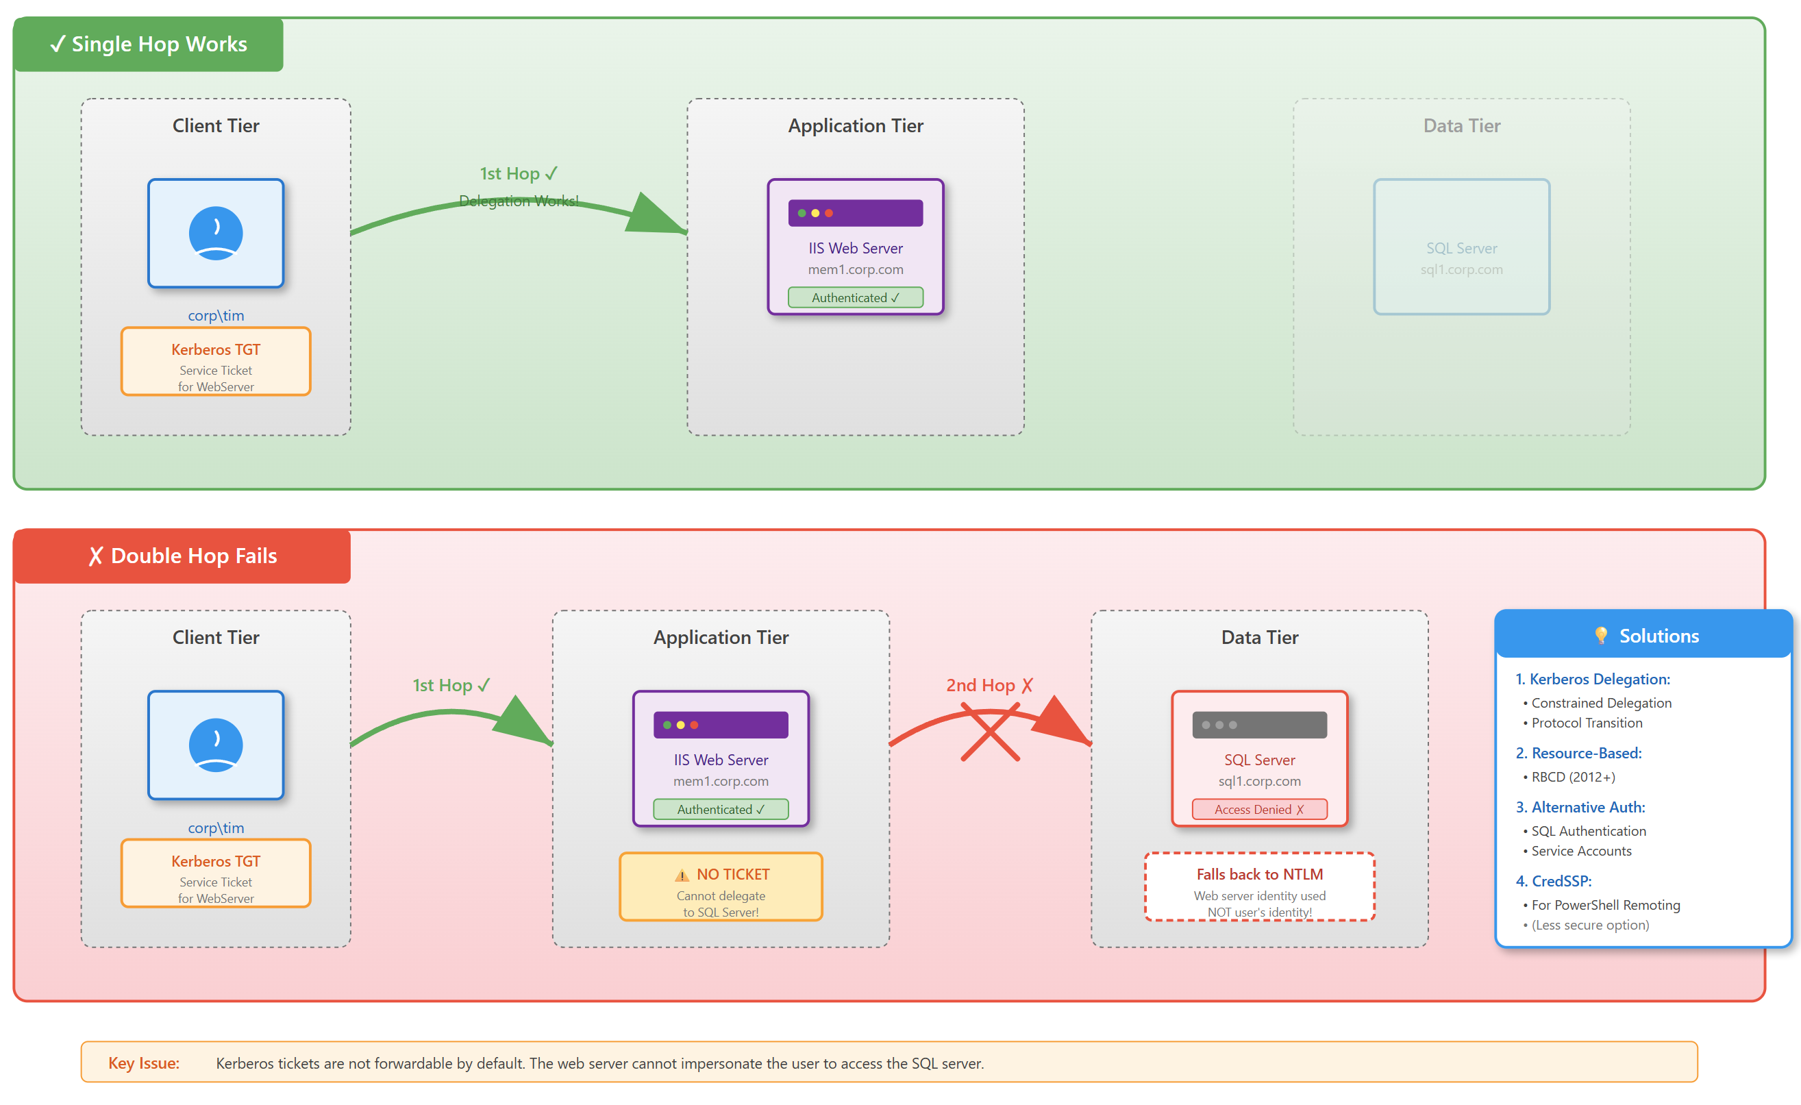
The Kerberos double-hop problem
Notes:
Image credit: Tim + Claude AI

Slide 16
4.6 Implement Just Enough Administration (JEA) and Just-In-Time (JIT) privileged access

Slide 17
Provide just-enough and just-in-time access
JEA PowerShell endpoints expose only approved cmdlets
Session configurations restrict the admin runtime environment
Role capabilities define what operators can do
Microsoft Entra Privileged Identity Management provides JIT elevation
Fabrikam enforces time-boxed, auditable admin sessions
Notes:
Slide: Implement Just Enough Administration (JEA) and Just‑in‑Time (JIT) privileged access
Framing: Permanent elevated privileges are high risk; JEA and JIT offer ways to limit exposure by granting elevated permissions only when needed, and in a controlled way.
JEA PowerShell endpoints expose only approved cmdlets
Create constrained endpoints so that when someone needs admin‑type tasks, they only have access to safe, pre‑approved commands, rather than full admin shell.
Session configurations restrict the admin runtime environment
Limit what features or modules are available during elevated sessions; restrict interactive access; remove risky features; log session activity.
Role capabilities define what operators can do
Define specific operator roles (with limited permissions) rather than giving full admin rights. Helps implement least privilege.
Microsoft Entra Privileged Identity Management provides JIT elevation
Use PIM to time‑box elevated access, require requests/approvals, and ensure that rights are not continuously active.
Fabrikam enforces time‑boxed, auditable admin sessions
In your scenario, ensure elevation sessions automatically expire and actions are logged and auditable.
AZ‑801 Exam Tip: When a question describes a scenario with requirement for “minimal persistent privileges”, “auditable sessions”, or “just‑in‑time”, options like JEA, JIT or PIM are often the correct choice — but check whether prerequisites are satisfied.

Slide 18
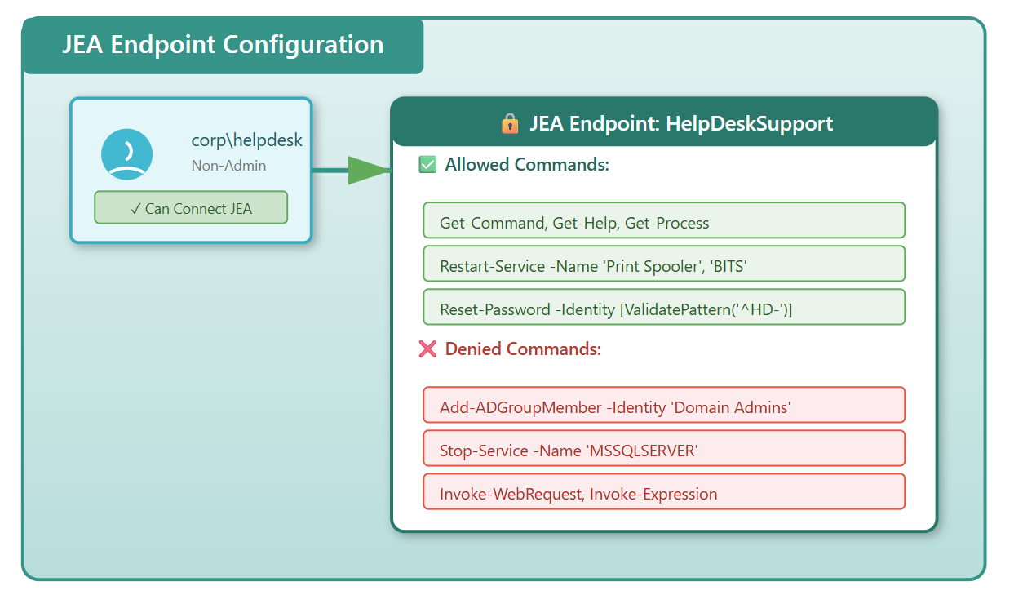
JEA for PowerShell architecture
Notes:
Image credit: Tim + Claude AI

Slide 19
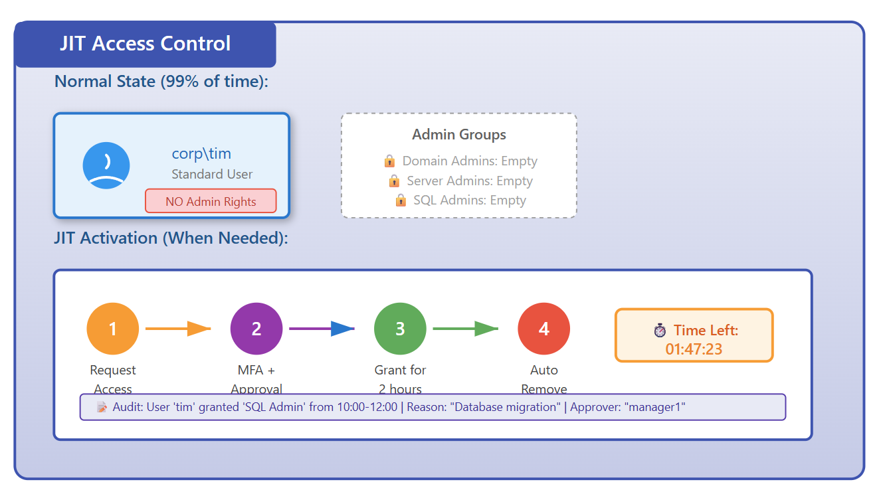
JIT Privileged Access architecture
Notes:
Image credit: Tim + Claude AI

