Slide 1


Exam AZ-801: Configuring Windows Server Hybrid Advanced Services, 2nd Ed
Tim Warner
Microsoft Certified Trainer and Microsoft MVP

Slide 2

Lesson 8: Implement Failover Clusters
8.1. Implement a failover cluster on-premises, hybrid, or cloud-only
8.2. Create a Windows failover cluster, including workgroup clusters
8.3. Implement a stretch cluster across datacenters or Azure regions, including Storage Spaces Direct (S2D) campus clusters
8.4. Configure storage for failover clustering
8.5. Modify quorum options
8.6. Configure network adapters for failover clustering
Notes:
Image credit: Tim + ChatGPT Image Generation

Slide 3
8.1 Implement a failover cluster on-premises, hybrid, or cloud-only

Slide 4
The story thus far...
We’ve emerged from Windows Server 2025 security
We’re embarking on a high availability (HA) journey centered on Windows Server Failover Clustering (WSFC)

Slide 5
Ensure high availability with failover clustering
Provides automatic failover for apps and services
On-prem clusters use SAN or Storage Spaces Direct
Hybrid clusters extend on-prem workloads into Azure
Cloud-only clusters use Azure shared disks and proximity groups
Adventure Works uses hybrid clusters for SQL Server continuity
Notes:
Framing: Failover clustering is Windows Server’s built-in answer to high availability. It gives us confidence that critical workloads keep running even if individual servers don’t.
Provides automatic failover for apps and services
→ If a node goes down, the cluster moves workloads to another node automatically so users barely notice.
On-premises clusters use shared storage or S2D
→ You can hook into SAN/iSCSI, or go software-defined with Storage Spaces Direct for local disks.
Hybrid clusters span datacenters and Azure
→ Extend your cluster across sites or even into the cloud for extra resiliency.
Cloud-only clusters leverage Azure shared disks
→ In Azure, you don’t need SANs—use Azure shared disks plus proximity placement groups.
Workgroup clusters operate without Active Directory
→ Even if there’s no domain, you can still build a cluster using certificates and local accounts.
AZ-801 Exam Tip:
Remember: Cloud Witness is the recommended quorum solution for Azure-based cluste

Slide 6
8.2 Create a Windows failover cluster, including workgroup clusters

Slide 7
Build clusters with or without Active Directory
Cluster validation tests confirm hardware/software readiness
Failover Cluster Manager and PowerShell support creation
Workgroup clusters authenticate with local accounts/certs
Separate networks for heartbeat, client access, migration traffic
Contoso deploys workgroup clusters in isolated labs
Notes:
Framing: Not every environment has domain controllers handy. Windows Server lets us build clusters with or without AD, giving flexibility in labs, edge sites, and isolated scenarios.
Cluster validation tests confirm hardware/software readiness
→ Always run validation before cluster creation — it checks drivers, networking, and storage, and it’s required for Microsoft support.
Failover Cluster Manager and PowerShell support creation
→ Use the GUI wizard for simplicity or PowerShell (New-Cluster, Test-Cluster) when you need automation and repeatability.
Workgroup clusters authenticate with local accounts/certs
→ Instead of Kerberos, they rely on certificates or identical local admin credentials across nodes.
Separate networks for heartbeat, client access, migration traffic
→ Segmentation keeps cluster health checks reliable and prevents workload traffic from interfering with live migration.
Contoso deploys workgroup clusters in isolated labs
→ A common Microsoft example: Contoso uses workgroup clusters in lab or test networks where AD isn’t present.
AZ-801 Exam Tip:
If you see “Active Directory–detached cluster” on the exam, that’s Microsoft’s official name for a workgroup cluster

Slide 8
8.3 Implement a stretch cluster across datacenters or Azure regions, including Storage Spaces Direct (S2D) campus clusters

Slide 9
Extend clustering across sites for disaster recovery
Stretch clusters support automatic failover between sites
Site awareness prioritizes local nodes for normal ops
Storage Replica provides synchronous replication
S2D campus clusters extend software-defined storage across sites
Fabrikam deploys stretch clusters across two Azure regions
Notes:
Framing: Stretch or multisite clusters let you protect workloads across datacenters or even Azure regions. They add disaster recovery on top of high availability.
Stretch clusters support automatic failover between sites
→ If one site goes down, the cluster can shift workloads to the surviving site without admin intervention. This is true HA+DR in one solution.
Site awareness prioritizes local nodes for normal ops
→ Windows is smart about preferring nearby nodes under healthy conditions, cutting latency and keeping apps responsive.
Storage Replica provides synchronous replication
→ Every write is committed to both sites simultaneously, ensuring zero data loss when using synchronous mode (as long as latency is under 5ms).
S2D campus clusters extend software-defined storage across sites
→ With Storage Spaces Direct, nodes in different datacenters can pool local disks into one resilient storage fabric.
Fabrikam deploys stretch clusters across two Azure regions
→ This Microsoft scenario shows how an enterprise can pair regions for regional failover, a model exam writers love.
AZ-801 Exam Tip:
Watch for the words “synchronous replication” vs “asynchronous replication.” If the question mentions low-latency links, the correct answer is synchronous Storage Replica

Slide 10
8.4 Configure storage for failover clustering

Slide 11
Optimize storage for clustered workloads
Cluster Shared Volumes (CSV) allow multiple-node access
Shared VHDX files support guest clustering
Storage Spaces Direct eliminates SAN requirements
Witness disk/file share supports quorum decisions
Tailwind Traders leverages CSVs for Hyper-V workload
Notes:
Framing: Storage is the backbone of a failover cluster. Getting it right ensures workloads fail over cleanly and stay performant.
Cluster Shared Volumes (CSV) allow multiple-node access
→ CSVs let all nodes access the same disk at the same time, critical for VM mobility and Scale-Out File Server roles.
Shared VHDX files support guest clustering
→ A virtual hard disk shared between VMs allows guest-level clustering without needing external SAN storage.
Storage Spaces Direct eliminates SAN requirements
→ S2D pools local disks across nodes, giving you shared storage using commodity hardware instead of expensive arrays.
Witness disk/file share supports quorum decisions
→ Witnesses break ties in even-numbered clusters. Disk, file share, or cloud witness ensures clusters know who “owns” quorum.
Tailwind Traders leverages CSVs for Hyper-V workload
→ In Microsoft’s scenario, Tailwind runs Hyper-V VMs on CSVs to maximize availability and flexibility.
AZ-801 Exam Tip:
Expect questions that force you to choose between disk witness, file share witness, and cloud witness — remember, cloud witness is recommended for hybrid/Azure clusters

Slide 12
8.5 Modify quorum options

Slide 13
Maintain cluster availability with quorum models
Node majority suits odd-number clusters
Node and disk/file majority add resiliency for even-node clusters
Cloud witness uses Azure Storage for quorum votes
Dynamic quorum adjusts votes based on active members
Contoso uses Azure cloud witness for branch clusters
Notes:
Framing: Quorum is how a cluster decides who stays online and who shuts down. The right quorum model keeps workloads available without risking “split-brain”.
Node majority suits odd-number clusters
→ With an odd number of nodes, you don’t need extra witnesses — the majority rule keeps things simple and resilient.
Node and disk/file majority add resiliency for even-node clusters
→ A witness vote tips the balance in even-node setups, preventing ties when half the nodes drop.
Cloud witness uses Azure Storage for quorum votes
→ Lightweight and reliable — no on-prem hardware required. Perfect for hybrid or all-Azure clusters.
Dynamic quorum adjusts votes based on active members
→ The cluster is smart enough to remove votes from downed nodes, keeping quorum alive as long as possible.
Contoso uses Azure cloud witness for branch clusters
→ Microsoft’s example customer shows a branch cluster leaning on Cloud Witness for easy tie-breaking.
AZ-801 Exam Tip:
Remember: Explicit Deny beats Allow. If a witness isn’t reachable, it can’t cast a vote — plan quorum across sites carefully.

Slide 14
8.6 Configure network adapters for failover clustering

Slide 15
Tune networking for cluster performance and resiliency
NIC teaming aggregates bandwidth and provides redundancy
RDMA adapters boost storage and migration performance
SMB Multichannel uses multiple paths for higher throughput
Network priorities isolate heartbeat, storage, and client traffic
Fabrikam separates live migration from storage traffic
Notes:
Framing: Clustering depends on solid networking, so tuning adapters and traffic paths directly improves both performance and reliability.
NIC teaming aggregates bandwidth and provides redundancy.
This means multiple adapters can be grouped to increase throughput and ensure connectivity if one NIC fails.
RDMA adapters boost storage and migration performance.
Remote Direct Memory Access offloads work from the CPU and allows low-latency, high-throughput transfers during storage and VM moves.
SMB Multichannel uses multiple paths for higher throughput.
With SMB 3.0 and above, file transfers can spread across multiple NICs automatically for speed and resiliency.
Network priorities isolate heartbeat, storage, and client traffic.
Assigning priorities keeps health checks and storage traffic from being disrupted by user connections.
Fabrikam separates live migration from storage traffic.
Microsoft’s example shows how enterprises keep migration traffic on its own network to avoid bottlenecks during VM failover.
AZ-801 Exam Tip:
If you see a question about cluster networking, remember that dedicated networks and SMB Multichannel are best practices for performance.

Slide 16
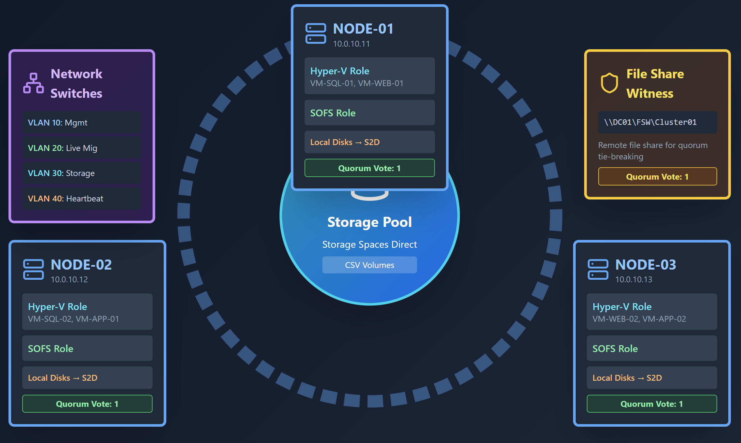
WSFC topology

