Slide 1


Exam AZ-801: Configuring Windows Server Hybrid Advanced Services, 2nd Ed
Tim Warner
Microsoft Certified Trainer and Microsoft MVP

Slide 2

Lesson 23: Monitor with Azure Services
23.1. Configure data collection rules for Azure Monitor
23.2. Create alerts
23.3. Monitor Azure VM performance by using VM Insights
23.4 Manage Windows Server resources with Azure Arc extensions and policies
23.5 Configure Azure Update Manager for hybrid patch orchestration
Notes:
Image credit: Tim + ChatGPT Image Generation

Slide 3
23.1 Configure data collection rules for Azure Monitor

Slide 4
Extend visibility with Azure Monitor and Arc
Azure services provide cloud-scale monitoring and automation
Azure Monitor centralizes logs, metrics, and alerts
VM Insights delivers deep performance telemetry
Azure Arc extends Azure management to on-premises servers
Contoso uses Azure services to unify hybrid monitoring
Notes:
The modern data center spans multiple environments, and Microsoft provides the tools to monitor it all from a single pane of glass.
Azure services provide cloud-scale monitoring and automation: Azure Monitor, VM Insights, Arc, and Update Manager form an integrated platform that works whether your servers live in Azure, on-premises, or across AWS and Google Cloud.
Azure Monitor centralizes logs, metrics, and alerts: Think of Azure Monitor as your unified telemetry hub—performance counters, event logs, application traces, and custom metrics all flow into Log Analytics workspaces where you can query and visualize them with Kusto Query Language or KQL.
VM Insights delivers deep performance telemetry: This is Azure Monitor on steroids specifically for virtual machines—you get granular CPU, memory, disk, and network metrics plus process-level visibility and dependency maps that show network connections between your application tiers.
Azure Arc extends Azure management to on-premises servers: Arc isn't just monitoring—it's the enabling technology that makes your physical servers and VMs in other clouds appear as native Azure resources, complete with extensions, policies, and role-based access control.
Contoso uses Azure services to unify hybrid monitoring: Our fictional enterprise example monitors 500 Azure VMs and 800 on-premises servers through a single Log Analytics workspace, applying the same alert rules and dashboards regardless of where the metal actually lives.
AZ-801 EXAM TIP: Microsoft expects you to articulate the value proposition of Azure Arc—it's not a replacement for traditional monitoring tools but rather an Azure control plane extension. Know that Arc-enabled servers support Azure Policy guest configuration, Microsoft Defender for Cloud, and Update Manager without requiring a VPN or ExpressRoute connection because the agent makes outbound HTTPS connections only.

Slide 5
Gather telemetry with data collection rules (DCRs)
DCRs define which logs and metrics to collect
Supports Windows Server, Linux, and Azure VMs
Multiple destinations: Log Analytics, Azure Storage, Event Hub
Granular filters reduce unnecessary data ingestion
Fabrikam applies DCRs to domain controllers for security auditing
Notes:
Data collection rules represent a fundamental shift in how we configure Azure monitoring—they're declarative infrastructure-as-code resources instead of imperative agent configurations.
DCRs define which logs and metrics to collect: Each DCR specifies data sources like performance counters, Windows Event Logs, or syslog entries, with complete control over sampling intervals and exactly which counters or log levels you want.
Supports Windows Server, Linux, and Azure VMs: The beauty of DCRs is they're platform-agnostic—the same DCR structure works for Windows Server 2012 R2 through Server 2025, modern Linux distributions, and Azure Stack HCI nodes.
Multiple destinations: Log Analytics, Azure Storage, Event Hub: Unlike legacy configurations that locked you into a single destination, DCRs support multiple data flows—send performance metrics to Log Analytics for alerting while simultaneously archiving to cold storage, or stream security events to Event Hub for real-time SIEM integration.
Granular filters reduce unnecessary data ingestion: This is where you save money—DCRs let you filter at the agent level using XPath queries for Windows events or specific performance counter thresholds, so you only pay to ingest what you actually need.
Fabrikam applies DCRs to domain controllers for security auditing: Our example scenario shows a common pattern—create a DCR that collects Security event log entries for audit failures, successful privilege use, and directory service changes, then associate that DCR with all domain controller VMs through Azure Policy.
AZ-801 EXAM TIP: Know the DCR workflow for the exam—create the DCR as an ARM resource, then create a data collection rule association that binds the DCR to target resources using their resource IDs. Understand that DCRs require Azure Monitor Agent or AMA, not the deprecated Microsoft Monitoring Agent or MMA. Be ready for scenario questions about choosing the right data source type—performance counters for metrics, Windows Event Logs for security events, Syslog for Linux.

Slide 6
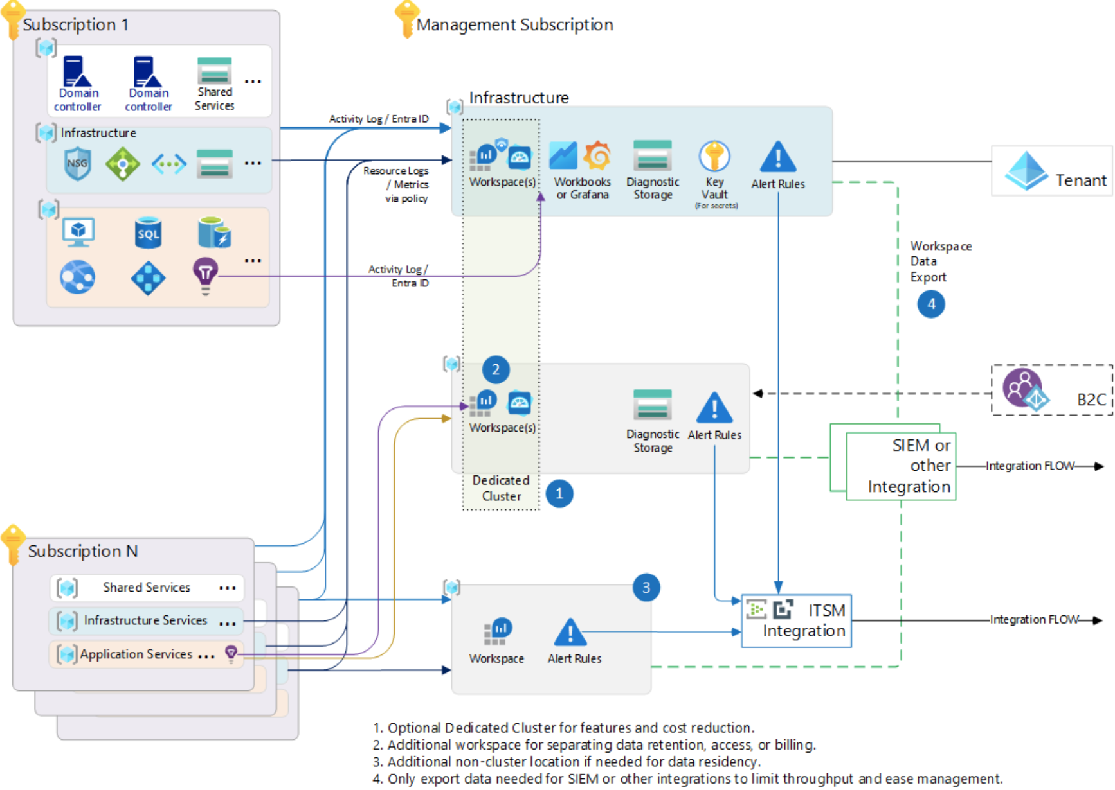
Azure Monitor enterprise architecture
timw.info/monitoring

Slide 7
23.2 Create alerts

Slide 8
Proactively detect issues with Azure alerts
Alerts trigger when thresholds or queries are met
Actions can notify via email, Teams, or ITSM systems
Dynamic thresholds adjust based on baselines
Action groups standardize responses across workloads
Tailwind Traders creates alerts for CPU spikes on hybrid SQL server
Notes:
Alerts transform passive monitoring into active operations—instead of discovering problems when users complain, you detect and respond to issues before they impact the business.
Alerts trigger when thresholds or queries are met: Azure Monitor evaluates your alert rules on a schedule—metric alerts check conditions every one to five minutes, while log query alerts can run as frequently as every minute against your Log Analytics data.
Actions can notify via email, Teams, or ITSM systems: Action groups are the notification and automation engine—configure email, SMS, push notifications to the Azure mobile app, webhooks to trigger Azure Functions or Logic Apps, or direct integration with ServiceNow and other ITSM platforms.
Dynamic thresholds adjust based on baselines: This is machine learning applied to alerting—instead of guessing whether 80% CPU is normal for a given workload, dynamic thresholds analyze historical patterns and alert when current behavior deviates significantly from learned baselines.
Action groups standardize responses across workloads: Create an action group once, then reuse it across hundreds of alert rules—this is how enterprises maintain consistent notification and remediation patterns without duplicating configuration.
Tailwind Traders creates alerts for CPU spikes on hybrid SQL server: Our scenario demonstrates a practical pattern—a metric alert on an Arc-enabled SQL Server that triggers when CPU exceeds 90% for 10 consecutive minutes, firing an action group that pages the DBA team and simultaneously runs a diagnostic collection script.
AZ-801 EXAM TIP: Microsoft tests your knowledge of alert rule types—metric alerts evaluate numeric values from Azure Monitor Metrics, log query alerts evaluate KQL queries against Log Analytics, and activity log alerts trigger on Azure control plane events like VM deletion or NSG changes. Know the severity levels zero through four where zero is critical and four is informational, and understand that alert processing rules let you suppress or modify notifications during maintenance windows without disabling the underlying alert rules.

Slide 9
23.3 Monitor Azure VM performance by using VM Insights

Slide 10
Gain deep visibility with VM Insights
Collects detailed CPU, memory, disk, and network metrics
Dependency map visualizes app-to-app and service relationships
Uses Azure Monitor Agent for data collection
Supports interactive performance charts and queries
Adventure Works leverages VM Insights to troubleshoot app latency
Notes:
VM Insights is your performance analysis powerhouse—it goes far beyond basic metrics to give you the data you need for capacity planning, troubleshooting, and optimization.
Collects detailed CPU, memory, disk, and network metrics: We're talking about granular data here—not just overall CPU percentage but per-core utilization, not just memory total but available bytes and page faults per second, disk latency by volume, and network throughput by adapter.
Dependency map visualizes app-to-app and service relationships: The dependency agent running on your VMs discovers all TCP connections, showing you which servers talk to your domain controllers, which web servers connect to which database servers, and what external services your applications depend on—this is invaluable during migration planning and outage troubleshooting.
Uses Azure Monitor Agent for data collection: VM Insights has migrated to the modern AMA architecture, which means it leverages data collection rules and supports both Azure VMs and Arc-enabled servers with the same agent stack.
Supports interactive performance charts and queries: The VM Insights portal experience provides pre-built performance views with time range selection and filtering, but you can also drop into KQL queries against the InsightsMetrics table when you need custom analysis.
Adventure Works leverages VM Insights to troubleshoot app latency: Picture this scenario—users report slow application response times, the infrastructure team enables VM Insights across the app tier, and the dependency map immediately reveals that the web servers are making excessive connections to a single database replica that's saturated, leading to a load balancing configuration fix.
AZ-801 EXAM TIP: For the exam, know that VM Insights stores data in three specific Log Analytics tables—InsightsMetrics for performance data, VMProcess for running processes, and VMConnection for network connections. Understand that enabling VM Insights requires associating a VM with a specific DCR that Microsoft creates automatically when you enable through the portal. Be ready for questions about the dependency agent, which is optional but required for the dependency map feature, and know that it can take 10 to 15 minutes after enabling before you see data appear in the portal.

Slide 11
23.4 Manage Windows Server resources with Azure Arc extensions and policies

Slide 12
Govern hybrid servers with Azure Arc
Azure Arc projects on-premises servers into Azure for management
Extensions deploy monitoring, security, and configuration tools
Azure Policy enforces compliance across hybrid infrastructure
Role-based access controls secure delegated management
Fabrikam manages 300 on-prem servers consistently with Arc policies
Notes:
Azure Arc represents Microsoft's vision for hybrid and multi-cloud management—it brings the Azure control plane to infrastructure running anywhere.
Azure Arc projects on-premises servers into Azure for management: When you onboard a server to Arc, it becomes a first-class Azure resource with its own resource ID, visible in the Azure portal, queryable through Resource Graph, and manageable through ARM templates and Bicep.
Extensions deploy monitoring, security, and configuration tools: Arc-enabled servers support VM extensions just like native Azure VMs—install Azure Monitor Agent, Microsoft Defender for Endpoint, custom script extensions, and Log Analytics without building complex deployment pipelines or managing agent packages.
Azure Policy enforces compliance across hybrid infrastructure: This is governance at scale—assign Azure Policy definitions that check for and remediate configuration drift, enforce tagging standards, ensure security agents are installed, and audit compliance across thousands of servers regardless of where they physically run.
Role-based access controls secure delegated management: Arc resources respect Azure RBAC, so you can grant the networking team contributor rights to Arc servers in the network resource group while giving the database team only read access, all managed through Azure Active Directory now called Microsoft Entra ID.
Fabrikam manages 300 on-prem servers consistently with Arc policies: Our example enterprise assigns a policy initiative that requires all Arc servers to have Azure Monitor Agent installed, security logs flowing to their SIEM, and Microsoft Defender for Servers enabled, with automatic remediation tasks that deploy missing components.
AZ-801 EXAM TIP: Know the Arc onboarding process for the exam—download the Connected Machine agent installer, run azcmagent connect with appropriate parameters including subscription, resource group, and region, and understand that Arc agents make outbound HTTPS connections only so no inbound firewall rules are required. Be aware that Arc-enabled servers support Azure Update Manager, VM extensions, Azure Policy guest configuration, and Microsoft Defender for Cloud. Understand the pricing model—Arc for servers is free, but the services you layer on top like Update Manager and Defender have their own costs.

Slide 13
23.5 Configure Azure Update Manager for hybrid patch orchestration

Slide 14
Streamline patching with Azure Update Manager
Unified update management for Azure and Arc-enabled servers
Schedule patch windows by group or workload type
Pre/post scripts customize update workflows
Compliance reports confirm patch status across environments
Contoso orchestrates monthly patching across global fleet
Notes:
Azure Update Manager represents the evolution of Azure's update management capabilities, consolidating and improving what was previously spread across multiple services.
Unified update management for Azure and Arc-enabled servers: Update Manager works natively with both Azure VMs and Arc-enabled servers, giving you a single interface and API for patch management whether your servers run in Azure, on-premises, or in other clouds.
Schedule patch windows by group or workload type: Create maintenance configurations that define when patches should be installed—separate schedules for development versus production, different windows for web servers versus database servers, or staggered deployments across geographic regions.
Pre/post scripts customize update workflows: Hook into the patching process by running PowerShell scripts before updates to drain load balancer pools or backup databases, and after updates to validate application health and return servers to service.
Compliance reports confirm patch status across environments: Update Manager provides centralized visibility into patch compliance—see which servers are missing critical updates, track patching success rates, and export compliance data for audit requirements.
Contoso orchestrates monthly patching across global fleet: Our scenario shows an enterprise pattern—maintenance configurations that patch dev/test on the first Tuesday, UAT servers on the second Tuesday, and production on the third Tuesday, with Patch Tuesday plus seven to ten days giving you time to test Microsoft's monthly rollup.
AZ-801 EXAM TIP: Microsoft expects you to know that Update Manager replaces the deprecated Azure Automation Update Management solution—don't confuse the two on exam questions. Understand that Update Manager leverages maintenance configurations which are Azure resources that define patching schedules and can be associated with multiple VMs through Azure Policy. Know the assessment versus deployment distinction—assessments scan for available updates without installing them, while deployments actually apply patches. Be aware that Update Manager for Arc-enabled servers requires the Arc agent and supports Windows Server 2012 R2 and later.

