Slide 1


Exam AZ-801: Configuring Windows Server Hybrid Advanced Services, 2nd Ed
Tim Warner
Microsoft Certified Trainer and Microsoft MVP

Slide 2

Lesson 2: Secure Local Accounts and Passwords
2.1. Implement Windows Local Administrator Password Solution
2.2. Configure password policies
2.3. Implement Microsoft Entra Password Protection for AD DS
Notes:
Image credit: Tim + ChatGPT Image Generation

Slide 3
2.1 Implement Windows Local Administrator Password Solution

Slide 4
Bridging from Lesson 1 (Core OS Security)
Secured-core Server is a Microsoft spec/badge/qualification that requires substantial server hardware investment
We can qualify our machines by using PowerShell and configure with Group Policy
OSConfig is a security-specific “easy button” for server state configuration
  One-command apply Security Compliance Toolkit (SCT) scenarios
  PowerShell DSC is the “custom install” option
Notes:
Framing: We’re going to look at how modern tools can shift password security from manual & risky to automated, adaptive, and much more resilient.
Legacy password practices create risk and overhead
If you reuse local Administrator passwords, or use weak domain password settings across all users, one breach gives attackers a lot of leverage. The help desk gets bogged down, audits fail, and compliance becomes a gamble.
Windows LAPS automates local admin password rotation
LAPS gives each machine its own unique local-admin password, rotates it on schedule, and ensures it’s stored securely—no more shared credentials floating around.
Fine-grained password policies tailor rules to user groups
Instead of one flat policy, you can have different rules for executives vs service accounts vs standard users—length, complexity, history, lockout thresholds all vary.
Microsoft Entra Password Protection blocks weak passwords
Cloud-curated lists + custom banned terms work together to stop easily guessable or breached passwords. Once enforced, DC agents reject bad password choices; until then, you can audit to see what needs adjusting.
Hybrid integration improves overall security posture
When you combine LAPS, fine-grained policies, and Entra Password Protection, you cover more attack surfaces, reduce manual effort, and get better visibility. That’s what real enterprise security looks like in a hybrid world.
Exam tip: If you see “what’s the solution to stop shared local Administrator passwords?” on the exam—Windows LAPS is the answer.

Slide 5
Strengthen AuthN with modern password management
Legacy password practices create risk and overhead
Windows LAPS automates local admin password rotation
Fine-grained password policies tailor rules to user groups
Microsoft Entra Password Protection blocks weak passwords
Hybrid integration improves overall security posture
Notes:
Framing: We’re going to look at how modern tools can shift password security from manual & risky to automated, adaptive, and much more resilient.
Legacy password practices create risk and overhead
If you reuse local Administrator passwords, or use weak domain password settings across all users, one breach gives attackers a lot of leverage. The help desk gets bogged down, audits fail, and compliance becomes a gamble.
Windows LAPS automates local admin password rotation
LAPS gives each machine its own unique local-admin password, rotates it on schedule, and ensures it’s stored securely—no more shared credentials floating around.
Fine-grained password policies tailor rules to user groups
Instead of one flat policy, you can have different rules for executives vs service accounts vs standard users—length, complexity, history, lockout thresholds all vary.
Microsoft Entra Password Protection blocks weak passwords
Cloud-curated lists + custom banned terms work together to stop easily guessable or breached passwords. Once enforced, DC agents reject bad password choices; until then, you can audit to see what needs adjusting.
Hybrid integration improves overall security posture
When you combine LAPS, fine-grained policies, and Entra Password Protection, you cover more attack surfaces, reduce manual effort, and get better visibility. That’s what real enterprise security looks like in a hybrid world.
Exam tip: If you see “what’s the solution to stop shared local Administrator passwords?” on the exam—Windows LAPS is the answer.

Slide 6
Manage local admin passwords automatically
Windows LAPS replaces legacy LAPS with modern integration
Supports both on-prem AD and Microsoft Entra ID
Passwords rotate automatically with configurable complexity
Secure retrieval via Windows Admin Center or PowerShell
Adventure Works enforces just-in-time emergency access for admins
Notes:
Framing: Let’s zoom in on LAPS—how to set it up, what it really gives you, and why it’s integral to modern password hygiene.
Windows LAPS replaces legacy LAPS with modern integration
The newer version works well both on-prem AD and Microsoft Entra ID, so you can manage devices in hybrid or cloud-joined forests.
Supports both on-prem AD and Microsoft Entra ID
Devices joined only to Entra ID or hybrid joined can also back up their local admin password to Entra ID, so retrieval can be centrally managed with role-based access.
Passwords rotate automatically with configurable complexity
You pick the interval when passwords expire (say 30 days), the minimum length, character sets—and LAPS handles the rest without human intervention.
Secure retrieval via Windows Admin Center or PowerShell
Admins don’t have to RDP into machines; they pull passwords securely via tools, with permissions tightly controlled.
Adventure Works enforces just-in-time access for admins
Rather than giving standing local admin rights, techs request temporary access or retrieve passwords only when necessary, reducing exposure.
💡 Exam Tip: LAPS often shows up in case study questions. Remember: it rotates local admin passwords and stores them securely in AD or Entra.

Slide 7
2.2 Configure password policies

Slide 8
Apply different password requirements to user groups
Fine-grained password policies (FGPP) extend beyond domain defaults
Password Setting Objects (PSOs) define unique rules
Precedence values resolve conflicts across groups
History and minimum age settings prevent rapid reuse
Contoso applies stronger policies for executives vs. service accounts
Notes:
Framing: Now we shift from local admin passwords to user account passwords—and how to make them smarter per user type.
Fine-grained password policies (FGPP) extend beyond domain defaults
Instead of everybody being under the same restriction, you define specific policies for groups that need stronger protection.
Password Setting Objects (PSOs) define unique rules
A PSO is an AD object that holds your tailored policy—min length, complexity, lockout behavior, history—and you apply it to a security group or individual user.
Precedence values resolve conflicts across groups
If a user is in two groups with different PSOs, the PSO with the lower numerical precedence value takes effect. Plan them so important users get the strictest one.
History and minimum age settings prevent rapid reuse
You don’t want someone changing their password 5 times in a row just to get back to “Password1!”. Enforce history and minimum age so reused or trivial passwords are blocked.
Contoso applies stronger policies for executives vs. service accounts
For example, executives may need 14-character complex passwords, frequent rotation; service accounts might get special exemption patterns but still basic guardrails.

Slide 9
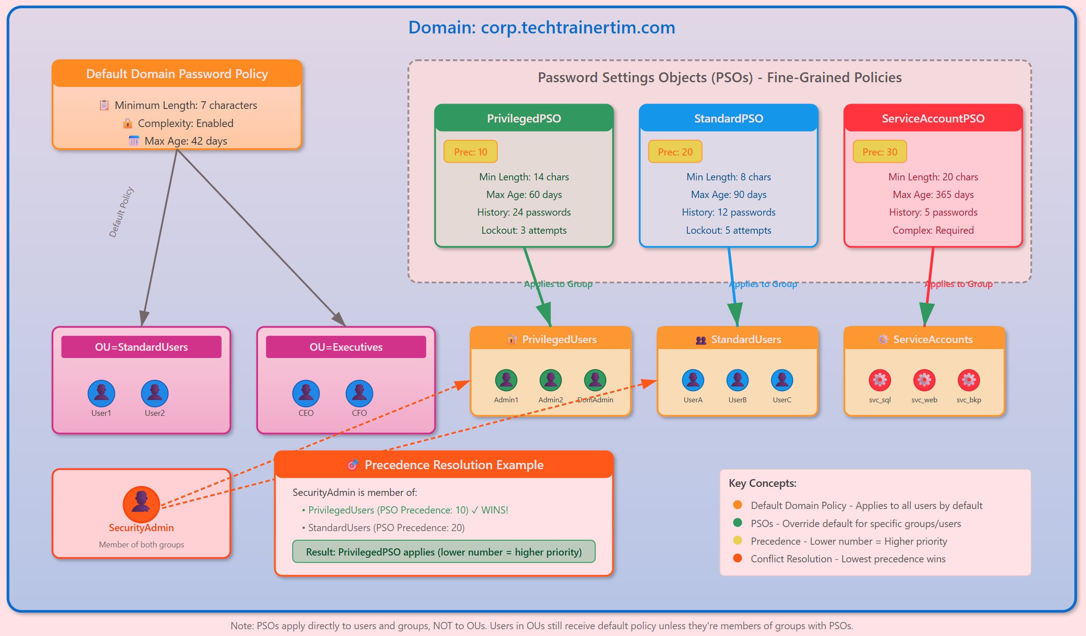
Fine-Grained Password Policy (FGPP)
Notes:
Infographic made by Tim with Claude AI, all rights are his.

Slide 10
2.3 Implement Microsoft Entra Password Protection for AD DS
Notes:
Now let’s talk about tailoring password policies with more precision.
Fine-grained password policies (FGPP) extend beyond domain defaults. The old way was “one policy for everyone.” FGPP lets us break that limitation.
Password Setting Objects (PSOs) define unique rules. A PSO is just an object in AD that spells out length, complexity, history, and lockout rules.
Precedence values resolve conflicts across groups. If a user belongs to multiple groups with different PSOs, the one with the highest priority (lowest number) wins.
History and minimum age settings prevent rapid reuse. These rules stop clever users from flipping back to their favorite weak password.
Contoso applies stronger policies for executives vs. service accounts. For example, executives get a 16-character minimum and frequent rotations, while service accounts use a slightly different baseline.
💡 Exam Tip: Expect a “which setting wins” type of question. If multiple PSOs apply, the lowest precedence number takes effect.

Slide 11
Prevent weak passwords with Entra Password Protection
Microsoft Entra Password Protection
DC agents enforce banned password lists during password changes
Proxy services connect on-prem AD to Microsoft Entra
Global list blocks millions of common weak passwords
Custom lists stop organization-specific weak terms
Fabrikam monitors password protection events in the Azure portal
Notes:
Framing: Finally, let’s add the blocking element—stop weak or compromised passwords before they become a problem.
Microsoft Entra Password Protection
This is the service that gives you both the global banned list (crowdsourced from known passwords) and tools to define your custom banned list.
DC agents enforce banned password lists during password changes
When a user changes or resets a password on-prem, the Domain Controller agent checks against the banned lists and, if in enforce mode, rejects bad choices.
Proxy services connect on-prem AD to Microsoft Entra
Because DCs often don’t talk directly to public endpoints, the proxy bridges that gap; it ensures policy sync and central control.
Global list blocks millions of common weak passwords
Microsoft maintains a huge corpus of breached / weak password terms—ones that show up over and over—so you get protection from broadly known bad actors.
Custom lists stop organization-specific weak terms
Terms like your company name, product names, or seasonal phrases get banned via custom lists so users can’t pick “AdventureWorks2025!” or “Tailwind123!” if those are obvious in your environment.
Fabrikam monitors password protection events in the Azure portal
Before enforcing, you review logs—how many users tried bad passwords, where those attempts came from. Audit mode helps you tune policy without surprising your users.
💡 Exam Tip: Know the difference between domain password policy vs. fine-grained policy vs. Entra Password Protection. Entra is the only one that blocks weak words dynamically.

Slide 12
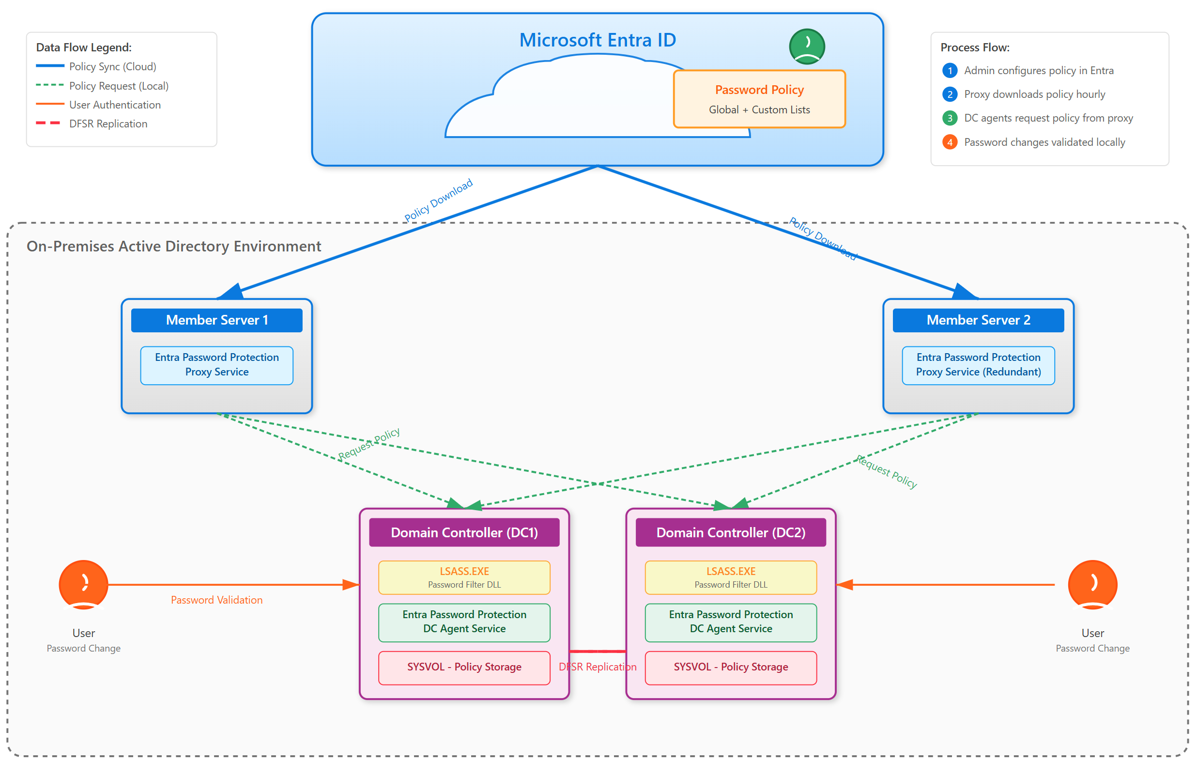
Entra Password Protection architecture
Notes:
Infographic made by Tim with Claude AI, all rights are his.

Slide 13
Diagram title in sentence case
go.techtrainertim.com/blah

