Slide 1


Exam AZ-801: Configuring Windows Server Hybrid Advanced Services, 2nd Ed
Tim Warner
Microsoft Certified Trainer and Microsoft MVP

Slide 2

Lesson 3: Manage Protected Users and RODCs
3.1. Manage protected users
3.2. Manage account security on a Read-Only Domain controller (RODC)
3.3. Harden domain controllers
Notes:
Image credit: Tim + ChatGPT Image Generation

Slide 3
3.1 Manage protected users

Slide 4
Enhance domain security with advanced protection features
Domain controllers are prime attack targets
Protected Users group enforces stricter authentication
Read-Only Domain Controllers (RODCs) reduce branch office risk
Hardening techniques defend against credential theft
Tailwind Traders raises the bar for privileged account protection
Notes:
This slide sets the big picture: domain controllers are prime targets. If attackers compromise one, they can control your whole Active Directory forest. Here are the tools and approaches we’ll focus on to raise the bar.
Domain controllers are prime attack targets. Every attacker knows the DC (domain controller) is where the crown jewels are stored. If you can dump credentials or modify group memberships there, you own the environment.
Protected Users group enforces stricter authentication. Microsoft built this group to make sure privileged accounts don’t use weak, legacy protocols. Membership here cuts off NTLM (NT LAN Manager) and older encryption types, forcing Kerberos-only authentication.
Read-Only Domain Controllers reduce branch office risk. In places where physical security is weak, like branch offices, an RODC (Read-Only Domain Controller) is safer. It hosts a read-only AD database, and only caches passwords for accounts you explicitly allow.
Hardening techniques defend against credential theft. Features like Restricted Admin mode and LSASS (Local Security Authority Subsystem Service) protection reduce the chance of tools like Mimikatz succeeding.
Tailwind Traders raises the bar for privileged account protection. In our fictional company example, Tailwind Traders has combined Protected Users and RODCs with DC hardening, making their privileged accounts much tougher targets.
💡 Exam Tip: On AZ-801, watch for scenarios about remote branch offices or cached credentials. The safe answer will often be: deploy an RODC and limit which passwords are allowed to replicate.

Slide 5
Enforce enhanced authentication for privileged accounts
Protected Users group requires Kerberos-only authentication
Blocks NTLM, DES, and RC4 for group members
Prevents credential delegation and local caching
Requires Windows Server 2012 R2 domain functional level or higher
Adventure Works adds domain admins to Protected Users to cut token lifetimes
Notes:
The Protected Users group is Microsoft’s way of enforcing stricter rules for high-value accounts.
First, it requires Kerberos-only authentication. That means older protocols like NTLM (NT LAN Manager), DES (Data Encryption Standard), and RC4 aren’t allowed. These are legacy and often exploited.
Second, credentials can’t be cached locally or delegated to other services. That’s a huge win against pass-the-hash and pass-the-ticket attacks.
To use it, your domain must be running at least Windows Server 2012 R2 functional level.
A practical example: Adventure Works moved their domain admins into Protected Users. The result? Shorter ticket lifetimes and less risk if an admin account is stolen.
💡 Exam Tip: If you see an exam scenario about stopping cached credentials or legacy auth methods, the Protected Users group is the answer.

Slide 6
3.2 Manage account security on a Read-Only Domain controller (RODC)

Slide 7
Deploy domain controllers with limited attack surface
Read-Only Domain Controllers (RODCs) host a read-only copy of Active Directory
Password Replication Policy (PRP) controls cached credentials
Unidirectional replication blocks unauthorized directory changes
Ideal for Contoso’s branch offices with limited physical security
Supports read-only DNS and SYSVOL for local resiliency
Notes:
Slide: Deploy domain controllers with limited attack surface
Framing: Branch offices are tricky: they often don’t have the same physical security as headquarters. That’s exactly where Read-Only Domain Controllers (RODCs) shine. This slide covers how they reduce risk without sacrificing functionality.
Read-Only Domain Controllers (RODCs) host a read-only copy of Active Directory. Think of it as a “look but don’t touch” domain controller. Even if an attacker compromises the server, they can’t change group memberships, create accounts, or modify the AD database.
Password Replication Policy (PRP) controls cached credentials. With PRP, you decide which accounts can have their credentials cached locally. By default, sensitive accounts like Domain Admins are denied. That way, if someone steals the RODC, they can’t log on as an admin.
Unidirectional replication blocks unauthorized directory changes. Replication only flows one way — from a writable domain controller down to the RODC. No changes ever replicate back up. This one-way design prevents poisoned data from spreading through the forest.
Ideal for Contoso’s branch offices with limited physical security. In our scenario, Contoso can safely deploy domain services to a small office in a strip mall — where you might worry about break-ins — without risking the entire corporate forest.
Supports read-only DNS and SYSVOL for local resiliency. The RODC also delivers read-only DNS services and SYSVOL replication. That means branch users can still resolve names and access logon scripts or Group Policy, even if the WAN link is flaky.
💡 Exam Tip: On AZ-801, if the scenario mentions “stolen server hardware in a branch office,” the right solution is a Read-Only Domain Controller. Microsoft loves to test that specific branch-office risk scenario.

Slide 8
3.3 Harden domain controllers

Slide 9
Reduce attack surface with domain controller hardening
Restricted Admin mode prevents credential exposure via RDP
Protected Process Light (PPL) protects LSASS from memory attacks
LSA protection blocks unauthorized code injection
Attack Surface Reduction rules mitigate common exploits
Fabrikam continuously audits DCs for drift from baseline security
Notes:
Slide: Reduce attack surface with domain controller hardening
Even with Protected Users and Read-Only Domain Controllers in place, domain controllers themselves remain high-value targets. Hardening them directly is non-negotiable. This slide highlights key techniques that limit credential theft and keep attackers from moving laterally.
Restricted Admin mode prevents credential exposure via RDP. When you remote into a DC using Remote Desktop Protocol, your credentials normally get stored in memory. Restricted Admin mode stops this by authenticating with the machine account instead of your user account — so nothing reusable is left behind.
Protected Process Light (PPL) protects LSASS from memory attacks. LSASS (Local Security Authority Subsystem Service) is where Windows stores cached credentials. Tools like Mimikatz target it directly. Running LSASS as a protected process means only trusted, signed code can access it, shutting down many common credential-dumping attacks.
LSA protection blocks unauthorized code injection. The Local Security Authority (LSA) is another frequent attack vector. Enabling LSA protection tells Windows to reject unsigned code and drivers, dramatically reducing the risk of attackers injecting malicious modules.
Attack Surface Reduction (ASR) rules mitigate common exploits. These rules, part of Microsoft Defender, apply behavior-based controls. For example, they can stop Office apps from spawning child processes, or block script execution paths attackers commonly use.
Fabrikam continuously audits DCs for drift from baseline security. In our fictional company example, Fabrikam enforces a standard security baseline for DCs. Regular audits ensure that if someone disables a protection setting or installs unauthorized software, it’s caught quickly and remediated.
💡 Exam Tip: Expect AZ-801 to test which hardening feature stops pass-the-hash or LSASS credential dumping. The safe bets are Protected Process Light and LSA protection.

Slide 10
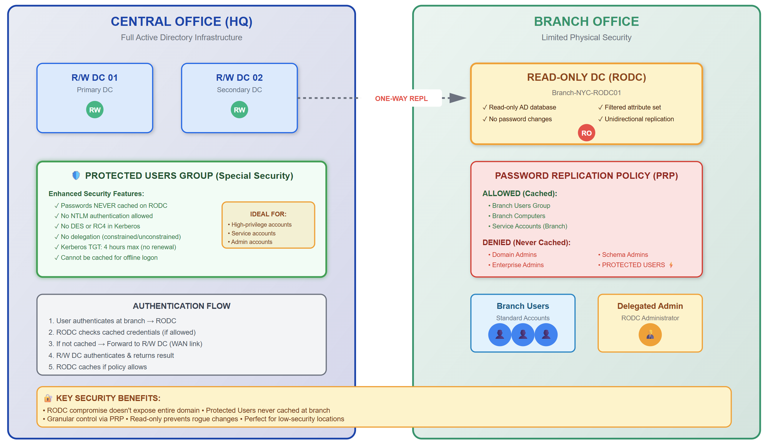
RODC branch office architecture
Notes:
Image credit: Tim + Claude AI

