Slide 1


Exam AZ-801: Configuring Windows Server Hybrid Advanced Services, 2nd Ed
Tim Warner
Microsoft Certified Trainer and Microsoft MVP

Slide 2

Lesson 6: Secure Windows Server Networking
6.1. Manage Windows Defender Firewall
6.2. Implement domain isolation
6.3. Implement connection security rules
6.4. Create and configure network security groups (NSGs) for Windows Server virtual machines on Azure
Notes:
Image credit: Tim + ChatGPT Image Generation

Slide 3
6.1 Manage Windows Defender Firewall

Slide 4
Control network access with WDF
Windows Defender Firewall (WDF)
Profiles (Domain, Private, Public) adapt to network context
Inbound and outbound rules filter traffic at host level
PowerShell automates firewall configuration at scale
Group Policy enforces consistent firewall baselines
Adventure Works logs firewall events for auditing
Notes:
Framing: Time to master Windows Defender Firewall — the unsung hero protecting Windows servers while everyone shops for expensive appliances.
Windows Defender Firewall (WDF) WDF tracks connection state and makes intelligent decisions based on whether traffic is part of an established session. It understands full conversation context, not just individual packets.
Profiles (Domain, Private, Public) adapt to network context When your server detects the corporate domain, it applies relaxed internal rules. Move to an untrusted network, and the Public profile automatically locks everything down.
Inbound and outbound rules filter traffic at host level You're not just blocking incoming attacks — you're preventing data exfiltration by controlling what leaves your servers. Every rule can specify protocols, ports, programs, users, and IPsec requirements.
PowerShell automates firewall configuration at scale With cmdlets like New-NetFirewallRule, you can deploy complex configurations to hundreds of servers in minutes. Infrastructure as code for your firewall policies.
Group Policy enforces consistent firewall baselines One GPO ensures every domain server gets identical firewall rules, automatically applied and continuously enforced. Manual configuration drift becomes impossible.
Adventure Works logs firewall events for auditing They log every blocked connection and every access to sensitive services. When auditors ask "who accessed what," you have forensic-level detail ready.
💡 Exam Tip: Watch for "allowing RDP only from jump boxes." The answer involves creating inbound rules with source IP restrictions, deployed through Group Policy.

Slide 5
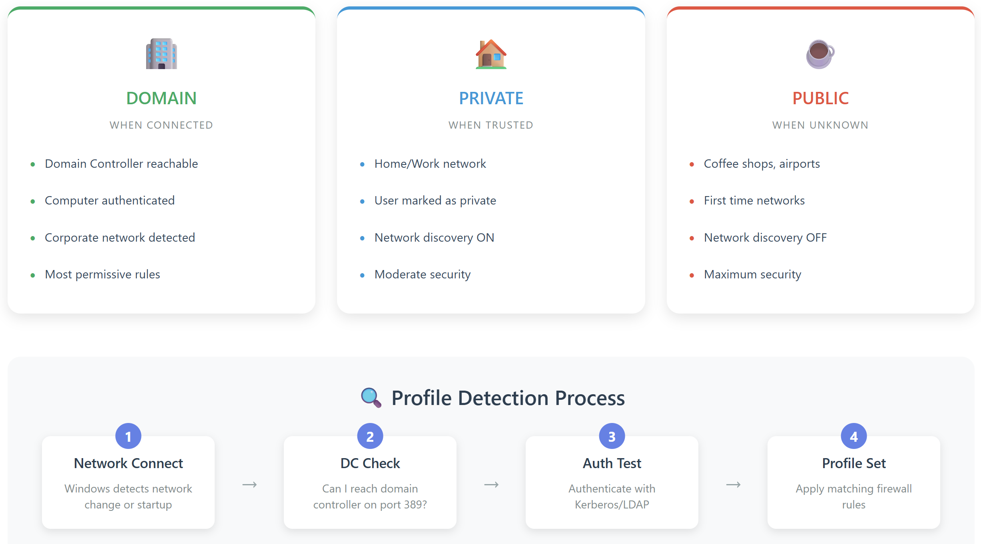
Windows Firewall NLA in action
Notes:
Image credit: Tim + Claude AI
“Windows Firewall doesn’t just guess which rules to apply — the Network Location Awareness service, or NLA, makes that call.
On the left, if the computer can reach a domain controller and successfully authenticate, NLA knows we’re on the corporate LAN. That’s the Domain profile — most permissive, since we’re in a managed environment.
In the middle, if we’re not domain-joined but we or policy mark the network as trusted, NLA applies the Private profile — good for home or office, with moderate security and network discovery turned on.
On the right, if the network is brand new or looks untrusted, NLA sets the Public profile. That’s maximum lockdown — network discovery is off, and it’s what you want at the coffee shop or airport.
Now, look at the bottom flow: NLA kicks in whenever Windows detects a network connection or change. First, it does a DC check — can I reach a domain controller on LDAP port 389? Next, it runs an authentication test with Kerberos or LDAP. If that succeeds, Domain profile wins. If not, we fall back to Private or Public.
Finally, it applies the matching firewall rule set.
That’s how Windows Firewall dynamically adjusts security — NLA evaluates the environment, then flips profiles automatically.”

Slide 6
6.2 Implement domain isolation

Slide 7
Enforce trusted boundaries with domain isolation
IPsec authenticates and encrypts all domain traffic
Server isolation policies restrict access to sensitive systems
Authentication exemptions handle legacy or non-domain devices
Certificate-based auth strengthens identity verification
Contoso segments production servers from test environments
Notes:
Framing: Domain isolation is an invisible moat around your domain-joined computers. IPsec and Kerberos create network boundaries that follow Active Directory trust, not VLANs.
IPsec authenticates and encrypts all domain traffic Every packet gets mutual authentication using Kerberos, followed by ESP encryption. It's a private encrypted tunnel for every connection.
Server isolation policies restrict access to sensitive systems Domain isolation keeps outsiders out, but server isolation goes further — only specific accounts or computers can connect. Your SQL Server only accepts connections from web servers.
Authentication exemptions handle legacy or non-domain devices That ancient printer that can't do IPsec gets a specific exemption, identified by IP or MAC address. You punch controlled holes in your isolation policy.
Certificate-based auth strengthens identity verification Critical servers can require both Kerberos and a specific certificate — two-factor authentication at the network level.
Contoso segments production servers from test environments Even if someone misconfigures a connection string, the network itself refuses connections from test to production systems.
💡 Exam Tip: Microsoft loves "non-domain computers must be prevented from connecting to file servers." That's domain isolation using Request Authentication rules in Windows Defender Firewall with Advanced Security.

Slide 8
6.3 Implement connection security rules

Slide 9
Secure data in transit with IPsec rules
Connection security rules establish authenticated channels
Authentication methods include Kerberos, certs, pre-shared keys
Encryption ensures confidentiality and integrity of data
NAT traversal allows secure comms across network address translation
Fabrikam configures Quick Mode and Main Mode settings for VPN traffic
Notes:
Framing: Connection security rules mandate encryption and authentication for specific traffic flows without rebuilding your network.
Connection security rules establish authenticated channels These rules require proof of identity with Kerberos and encryption with AES before the first data packet flows.
Authentication methods include Kerberos, certs, pre-shared keys Domain members use Kerberos by default. Add certificates for extra security or pre-shared keys for non-domain devices. Each method fits different security needs.
Encryption ensures confidentiality and integrity of data Rules don't just authenticate — they encrypt using ESP with AES-256. Your data travels in encrypted tunnels that prevent eavesdropping and tampering.
NAT traversal allows secure comms across network address translation Connection security rules include NAT-T support that encapsulates IPsec in UDP port 4500. Secure connections work across complex network topologies.
Fabrikam configures Quick Mode and Main Mode settings for VPN traffic They fine-tune IPsec parameters for both security and performance — Main Mode for security associations, Quick Mode for data protection.
💡 Exam Tip: Look for "requiring encryption for database traffic." Create connection security rules requiring authentication and encryption, combined with firewall rules blocking non-IPsec traffic.

Slide 10
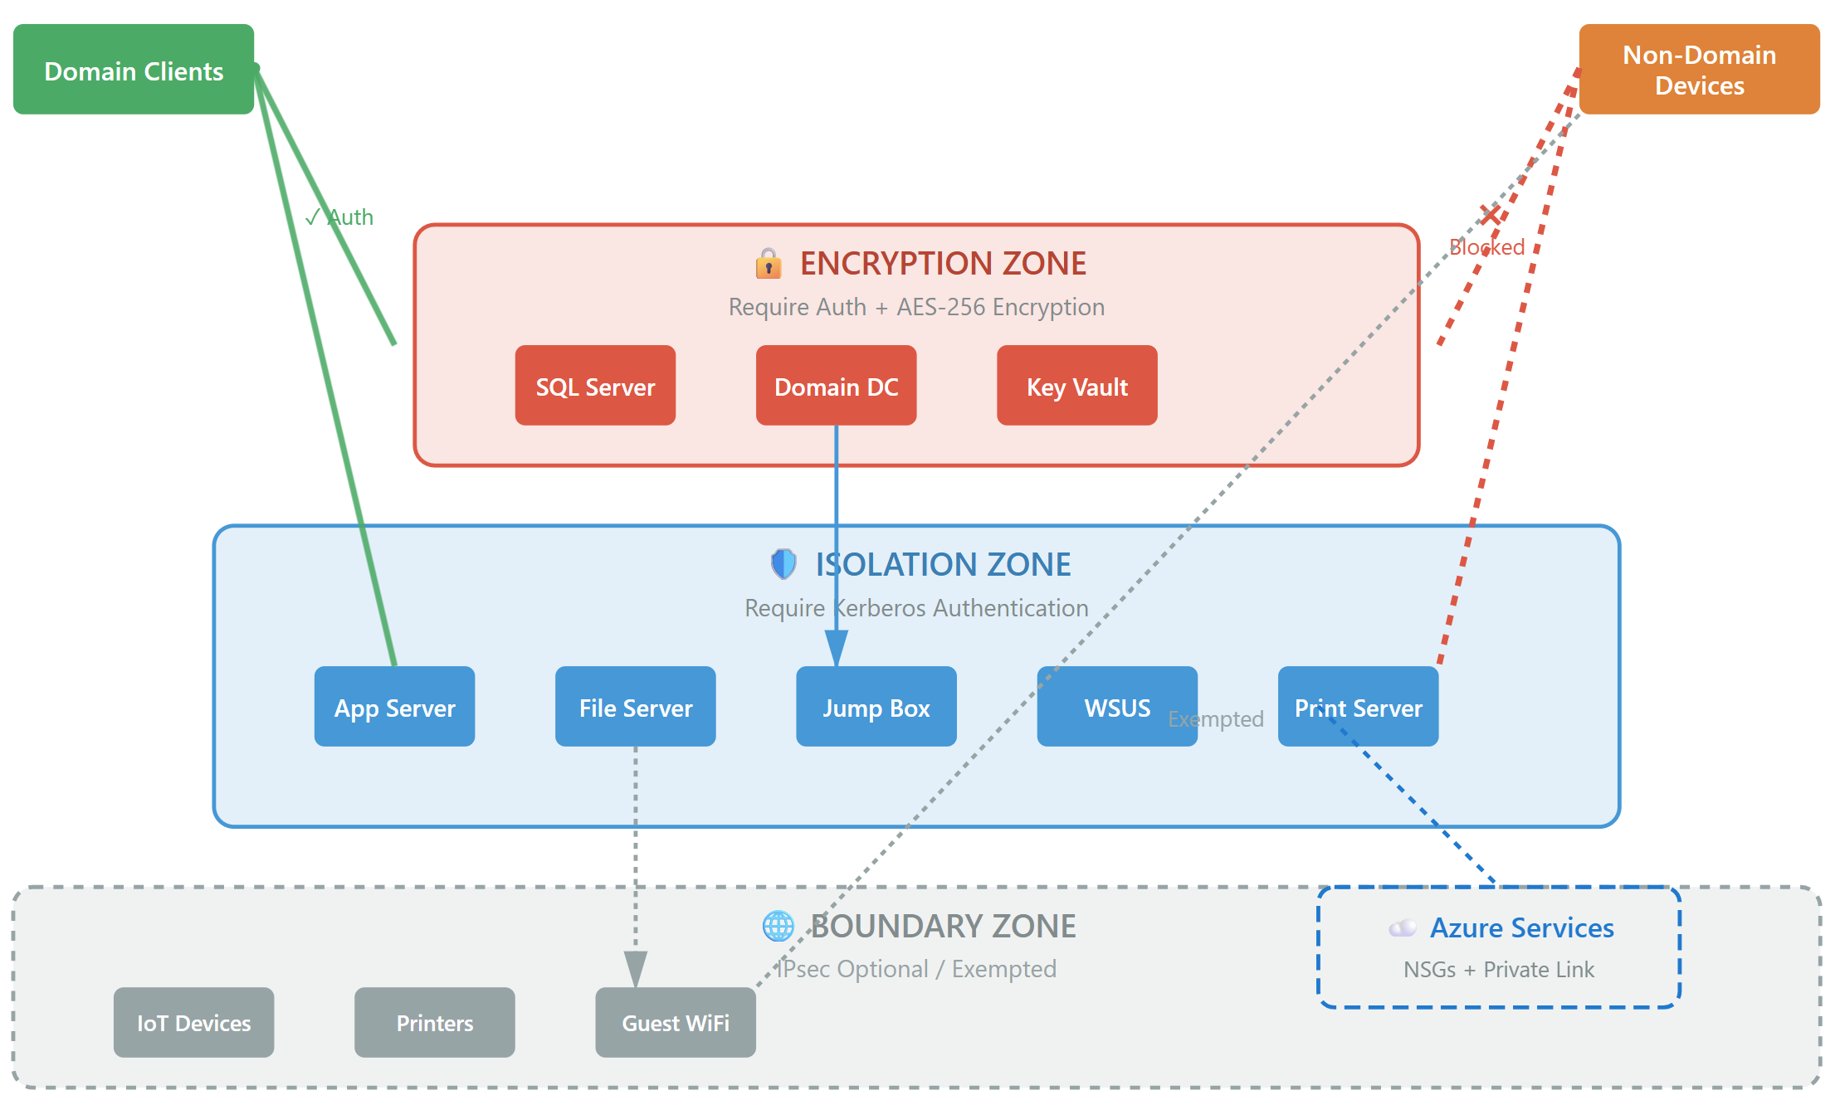
Connection Security Rules in action
Notes:
Image: Created and owned by Tim Warner with assistance from Claude AI
Alright, three zones, three security levels — that's the modern IPsec architecture.
Start at the top. Domain Clients on the left have Kerberos tickets. Non-Domain Devices on the right? They've got nothing. Watch what happens.
Red zone — your crown jewels. Domain Controllers, SQL Servers, Key Vault. These demand authentication plus AES-256 encryption. Domain clients get the green light straight through. Non-domain devices? See that red X? Blocked completely. They can't even knock on the door.
Blue zone — your everyday servers. App servers, file servers, jump boxes. These require Kerberos authentication but skip encryption for performance. Domain clients sail through. Non-domain devices hit another wall — access denied.
Gray zone at the bottom — your legacy junk. Old printers, IoT devices, guest WiFi. IPsec is optional because half this stuff runs firmware from 2002. Even non-domain devices can reach these. It's your demilitarized zone for ancient tech.
See Azure Services on the right? This isn't just on-prem — your NSGs in Azure follow the same pattern.
Here's the magic: Zero firewall rules. Zero IP management. Just Group Policy saying 'if you're domain-joined, you're in. If not, you're out.' Simple, scalable, bulletproof."

Slide 11
6.4 Create and configure network security groups (NSGs) for Windows Server virtual machines on Azure

Slide 12
Protect Azure VMs with network security groups
NSGs act as distributed firewalls at NIC and subnet levels
Application security groups simplify management by workload type
Service tags represent trusted Microsoft services
(e.g., AzureStorage)
Priority rules determine evaluation order and enforcement
Tailwind Traders analyzes NSG flow logs to detect blocked traffic
Notes:
Slide: Create and configure network security groups (NSGs) for Windows Server virtual machines on Azure
Framing: Network Security Groups are cloud-native firewalls in Azure, filtering traffic at the fabric level before it reaches your VMs.
NSGs act as distributed firewalls at NIC and subnet levels Unlike edge firewalls, NSGs attach directly to network interfaces or subnets. Every VM gets personal firewall rules that follow it anywhere in Azure.
Application security groups simplify management by workload type Instead of maintaining changing IP lists, tag VMs as "WebServers" or "DatabaseServers" and write rules using logical groups. Scaling VMs automatically inherit the right rules.
Service tags represent trusted Microsoft services (e.g., AzureBackup) Rather than tracking IP ranges, use tags like "Storage.WestUS" or "AzureActiveDirectory" in your rules. Microsoft maintains these ranges for you.
Priority rules determine evaluation order and enforcement Rules process from 100 to 4096, lower numbers first. Once a rule matches, processing stops — put your most specific rules at the lowest priorities.
Tailwind Traders analyzes NSG flow logs to detect blocked traffic They send flow logs to Log Analytics to identify suspicious patterns, seeing every allowed and denied connection across their Azure infrastructure.
💡 Exam Tip: Microsoft asks about "allowing Azure Backup while blocking internet." Use service tags — allow "AzureBackup" while denying "Internet." No IP maintenance required.

Slide 13
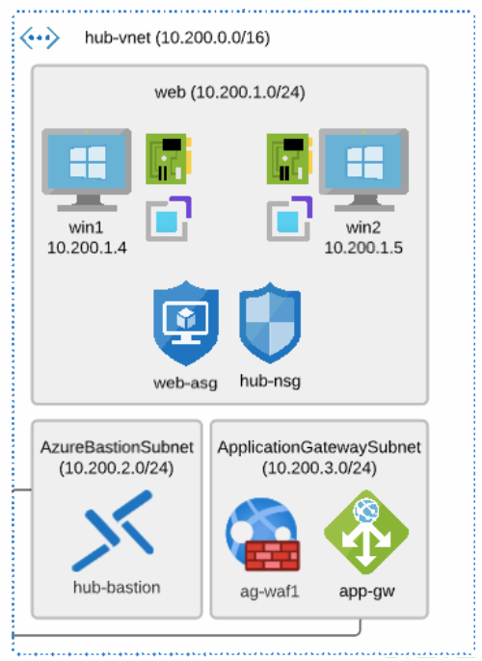
Azure NSGs in action
Notes:
Image credit: Tim’s own work in Visio

