Slide 1

Exam AZ-801: Configuring Windows Server Hybrid Advanced Services Crash Course
Tim Warner
@TechTrainerTim

Slide 2


Tim Warner
Based in Nashville, TN, US
Central time zone
MCT, MVP
Twitter: @TechTrainerTim
Badge: TechTrainerTim.com

Slide 3
Day 1 of 2 Agenda
Introduction
Windows Server hybrid security
Windows Server high availability
Disaster Recovery (start)

Slide 4
Day 2 of 2 Agenda
Content catch-up
Disaster Recovery (finish)
Server and Workload Migration
Monitoring and Troubleshooting

Slide 5
Course Materials
timw.info/az801

Slide 6
Course Expectations
We'll learn by doing – at least 70 percent demo
Real-world approach
Please review the recordings…several times!
10-minute break at midpoint
I’m here to answer your questions – take advantage of this
Use the Q&A panel

Slide 7
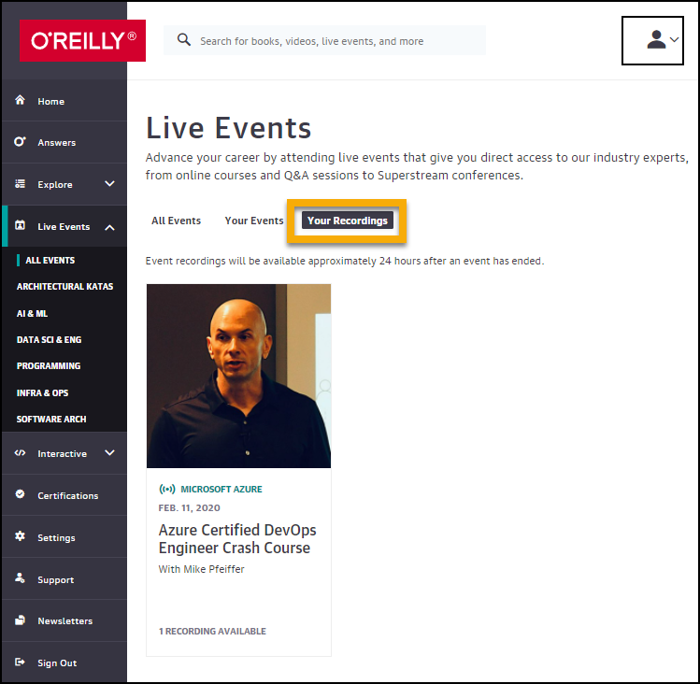
Session Recordings

Slide 8
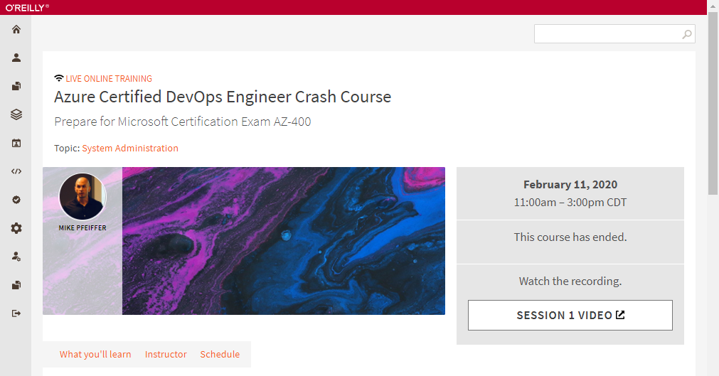
Session Recordings

Slide 9
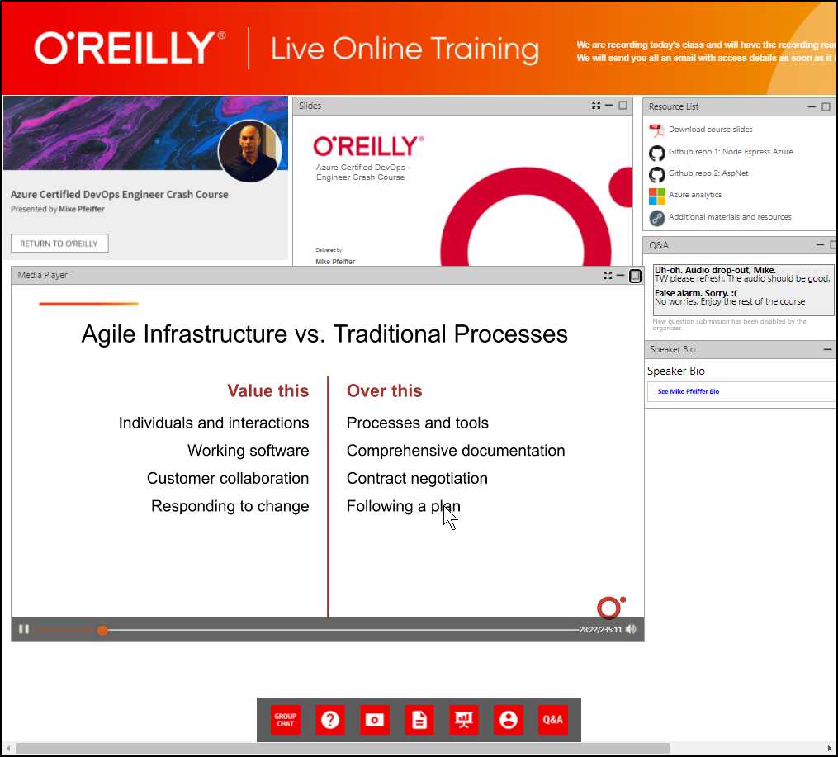
Session Recordings

Slide 10
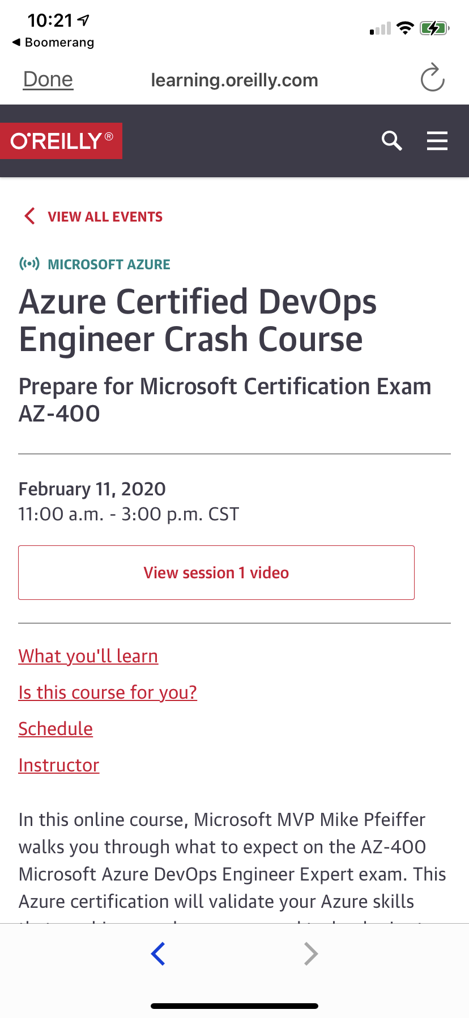
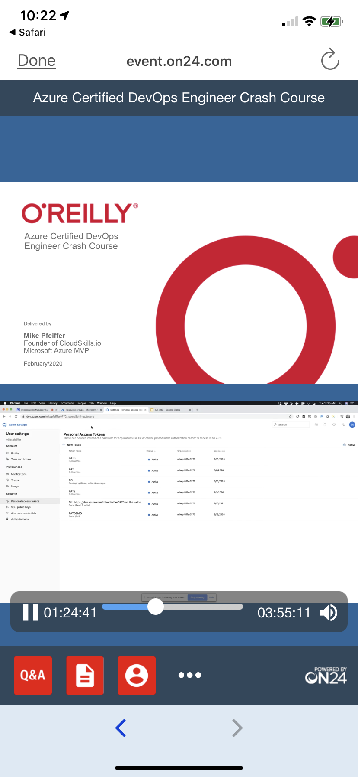
Mobile Browser: learning.oreilly.com

Slide 11
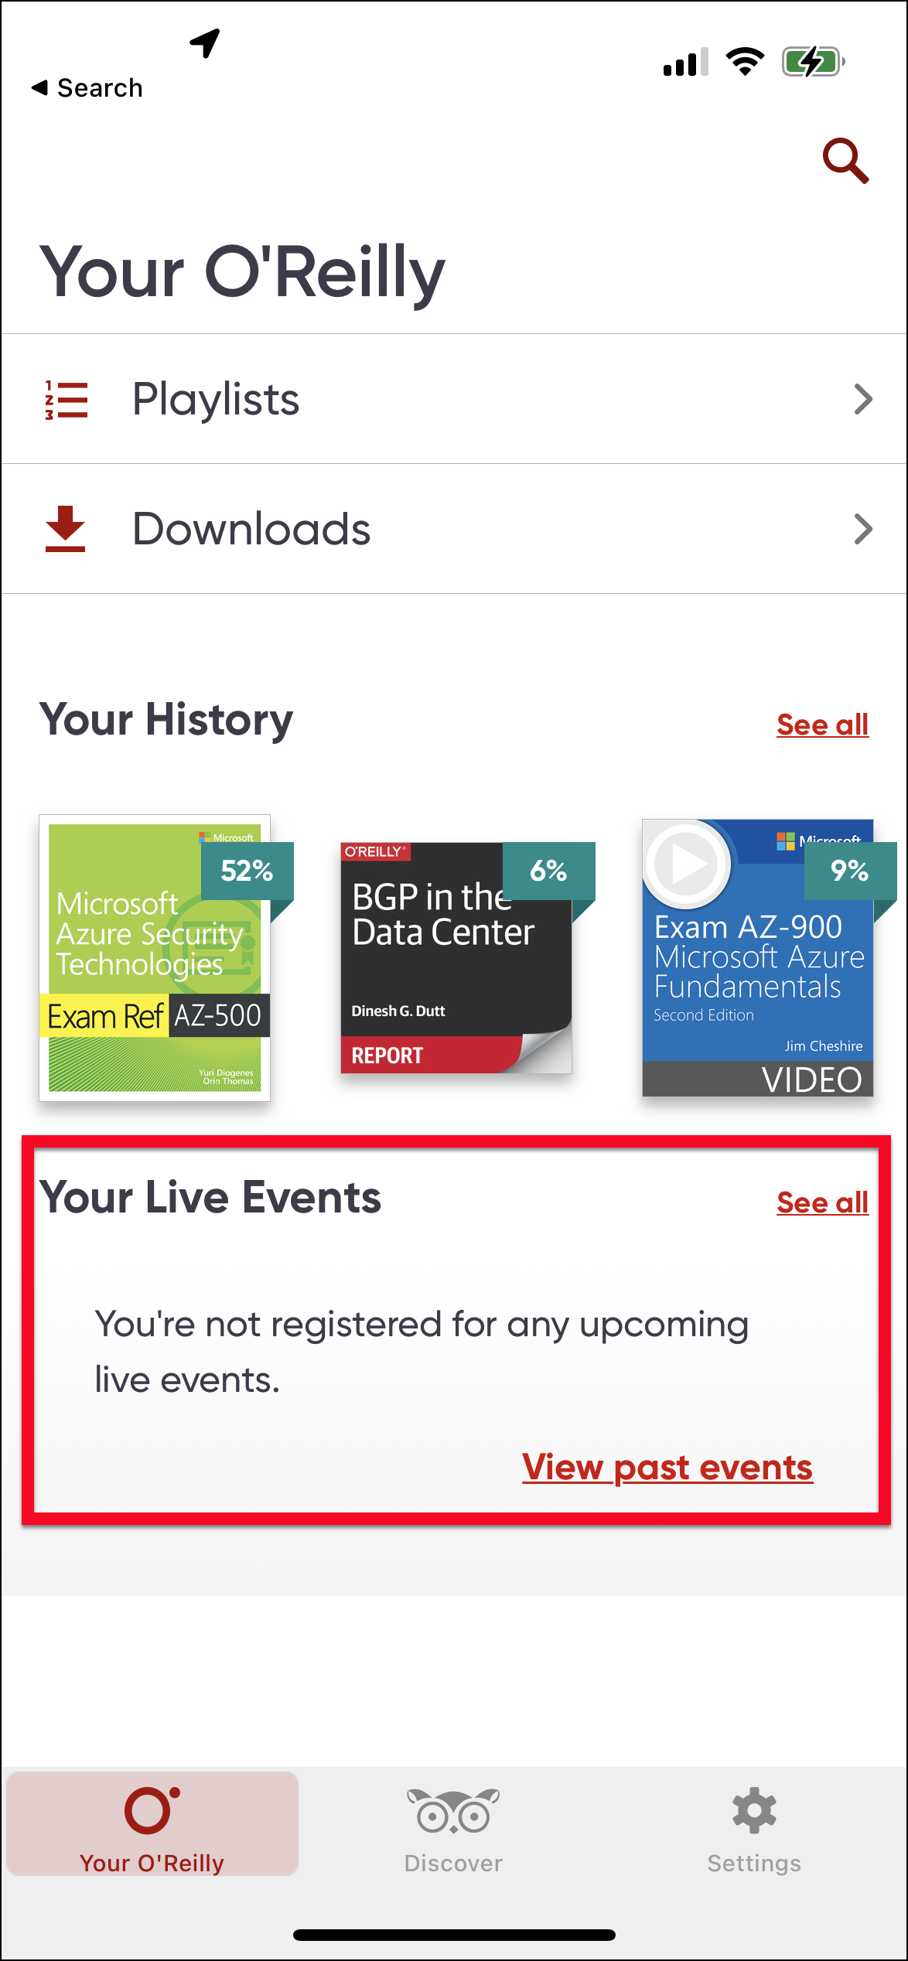
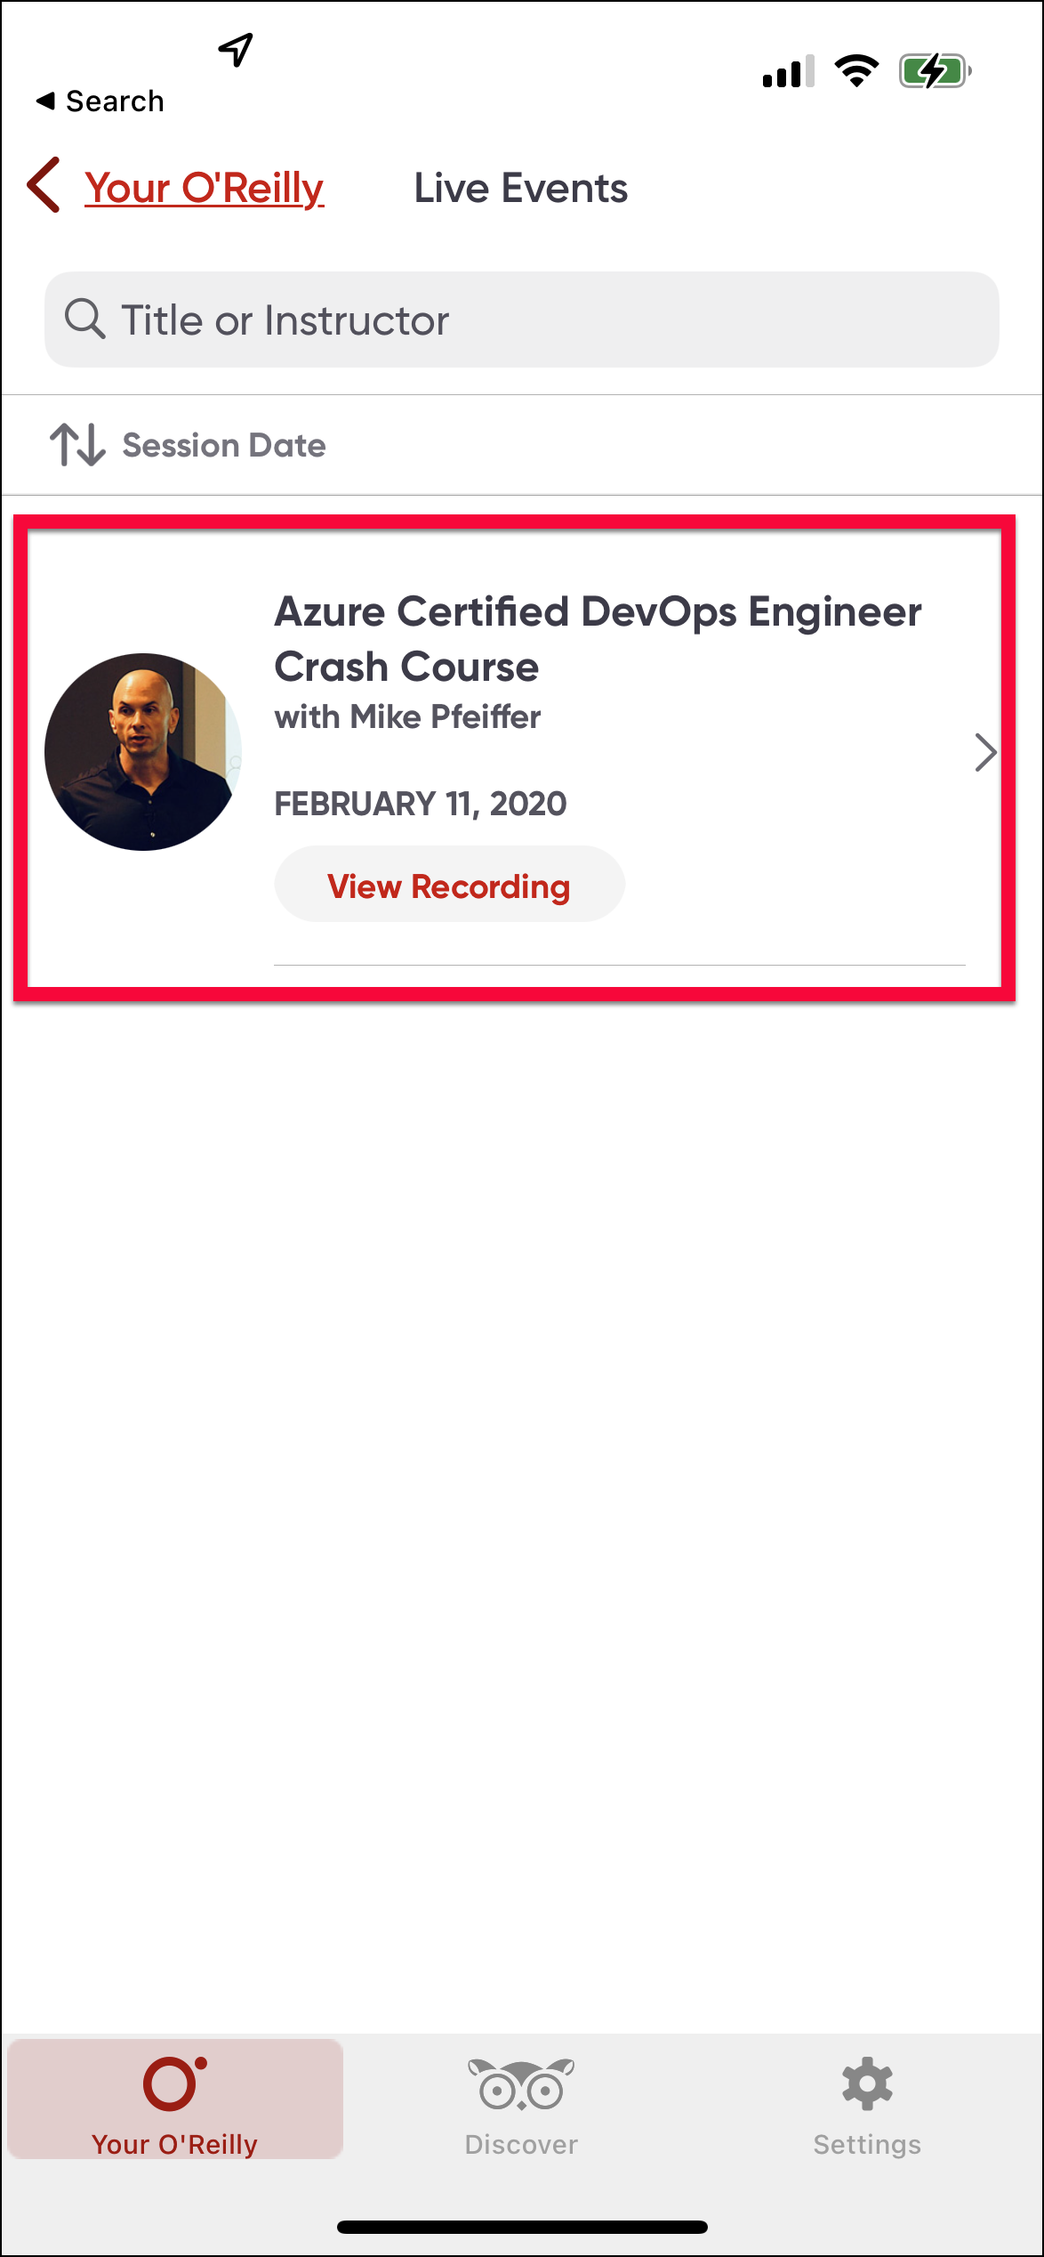
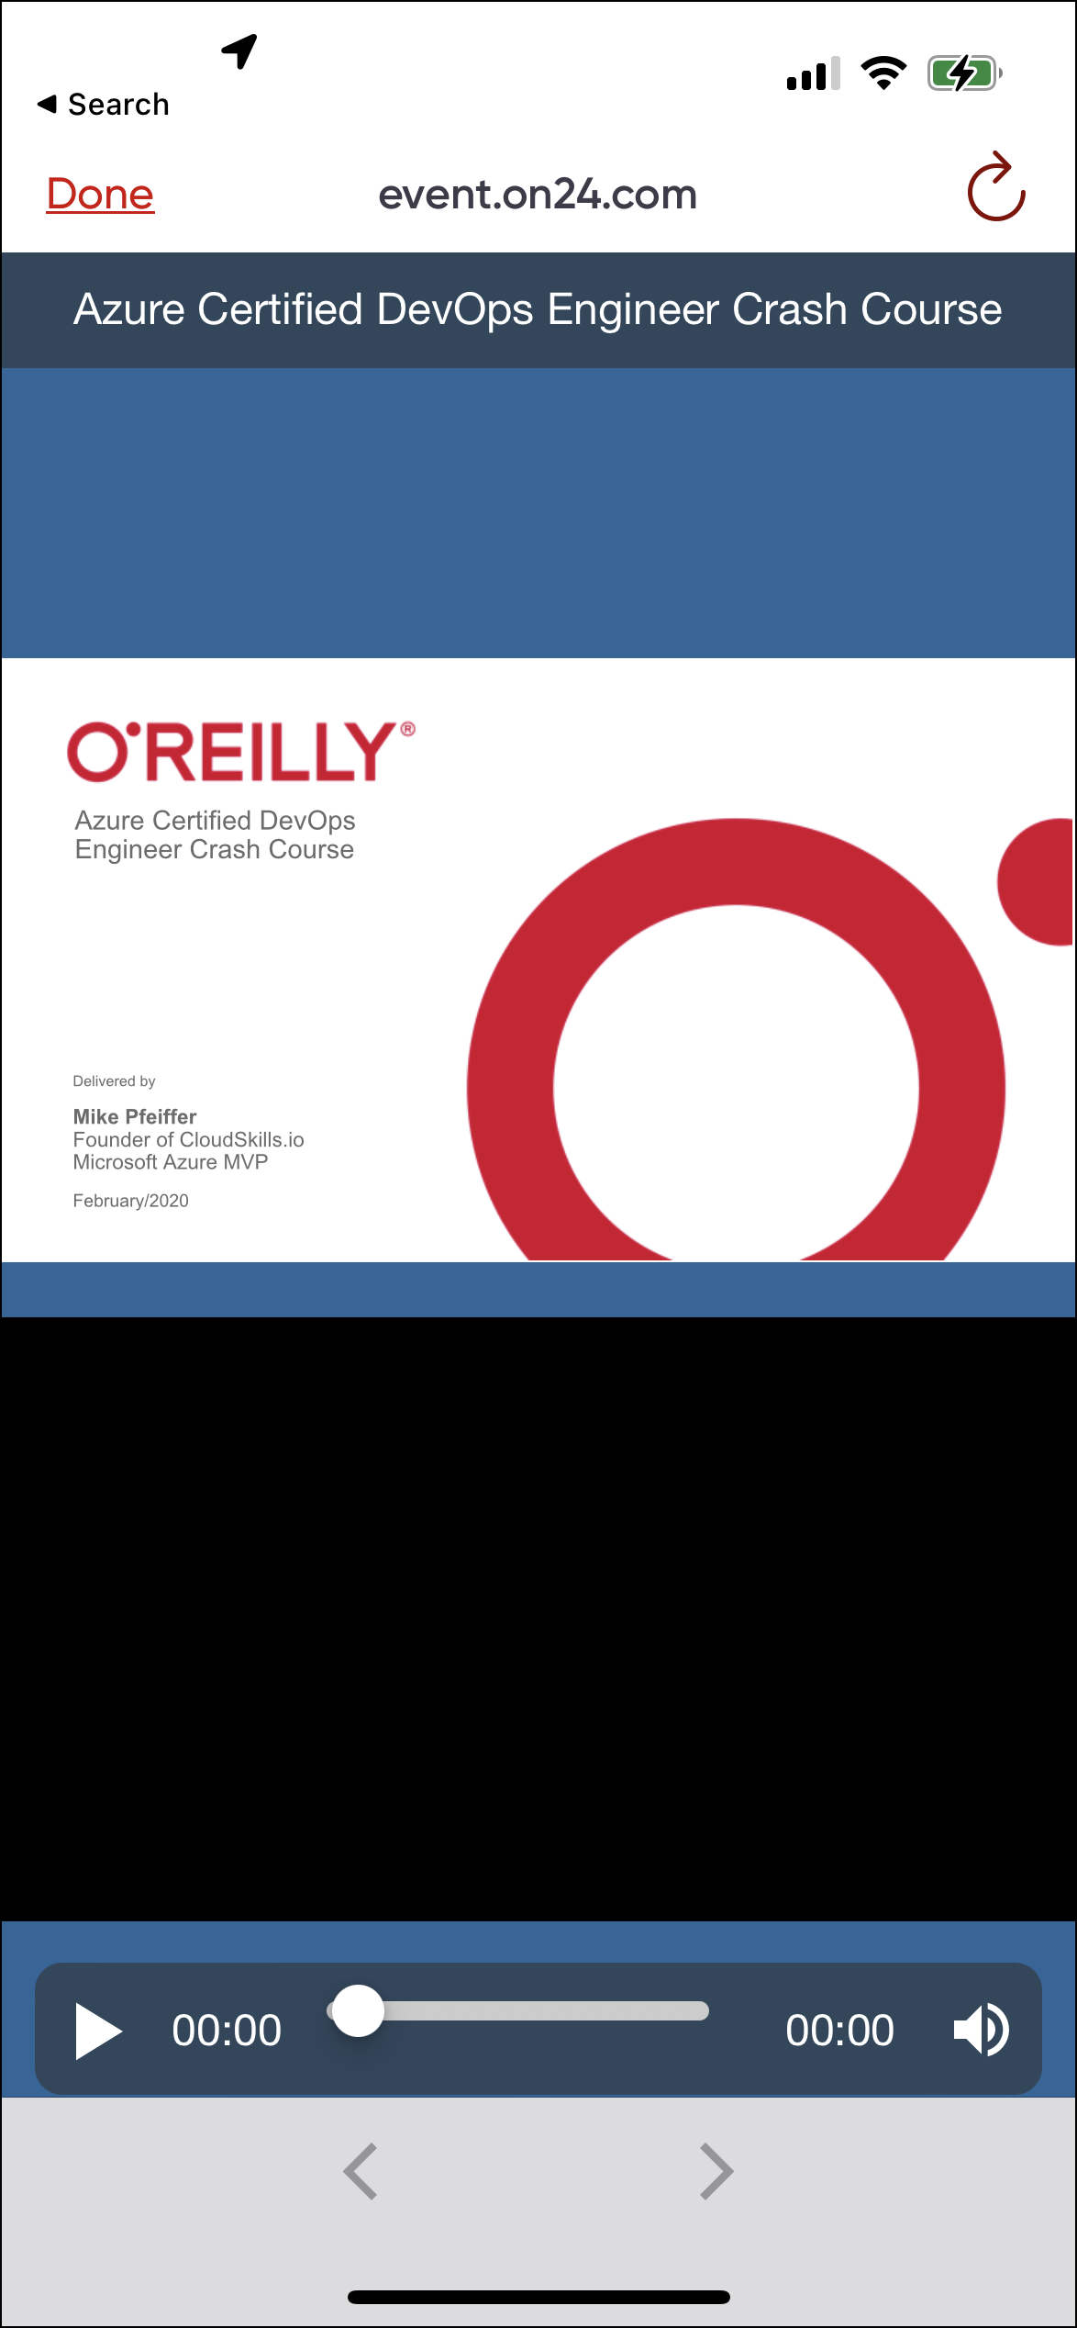
O'Reilly Mobile App

Slide 12

Microsoft Certification Tiers

Slide 13
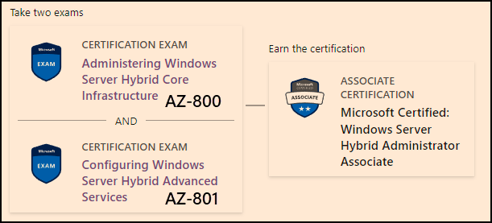
Windows Server Hybrid Admin Assoc.
1-year cert validity

Slide 14
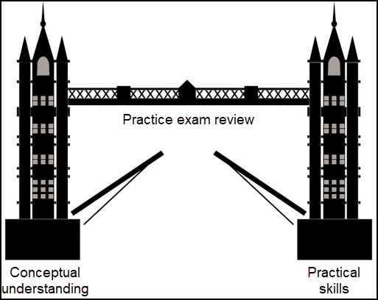
Tim's Certification Study Model

Slide 15
Thank you!
Course materials: timw.info/az801
Twitter: @TechTrainerTim
Work: timw.info/ps
Web: TechTrainerTim.com

Slide 16
Title

Slide 17
Title

