Slide 1
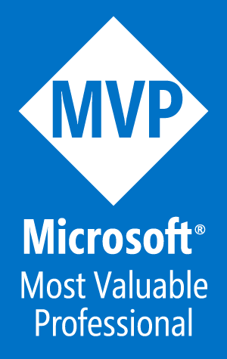
Azure Architect – IaaS or PaaS?
Tim Warner
tim-warner@pluralsight.com
Notes:
DSC
Monday, May 22, 2017
11:45a – 12:45pm
AZURE AD SSO
Tuesday, May 23, 2017
10:00a – 11:00a
AZURE NETWORKING
3:00p – 4:00p
PAAS vs IAAS
4:30p – 5:30p

Slide 2

Learning Objectives
Define our terms
Review Microsoft PaaS and IaaS product offerings
Perform comparison/contrast review
Your contributions are desirable necessary!

Slide 3

Session Materials
timw.info/itt

Slide 4
Define Our Terms

Slide 5
Software-as-a-Service (SaaS)
A software delivery model in which software is licensed on a subscription basis and is centrally hosted. It is sometimes referred to as "on-demand software"
timw.info/sd1
© ITtransformation. All rights reserved.
http://www.ITtransformation.events

Slide 6
Platform-as-a-Service (PaaS)
A development platform allowing customers to develop, run, and manage applications without the complexity of building and maintaining the infrastructure typically associated with software development
timw.info/pd1
© ITtransformation. All rights reserved.
http://www.ITtransformation.events

Slide 7
Infrastructure-as-a-Service (PaaS)
Online services that abstract IT staff from infrastructure details like physical computing resources, location, data partitioning, scaling, security, backup etc.
timw.info/id1
© ITtransformation. All rights reserved.
http://www.ITtransformation.events

Slide 8

Review Microsoft Azure PaaS

Slide 9
Azure App Services
Web Apps
API Apps
First-class support for:
ASP.NET, Node.js, Java, PHP, Python
DevOps optimization:
PowerShell/Azure CLI Visual Studio Team Services GitHub Bitbucket
Global scale and high availability
Hosted RESTful APIs in the Azure cloud
Supports any Azure App Services language/framework
Consume service data using the standard Swagger (OpenAPI) API framework
© ITtransformation. All rights reserved.
http://www.ITtransformation.events

Slide 10
Azure App Services
Mobile Apps
Logic Apps
Rich back-end functionality for:
iOS, Android, Windows Phone Xamarin Cordova
User authentication
Azure AD Facebook, Twitter, etc.
Push notifications
Scalable workflow engine (IFTTT)
Events trigger workflow (Azure functions = events trigger code)
Logic apps can use Azure functions in their workflows
Sibling to Microsoft BizTalk Server 2016 on premises and Azure BizTalk Services
© ITtransformation. All rights reserved.
http://www.ITtransformation.events

Slide 11
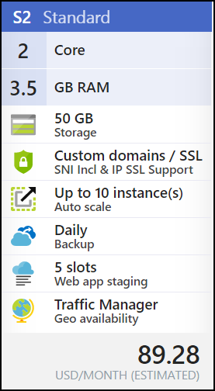
Azure App Service Notes
Compute
Instance sizes
App Service Plan
Storage
Link storage accounts
Content Delivery Network (CDN)
Networking/Scale
Traffic Manager
Autoscale

Slide 12
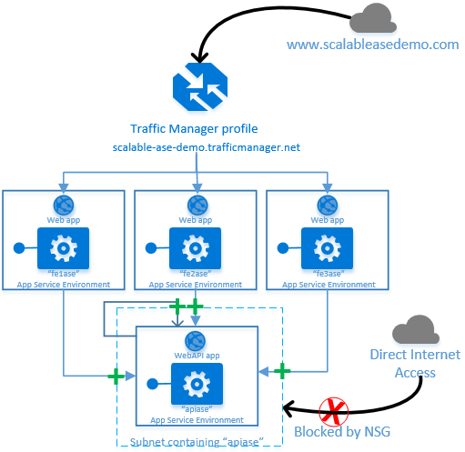
App Service Environment (ASE)
Isolated on an Azure virtual network
Network security groups (NSGs)
Web application firewall (WAF)
Dedicated hardware resources
Requires high-end VM classes and premium storage
Front-end
Back-end
Expensive
timw.info/ase1

Slide 13
Other Microsoft PaaS Options
Azure SQL Database
Azure Managed Instance
Azure DocumentDB
Azure HDInsight (Hadoop)
Azure Functions

Slide 14
Review Microsoft Azure IaaS

Slide 15
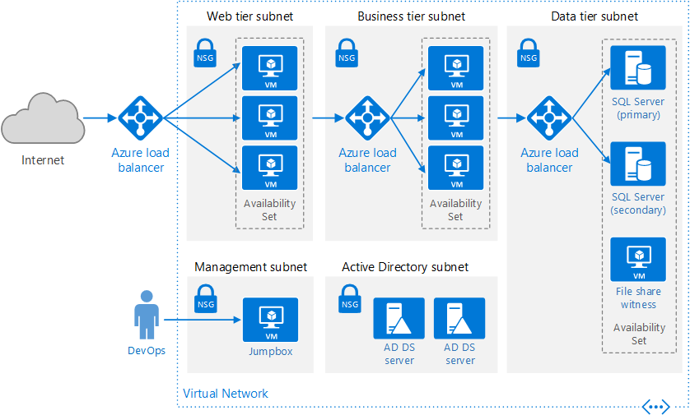
Azure Virtual Machines

Slide 16
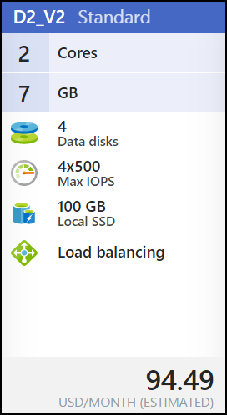
Azure IaaS Notes
Compute
Instance sizes
Licensing
Storage
Standard vs. Premium
Traditional vs. Managed disks
Networking
Public and private IP addresses
Network Security Groups (NSGs)

Slide 17
Perform a Comparison/Contrast Review

Slide 18
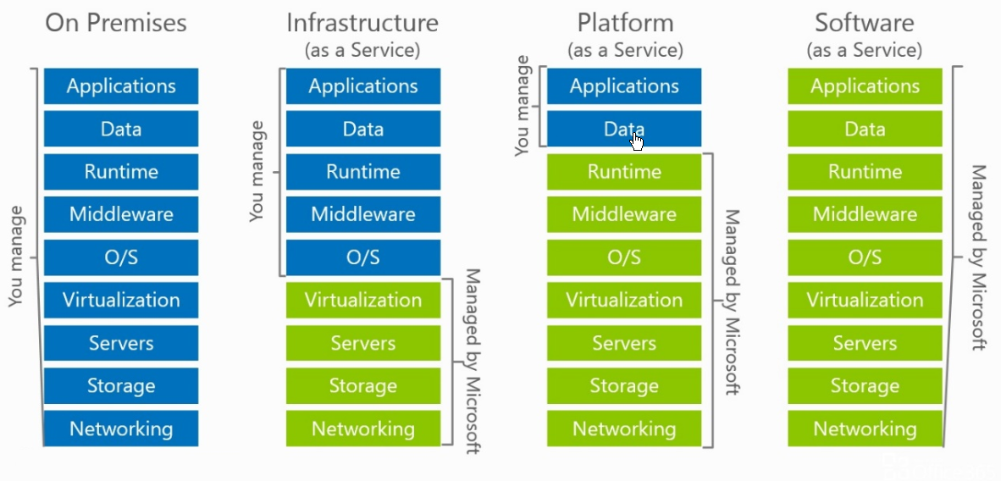
Layers of Abstraction
timw.info/an1

Slide 19
Layers of Abstraction
Functions
App Services
Container Service
Virtual Machines
Hardware Host

Slide 20
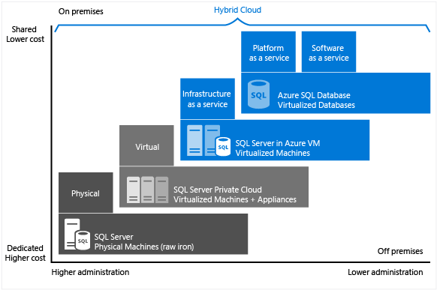
SQL Server – A Typical Workload
timw.info/sql1

Slide 21
Advantages
PaaS
IaaS
Reduce coding time
Reduce development staff
Develop for multiple platforms with minimal friction
Support geographic dev teams and audiences
Manage the SDLC
Eliminate CapEx
Improves BC/DR
Increase stability and reliability
Enhance security
Get new apps to users faster
Agility
Control
© ITtransformation. All rights reserved.
http://www.ITtransformation.events

Slide 22
Disadvantages
PaaS
IaaS
You don’t have “full stack” access to the host VM
Potential for vendor lock-in
App Services doesn’t officially support every dev stack or framework version
Greater vendor trust required:
Multi-tenancy/security
System availability
Decreased agility
Responsibility to patch, secure, and back up your VM environment
No control over virtualization host
Could be much more expensive than PaaS for similar service level
Lock-in
Cumbersome
© ITtransformation. All rights reserved.
http://www.ITtransformation.events

Slide 23

Review
You get a VM in both App Services and Virtual Machines
Fear of multi-tenancy may be unwarranted
You may have business requirements that “force” you to choose one or the other model
You can combine them!
You can always migrate workloads between the two models

Slide 24
Questions?
Please use Events XD (EventBoard) to fill out a session evaluation.
Thank you!
timw.info/itt
@TechTrainerTim

