Slide 1

“Round Trip” Desired State Configuration
Tim Warner
tim-warner@pluralsight.com
Notes:
DSC
Monday, May 22, 2017
11:45a – 12:45pm
AZURE AD SSO
Tuesday, May 23, 2017
10:00a – 11:00a
AZURE NETWORKING
3:00p – 4:00p
PAAS vs IAAS
4:30p – 5:30p

Slide 2

Learning Objectives
Gain a holistic view of the PowerShell DSC lifecycle
Get comfortable with DSC “parts ‘n’ pieces”
Become immediately effective

Slide 3

Session Materials
timw.info/itt

Slide 4
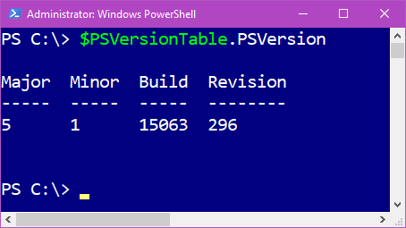
Today’s Assumption

Slide 5
DSC from the Highest Level

Slide 6

Server Configuration Drift = BAD

Slide 7
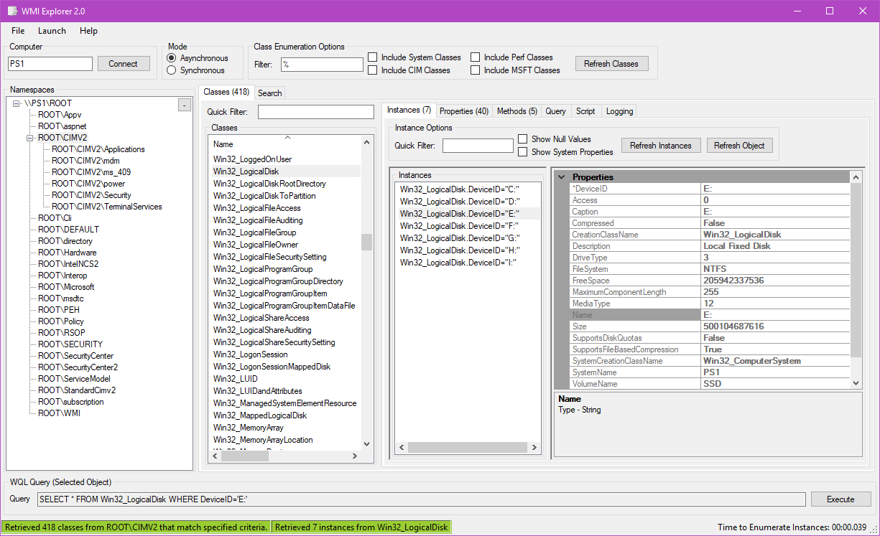
Acronym Alphabet Soup!
IETF developed the CIM standard
WMI is Windows’ CIM server
OMI is Linux’ CIM server
WinRM is Windows’ WS-Man provider
PSRP is Linux’ WS-Man provider

Slide 8
What “Round Trip” DSC Means
Troubleshooting
LCM config
Deployment
Resources
Configurations

Slide 9
GP vs. DSC
Group Policy
Desired State Configuration
Requires AD
No OS dependencies
Prevents OS changes
GUI reliance (GPMC.msc)
Excels at desktop mgmt.
Not DevOps friendly
“Black box”
No directory service dependency
WMF 4.0 or 5.x
Reverts OS changes
Complete automation
Intended for Win/Lin servers
Fully supports CI/CD
Open source with community support

Slide 10
Local Configuration Manager (LCM)

Slide 11
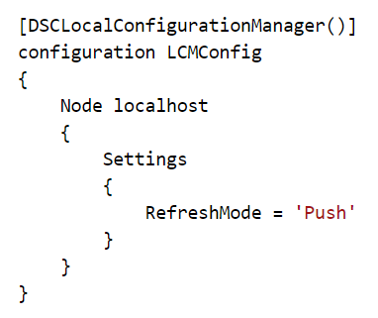
Local Configuration Manager (LCM)
The engine of DSC
Node “meta configuration”
Push or pull mode
Configuration policy

Slide 12
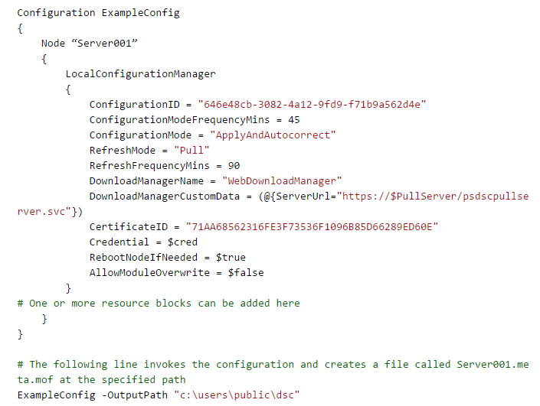
Local Configuration Manager (LCM)

Slide 13
Resources

Slide 14
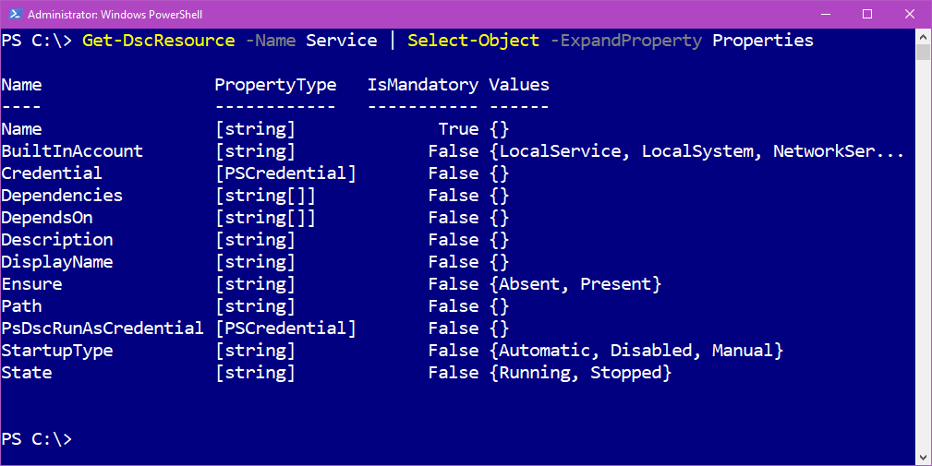
Resources
Building blocks of DSC
A PowerShell module
MOF schema; PS1 implementation

Slide 15
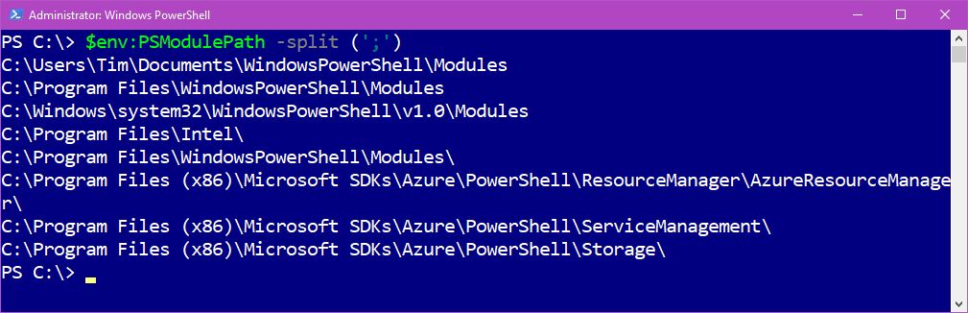
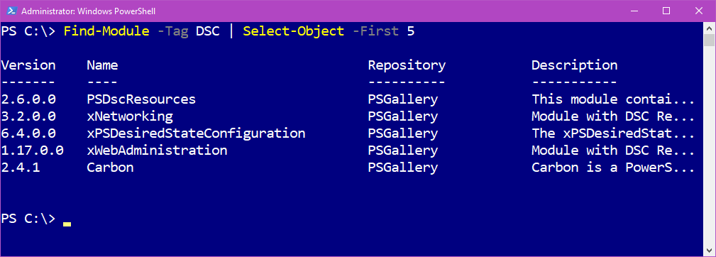
Resources

Slide 16
Obtaining Resources
Built-in resources
x and c resources
Your own resources

Slide 17
Authoring Resources
MOF
xDscResourceDesigner
PowerShell classes
C#

Slide 18
Configurations

Slide 19
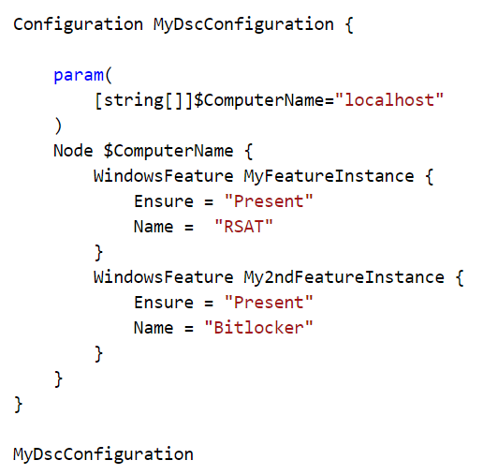
Configurations
Configuration block (like a function)
Parameter declarations
Node block (>=1)
Resource block (>=1)

Slide 20
Azure Automation DSC

Slide 21
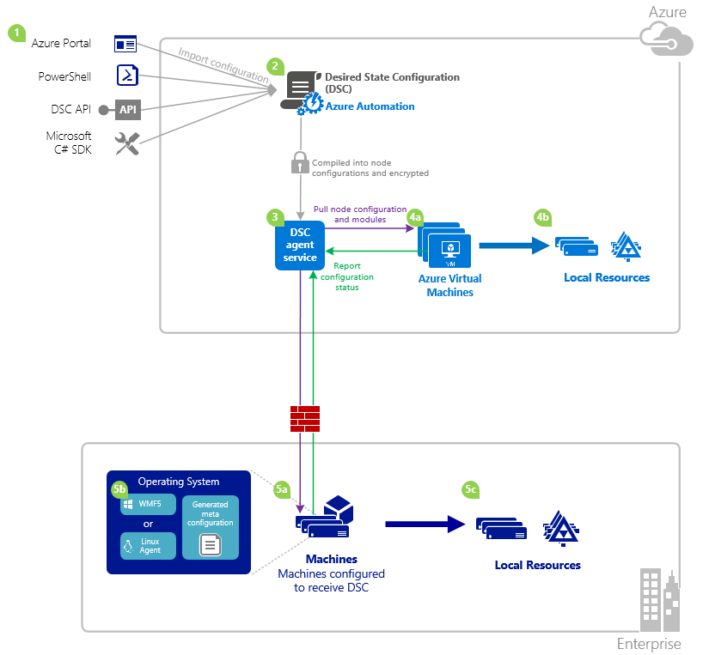

AADSC
timw.info/aadsc

Slide 22
Monitoring and Troubleshooting

Slide 23

Troubleshooting DSC: Jump Start
Test-DscConfiguration
Start-DscConfiguration -Verbose -WhatIf
Restore-DscConfiguration
Remove-DscConfigurationDocument
Current
Previous
Pending
Get-Command -Noun AzureRMAutomation*

Slide 24
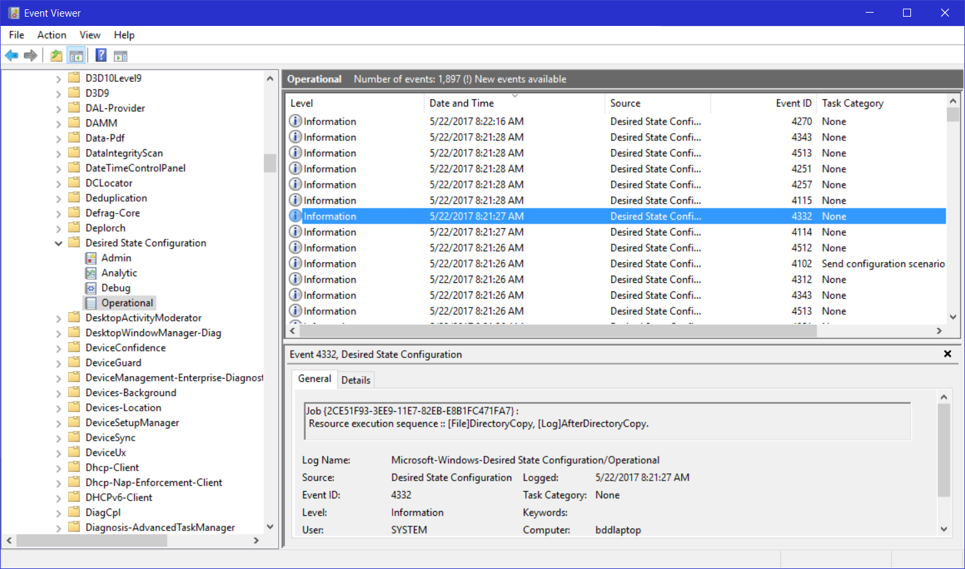
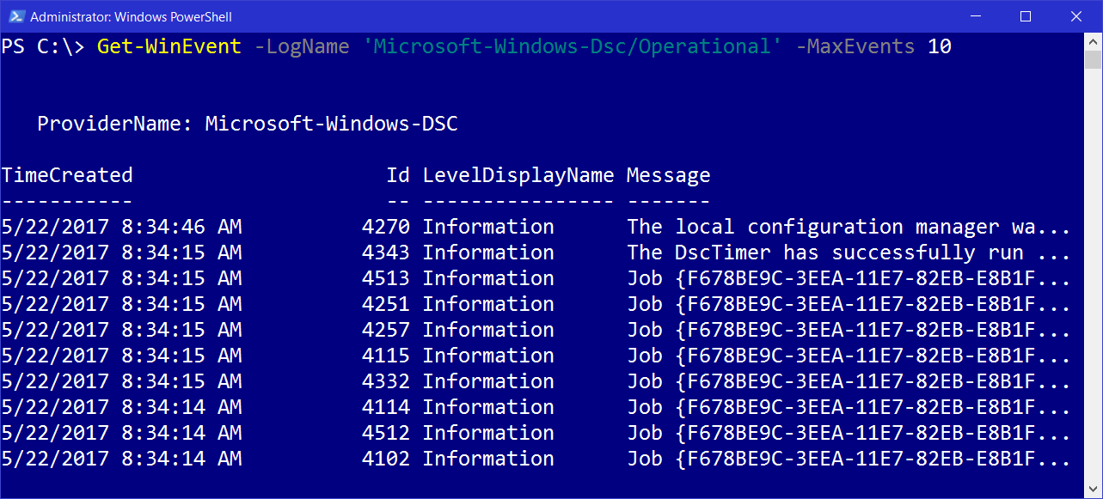
Event Logs

Slide 25
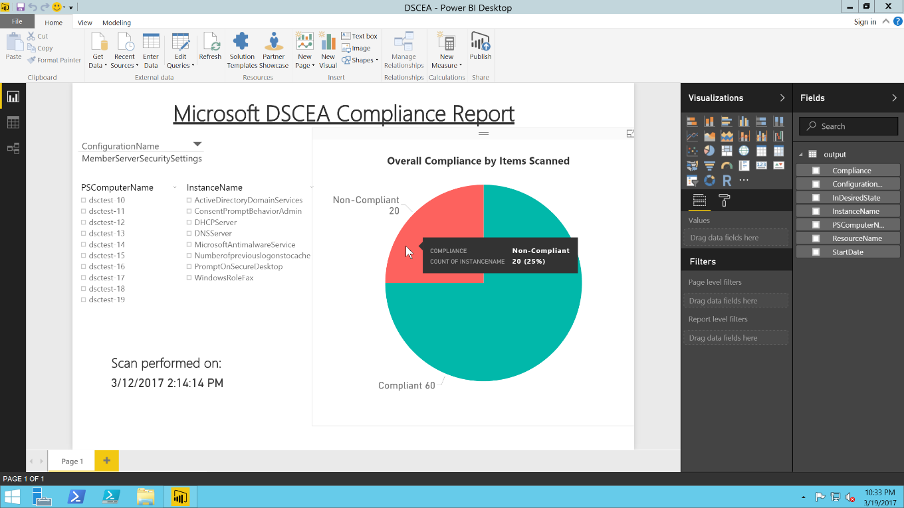
DSC Environment Analyzer (DSCEA)
timw.info/dscea

Slide 26



Demo: Tying it all Together

Slide 27

Review
DSC presents a low (cost) entry point for server configuration management (Windows + Linux)
If you already use Azure, you can’t beat Azure Automation DSC
Microsoft’s hybrid cloud strategy means it doesn’t matter where your servers are

Slide 28
Questions?
Please use Events XD (EventBoard) to fill out a session evaluation.
Thank you so much!
timw.info/itt
@TechTrainerTim

