Slide 1

Azure Networking Deep Dive
Tim Warner
tim-warner@pluralsight.com
Notes:
DSC
Monday, May 22, 2017
11:45a – 12:45pm
AZURE AD SSO
Tuesday, May 23, 2017
10:00a – 11:00a
AZURE NETWORKING
3:00p – 4:00p
PAAS vs IAAS
4:30p – 5:30p

Slide 2

Learning Objectives
Connect Azure VMs within a virtual network
Connect virtual networks
Connect to on-premises networks
Route and filter network traffic
Monitor and troubleshoot Azure networks

Slide 3

Session Materials
timw.info/itt

Slide 4

Preliminary Knowledge

Slide 5

Preliminary Knowledge
What You Should Know
How to Address Gaps
TCP/IP protocol suite
IPv4 addressing and subnetting
Network devices (routers, load balancers, firewalls)
Network troubleshooting
Network security
Exam 98-366: Networking Fundamentals

Slide 6
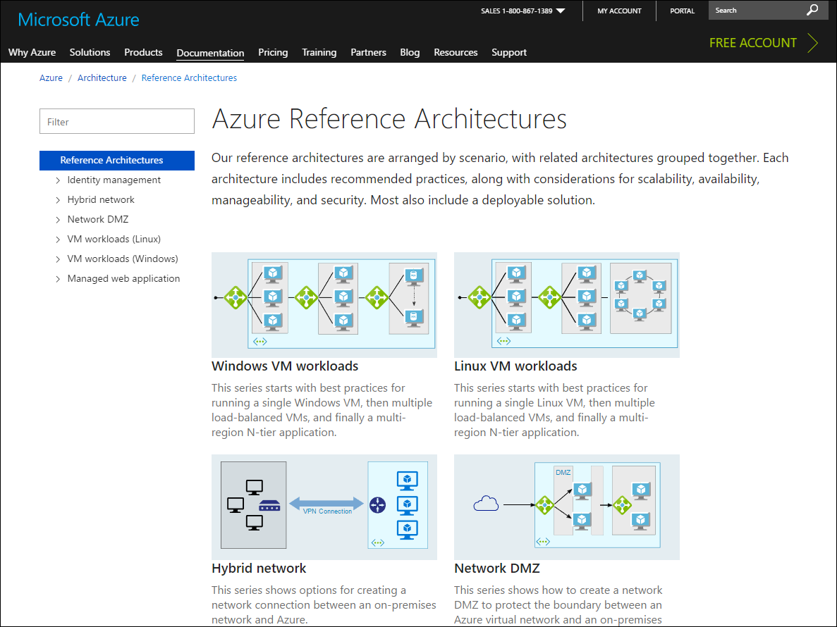
Azure Architecture Center
timw.info/acz

Slide 7

Ready to Dive into the Deep Water?

Slide 8
Connect Azure VMs

Slide 9
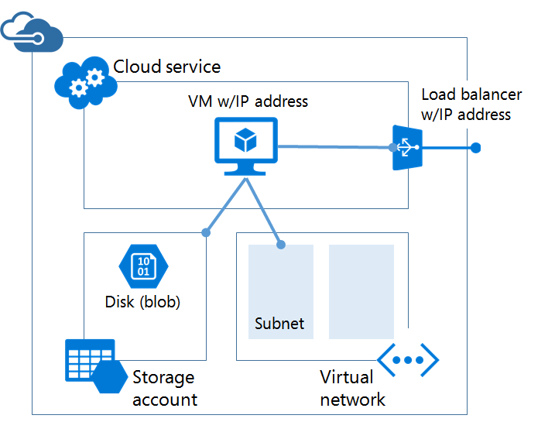
Azure Service Management (IaaS v1)
timw.info/asmz

Slide 10
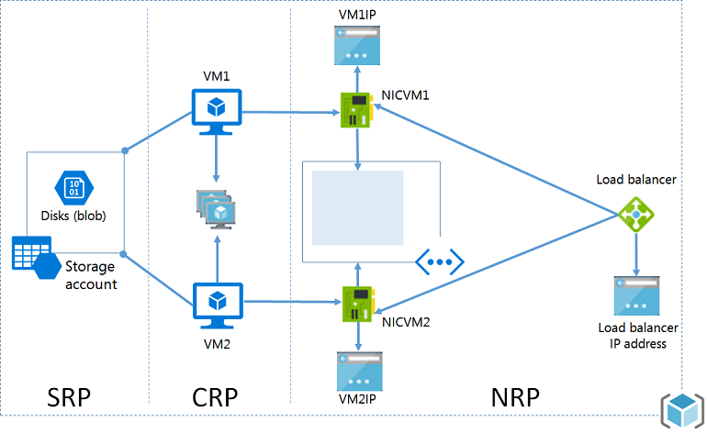
Azure Resource Manager (IaaS v2)
timw.info/aa1

Slide 11
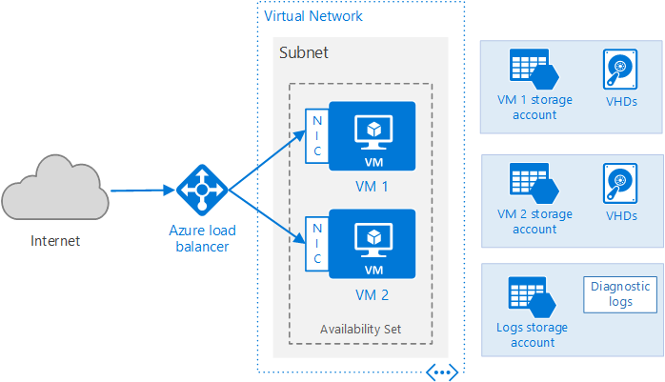
Azure Public Cloud Networking Architecture
timw.info/vmz

Slide 12
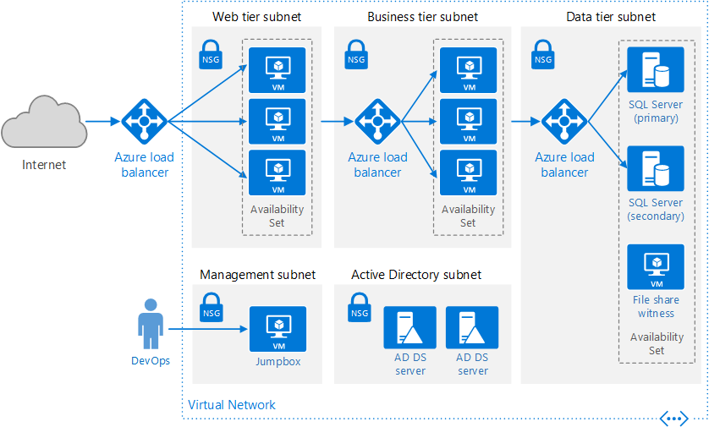
Virtual IP Addresses and Name Resolution
Reserved IPs
IPv6
timw.info/dnsz

Slide 13
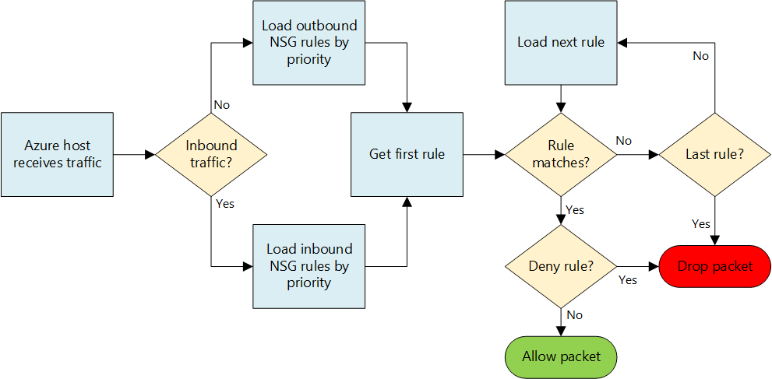
Network Security Group (NSG)
Attach to subnet or vNIC
timw.info/nsg1

Slide 14
Connect Virtual Networks

Slide 15
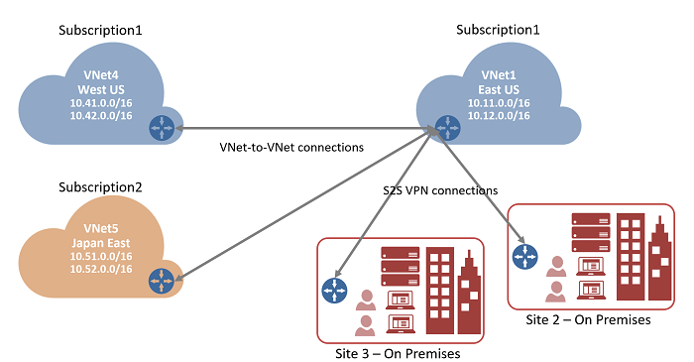
Vnet-to-Vnet VPN
Vnets can be in different Azure regions
timw.info/vn22

Slide 16
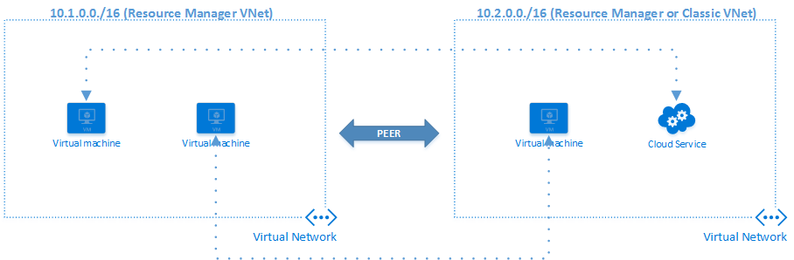
Vnet Peering
Vnets must be in the same Azure region
timw.info/vp1

Slide 17
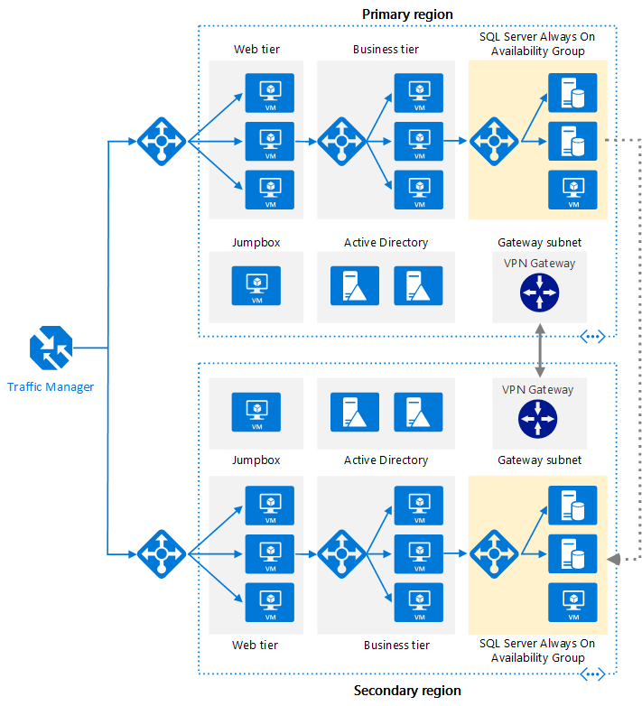
Multi-Region IaaS
timw.info/mrz

Slide 18
Connect to On-Premises Networks

Slide 19
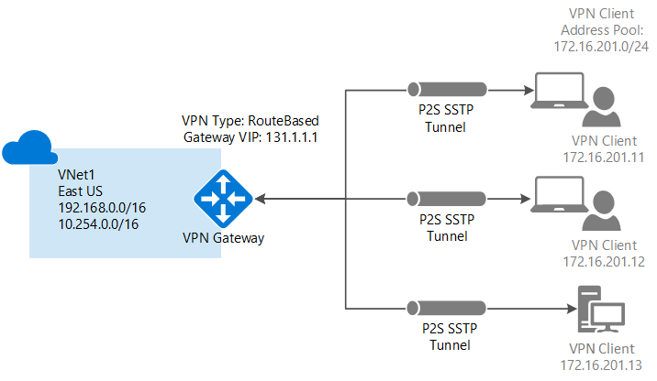
Point-to-Site VPN
timw.info/p2ss

Slide 20
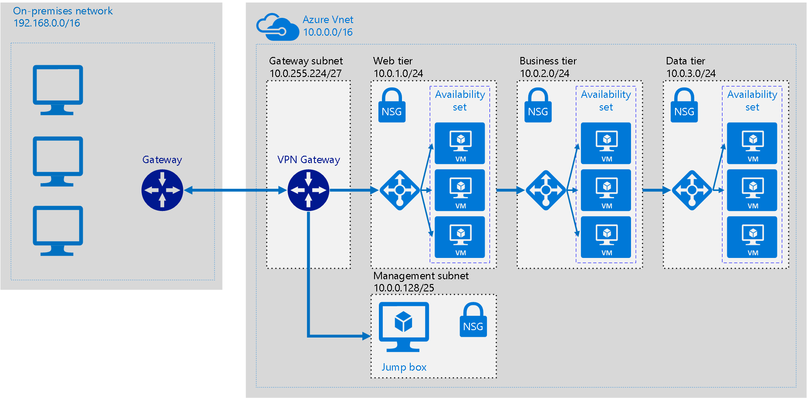
Site-to-Site VPN
timw.info/hbz

Slide 21
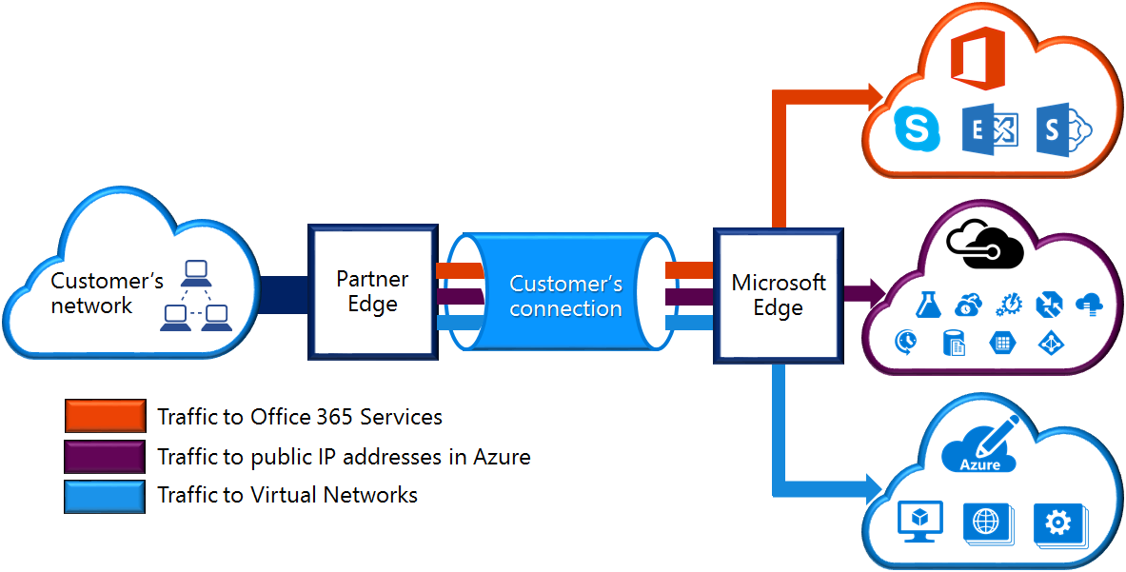
ExpressRoute
timw.info/er1

Slide 22
Route and Filter Network Traffic

Slide 23
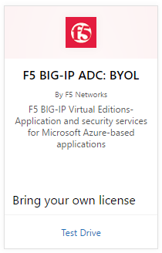
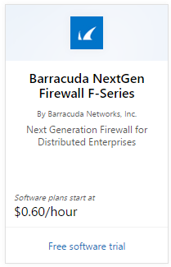
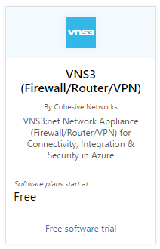
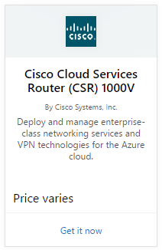
Azure Network Virtual Appliances
timw.info/

Slide 24
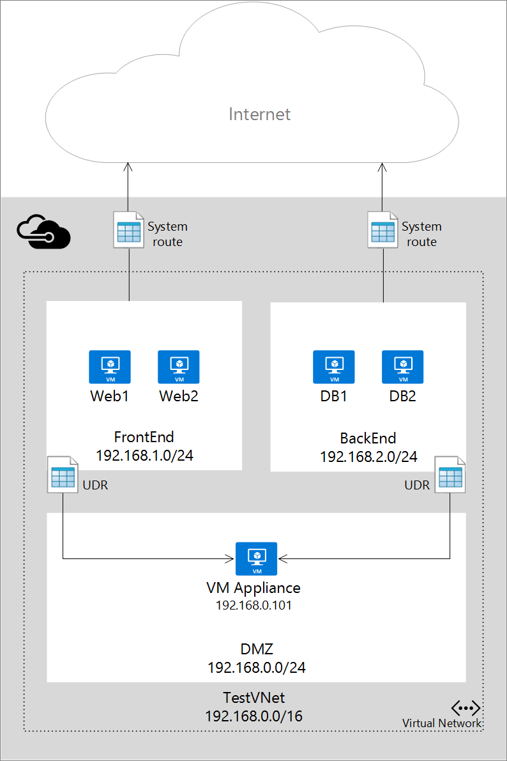
User-Defined Routes and IP Forwarding
Azure routes
User-defined routes
timw.info/udr1

Slide 25
Monitor and Troubleshoot Azure Networks

Slide 26
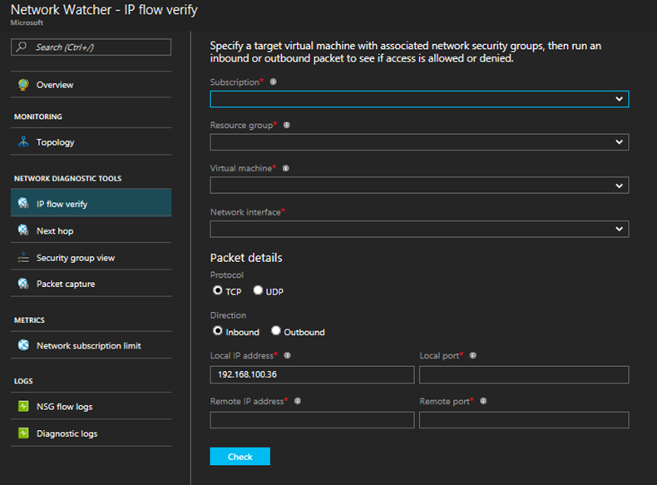
Network Watcher
Test Network Security Group (NSG) rules
timw.info/nw1

Slide 27
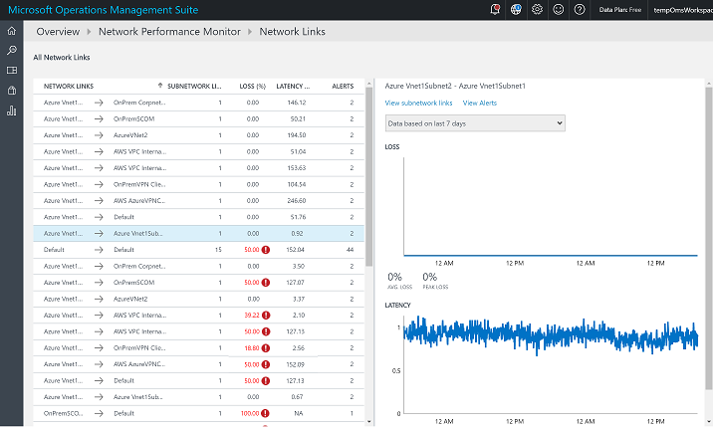
Network Performance Monitor
Operations Management Suite (OMS)
Log Analytics
timw.info/npm1

Slide 28

Review
Azure networking is tough because the stakes are high and the skill set is broad
Plan, plan, plan
IP address ranges
VPN hardware purchases
Azure advisory frameworks:
Azure Advisor
Azure Security Center (ASC)

Slide 29
Questions?
Please use Events XD (EventBoard) to fill out a session evaluation.
Thank you!
timw.info/itt
@TechTrainerTim

