Slide 1


Microsoft SQL Server to Microsoft Azure Training Course
Tim Warner

Slide 2

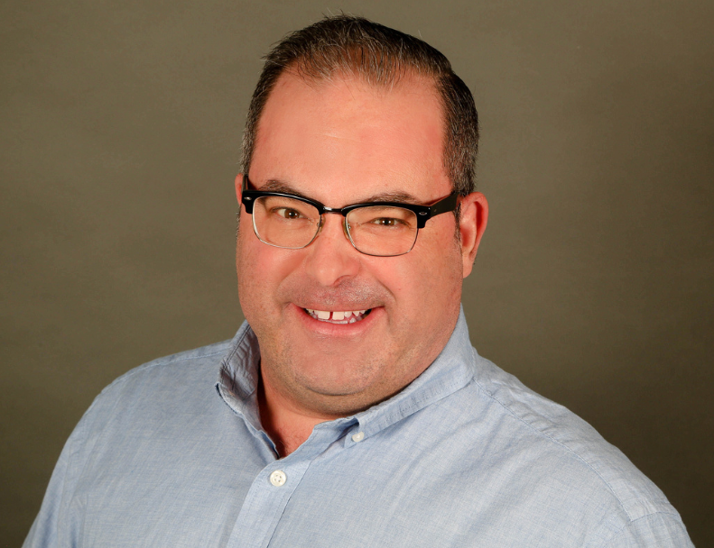
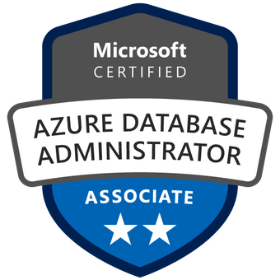
Tim Warner
Based in Nashville, TN, US
Central time zone
MCT, MVP
Twitter: @TechTrainerTim
Web: TechTrainerTim.com

Slide 3
Day 1 of 2 Agenda
Introduction
Microsoft Azure SQL Database Hosting Options
SQL Server to Azure Migration
Configure Database Security

Slide 4
Day 2 of 2 Agenda
Content catch-up
Configure Azure SQL Database High Availability and Disaster Recovery
Monitor and Optimize Azure SQL Server
Integate Azure SQL Server throughout Azure

Slide 5
Course Materials
timw.info/sqlazure

Slide 6
A Different Kind of Training
We'll learn by doing – at least 80 percent demo
Visual, case study approach
10-minute break at midpoint
I’m here to answer your questions – take advantage of this!
Use the Q&A panel instead of group chat, please

Slide 7
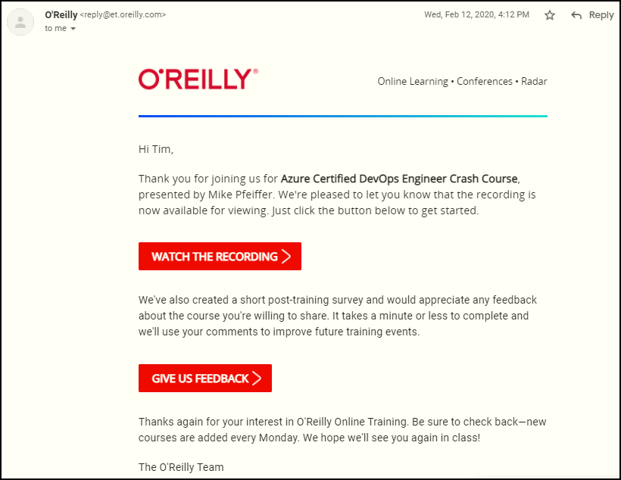
Session Recordings

Slide 8
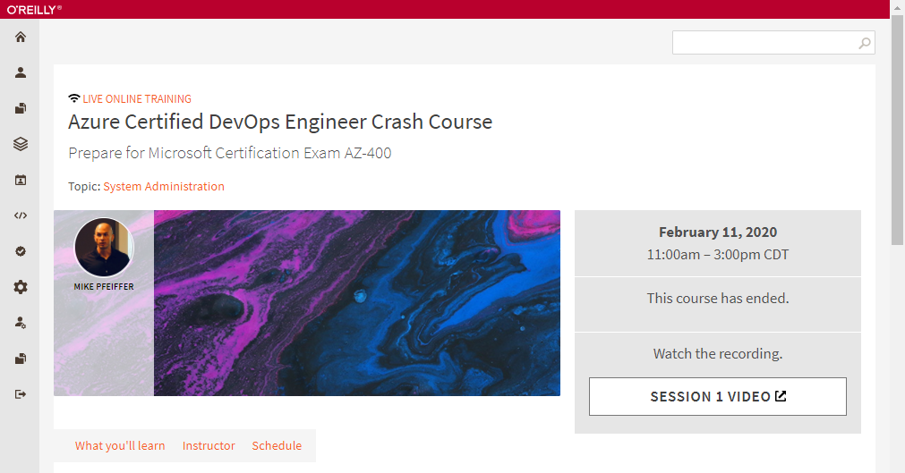
Session Recordings

Slide 9
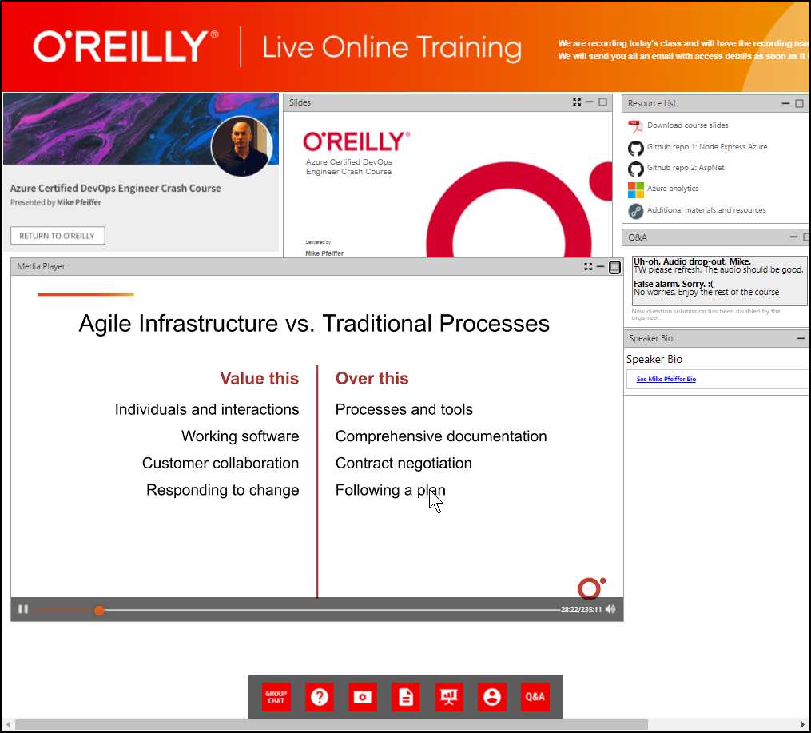
Session Recordings

Slide 10
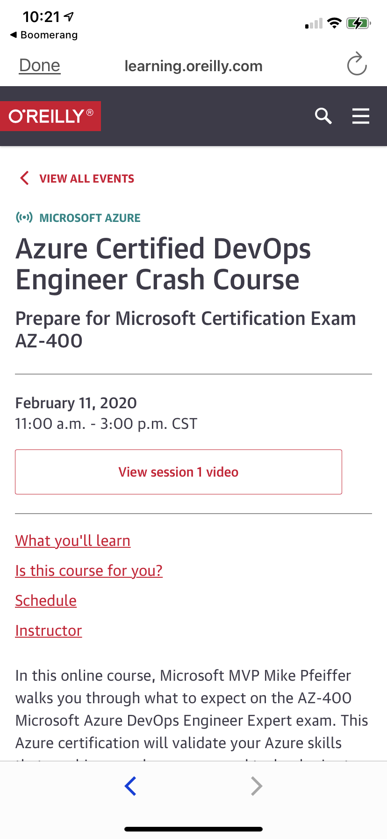
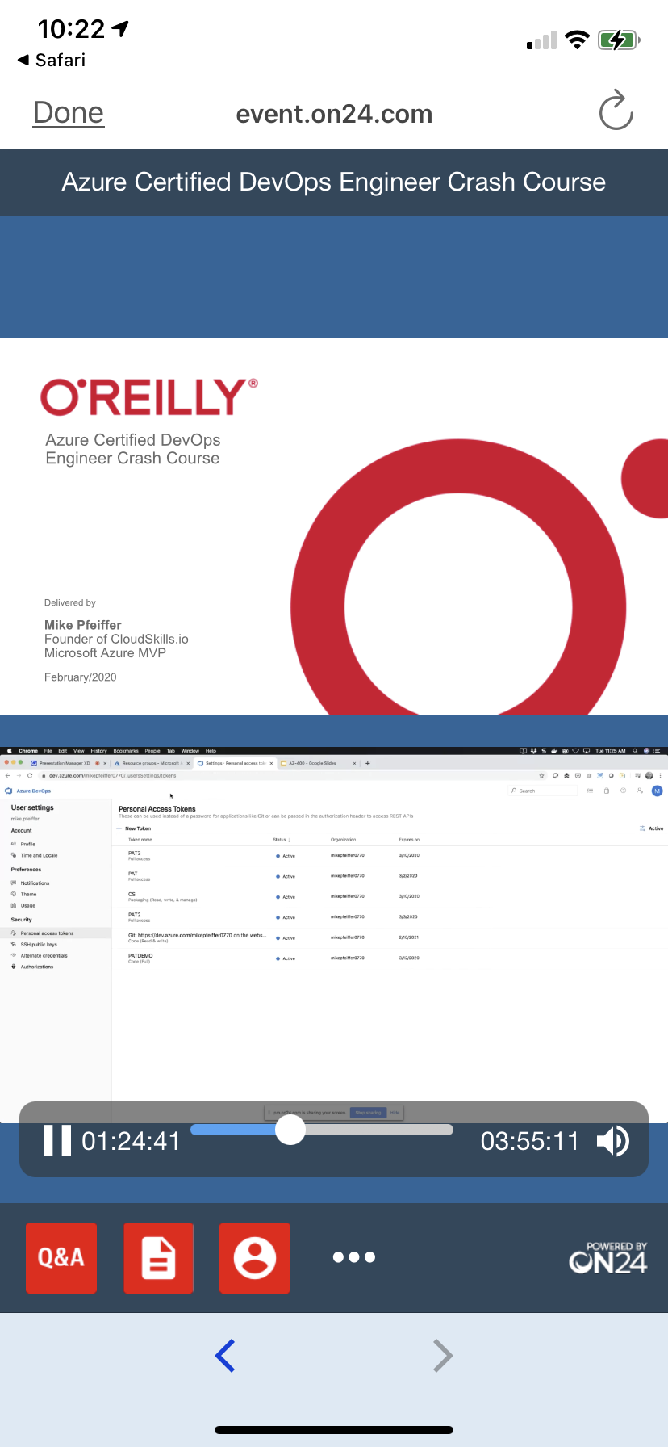
Session Recordings

Slide 11
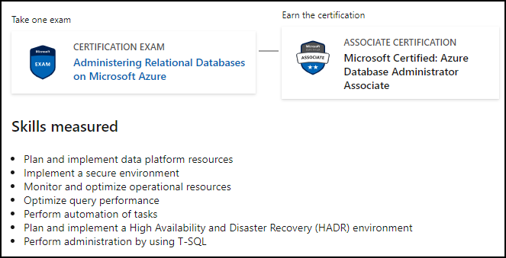
Microsoft Role-Based Certification
DP-300

Slide 12
Thank you!
Course materials: timw.info/sqlazure
Twitter: @TechTrainerTim
Web: TechTrainerTim.com

Slide 13
Data Fundamentals

