Slide 1



A Real, Live PowerShell Beginner's Tutorial
Tim Warner
author/tech evangelist, pluralsight
@TechTrainerTim azuredepot.com

Slide 2

Session Materials
timw.info/sqlsatnash

Slide 3
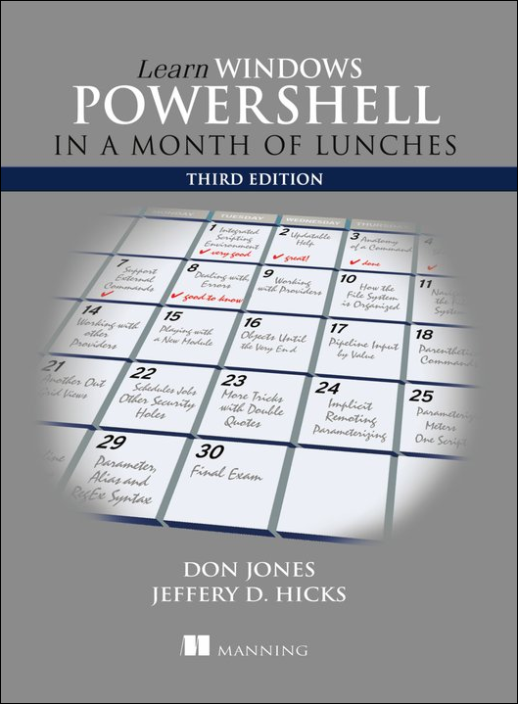
Book Reference
The reference PowerShell beginner's textbook

Slide 4
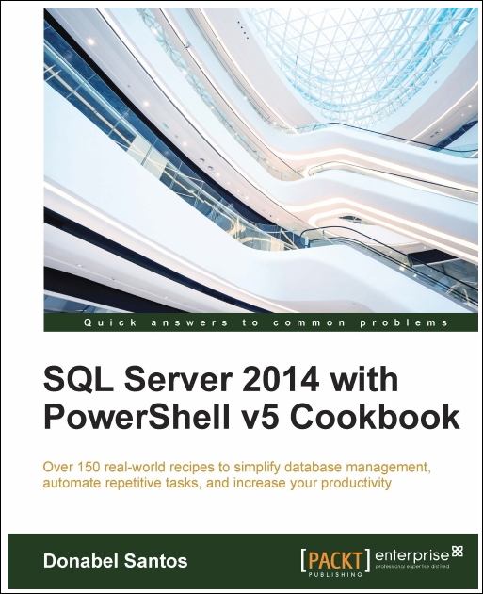
Book Reference
Tech cookbooks are always a good idea for busy IT pros

Slide 5
Please complete the evaluation
Tim Warner
timothywarner316@gmail.com
@TechTrainerTim
azuredepot.com
Thank You!

