Slide 1

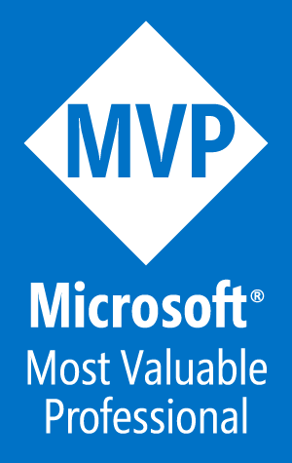
PowerShell in "PowerShelling" Azure
Tim Warner
author/tech evangelist, pluralsight
@TechTrainerTim azuredepot.com

Slide 2
Understand Azure Resource Manager (ARM)
Get productive with Azure PowerShell
Step into ARM templates
Agenda

Slide 3

Session Materials
timw.info/azposh

Slide 4

Understand Azure Resource Manager

Slide 5
ARM Facts
Released in 2014 (Azure was GA in 2010)
Componentized rather than monolithic
JSON instead of XML
REST APIs (Portal, PS, Azure CLI, SDK)
RBAC
Template-based deployment

Slide 6
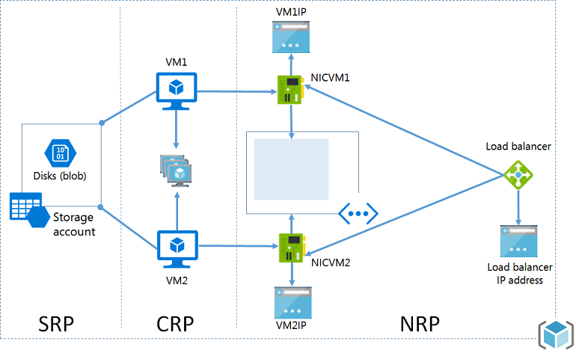
ARM Architecture
timw.info/armarch3

Slide 7
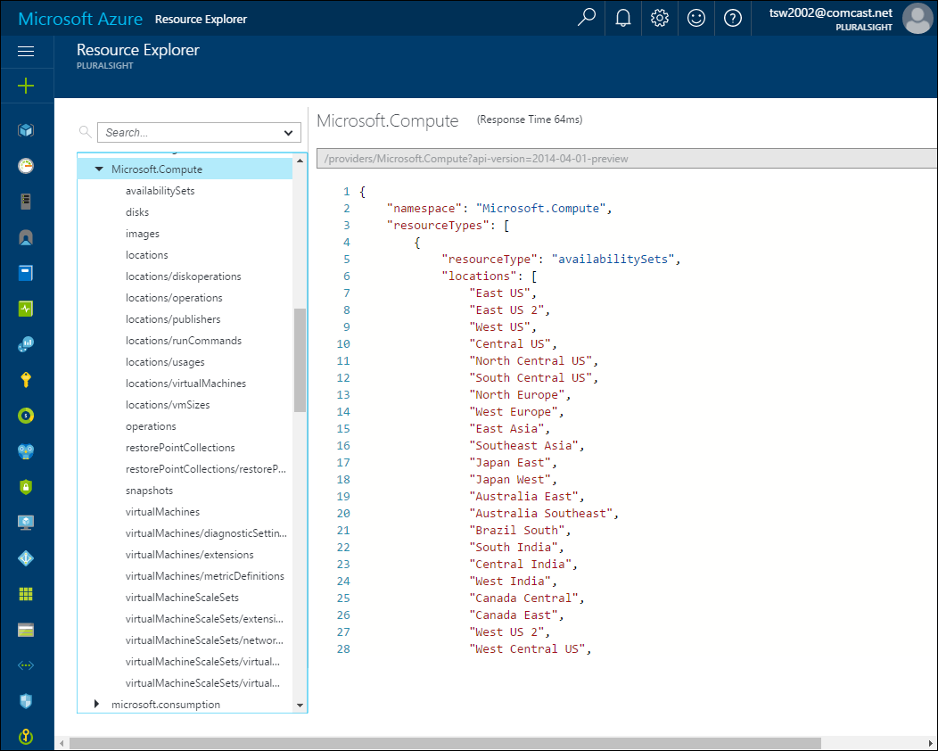
Azure Resource Explorer
Explore the REST API

Slide 8
Create a Windows Server VM in the Azure Portal
Save the ARM deployment template

Slide 9

Get Productive with Azure PowerShell

Slide 10
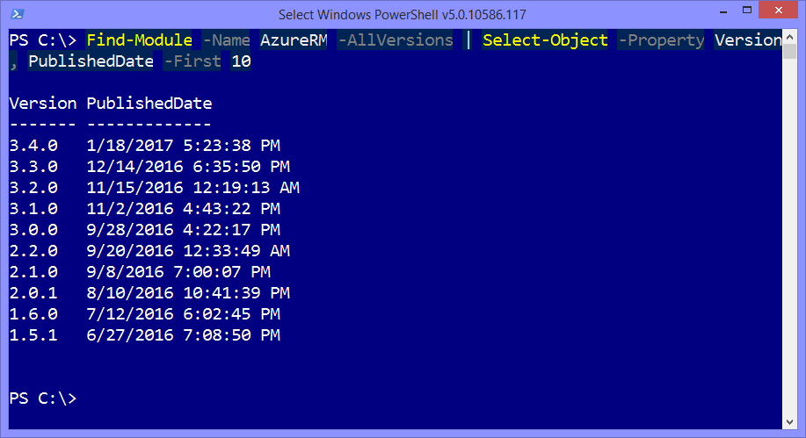
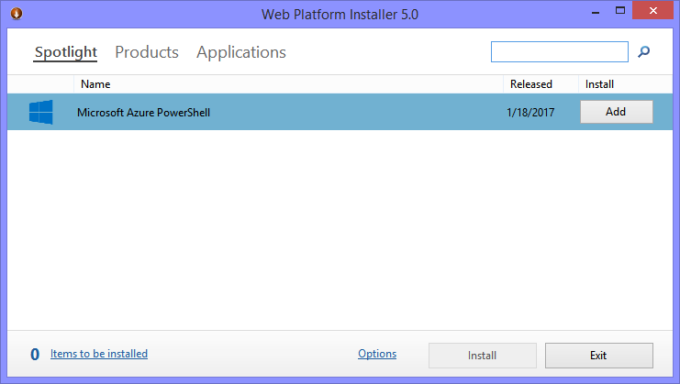
Obtain the ARM Modules

Slide 11
Discover
AzureRM modules
Azure RM commands
Deploy a Windows Server VM

Slide 12

Step Into Poo ARM Templates

Slide 13
ARM Template Facts
Every Azure deployment uses these templates
Deterministic
Idempotent
Parameters and variables
Functions
Nested templates

Slide 14
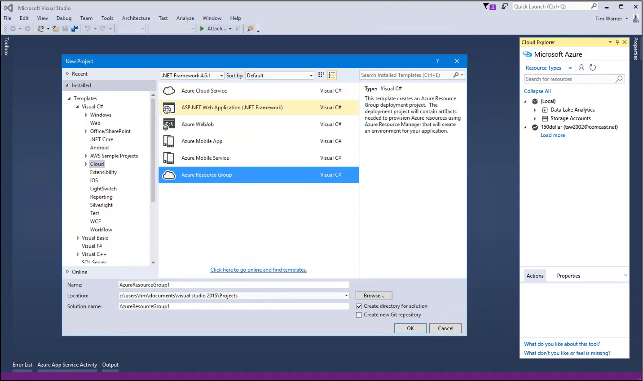
Visual Studio with the Azure .NET SDK

Slide 15
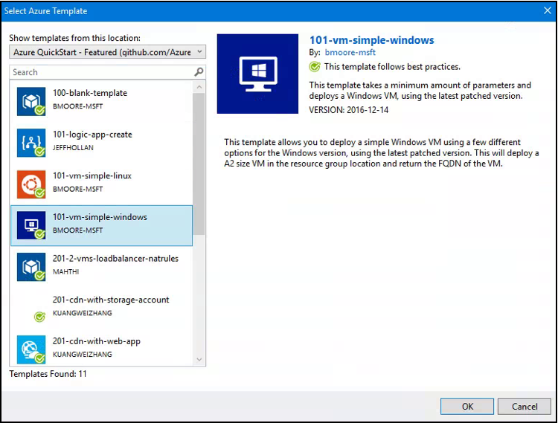
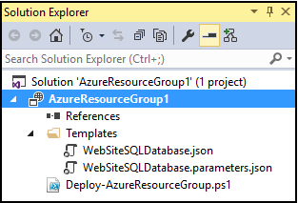
Visual Studio with the Azure .NET SDK

Slide 16
Azure Resource Explorer
Review the ARM template we downloaded earlier
Visual Studio Code
Azure Quickstart Templates
Resource Visualizer

Slide 17
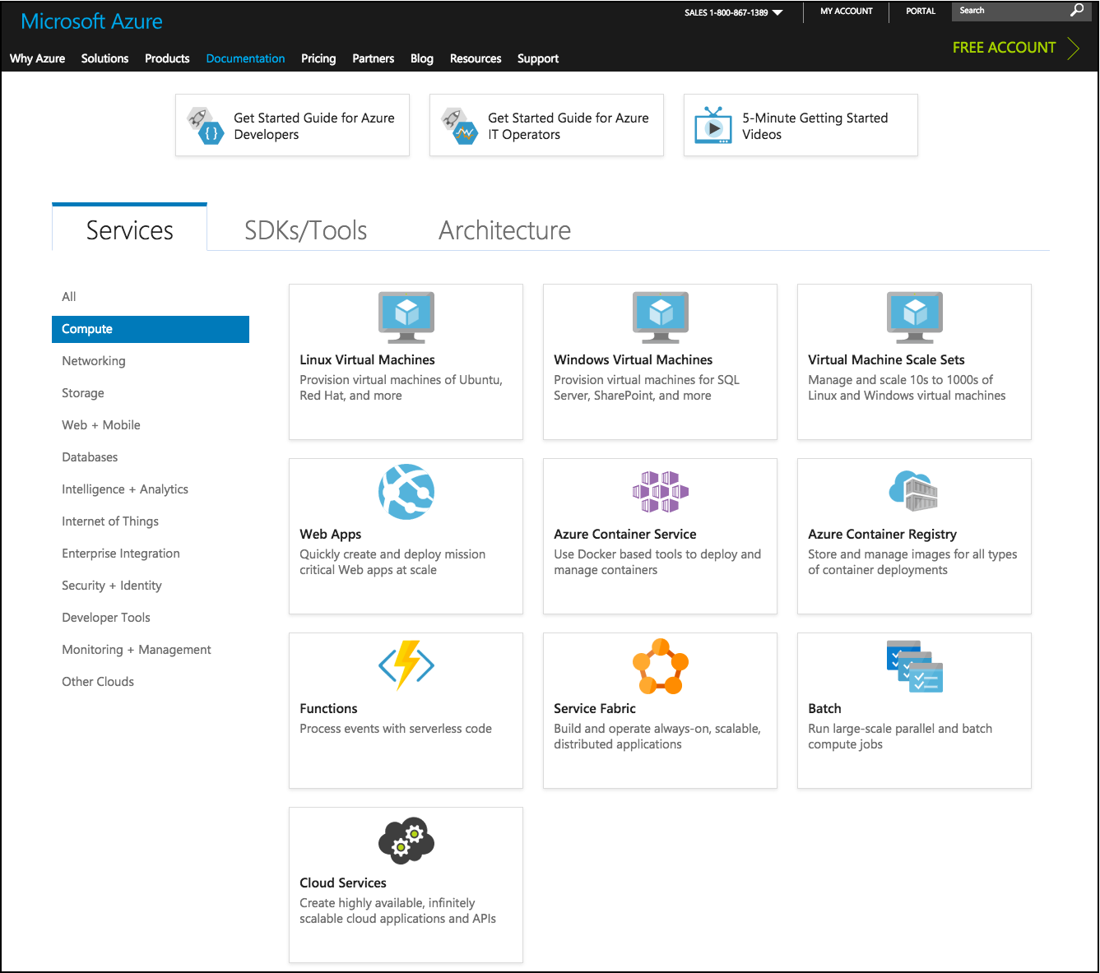
Book Reference
Azure books almost always deal with Azure v1 (ASM)
Microsoft is centrally locating their TechNet and MSDN product docs
docs.microsoft.com/azure

Slide 18
Materials: timw.info/azposh
Twitter: @TechTrainerTim
Mail: azuredepot.com/contact
Thank You!

