Slide 1
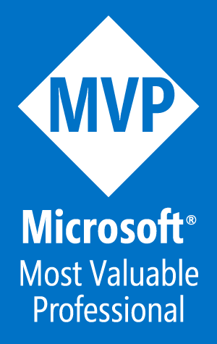
Deploy an n-Tier Web App Pod with PowerShell and Azure
Tim Warner
Author, Pluralsight
Wednesday, April 12, 2017
10:00 - 10:45 am

Slide 2
Your Takeaways
Understand ARM templates and template deployment in Azure
Shorten your learning curve with ARM template helper resources
Deploy a web app using an ARM template

Slide 3

Session Materials
timw.info/awa
Check out yesterday’s session materials on managing Azure web apps

Slide 4
ARM Template Quick Start

Slide 5
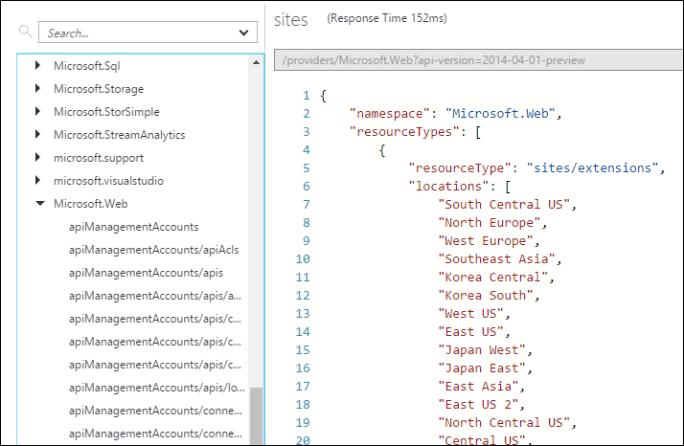
Resource Explorer (resources.azure.com)
“Everything’s a resource”

Slide 6
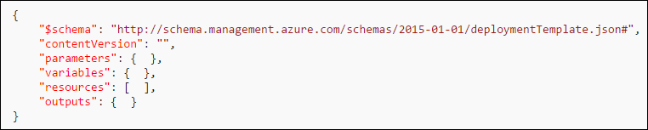
JSON Template Format
Required
Required; dev use only
Values returned by deployment
Required; included resources
Values used in expressions
Customize deployment

Slide 7
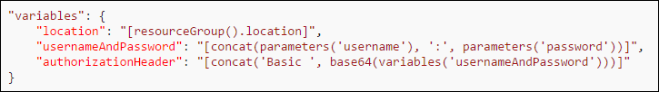
Expressions and Functions
expression
function

Slide 8
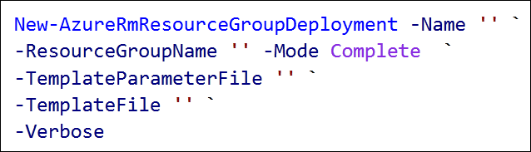
Template Deployment
Complete (strict)
Incremental (no deletion of existing resources)
Can be local file or URI

Slide 9
ARM Template Helpers

Slide 10
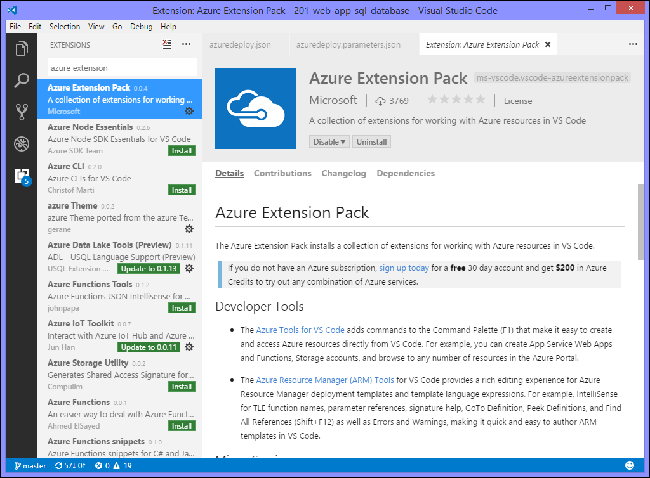
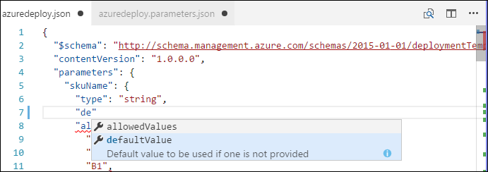
Visual Studio Code

Slide 11
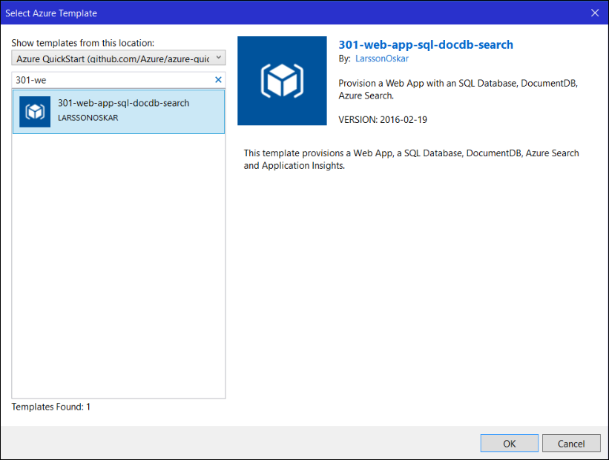
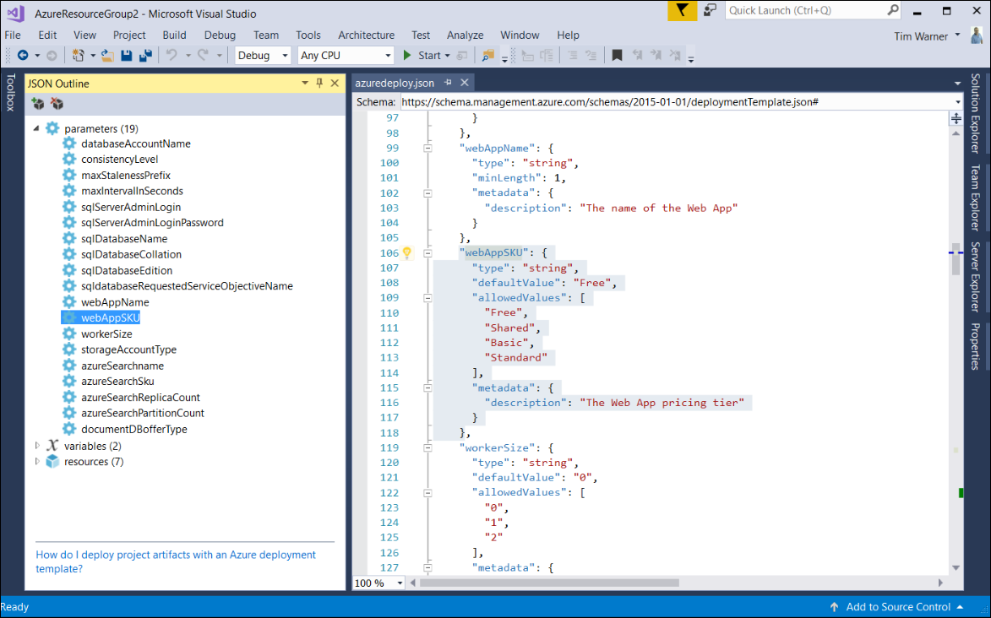
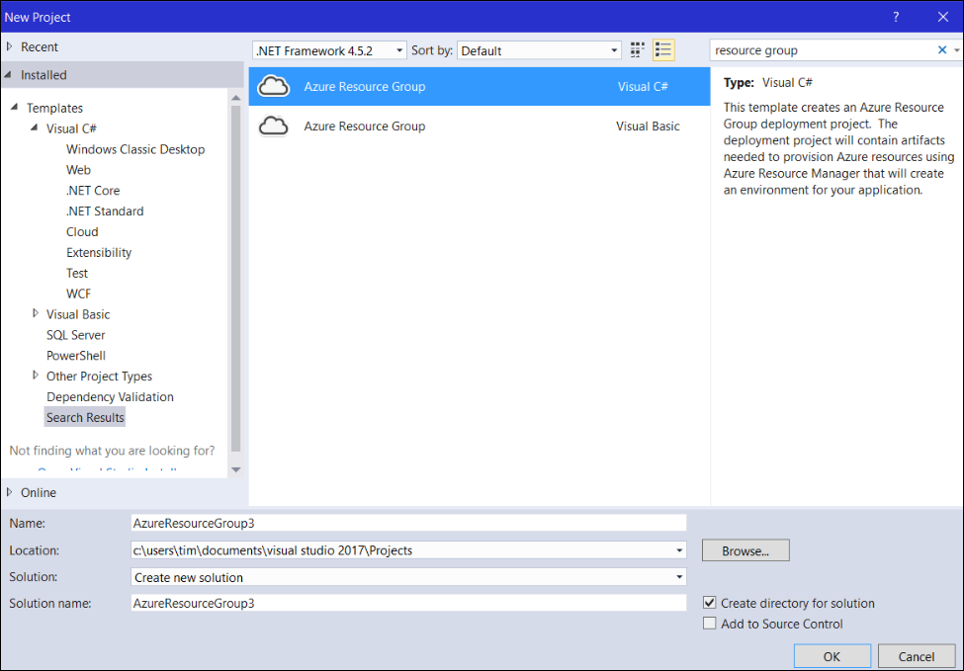
Visual Studio 2017 Community Edition

Slide 12
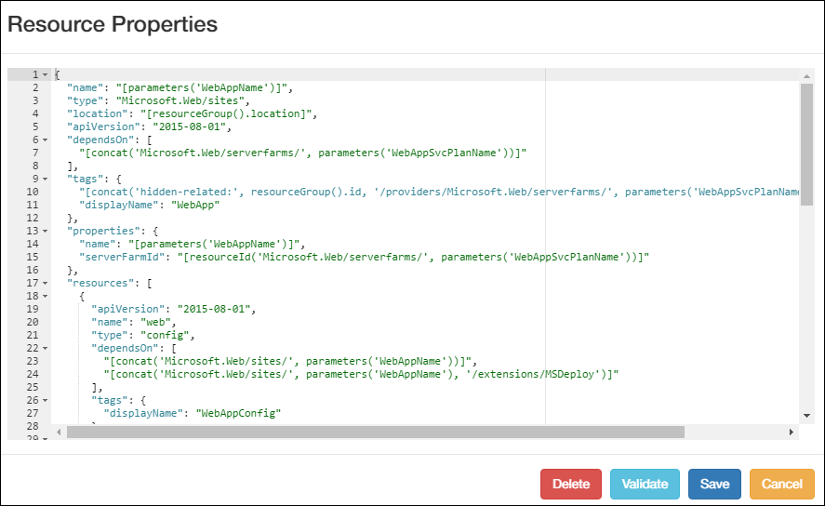
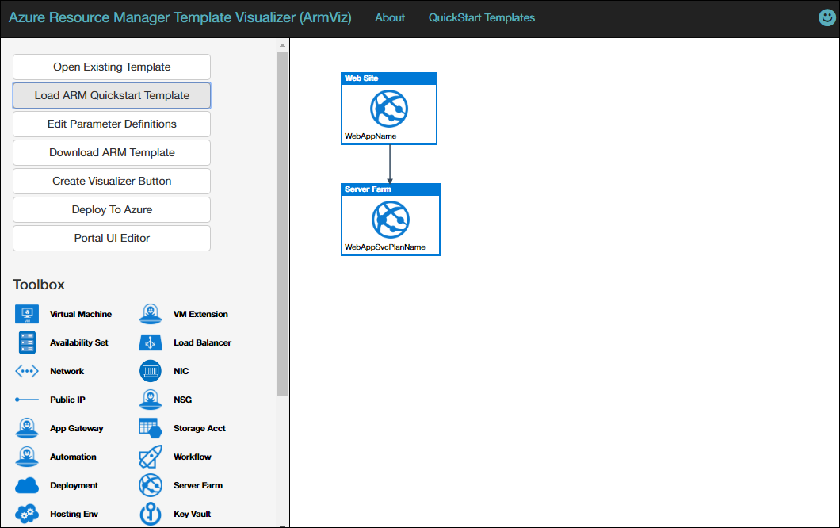
Azure Resource Visualizer (armviz.io)

Slide 13
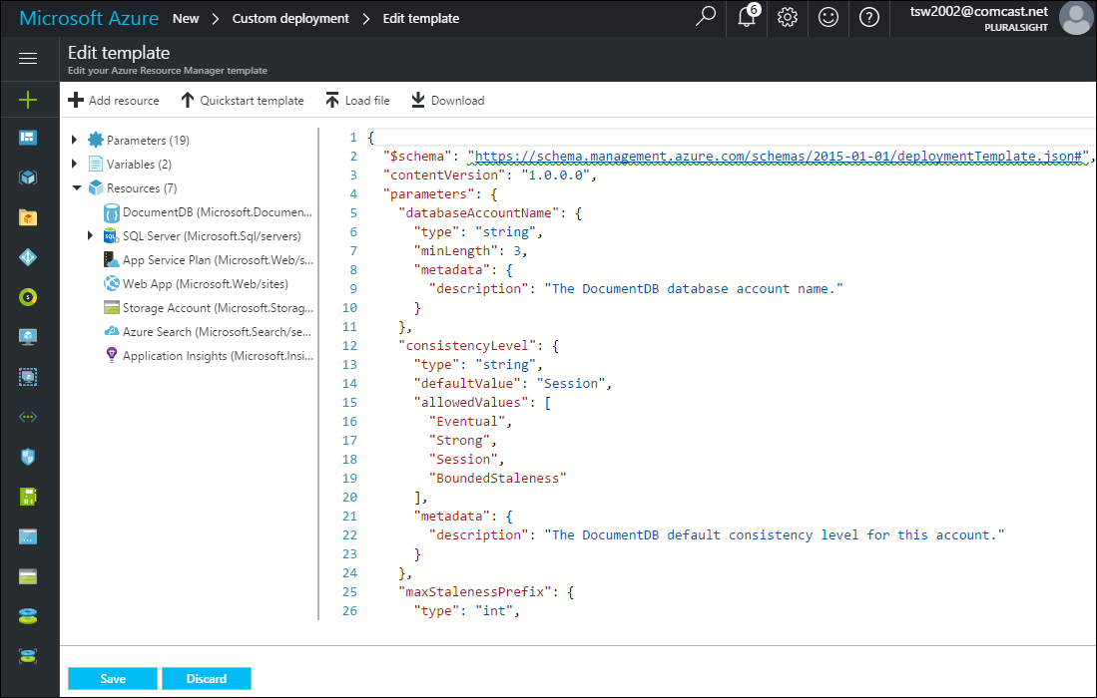
Azure Portal

Slide 14
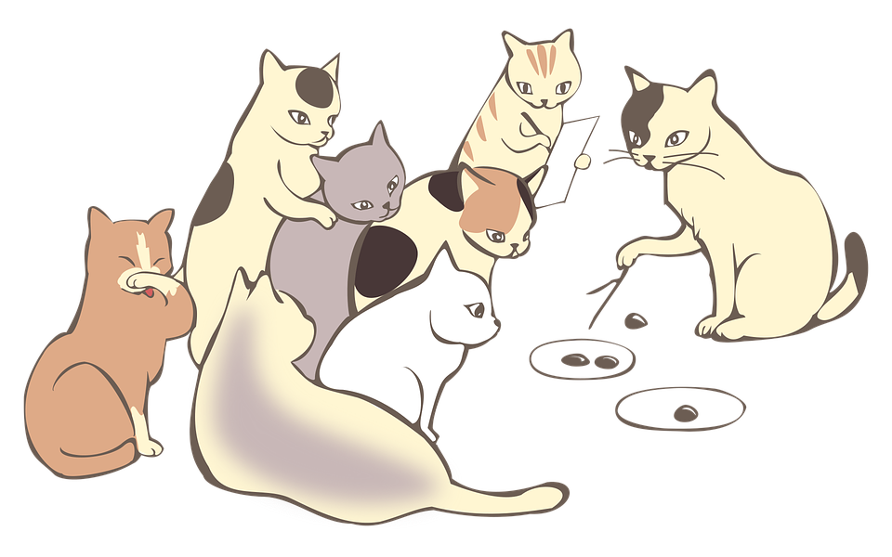
Demo Tasks
Resource Explorer
Automation Script
Resource Group > Deployments

Slide 15
Deploy a Web App

Slide 16
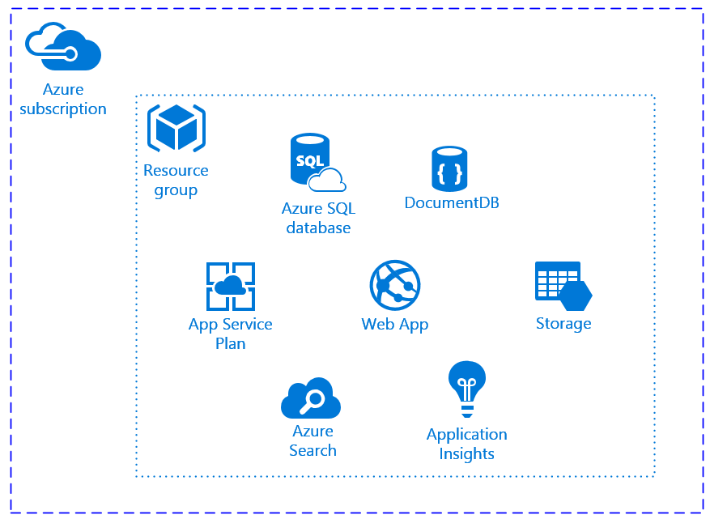
Our “Simple” PaaS Solution

Slide 17
Demo Tasks
Azure Quickstart Templates & Portal
Visual Studio

Slide 18

Thank you!
Don't You Forget About Me the evaluation
Materials: timw.info/awa
Twitter: @TechTrainerTim
Site: techtrainertim.com
Mail: timothy-warner@pluralsight.com
timw.info/bi1

