Slide 1
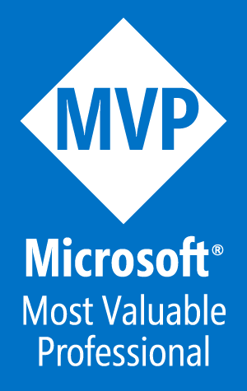
Manage Azure Web Apps with Visual Studio and PowerShell
Tim Warner
Author, Pluralsight
Tuesday, April 11, 2017
1:00 - 1:45 pm

Slide 2
Your Takeaways
Understand Azure App Services
Explore the AzureRM.Websites PowerShell module
Create and manage Web apps programmatically
Visual Studio integration points
If we have time...get familiar with Azure CLI v2.0

Slide 3

Setting Expectations
45 min + lots o’ content = drinking from the fire hose
I make all my session materials available for your studying pleasure
If you need ARM template deployment info:
“Deploy an n-Tier Web App Pod with PowerShell and Azure”
Wednesday, April 12 10:00 – 10:45 am
timw.info/firehose

Slide 4

Session Materials
timw.info/awa

Slide 5
Understand Azure App Services

Slide 6
Layers of Abstraction
Azure Functions
Azure App Services (PaaS)
Azure VMs (IaaS)
Bare metal (hardware host)

Slide 7
Azure App Services App Types
Web Apps
API Apps
First-class support for:
ASP.NET
Node.js
Java
PHP
Python
DevOps optimization:
PowerShell/Azure CLI Visual Studio Team Services GitHub Bitbucket
Global scale and high availability
Hosted RESTful APIs in the Azure cloud
Supports any Azure App Services language/framework
Consume using the standard Swagger (OpenAPI) API framework

Slide 8
Azure App Services App Types
Mobile Apps
Logic Apps
Rich back-end functionality for:
iOS Android Windows Phone Xamarin Cordova
User authentication
Azure AD Facebook, Twitter, etc.
Push notifications
Scalable workflow engine (IFTTT)
Events trigger workflow (Azure functions = events trigger code)
Logic apps can use Azure functions in their workflows
Sibling to Microsoft BizTalk Server 2016 on premises and Azure BiZTalk Services

Slide 9
App Service Environments (ASEs)
Isolated on an Azure virtual network
Network security groups (NSGs)
Web application firewall (WAF)
Dedicated hardware resources
Requires high-end VM classes and premium storage
Front-end
Back-end
Expensive

Slide 10
Explore the AzureRM.Websites Module

Slide 11
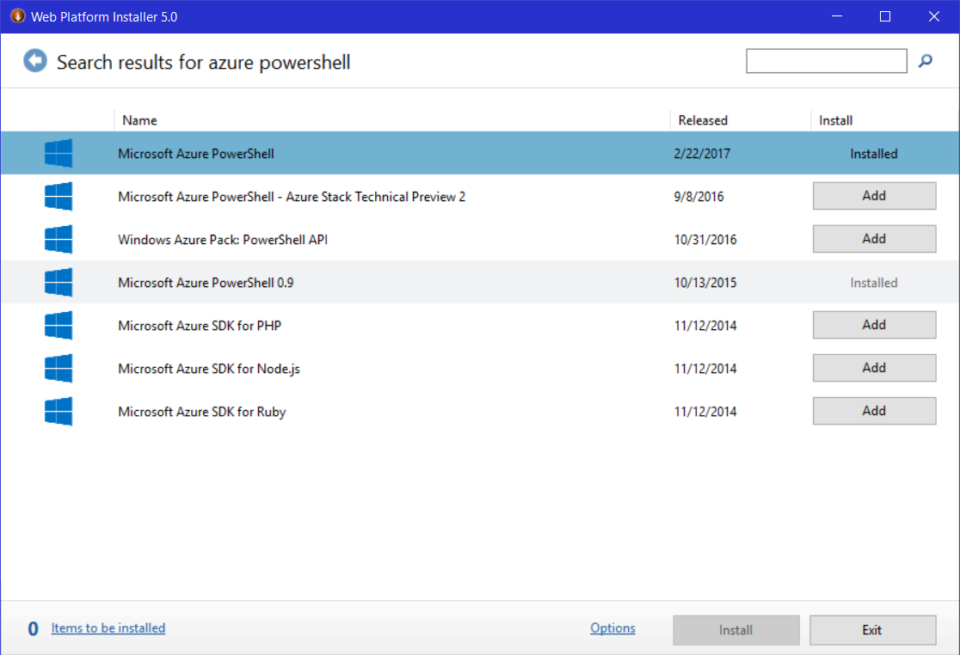
Web Platform Installer (Web PI)

Slide 12
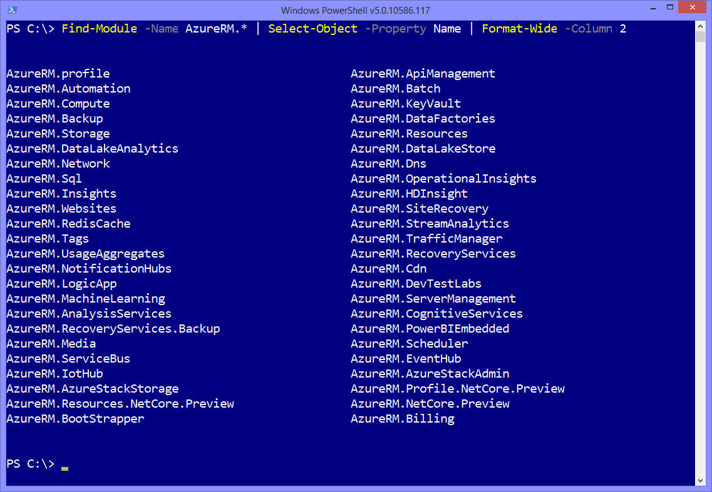

Slide 13
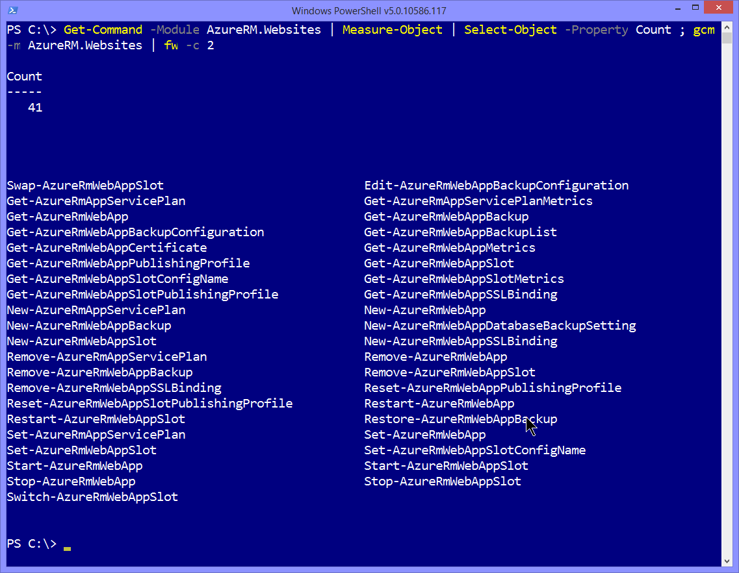

Slide 14
Create and Manage Azure Web Apps

Slide 15

Demo Tasks
Review portal experience
Azure PowerShell
Kudu PowerShell console
Cloud console

Slide 16
Visual Studio Integration Points

Slide 17
Demo Tasks
SDK availability
Create web app from template
Cloud explorer
Open Websites extension
JSON Outline

Slide 18
Understand Azure CLI v2.0

Slide 19

A Tale of Two Azure CLIs
Xplat-CLI: Node.js application
Azure Service Management (ASM)
Cross-platform programmatic access to Azure
Azure CLI v2.0: Python application
The two CLIs are incompatible (azure vs az)

Slide 20
Demo Tasks
Installation workflow
Play with the tool in the website context

Slide 21

Thank you!
Don't You Forget About Me the evaluation
Materials: timw.info/awa
Twitter: @TechTrainerTim
Site: techtrainertim.com
Mail: timothy-warner@pluralsight.com

