Slide 1

Deploy an n-Tier Web App Pod with PowerShell and Azure
Tim Warner
Author, Pluralsight
Wednesday, April 12, 2017
10:00 - 10:45 am

Slide 2
Our Agenda
ARM template "blink and you miss it" quick start
ARM template helpers and "cheaters"
Deploy some resources!

Slide 3

Session Materials
timw.info/awa

Slide 4
ARM Template Quick Start

Slide 5
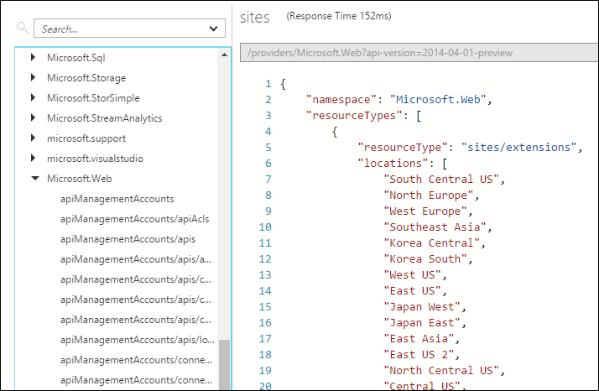
Resource Explorer

Slide 6
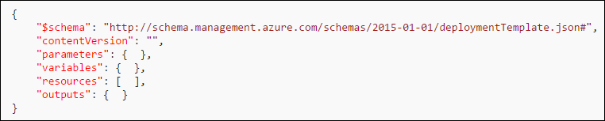
Template Format

Slide 7
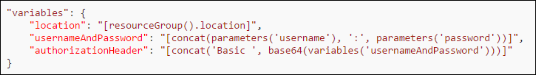
Expressions and Functions

Slide 8
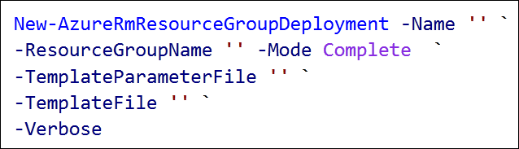
Template Deployment

Slide 9
ARM Template Helpers

Slide 10
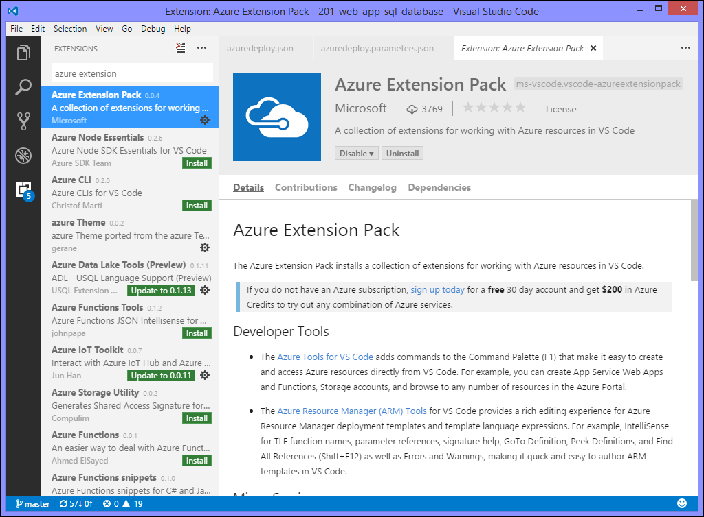
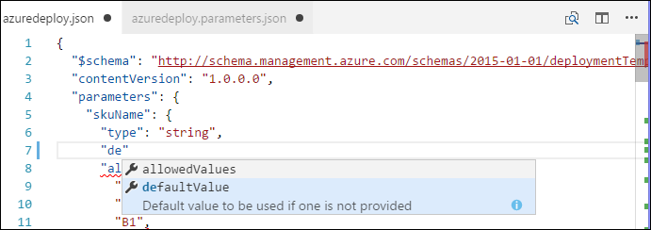
Visual Studio Code

Slide 11
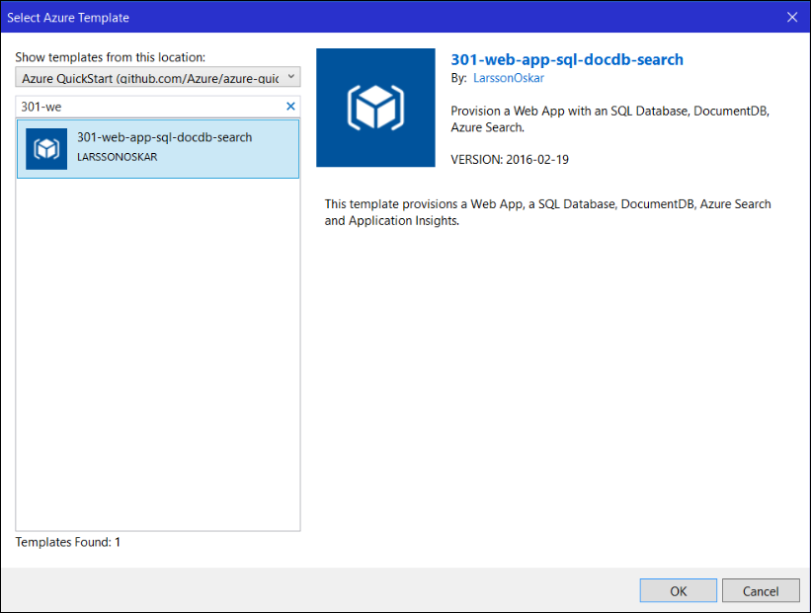
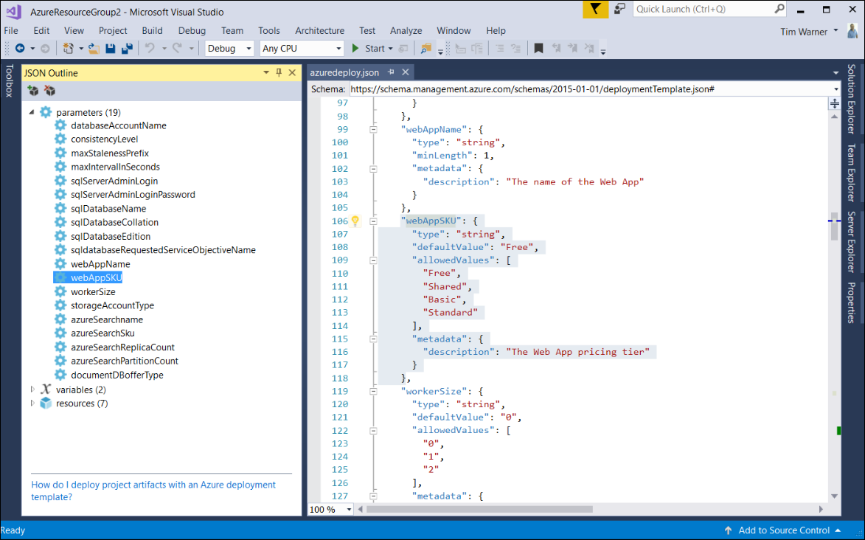
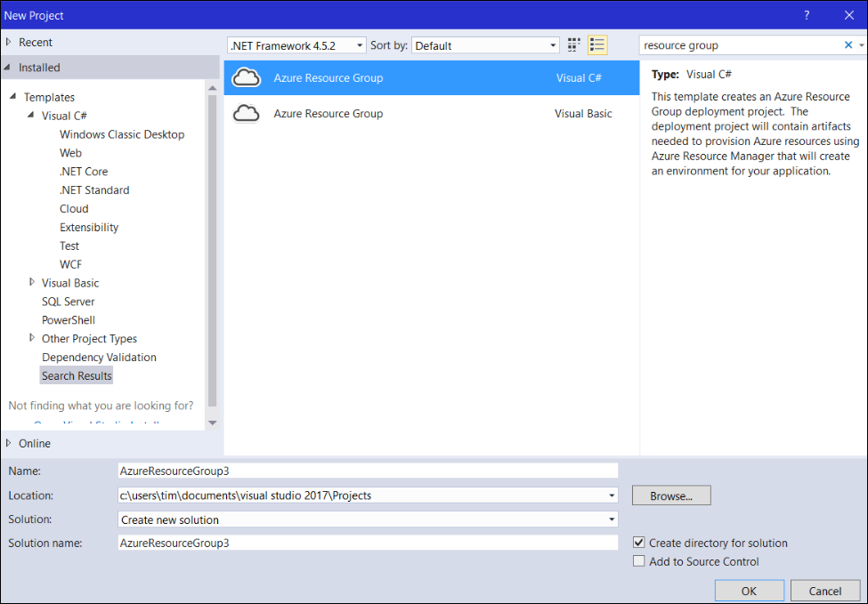
Visual Studio 2017 Community Edition

Slide 12
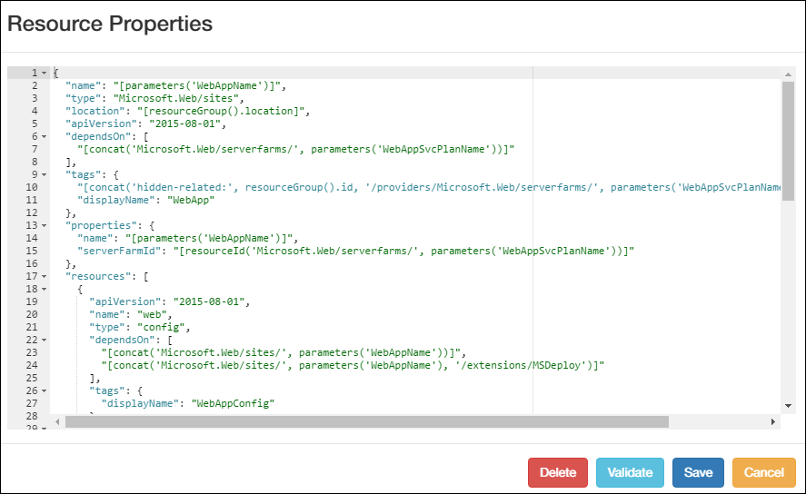
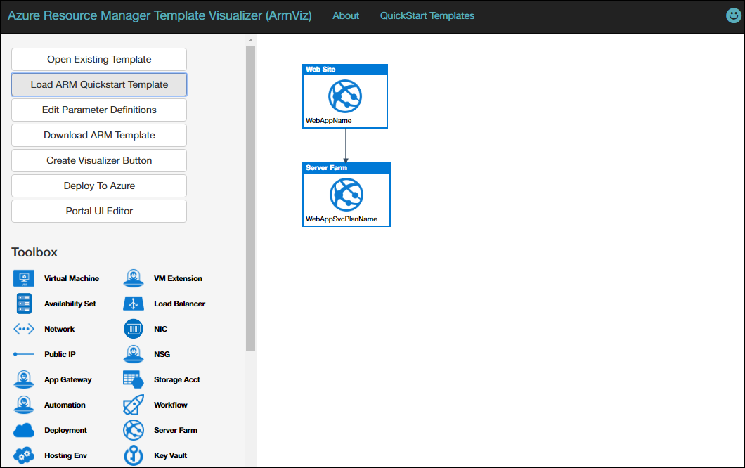
Azure Resource Visualizer (ARMVIZ)

Slide 13
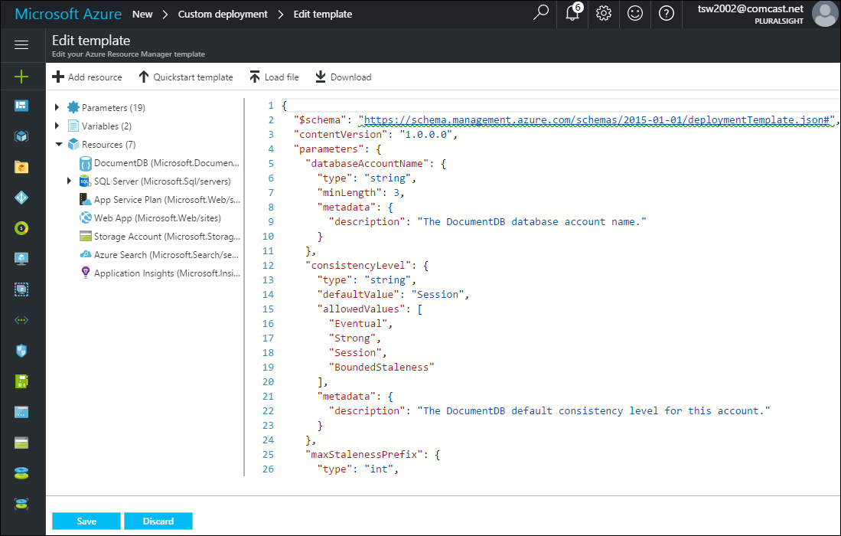
Azure Portal

Slide 14
Deploy Some Resources!

Slide 15
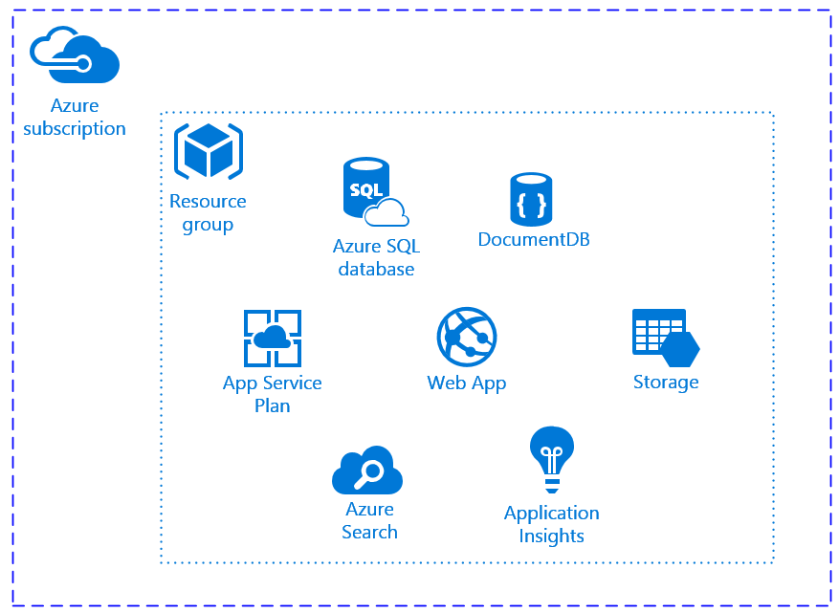
Our Solution

Slide 16

Thank you!
Don't You Forget About Me the evaluation
Materials: timw.info/awa
Twitter: @TechTrainerTim
Site: techtrainertim.com
Mail: timothy-warner@pluralsight.com
timw.info/bi1

Slide 17
Template Format
Required
Required; dev use only
Values returned by deployment
Required; included resources
Values used in expressions
Customize deployment

Slide 18
Expressions and Functions
expression
function

Slide 19
Visual Studio Code

Slide 20
Azure Resource Visualizer

Slide 21
Azure Resource Visualizer

Slide 22
Azure Portal

Slide 23
View resource group
Automation script
Deployments link
Azure Quickstart templates
ArmVIZ
2

Slide 24
Deploy an n-Tier Web Application

Slide 25
Template Deployment
Complete (strict)
Incremental (no deletion of existing resources)
Can be local file or URI

Slide 26
Our Solution

