Slide 1
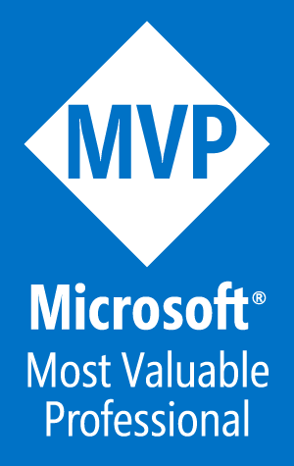
Manage Azure Web Apps with Visual Studio and PowerShell
Tim Warner
Author, Pluralsight
Tuesday, April 11, 2017
1:00 - 1:45 pm

Slide 2
Our Agenda
Understand Azure App Services
Explore the AzureRM.Websites PowerShell module
Create and manage Web apps programmatically
Deploy ARM templates with PowerShell
If we have time...understand Azure CLI v2.0

Slide 3

Session Materials
timw.info/awa

Slide 4
Understand Azure App Services

Slide 5
Azure App Services App Types
Web Apps
API Apps
First-class support for:
ASP.NET
Node.js
Java
PHP
Python
DevOps optimization:
PowerShell/Azure CLI Visual Studio Team Services GitHub Bitbucket
Global scale and high availability
Hosted RESTful APIs in the Azure cloud
Supports any Azure App Services language/framework
Consume using the standard Swagger (OpenAPI) API framework

Slide 6
Azure App Services App Types
Mobile Apps
Logic Apps
Rich back-end functionality for:
iOS Android Windows Phone Xamarin Cordova
User authentication
Azure AD Facebook, Twitter, etc.
Push notifications
Scalable workflow engine
Events trigger workflow (Azure functions = events trigger code)
Logic apps can use Azure functions in their workflows
Compare to IFTTT
Sibling to Microsoft BizTalk Server 2016 on premises and Azure BiZTalk Services

Slide 7
Explore the AzureRM.Websites Module

Slide 8
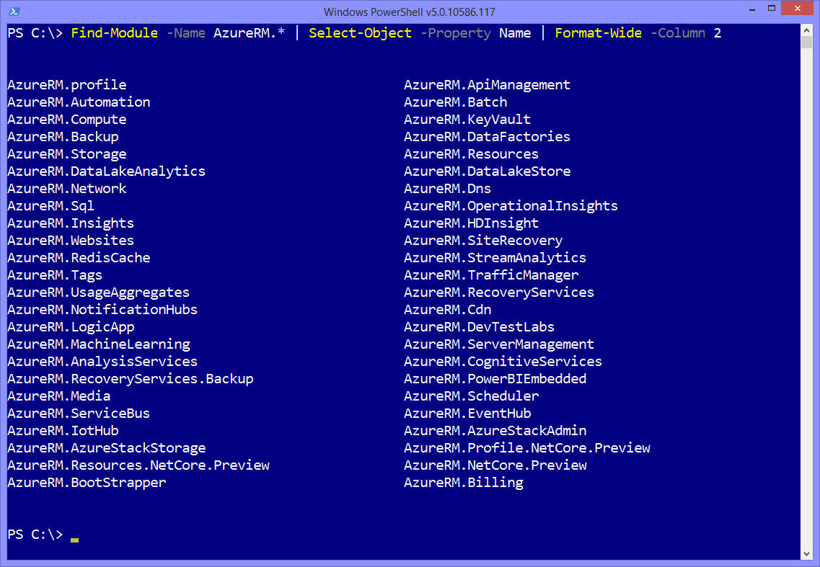

Slide 9
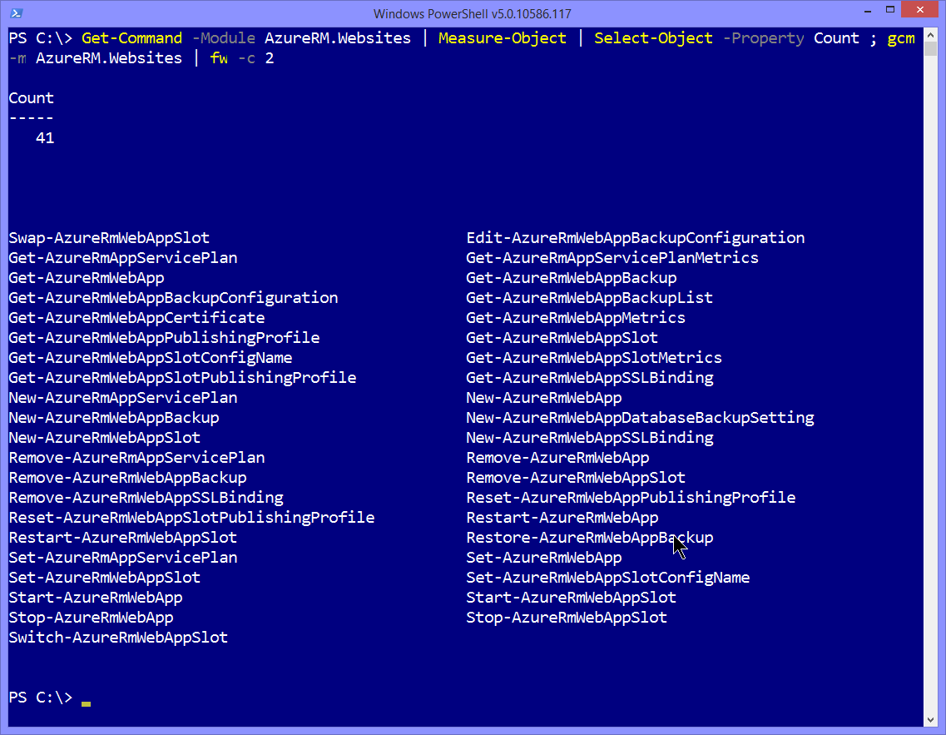

Slide 10
Demo: Create and Manage Azure Web Apps

Slide 11
Demo: Deploy ARM Templates

Slide 12
Understand Azure CLI v2.0

Slide 13
About the Azure CLI
Xplat-CLI: Node.js application
Azure Service Management (ASM)
Cross-platform programmatic access to Azure
Azure CLI v2.0: Python application
The two CLIs are incompatible (azure vs az)

Slide 14

Thank you!
Don't You Forget About Me the evaluation
Materials: timw.info/awa
Twitter: @TechTrainerTim
Site: techtrainertim.com
Mail: timothy-warner@pluralsight.com

