Slide 1
Tracking Down Network Abuse with Wireshark
Tim Warner
timothy-warner@pluralsight.com

Slide 2

Our Agenda
Why you should care about Wireshark
Identify use cases
Evaluate competition
How you use Wireshark
Install the tool
Perform packet captures
What problems you can solve with Wireshark
Detect network misuse/abuse
Undertake network forensics

Slide 3
Session Web Site
timw.info/wireshark

Slide 4



Why You Should Care About Wireshark

Slide 5


What is Wireshark?
Open-source, cross-platform packet analyzer
Developed in late 1990s as Ethereal by Gerald Combs
Laura Chappell (Wireshark University)
http://timw.info/wireshark

Slide 6
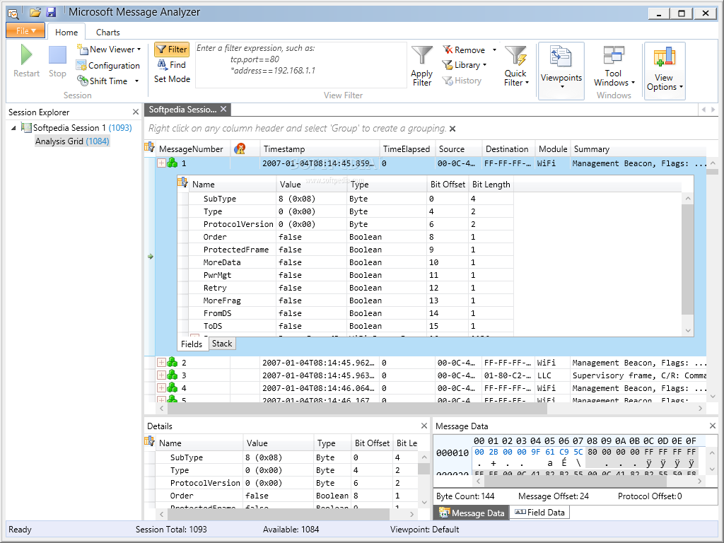
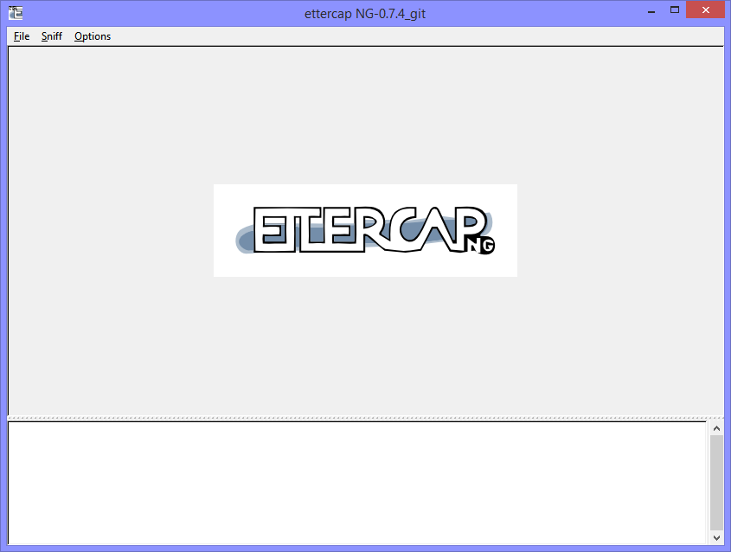
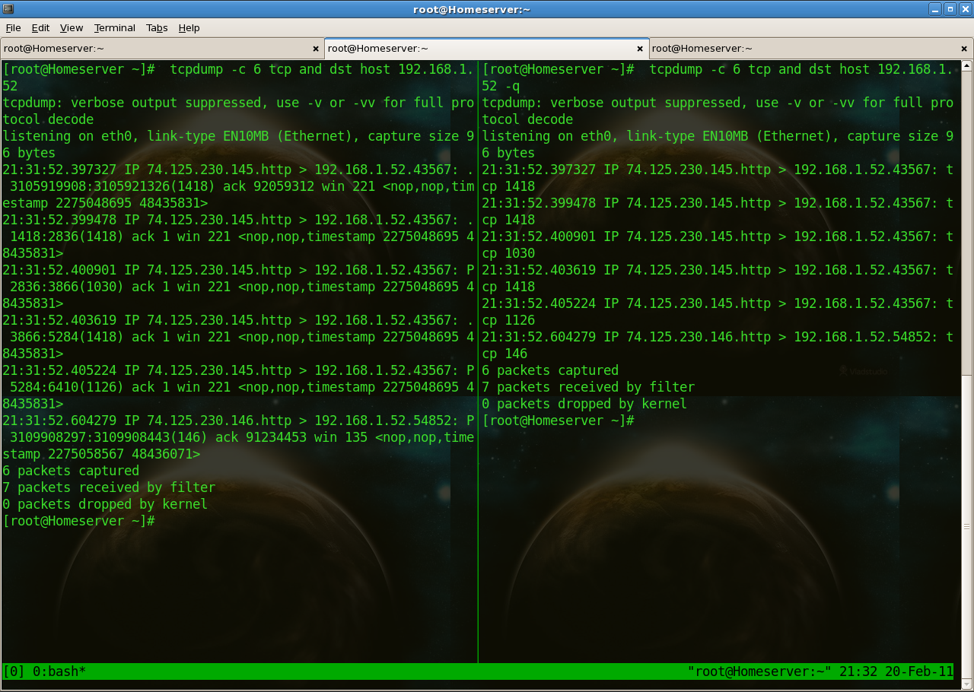
Alternatives

Slide 7
Why You Should Care
Transform qualitative hunches into quantitative data
Prepare forensics reports for HR or possibly court
Justify purchases or changes to the CIO

Slide 8

How You Use Wireshark

Slide 9
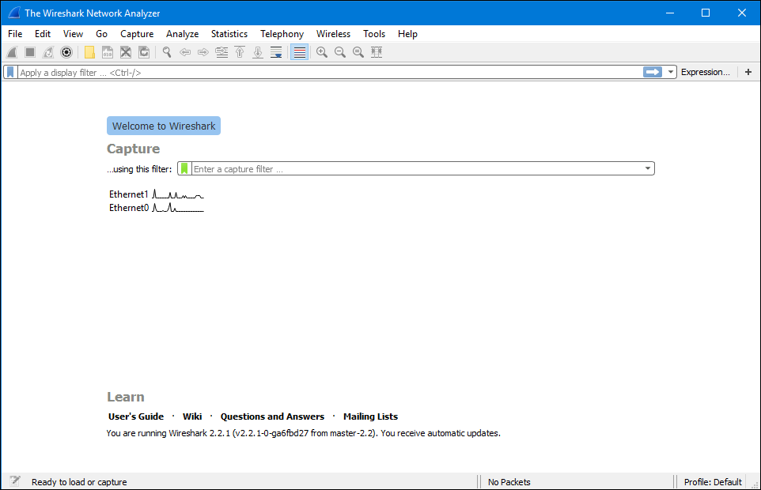
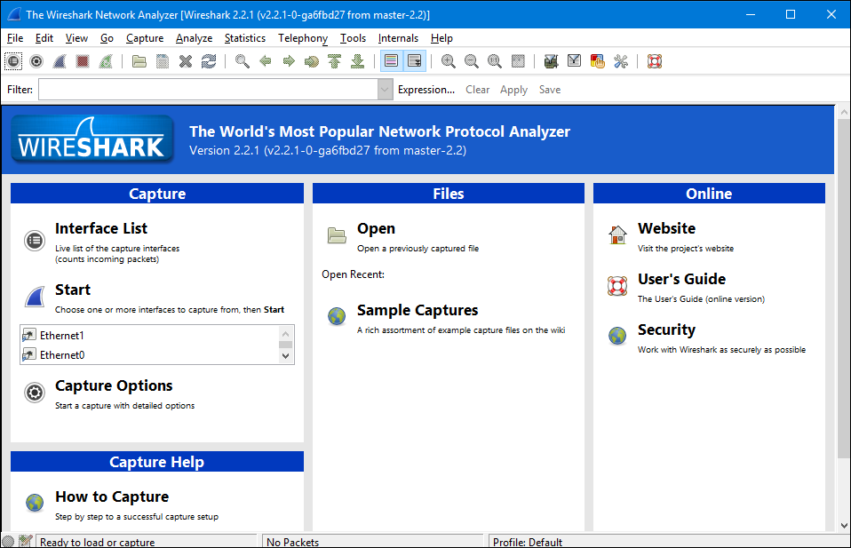
Wireshark Versions

Slide 10
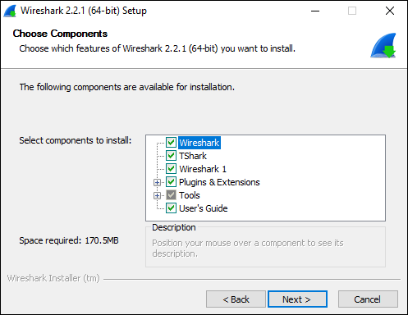
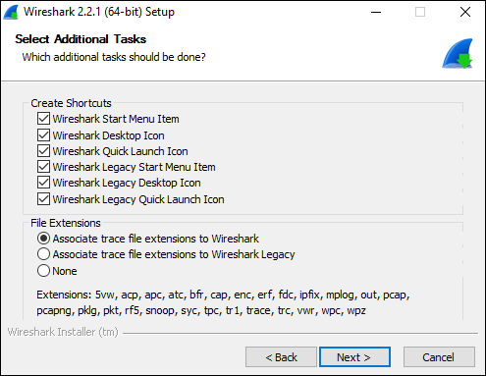
Installation

Slide 11
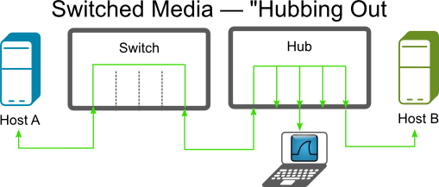
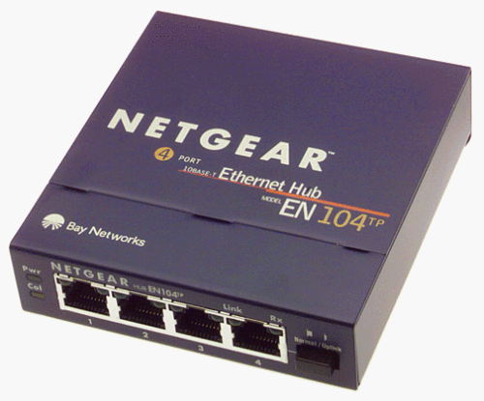
"Hubbing Out"
http://bit.ly/1QLBTvL
http://timw.info/wireshark

Slide 12
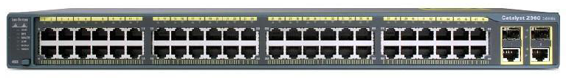
Port Mirroring
Switch(config)# no monitor session all
Switch(config)# monitor session 1 source interface fa0/1
Switch(config)# monitor session 1 destination interface fa0/2
Switch(config)# end
http://timw.info/wireshark

Slide 13
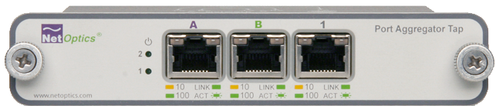
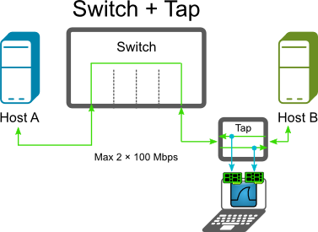
Port Aggregation Tap
http://bit.ly/1QLBTvL
http://timw.info/wireshark

Slide 14
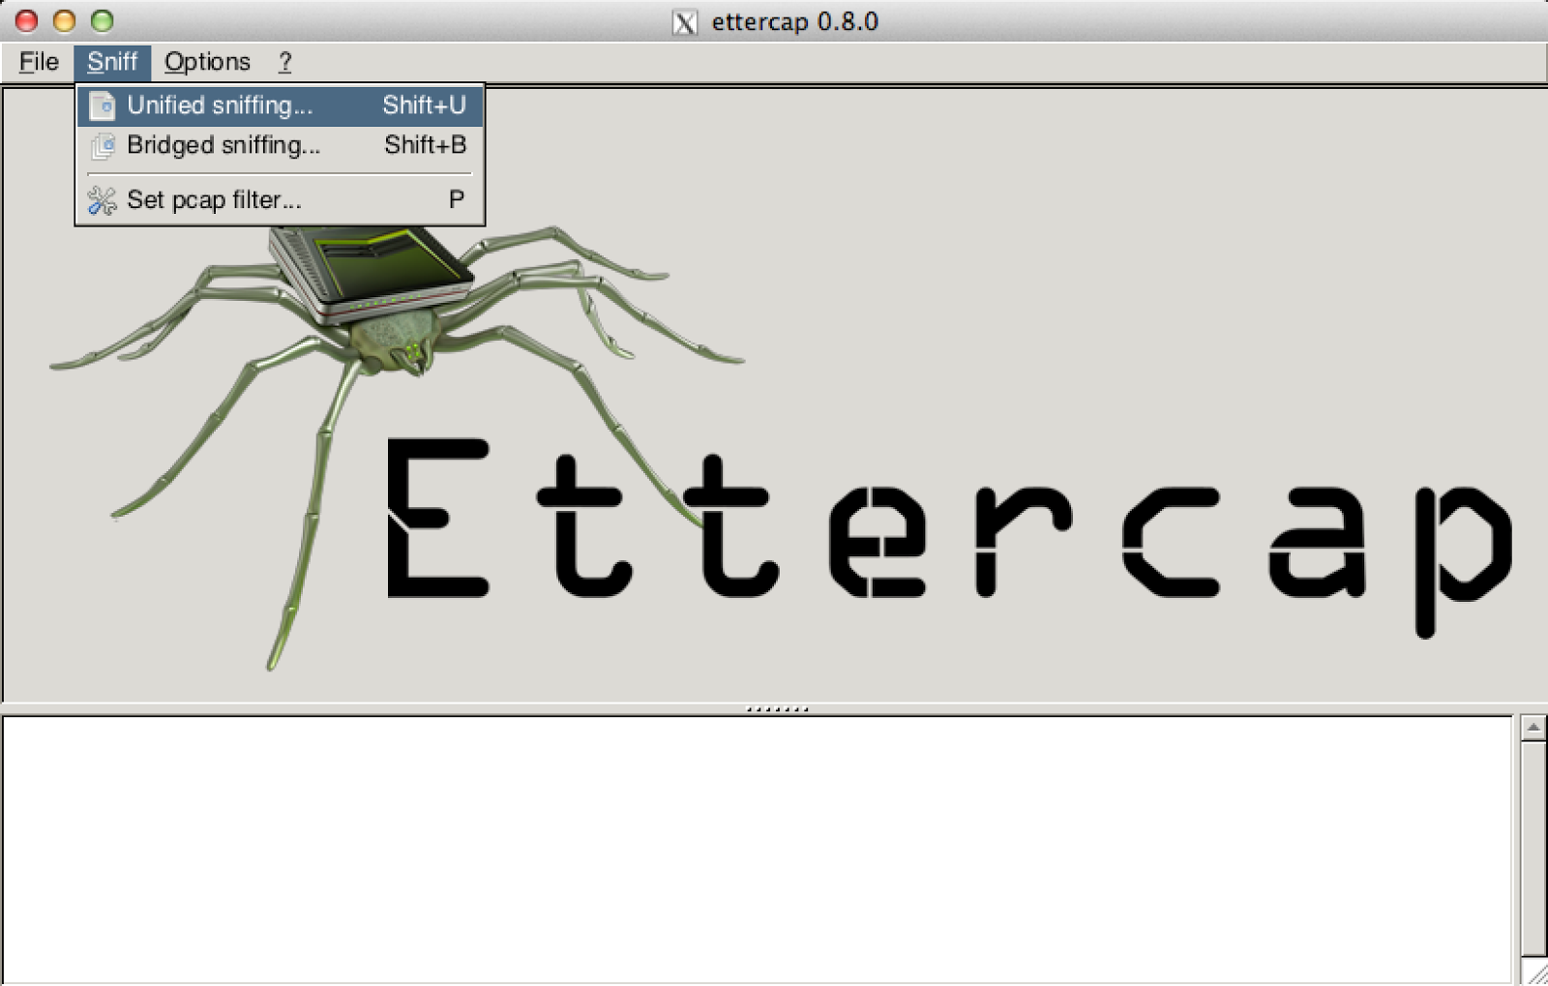
MAC Spoofing/MITM

Slide 15

Legalities
The Wireshark program itself is not illegal
Fundamental questions:
Do you own the network?
Are you authorized to perform packet capture?
Your tracing efforts could be considered a passive or even active attack
Terms of Use
Acceptable Use Policy

Slide 16
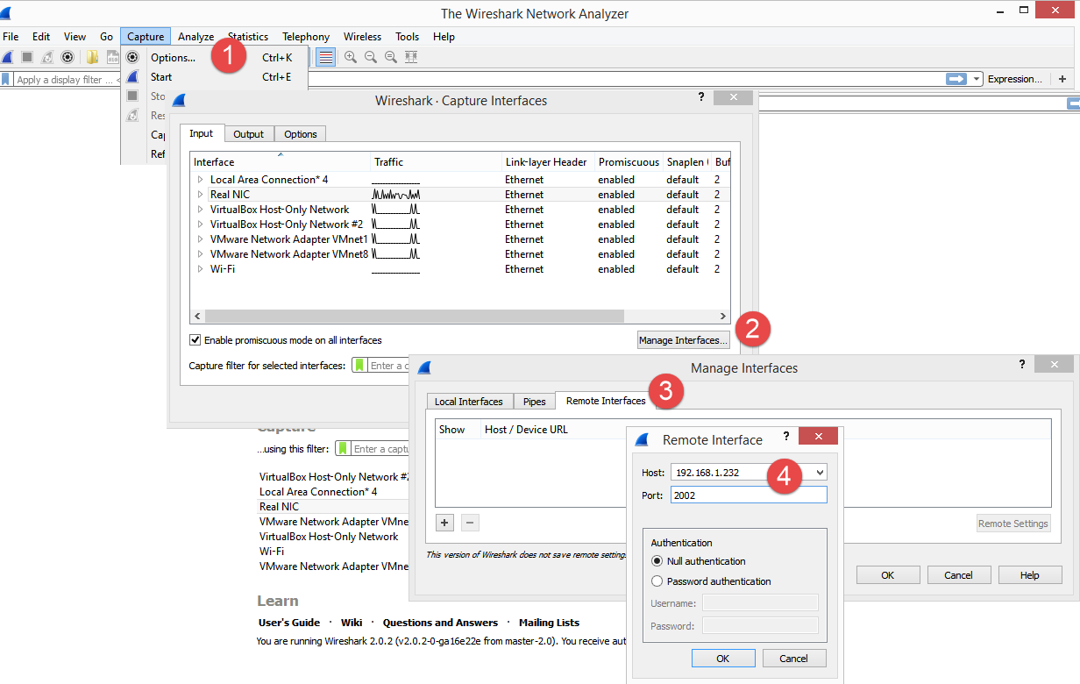
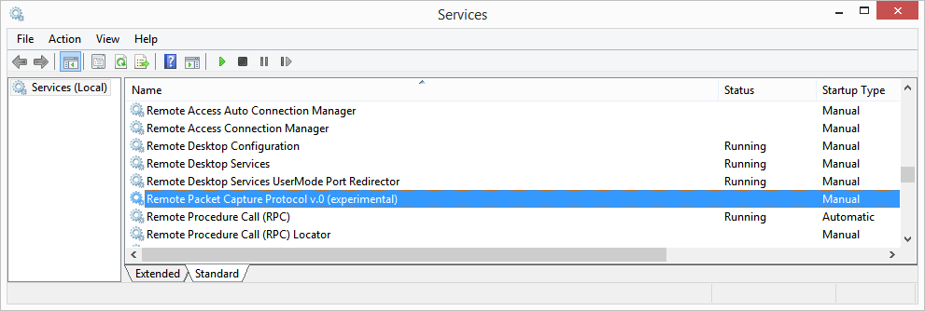
Remote Packet Capture
Install only the winPcap bits on each node

Slide 17
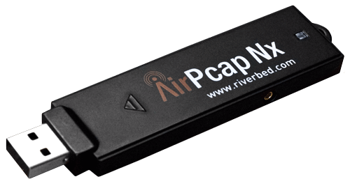
Capturing Wi-Fi
In Windows, you can't put your WNIC in monitor mode
By default, you can capture only IEEE 802.11 management/control frames (no data)
Linux doesn't have this problem (of course)
AirPcap
Riverbed Technologies
Director of Open Source Projects
Gerald Combs

Slide 18
Demo
Check out the Wireshark GUI interface(s)
Load capture files
Test tshark.exe

Slide 19
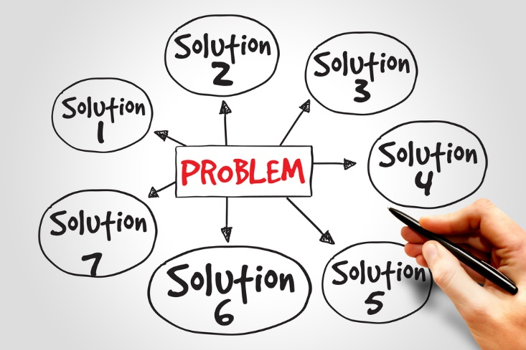
What Problems You Can Solve With Wireshark

Slide 20
Demo
Analyze capture files in the context of real-world scenarios
Gain some practice & experience with Wireshark

Slide 21
Questions?
Please use Event Board to fill out a session evaluation.
Thank you!
Tim Warner
timothy-warner@pluralsight.com
@TechTrainerTim
timwarnertech.com
http://timw.info/wireshark

