Slide 1
Bin 381 Milestone 4 Group 1
Which household should food-security teams visit first?
A screening aid built from the General Household Survey 2024, for decision-makers with limited budgets.
20,940
Households in the survey
30.6%
At risk of food insecurity
A screen
Not an eligibility test
Alexander Solomon ● Rudi Jan du Plessis ● Timothy Wubbeling

Slide 2
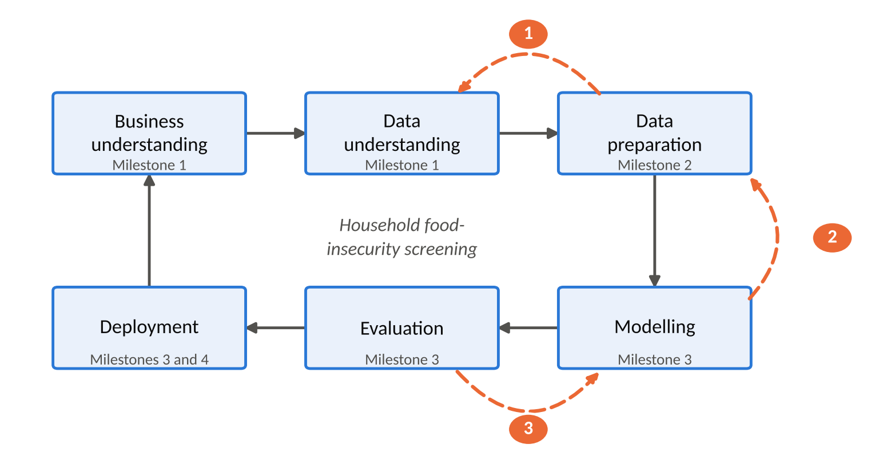
Goal and Approach
Three goals, six phases, three changes of mind
Indicators
Where food insecurity sits and who is affected
Classification model
Flag households that are likely to be at risk
Decision dashboard
Where food insecurity sits and who is affected
Dashed arrows: the integration key repair, the duplicate-ID finding and the move to binary model all sent us back a phase.

Slide 3
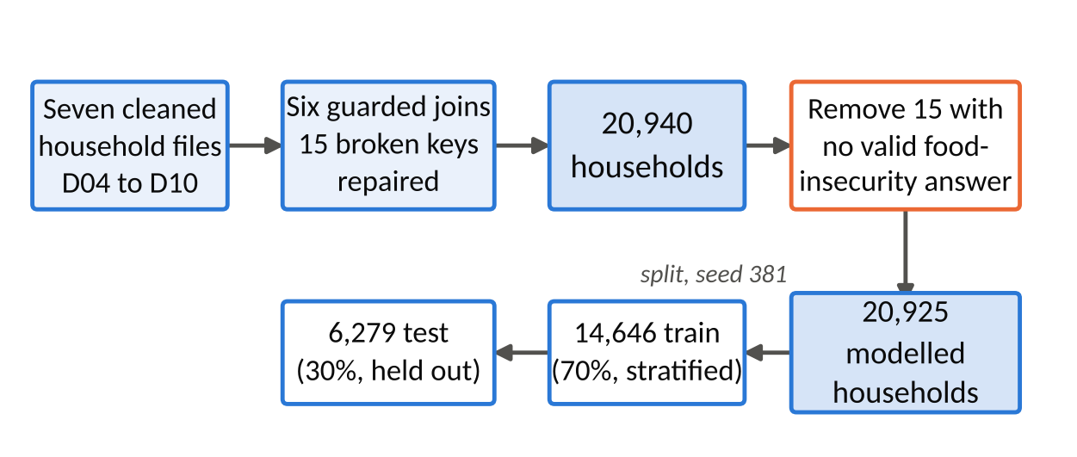
Data Strategy
Seven of eleven files, joined with no household lost
15
broken keys repaired
20,940 -> 20,925
Integrated, then modelled
16
leakage columns excluded
Person-level files D01-D03 and file D11 were left out, with reasons. Split: 14,646 train, 6,279 test.

Slide 4
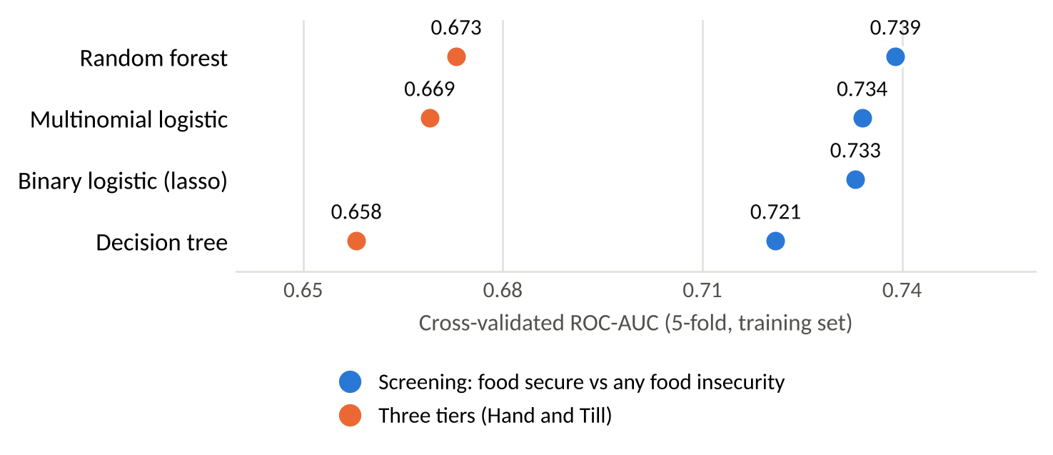
Modelling approach
Three tiers failed on the middle tier, so we kept binary lasso
Fair testing
Stratified 5-fold cross-validation, with no preprocessing outside the folds
The middle tier falls
No three-tier model recalls more than 3.2% of those households
Binary Lasso
One odds ratio per factor, which fits the app.
Cross-validated ROC-AUC. The binary lasso answers a different question, so it is not a like-for-like comparison
Class weights were tested and rejected because they damaged the probabilities.

