Slide 1
Bin 381 Milestone 4 Group 1
Which household should food-security teams visit first?
A screening aid built from the General Household Survey 2024, for decision-makers with limited budgets.
20,940
Households in the survey
30.6%
At risk of food insecurity
A screen
Not an eligibility test
Alexander Solomon ● Rudi Jan du Plessis ● Timothy Wubbeling
Notes:
Our question was a targeting one: when the institute can only follow up a fraction of households, which ones should it visit first? 20,940 households in the survey, three in ten at risk. What we built is a screen that ranks them - not a test of who qualifies for anything. Alexander takes the problem, the data and the modelling; Rudi the results and the dashboard; Timothy the app, the recommendations and the limits.

Slide 2
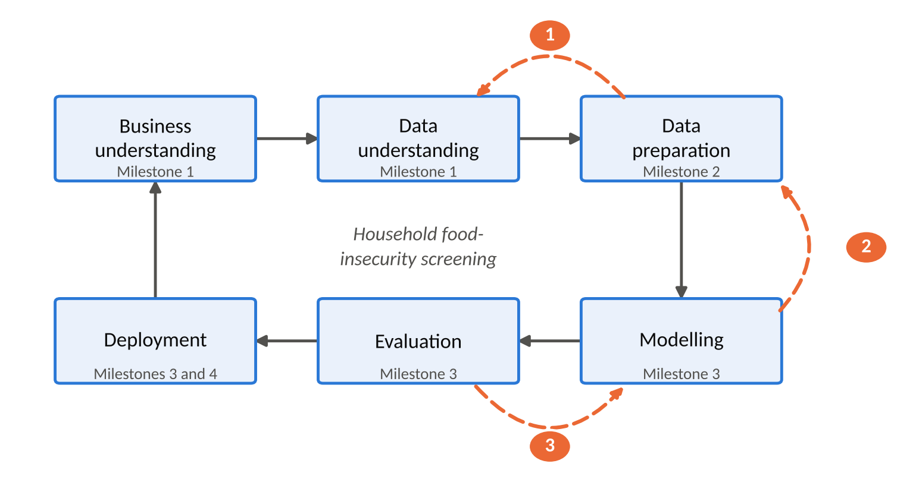
Goal and Approach
Three goals, six phases, three changes of mind
Indicators
Where food insecurity sits and who is affected
Classification model
Flag households that are likely to be at risk
Decision dashboard
Where food insecurity sits and who is affected
Dashed arrows: the integration key repair, the duplicate-ID finding and the move to binary model all sent us back a phase.
Notes:
Three goals from Milestone 1: rank the indicators, build an interpretable model without leakage, and give decision-makers self-service exploration. We followed CRISP-DM in order and went back three times when the evidence demanded it - the key repair, the duplicate-ID finding, and the move to a binary target. The dashed arrows on the diagram are those three returns.

Slide 3
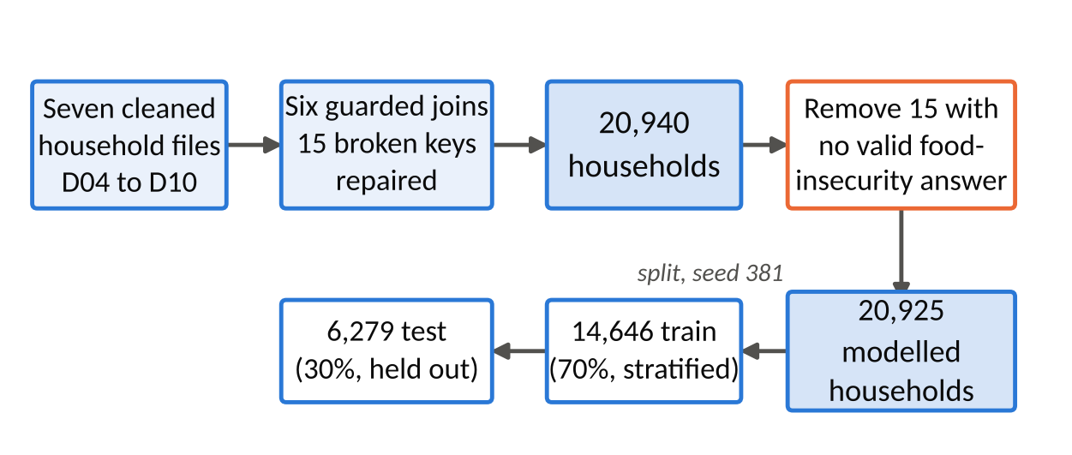
Data Strategy
Seven of eleven files, joined with no household lost
15
broken keys repaired
20,940 -> 20,925
Integrated, then modelled
16
leakage columns excluded
Person-level files D01-D03 and file D11 were left out, with reasons. Split: 14,646 train, 6,279 test.
Notes:
Seven of the eleven files are household-level and were kept. D01 to D03 are person-level and D11 is a different survey with no shared household IDs, so both were left out with reasons. The joins are guarded one-to-one joins that stop rather than drop a household: 15 placeholder keys in D05 were repaired, not discarded. Sixteen columns that define or proxy the target are excluded from the predictors, and the notebook fails if one appears.

Slide 4
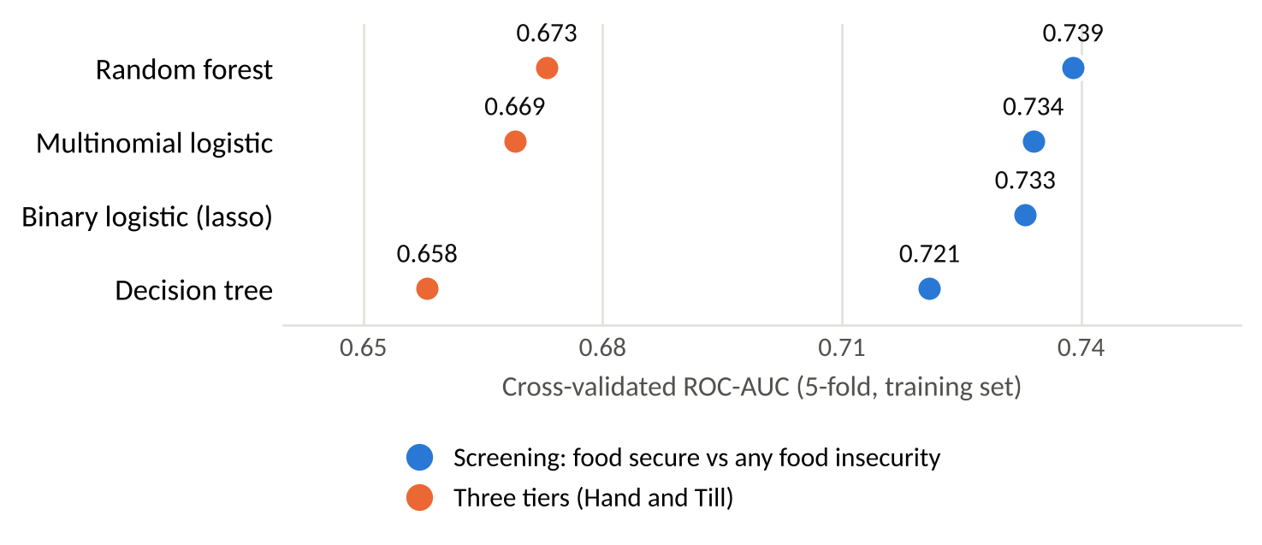
Modelling approach
Three tiers failed on the middle tier, so we kept binary lasso
Fair testing
Stratified 5-fold cross-validation, with no preprocessing outside the folds
The middle tier falls
No three-tier model recalls more than 3.2% of those households
Binary Lasso
One odds ratio per factor, which fits the app.
Cross-validated ROC-AUC. The binary lasso answers a different question, so it is not a like-for-like comparison
Class weights were tested and rejected because they damaged the probabilities.
Notes:
We tuned three model families with stratified five-fold cross-validation, with all preprocessing re-learned inside each fold. The three-tier target failed on the middle tier - no three-tier model recalls more than 3.2% of those households - and we had written the binary fallback down in advance rather than inventing it afterwards. Class weights were tested and rejected: they helped recall but wrecked the probabilities, and the app reports a probability.

Slide 5
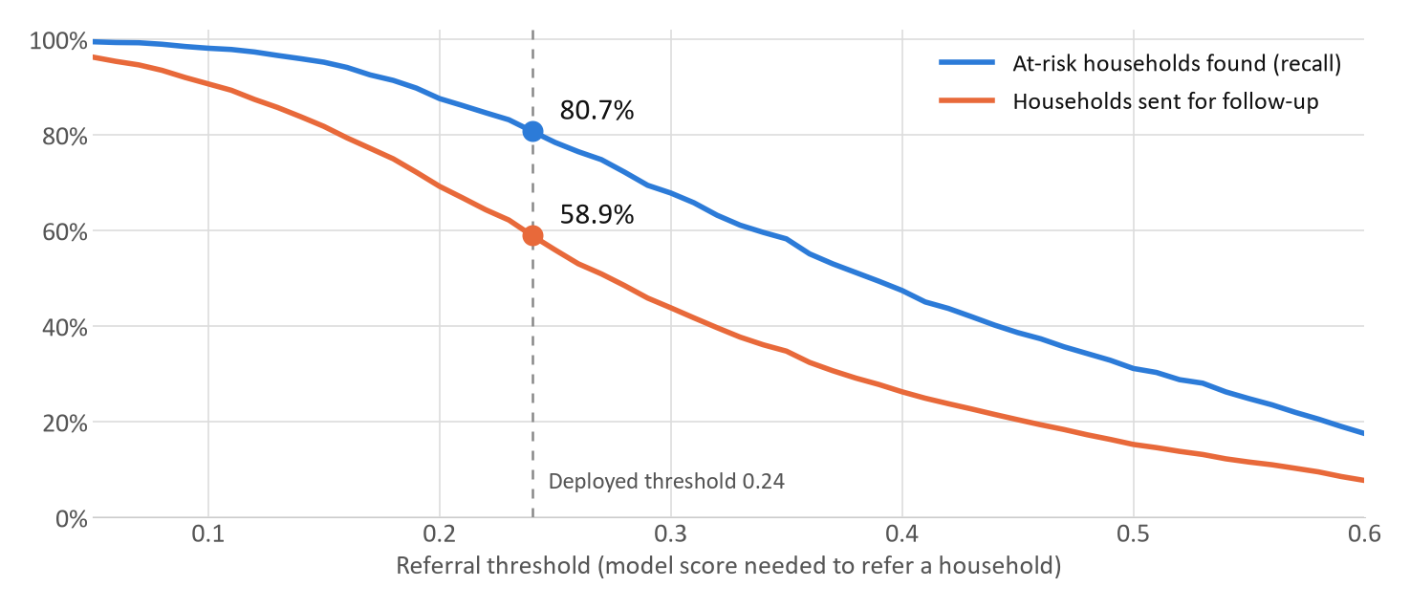
Model performance
The screen finds 4 in 5 at-risk households, and refers 3 in 5
80.7%
of at-risk households found
41.9%
of referrals genuinely at risk
58.9%
of households sent for follow-up
0.736
ROC-AUC (0.5 = coin flip)
Measured once on 6,279 held-out test households. The threshold was fixed on cross-validation before testing.
Notes:
We chose the threshold before we looked at the test data, with a rule agreed up front: find at least 80% of at-risk households at the fewest referrals. That lands on 0.24. On data the model had never seen it finds 80.7% of at-risk households, and 85.7% of the severely food insecure.
The cost is the orange line. Four in ten referrals turn out to be food secure, and we send three in five households for follow-up. That is a dial, not a fact: raise the threshold and you visit fewer households but miss more. The dashboard lets programme managers set it against the capacity they actually have.
A random forest scored slightly better (about 0.009 AUC). We kept the logistic model because every referral has to be explained to an official, and it gives one interpretable odds ratio per factor.

Slide 6
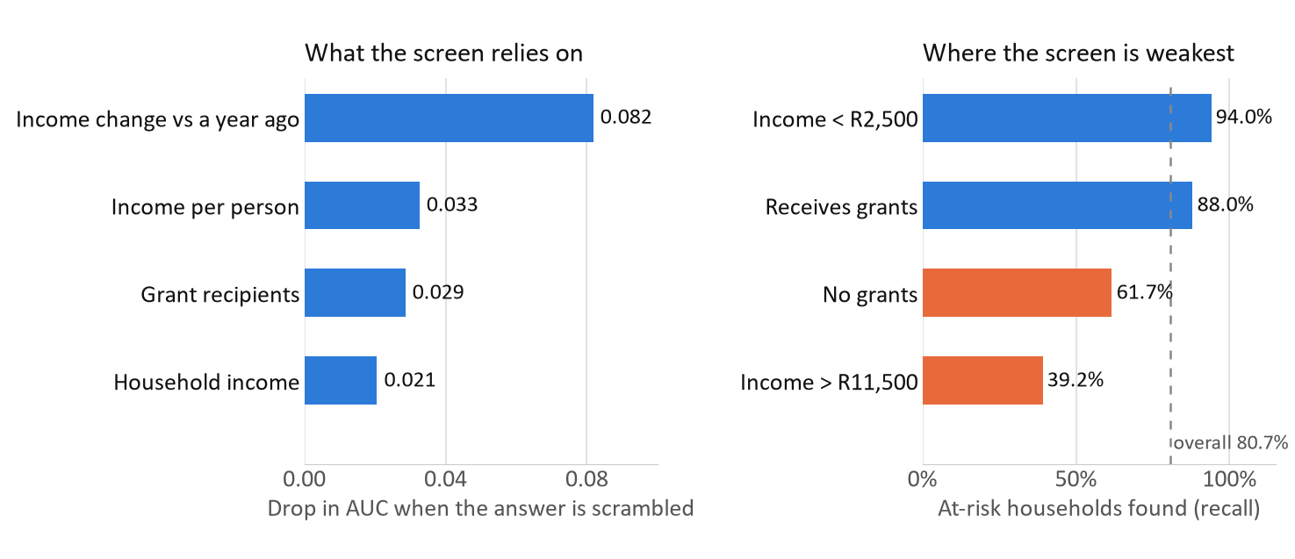
Key findings
Income change is the warning sign, but the better-off get missed
Income change leads
AUC drop 0.082, about 2.5 times the next answer
Grants mark need
37.6% of grant households are at risk vs 20.6% without: targeting, not harm
Weakest above R11,500
Only 39.2% found there, so a low score is not clearance
Left: permutation importance on the test set. Right: recall by group; orange is outside the 10-point tolerance band.
58.3% of households whose income fell sharply are food insecure, against 18-21% mid-scale.
Notes:
The strongest single signal is not income level, it is income change. Whether a household is worse off than a year ago matters about two and a half times more than any other answer, and it can be asked at intake in one sentence.
Grant households are more food insecure, not less: 37.6% against 20.6%. That is not evidence that grants cause harm. Grants are means-tested, so they mark households that were already poor, and one survey wave cannot separate targeting from effect.
The right-hand chart is the honest limitation. The screen finds 94% of at-risk households earning under R2,500 and only 39% above R11,500. It is weakest exactly where food insecurity is least expected, so a lower-risk result is not clearance, and self-referral stays open.

Slide 7
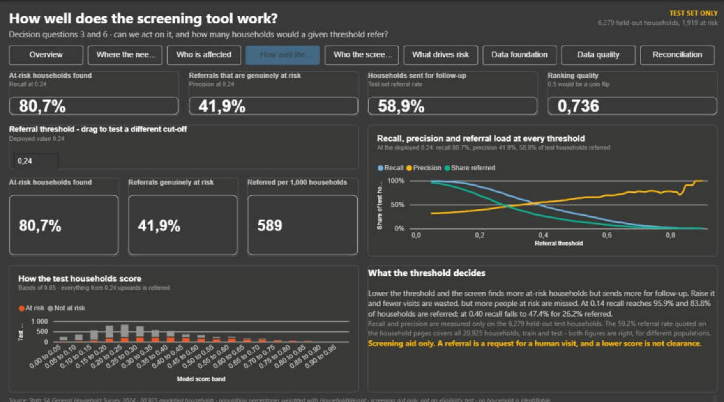
Dashboard demo
Setting the referral threshold against real capacity
How well the screen works
Change the threshold and watch recall and referrals move
Who the screen misses
Recall by income, grants and province, with intervals
What drives risk
Income change first, odds ratios with 95% intervals
Backup screenshot: the 'How well the screen works' page at the deployed threshold of 0.24.
Live in Power BI, then over to Timothy for the Shiny app.
Notes:
Have the dashboard open before the talk starts.
1. Overview page: six decision questions, every page answers one of them.
2. 'How well the screen works': the four cards are the slide 5 numbers, live from the final dataset.
3. Set the threshold to 0.30: recall drops from 80.7% to 67.8% and referrals from 59% to 44%, about 150 fewer households per thousand to visit and roughly one in eight at-risk households newly missed. Put it back to 0.24.
4. 'Who the screen misses': click through income, grants and province. Income above R11,500 sits far outside the tolerance band, a documented limitation.
5. 'What drives risk': income change at the top, odds ratios with confidence intervals.
6. Hand over to Timothy for the Shiny app.
If the live demo fails, use this screenshot and slides 5 and 6, and keep going.

Slide 8
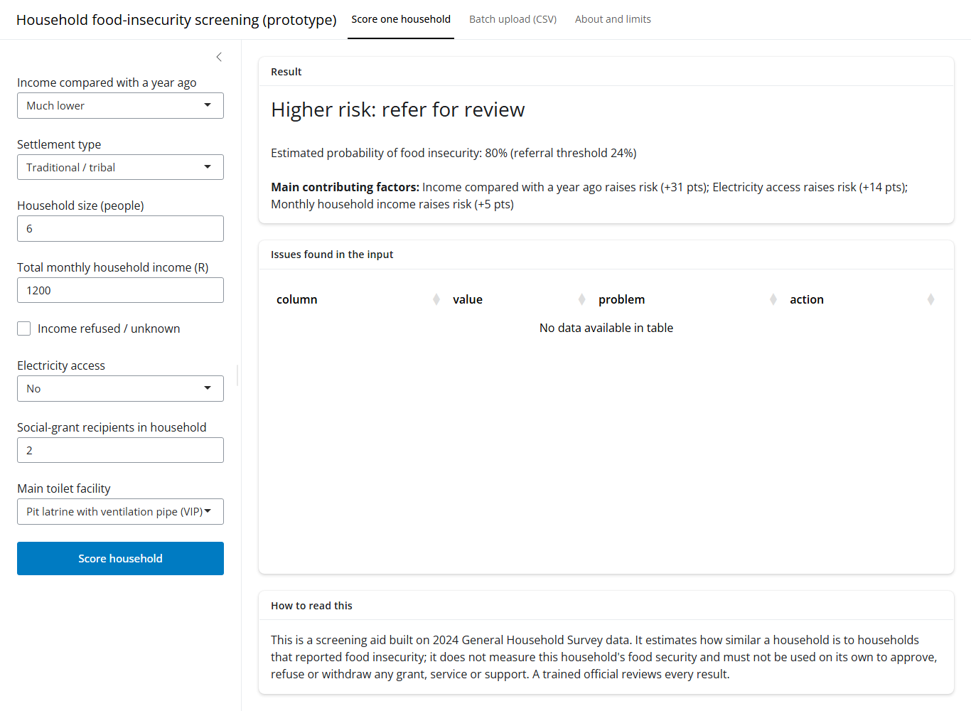
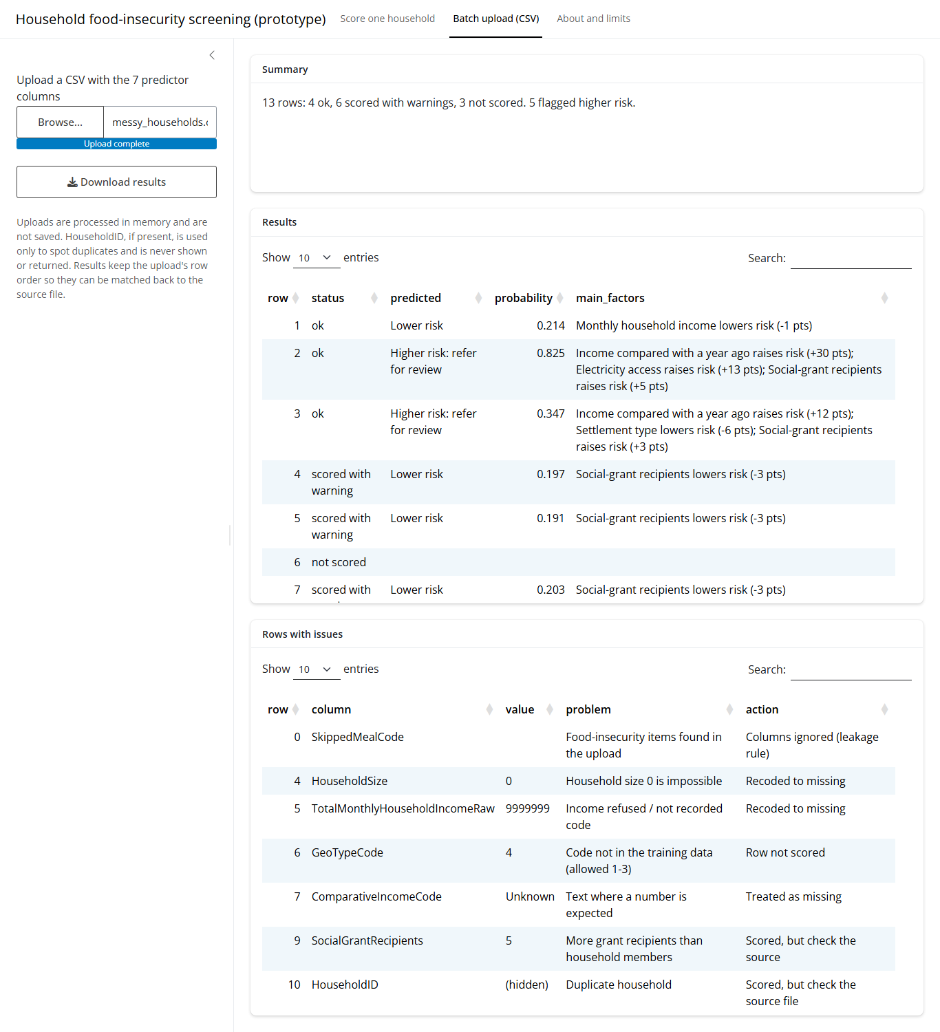
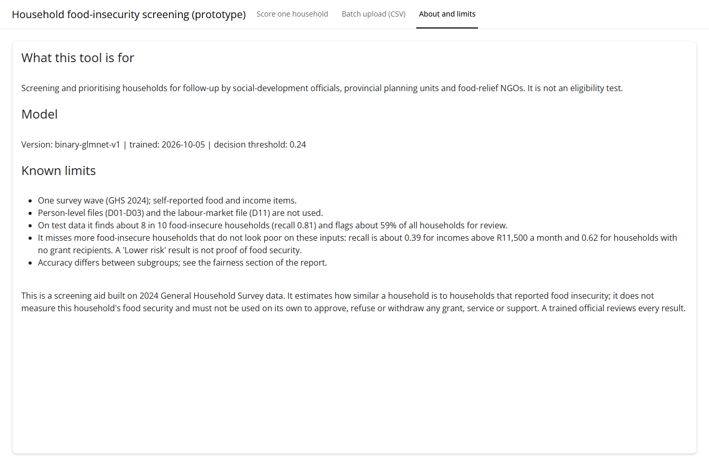
App demo
An official can score one household in about ten seconds
One household, scored
A batch, with the issues it refused
What the tool cannot tell you
Seven questions in. A probability, a recommendation and the three reasons out.
All 6,279 test households were pushed back through the app's own code path and compared with the saved predictions. Largest difference: zero.
Notes:
Live demo, in this order:
1. One household. Type the rural example: income fell sharply, no electricity, six people,
R1,200 a month, two grant recipients, pit latrine. Score it. Point at the three factors the app
gives back, and at the words it uses - "Higher risk: refer for review", never "food insecure".
2. The contrast. Change income to R30,000 and settlement to urban, re-score, and let the
probability drop. That is the whole model in one gesture.
3. The batch. Upload tests/messy_households.csv - 13 deliberately broken rows. Scroll the issues
table: sentinel codes recoded, an impossible household size rejected, a duplicate identifier
flagged, rows with too much missing left unscored rather than guessed.
4. The limits page. Land here, not on a score. Read the two lines about which households the
screen misses.
This is the part a field officer actually touches. Seven questions, short enough to ask at a door,
and the answer comes back with the three things that drove it - so the officer can say why a
household was referred, and a supervisor can disagree with it.
Likely question - what happens if someone uploads real household IDs? They stay in the file and
never leave the machine. Uploads are processed in memory and not written to disk, identifiers are
never returned in the download, and the monitoring log keeps totals only.

Slide 9
Recommendations
Five actions, each with the caution attached
Action | The number behind it | Who acts
Use it for outreach triage, and resource the referral rate | refers 58.9% of households; 41.9% of referrals are at risk | Programme managers
Ask about income change over the past year at intake | strongest single predictor, AUC drop 0.082, about 2.5x the next | Field staff
Coordinate relief with the grant registers | 37.6% of grant-receiving households at risk against 20.6% without | Social development
Fund the four highest-risk provinces first | Eastern Cape 43.0%, Northern Cape 40.5%, North West 37.1%, Mpumalanga 35.5%, against 28.3% nationally | Provincial teams
Audit "lower risk" households where the screen is weakest | recall 39.2% above R11,500 and 61.7% with no grants | Field officers, monthly
A screening aid. An official reviews every referral, and a low score is never clearance.
Notes:
Each of these starts from a number on Rudi's slides, and each has a limit attached, because the
limits are what make them safe to act on.
The first is a budget decision disguised as a technical one. At our threshold the tool refers about
three households in five, and about four in ten of those referrals turn out to be food secure. That
is the cost of finding four in five of the households that are at risk. Managers should size
follow-up capacity against that rate before go-live - or move the threshold knowingly, which the
dashboard lets them do, and accept that they will miss more people.
The second is the cheapest thing on this list. One question about whether income has fallen carries
more signal than anything else we measured, and it can be asked without the model at all.
The third needs the caution said out loud. Grant-receiving households are at higher risk because
grants are targeted at poor households. That is a reason to use the registers to find people
quickly. It is not evidence that grants cause food insecurity.
The last one is there because of what we found about ourselves. The screen is weakest for
households that do not look poor on our seven inputs. We chose not to patch that with a different
threshold for richer households, because that means treating people differently by income on the
basis of a proxy. We publish the gap instead, and ask for a monthly audit. Keep self-referral open.

Slide 10
Limits and next steps
What this cannot tell you, and what we would do next
The limits
What we would do next
Moderate discrimination: ROC-AUC 0.736
58.1% of referrals are not food insecure; 19.3% of at-risk households are missed
A proxy target from eight self-reported items, on one cross-sectional wave - association, never cause
No external validation, and recall is weakest where risk is least expected
Capture follow-up outcomes, so the next model trains on what was found
Add a second survey wave for within-household change
Bring in per-person income, employment, debt and local food prices
Re-validate on a new release before extending the threshold to it
A cheap, interpretable, monitored triage aid that finds four in five at-risk households and knows which ones it misses.
Survey data, not a census. A screening aid, not an eligibility test.
Notes:
We would rather say these ourselves than have them found.
An AUC of 0.736 is moderate. It separates risk better than chance by a useful margin, and it is
nowhere near good enough to decide anything on its own - which is exactly why the design keeps a
person in the loop and why we talk about referrals rather than decisions.
The deeper limitation is the target. We never observed whether a household went without food. We
built a proxy out of eight survey answers and predicted it from seven other answers about the same
household at the same moment. That tells you who looks like the households that report hunger. It
does not tell you why, and it cannot tell you what would change if you intervened. The reversed
grant result is the clearest case: targeting and effect cannot be separated in one cross-section.
So the first thing on the right matters most. The moment officials record what they actually found
when they visited, we can retrain on real outcomes instead of a survey proxy, and measure precision
in the field rather than against our own label.
Until then, the honest summary is the line at the bottom. Thank you - we are happy to take
questions on any slide.

