Slide 1
The effects of financial stress
on the Swedish economy
Master Thesis
Andreas Timoudas
Supervisor: Kieran P. Larkin
EC9901 VT22 Stockholm University

Slide 2
Agenda
Background
  Research Question
Methodology
  Data
Study design
  Identification
Results
Discussion
Conclusions

Slide 3
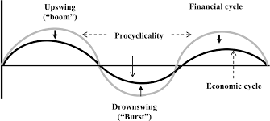
Background
Historical stress events
  Swedish Banking Crisis 1990s
  Dotcom Bubble 2000s
  Great Financial Crisis 2007
Key features of financial stress
  Increased uncertainty
  Increased degree of perceived risk

Slide 4
Research Question
How a small open economy as Sweden would be affected by a shock to financial stress and what connection there is between financial stress and macroeconomic variables such as GDP growth, inflation, and interest rates

Slide 5

Methodology
Mean Adjusted Bayesian VAR model
  $$Π\left(L\right)\left(x_{t}−μ\right)=e_{t}$$
Allows to set steady-state priors explicitly
Prior beliefs deals with over-parametrisation in VAR-models
steady-state BVAR-model is untractable, Gibbs sampler

Slide 6
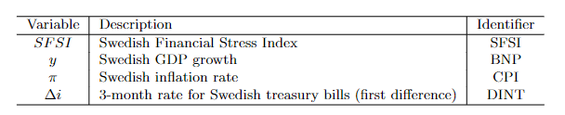
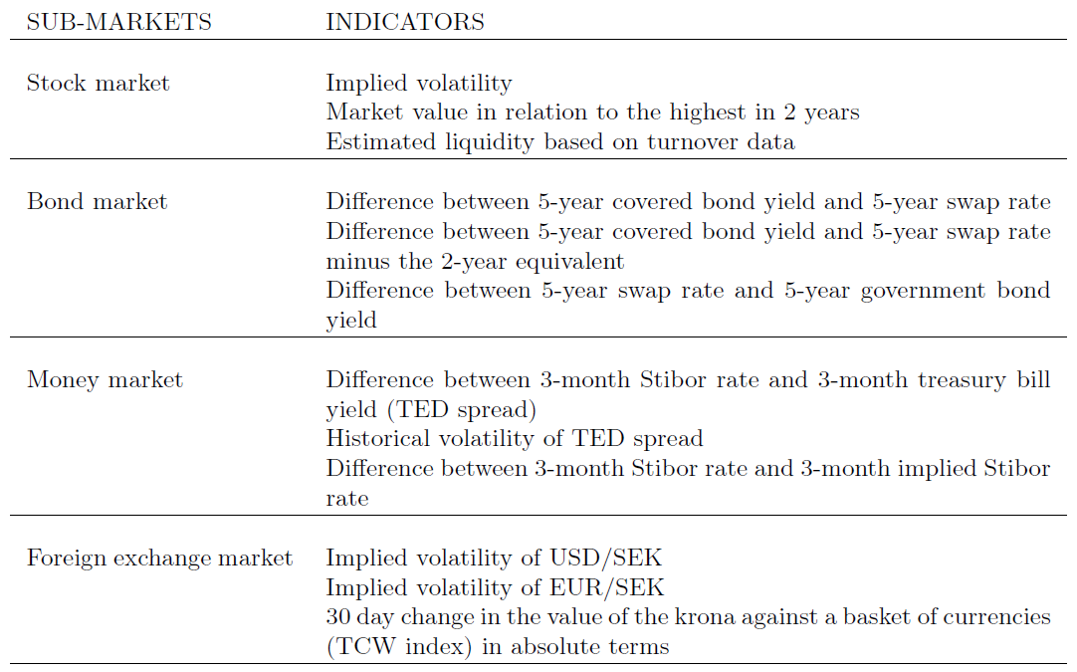
Data
Variables
  Swedish Financial stress index
  GDP growth
  Inflation rate
  3-month interest rate
Swedish Financial Stress Index
  Based on 4 sub-markets
  3 indicators for each market
  Captures volatility, spreads and valuation losses

Slide 7
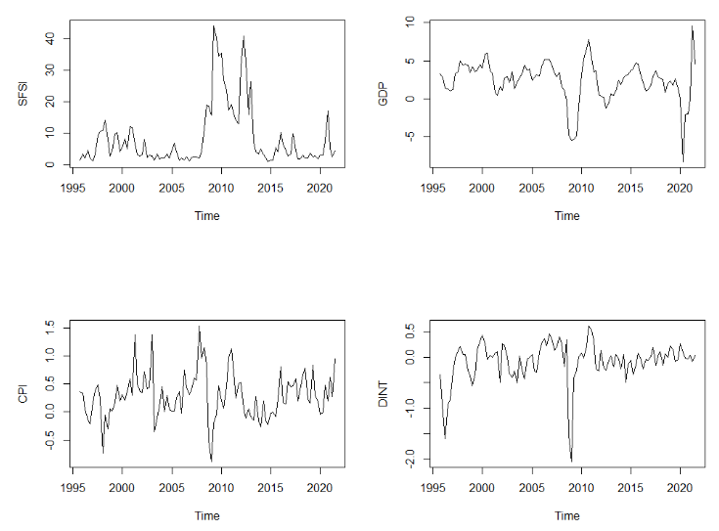


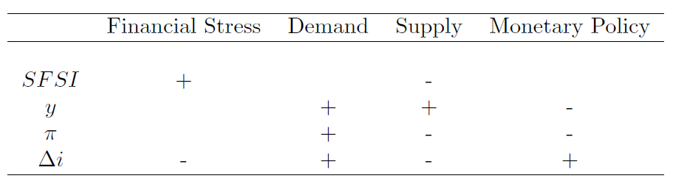
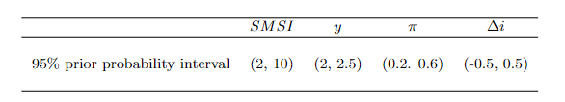
Study Design
VAR requires identification.
Cholesky, (recursive ordering)
Alternative recursive ordering
Sign restrictions

Slide 8
Results
Impulse Response function
Forecast Error Variance
Historical Decomposition

Slide 9
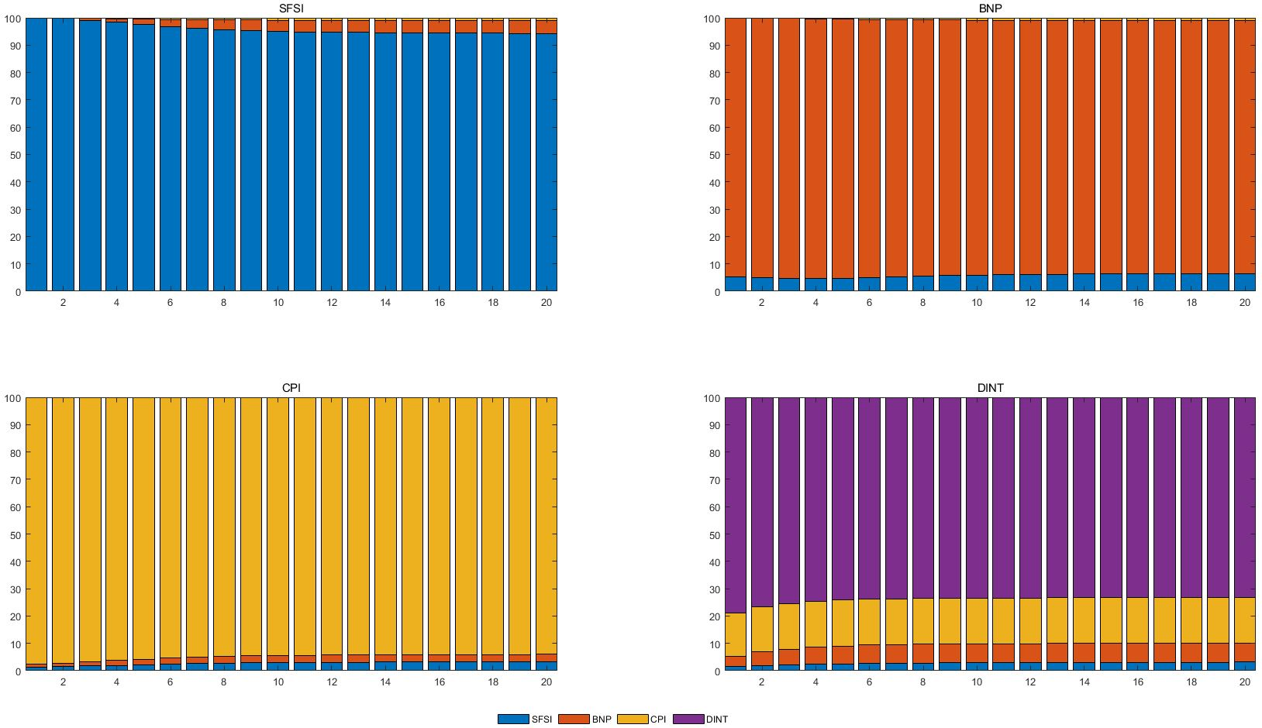
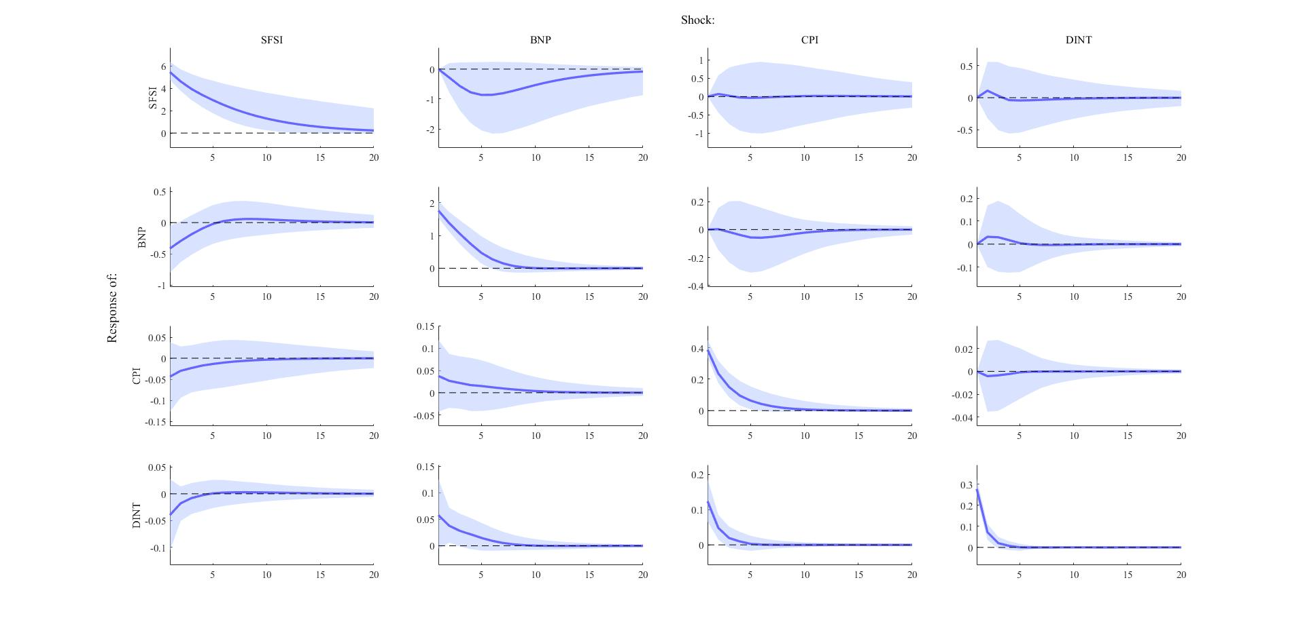
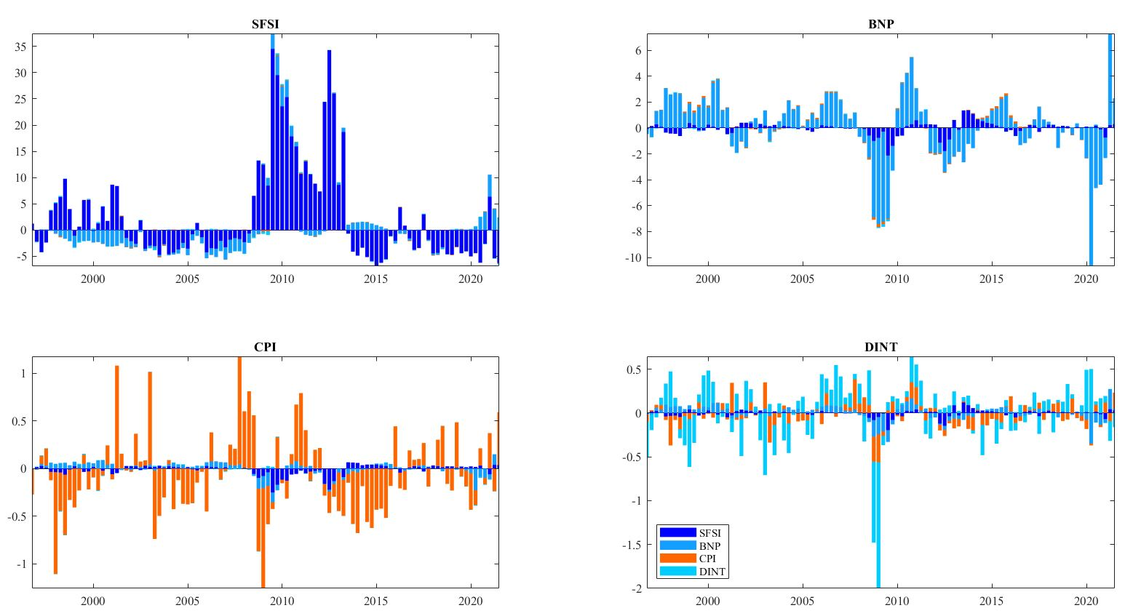
Cholesky

Slide 10
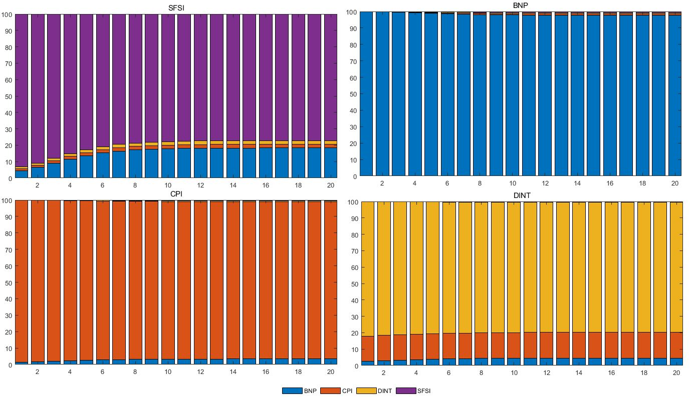
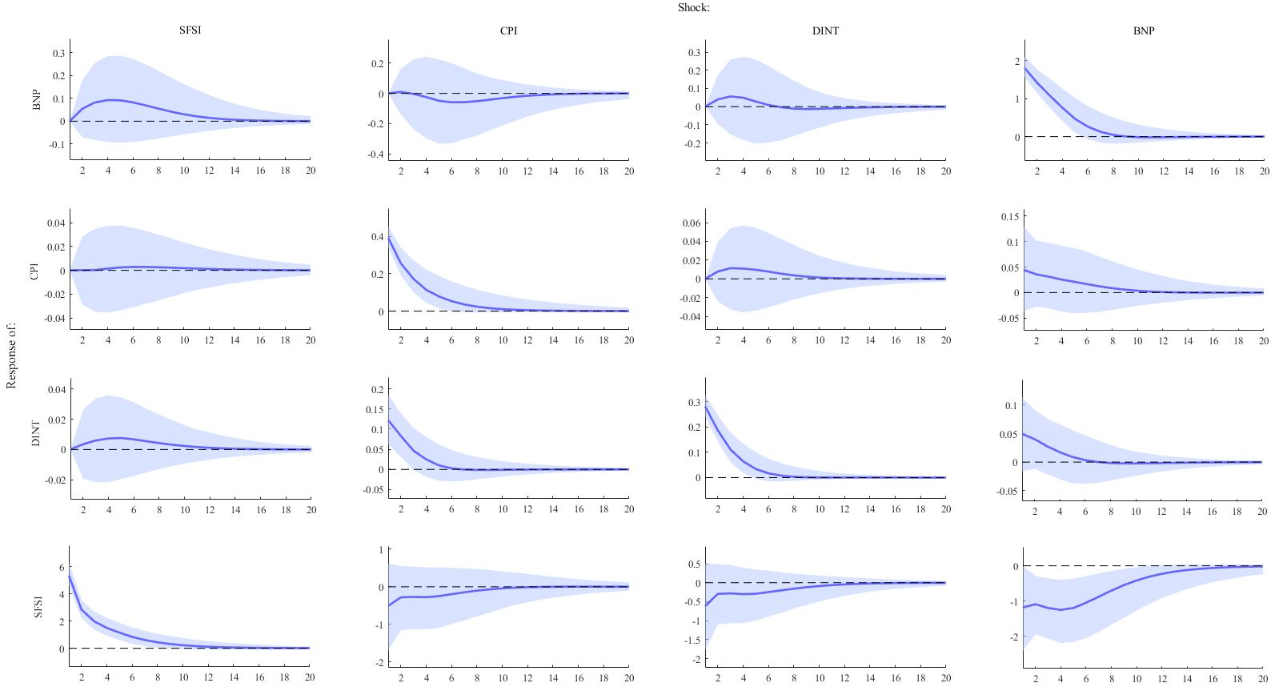
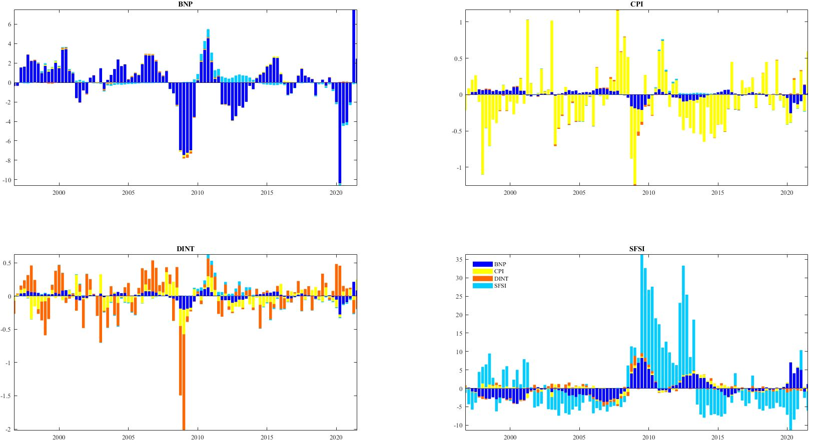
Cholesky alternative ordering

Slide 11
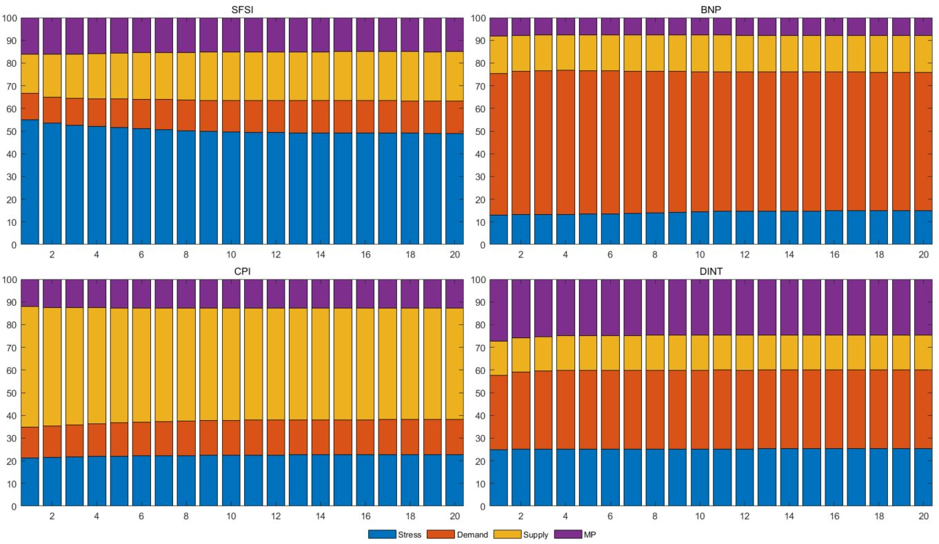
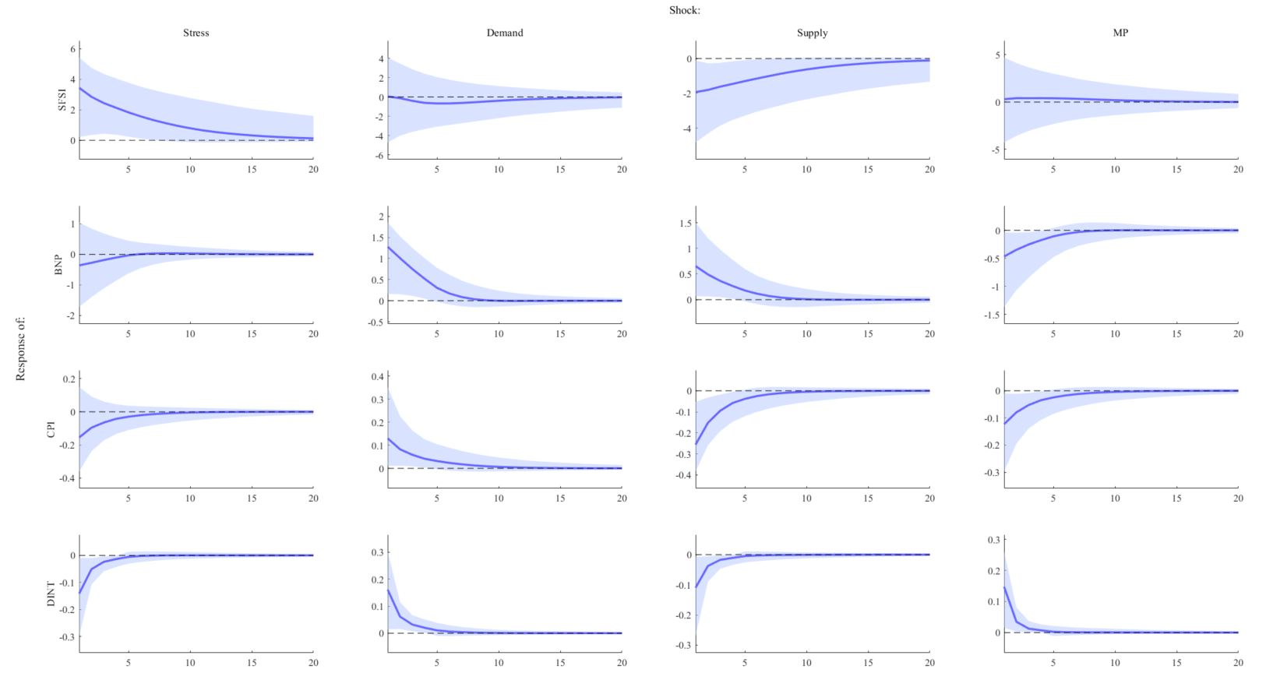
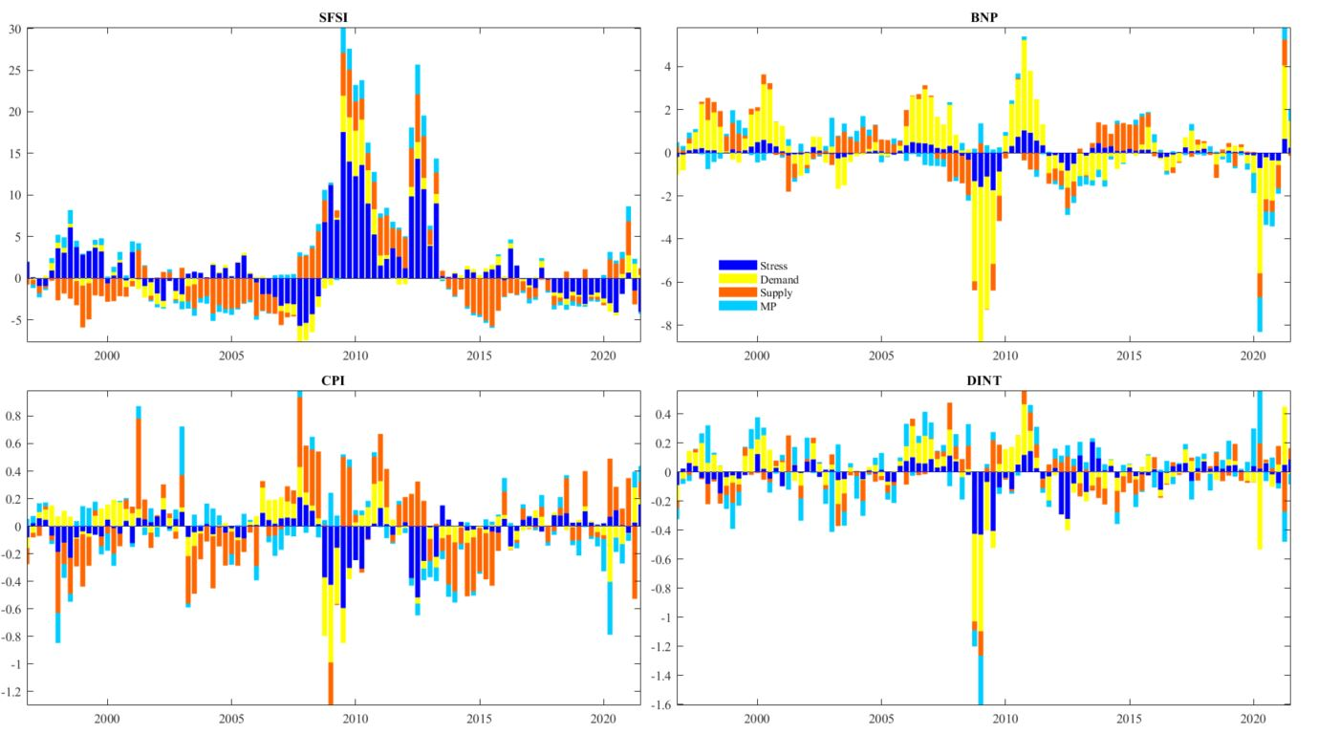
Sign restrictions

Slide 12
Discussion
Treats to identification
  Cholesky identification
  Sign restriction
Comparative results, previous studies
Other identification strategies
Other approaches

Slide 13
Conclusion
Difficult to model financial stress as an exogenous shock
Suggestive evidence of negative effects on Swedish economy
Results not robust across identification strategies
  Bloom (2009)
    US
    GDP growth ↓
  Stockhammar & Österholm (2014)
    Sweden
    GDP growth ↓
  Abbate et al. (2020)
    US
    GDP growth ↓ - Inflation rate ↑
  Van Roye (2011)
    Euro area
    GDP growth/Inflation rate/interest rate ↓

