Slide 1
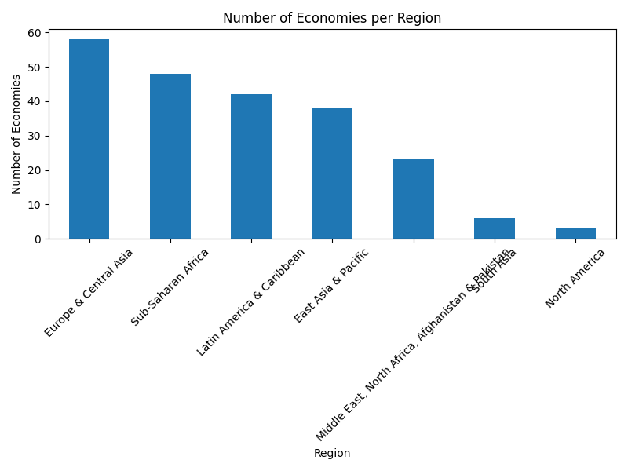
Number of Economies per Region

Slide 2
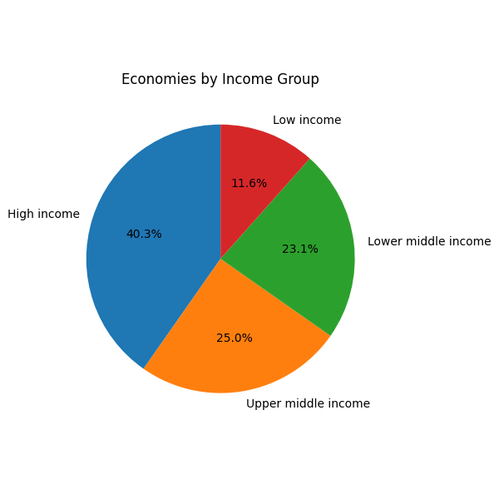
Economies by Income Group

Slide 3
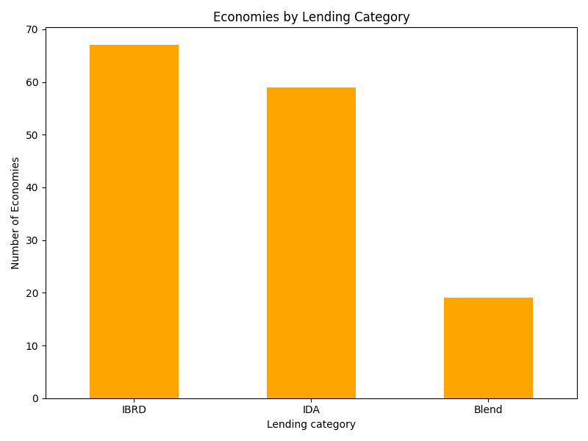
Economies by Lending Category

Slide 4
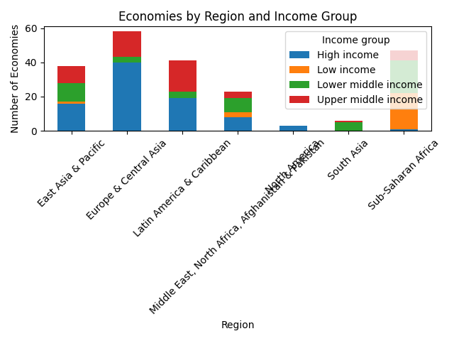
Economies by Region and Income Group

