Slide 1
WWARN Informatics
Overview & Roadmap

Slide 2
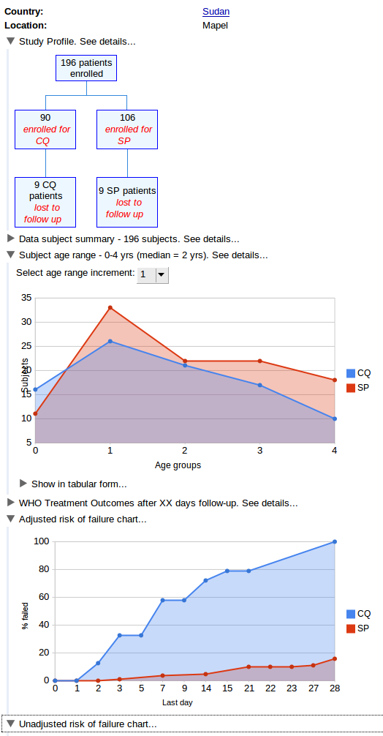
submitter
data
?
data could be submitted in any format
enable submitter to view standard analyses & outputs for their data
enable aggregation of data across studies
need at least to curate data into a standard structure

Slide 3
The WWARN Application
Chassis/WWARN
data
submission
submitter
curation
curator
system for data management = submission & curation of data
system for analysing, visualising and reporting curated data

Slide 4
Chassis/WWARN
Enables upload of data in any format
Provides framework for curation
Captures complete audit trail
Manage privacy
Manage quality

Slide 5
The WWARN Application
Enables visualisation, analysis & reporting for curated data
...

Slide 6
Roadmap
Release early and often
  Release production quality versions of Chassis/WWARN & The WWARN Application, with limited functionality, ASAP
  Add more functionality incrementally, in subsequent releases, as often as possible

Slide 7
Roadmap - Chassis/WWARN
Chassis/WWARN 1.0 Release
  First production release
  As soon as possible (aim, early 2010)
  Establish WWARN data management operational framework, i.e., workflow, roles & responsibilities
  Bare minimum to enable WWARN data management operations to begin
Chassis/WWARN 1.1, 1.2, 1.3, ...
  Subsequent releases (as often as possible) add support for curation of data (e.g., validation, transformation, ...?)

Slide 8
Roadmap - The WWARN Application
The WWARN Application, 1.0 Release
  First production release
  As soon as possible (aim, early 2010)
  Curated data from Chassis/WWARN 1.0
  Essential visualisation, analysis and reporting functionality only
The WWARN Application, 1.1, 1.2, 1.3, ...
  Subsequent releases, as often as possible, adding functionality

Slide 9
Roadmap (short-term)
Chassis/WWARN 0.1
  Limited functionality to enable submission of data in WHO format only
  ASAP (aim, this year)
The WWARN Application Preview Release
  Showcase future potential, using existing data
  ASAP (aim, this year)

