Slide 1
WWARN Informatics
Chassis/WWARN
Data Submission and Curation Workflow

Slide 2
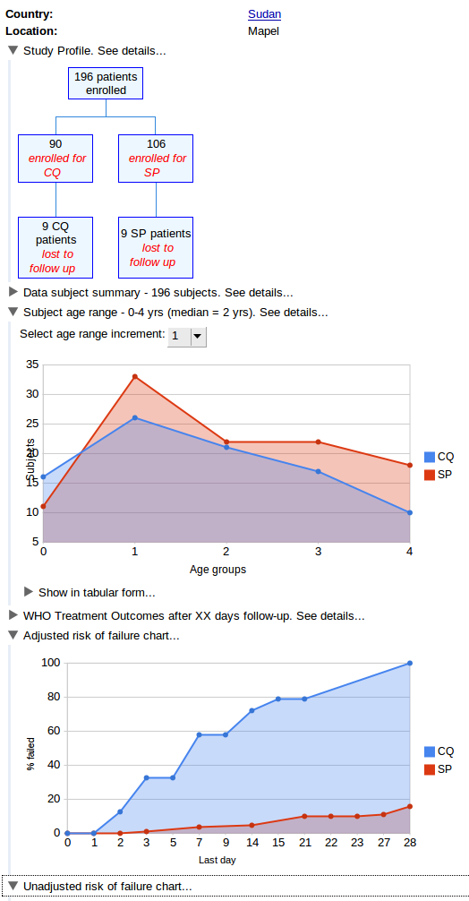
The WWARN Application
Chassis/WWARN
data
submission
submitter
curation
curator
metadata
(SSQ)
system for data management = submission + curation of data & metadata
system for analysing, visualising and reporting curated data

Slide 3
Chassis/WWARN Design Goals
Used by submitters & curators
Enables upload of data in any format
Provides framework for curation
Captures complete audit trail
Manage privacy
Manage quality

Slide 4
The WWARN Application
Enables visualisation, analysis & reporting for curated data
Used by submitters
Used by other researchers, public health officials, ...
(Out of scope for today)

Slide 5
Roadmap - Chassis/WWARN 1.0
Release first production quality version of Chassis/WWARN, ASAP (ideally early 2010)
First release - limited functionality
Add more functionality incrementally, in subsequent releases, based on feedback
Chassis/WWARN 1.0 - bare minimum to enable WWARN to begin operations

Slide 6
This Meeting
Illustrate the data submission & curation workflow model that we are proposing for Chassis/WWARN 1.0
(i.e., who does what, when)
does it make sense?
have we missed anything vital?

Slide 7
Use Case - shortest path, end-to-end
submitter asks for a user account to submit their data to WWARN
administrator creates submitter user account
submitter logs in to Chassis/WWARN
submitter creates a new study (title, summary, module(s))
submitter creates a new submission (title, summary, module(s), study)
submitter uploads submitted data
submitter creates a data dictionary (title, summary, module(s))
submitter uploads data dictionary file
submitter links submitted data to data dictionary
submitter requests gatekeeper review
gatekeeper reviews submission
gatekeeper accepts submission for curation
gatekeeper assigns curator
curator downloads submitted data & data dictionary
curator [offline] transforms data to standard format
curator uploads new revision of submitted data
curator enters log message describing changes, links new revision to previous revision
curator creates a standard data dictionary (title, summary, module(s))
curator links new revision of submitted data to standard data dictionary
curator creates release criteria specification (title, summary, module(s), file)
curator reviews data, approves for release

Slide 8
Study Questionnaire
... can bypass?

Slide 9
Submitted Data
... any format?
... can live without on-line tools for preview, at least for Chassis/WWARN 1.0?

Slide 10
Gatekeeper Review
... can decide not to accept a submission for curation?
... prioritise?
... each module can define their own acceptance criteria?
... what happens if submission has data for >1 module?
... need to request?

Slide 11
Data Dictionaries
... required prior to gatekeeper review?
... files or forms?

Slide 12
Revising Submissions
... submitters can revise submitted data prior to gatekeeper review?
... after gatekeeper review?

Slide 13
Studies and Submissions
... one study, one or more submissions?
... one submission, one or more studies?

Slide 14
Submission Permissions
... grant ownership (read/write)?
... grant read-only access?

Slide 15
Study Permissions
... visible, discoverable, private?
... grant ownership (read/write metadata, submit)
... grant submission authority (link submissions to study)
... link submission without authority?
... managing complexity (knock-on permissions)?

Slide 16
Dictionary Permissions
... keep some dictionaries private?
... discoverable?

Slide 17
Curation & Derivation
... off-line curation, download and upload of files ... can live with it?
... how capture the audit trail (derivation)?

Slide 18
Validation & Transformation
... can live with off-line validation & transformation, at least for Chassis/WWARN 1.0?

Slide 19
Release Criteria
... review w.r.t. release criteria?
... finer grained tagging w.r.t. individual criteria?

Slide 20
Curator Collaboration
... can any curator work on any submission? If not, how manage permissions?
... need to keep track of who has the ball?
... parallel/series?

Slide 21
Publishing Data (Open Access)
... making a submission public?
... making a study public?
... who decides? Study owner? Submission owner?

