Slide 1
WWARN Informatics
Overview & Roadmap

Slide 2

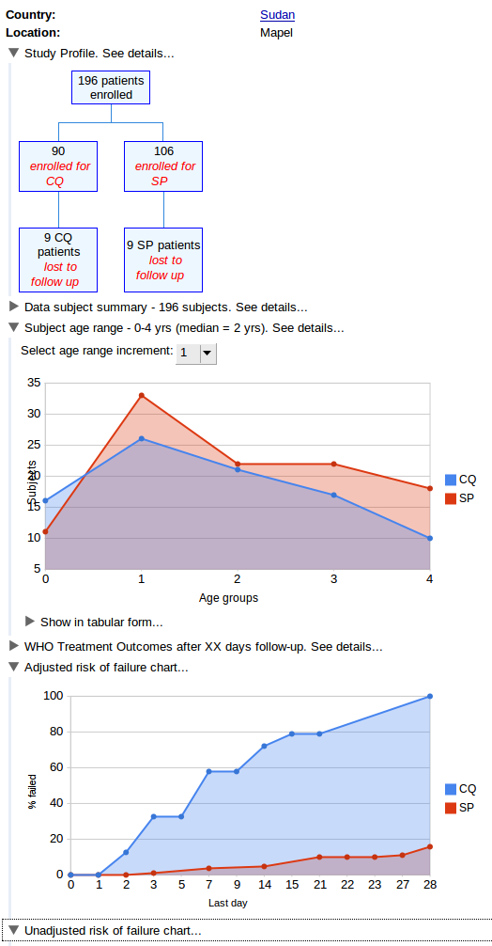
submitter
data
?
data could be submitted in any format
enable submitter to view standard analyses & reports for their study
enable analysis of data across studies
need to curate the data ...

Slide 3
Curation
data
standard analyses & reports need standardised data
curation means, at least, transforming data into standard...
  e.g., reviewing, renaming, removing, transforming, mapping, ..., variables (data structure)
  e.g., reviewing, validating, removing, transforming, mapping, calculating, ..., data values (data content)
submitter
curation
curator
metadata
(SSQ)

Slide 4
The WWARN Application
Chassis/WWARN
data
submission
submitter
curation
curator
metadata
(SSQ)
system for data management = submission + curation of data & metadata
system for analysing, visualising and reporting curated data

Slide 5
Chassis/WWARN Design Goals
Used by submitters & curators
Enables upload of data in any format
Provides framework for curation
Captures complete audit trail
Manage privacy
Manage quality
Integrate data across modules (clinical, pk, in vitro, molecular)

Slide 6
The WWARN Application
Enables visualisation, analysis & reporting for curated data
Used by submitters
Used by other researchers, public health officials, ...
Add value for submitters
Add value for everyone else

Slide 7
Roadmap
Feedback from community is vital (esp. from TAG)
Release first production quality version of Chassis/WWARN & The WWARN Application, ASAP (ideally early 2010)
First release - limited functionality
Add more functionality incrementally, in subsequent releases, based on feedback

