Slide 1

Daily Commit
Daily interview practice
for CS students
A small lesson makes starting easier
Notes:
0:00–0:18. Interview prep is easy to postpone. A long problem set feels like tomorrow's job, and debugging deserves practice too.
Sources: https://github.com/timpactwa/Daily_Commit/tree/1880ed666e2d1dee42982074187a904d76c96717/docs/PLAN.md

Slide 2
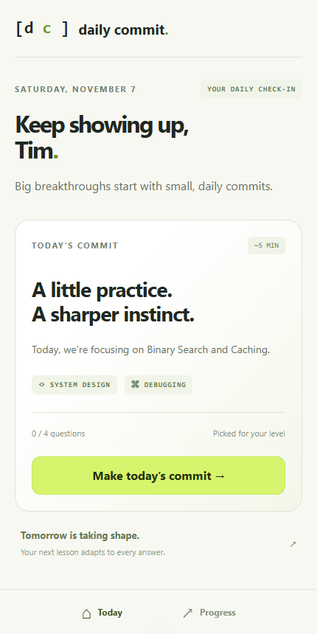
Five minutes, matched to your level
System design
Tradeoffs, sequences and diagrams
Debugging
Find the faulty line in tested code
Placement sets your starting level
Notes:
0:18–0:25, then mirrored phone until 2:05. We built Daily Commit: five minutes of daily interview practice across system design and debugging. Use docs/demo-script.md for exact phone actions.
Product screenshot: local development app using built-in mock data, not a production user or a generated image.
Sources: https://github.com/timpactwa/Daily_Commit/tree/1880ed666e2d1dee42982074187a904d76c96717/app/src/screens/Dashboard.tsx

Slide 3
The adaptive engine
01 Answer
02 Update
03 Select
Grade the submitted
response on the server
Adjust topic skill and
question difficulty
Prioritize weak topics
and recent misses
Next-question target: student rating minus 150
Notes:
Supporting slide for questions or a failed phone display. Every answer updates the student's topic rating and the question's live difficulty. Misses affect the next-lesson preview before completion. A gap of 150 Elo points implies about 70% expected score; realized lesson success can differ.
Sources: https://github.com/timpactwa/Daily_Commit/tree/1880ed666e2d1dee42982074187a904d76c96717/contracts/rating.md
Sources: https://github.com/timpactwa/Daily_Commit/tree/1880ed666e2d1dee42982074187a904d76c96717/engine/elo.py
Sources: https://github.com/timpactwa/Daily_Commit/tree/1880ed666e2d1dee42982074187a904d76c96717/engine/selection.py

Slide 4
Every retained bug breaks a test
Original
while lo <= hi:
One changed line
while lo < hi:
search([4], 4): expected 0, got -1
Notes:
Supporting slide during questions or terminal failure. Stage 2:05–2:40 normally shows python -m pipeline demo binary_search. Original passes six cases; line 4 changes <= to <; three cases fail. Twelve candidates: seven fail, two pass, three time out. This verifies a defect against supplied cases, not exhaustive correctness.
Sources: https://github.com/timpactwa/Daily_Commit/tree/1880ed666e2d1dee42982074187a904d76c96717/pipeline/cli.py
Sources: https://github.com/timpactwa/Daily_Commit/tree/1880ed666e2d1dee42982074187a904d76c96717/pipeline/corpus/binary_search.py
See docs/pipeline-demo-output.txt for the saved run.

Slide 5
Question difficulty gets better calibrated
Mean absolute difficulty error (Elo points)
300 students
14 days
120 synthetic questions
Simulation evidence for calibration, not measured learning gains
Notes:
2:40–2:53. In a simulation of 300 students over fourteen days, question difficulty error falls from 119 to 52 Elo points. That tests calibration. Real student outcomes are our next test.
Source: PYTHONHASHSEED=0 python -m engine.simulate --students 300 --days 14 --seed 1. Synthetic bank: 120 questions. True student skill remains fixed. Rounded mean absolute question-rating error.
Sources: https://github.com/timpactwa/Daily_Commit/tree/1880ed666e2d1dee42982074187a904d76c96717/engine/simulate.py
See docs/demo-evidence.md.

Slide 6
Daily Commit
Five minutes a day,
matched to you
Next: more tested functions and student trials
Notes:
2:53–3:00. Next, we expand the corpus and test with students. Five minutes a day, matched to you. Daily Commit.
Future work is proposed, not shipped. Existing spaced review is already implemented.
Sources: https://github.com/timpactwa/Daily_Commit/tree/1880ed666e2d1dee42982074187a904d76c96717/docs/PLAN.md

