Slide 1
Spark Overview

Slide 2
Overview
What is Spark?
History of Spark
Spark & Clusters
Deploying
Spark Shell
Programming Model

Slide 3
What is Spark?
Spark
is a distributed processing engine for big data,
is agnostic toward cluster types (Mesos, YARN, Amazon EC2, etc),
handles batched & streaming data with a unified API,
assumes the use of read-only data,
defers data processing until absolutely required,
supports the Java, Scala, Python & R languages, and
is open source (Apache Spark).

Slide 4
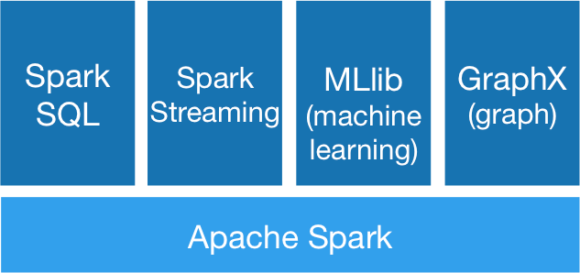
Spark Architecture
A powerful set of tools
Beyond traditional Hadoop
Source: http://spark.apache.org

Slide 5

Spark & Clusters
Source: http://spark.apache.org/docs/latest/cluster-overview.html
A Spark application runs as independent sets of processes on nodes of a cluster, coordinated by a SparkContext in a driver program.
Driver must be network-addressable from workers
Driver should be network-local to cluster
"Remote" drivers should really be apps that RPC to local drivers

Slide 6
Deploying
Submit your application jar plus its dependencies as an assembly
Use Scala's sbt-assembly or Java's maven-assembly-plugin
Do not include Spark or Hadoop dependencies
Use "provided" scope
Will be provided by Spark runtime
Submit application jar to Spark cluster via Spark's bin/spark-submit script

Slide 7
Deploying (2)
Common spark-submit options
--class mainClass
main class, like org.apache.spark.examples.SparkPi
--master masterUrl
cluster URL, like local[*] or spark://23.195.26.187:7077
--deploy-mode mode
deployment mode, like cluster or client
cluster means your driver is local to the cluster
client means that it's remote (not local to the cluster)
…
applicationJar
your application assembly jar, like sparkpi-0.0.1.jar
applicationArguments
your application-specific arguments

Slide 8
Spark Shell
Spark provides a Scala-based REPL: bin/spark-shell
Value sc of type SparkContext automatically provided by shell
$ bin/spark-shell
. . .
Spark context available as sc.
SQL context available as sqlContext.
Welcome to
____ __
/ __/__ ___ _____/ /__
_\ \/ _ \/ _ `/ __/ '_/
/___/ .__/\_,_/_/ /_/\_\ version 1.5.2
/_/
Using Scala version 2.11.7 (Java HotSpot(TM) 64-Bit Server VM, Java 1.8.0_31)
Type in expressions to have them evaluated.
Type :help for more information.
scala>

Slide 9
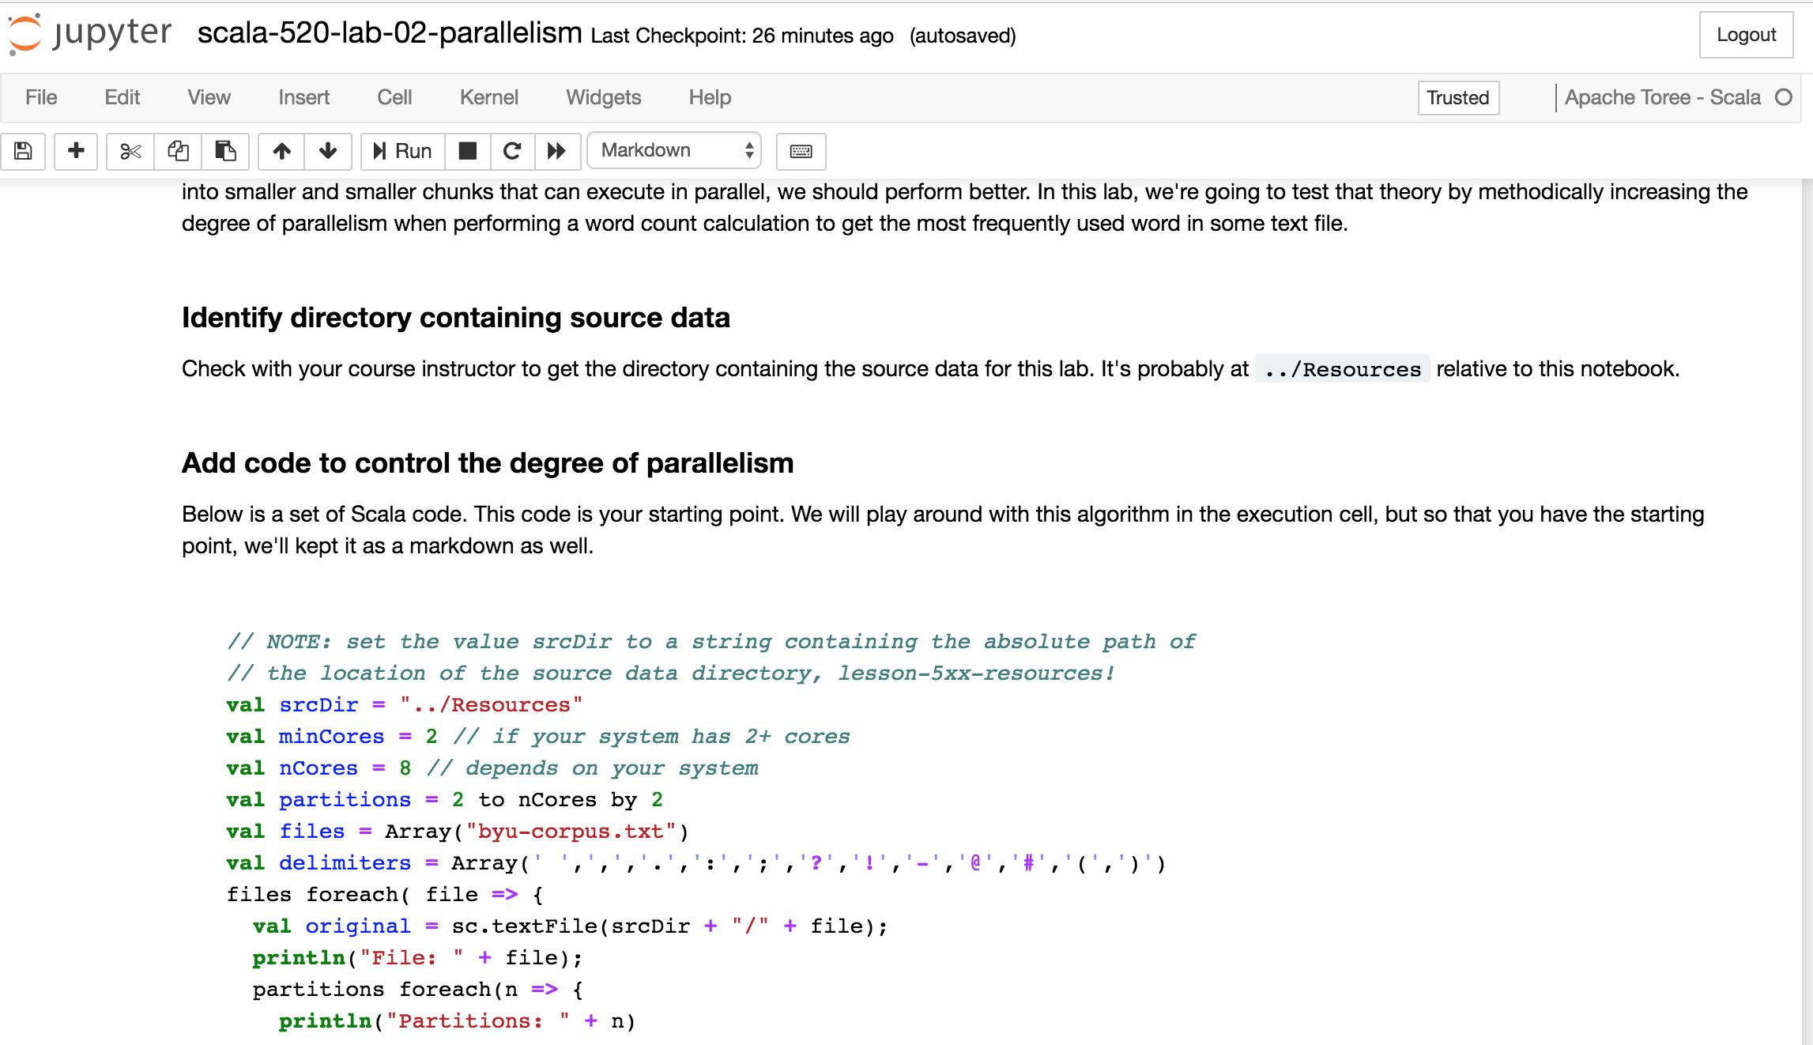
Jupyter Notebooks

Slide 10
Programming Model
RDD
Resilient Distributed Dataset
Distributed collection of JVM objects
Most flexible, but least abstract
DataFrame
Distributed collection of Row objects; like relational tables
Supports SQL dialect with hierarchical data support
Optimizer for performance enhancements
Less flexible, but faster
DataSet
Typesafe enhancement of DataFrame API
Type safety achieved via Encoders
Interoperates with DataFrames

Slide 11
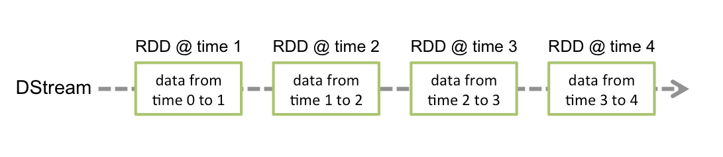
Programming Model (2)
Static Data Processing
See RDD, DataFrame & DataSet
Streaming Data Processing
Use "Discretized Streams" or "DStreams"
A DStream is an RDD over a continuous series of underlying RDDs
Each RDD in a DStream represents data from the stream for a given interval
Source: http://spark.apache.org/docs/latest/streaming-programming-guide.html#discretized-streams-dstreams
Spark provides the same API for static and streaming data!

Slide 12
Conclusion
Spark is a fast multilingual distributed processing engine for big data stored in clusters that provides a consistent programming model for streaming and static read-only data.

