Slide 1
Spark Streaming

Slide 2
Overview
Streaming v. Batch Programs
Streaming Context
DStreams
Stateful Processing
Window Operations
Join & Transform Operations
Output Operations
Design Patterns for Custom Output Operations
Caching DStreams
Checkpointing
Deploying Spark Streaming Applications

Slide 3
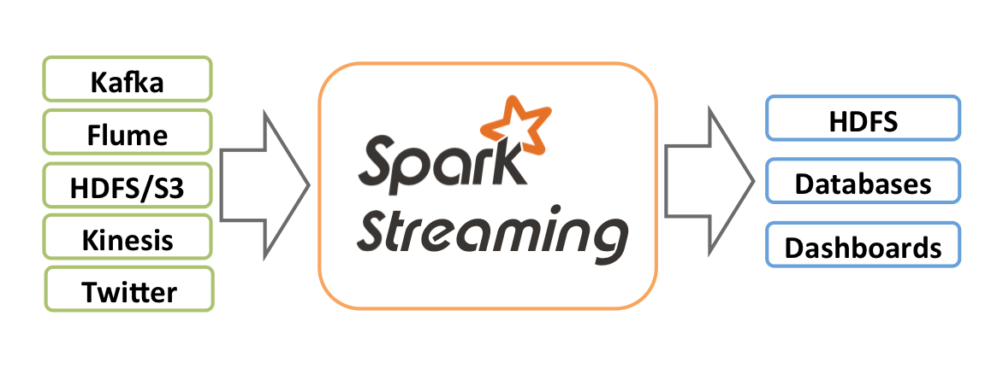
Streaming v. Batch Programs
Batch programs operate on historical data
Ad-Hoc queries in Spark shell
Statistical analysis, machine learning, …
Periodic batch programs: daily, weekly, monthly, quarterly, …
Streaming programs operate on continuously incoming data
From streams (Twitter, Kinesis), distributed messaging (Kafka, MQTT), log data (Flume, web logs), raw sockets, …
With 24x7 uptime requirements
Source: http://spark.apache.org/docs/latest/streaming-programming-guide.html

Slide 4
Streaming Context
Just as plain, old Spark programs use a SparkContext, Spark Streaming uses a StreamingContext
StreamingContext requires
an existing SparkContext, or
a SparkConfig
StreamingContext is a factory for many common stream types
TCP: socketStream, socketTextStream, rawSocketStream
Hadoop: fileStream, textFileStream, binaryRecordsStream
Akka: actorStream
Custom streams: implement Receiver, then use receiverStream

Slide 5
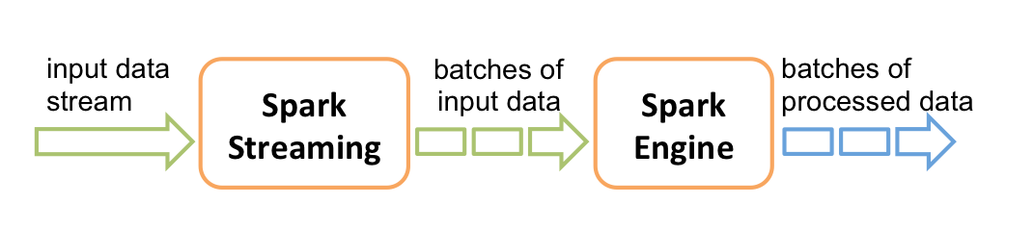
DStreams
"Discretized Streams": core abstraction of Spark Streaming
A continuous stream of data received from a source, divided into batches
Source: http://spark.apache.org/docs/latest/streaming-programming-guide.html

Slide 6
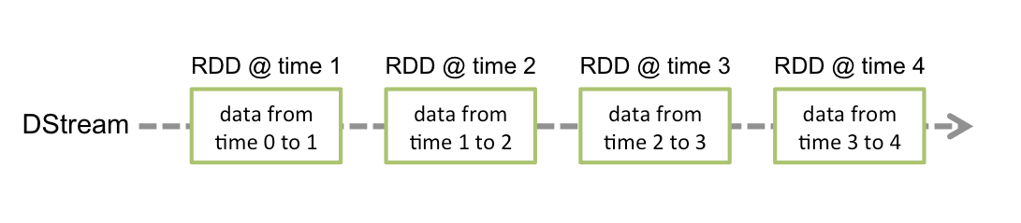
DStreams: Internals & Operations
Internally, a DStream is represented as a continuous series of RDDs, one per batch interval
Source: http://spark.apache.org/docs/latest/streaming-programming-guide.html
DStream operations
Translate to operations on its underlying RDDs
Behave like RDDs, but are not RDDs themselves
DStream transformations return DStreams
count, map, flatMap, reduce, …
Similar to RDDs
But they represent continuous streams, not static data!

Slide 7
Stateful Processing: updateStateByKey
Defined on PairDStreamFunctions when DStream[(K, V)]
Allows you to maintain state while continuously updating it
Like running totals, averages, trends…
Two steps
Define the state type S that will be maintained
Define update function as one of two types
(Seq[V], Option[S]) => Option[S]
(Iterator[(K, Seq[V], Option[S])]) => Iterator[(K, S)]
Returning None causes removal of state S at key K
Running Total Example
val d:DStream[(String,Int)] = …
def update(vals: Seq[Int], count: Option[Long]) = Some(vals.sum + (count getOrElse 0L))
d.updateStateByKey[Long](update)

Slide 8
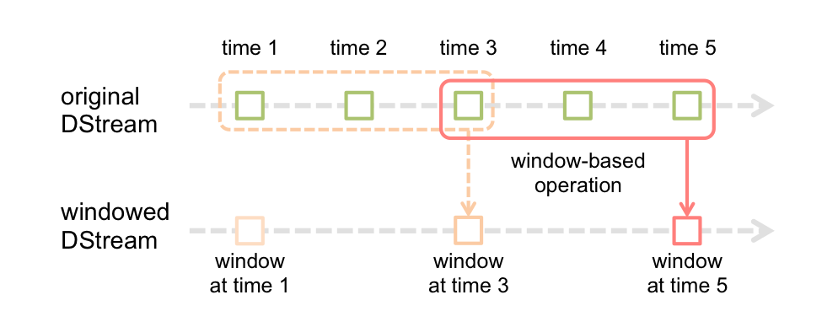
Window Operations
Allows you to apply transformations over a sliding window of data
Window defined by length & sliding interval
See window/countByWindow(len, dur), reduceByWindow/reduceByKeyAndWindow(fn, len, dur)
Example: ds.window(Seconds(3), Seconds(2))
Source: http://spark.apache.org/docs/latest/streaming-programming-guide.html

Slide 9
Join & Transform Operations
For any operation not defined on DStream, you can use transform to perform RDD-to-RDD functions on the DStream
val spam = ssc.sparkContext.newAPIHadoopRDD(…)
val dirty = ssc.textFileStream(…)
val clean = dirty.transform( rdd => rdd.join(spam).filter(...))
DStreams can be joined with other DStreams
val ds3 = ds1.join(ds2)
DStreams can be joined with RDDs via transform
val rdd: RDD[String,String] = …
val window = someStream.window(Seconds(1))
val joined = window.transform { x => x.join(rdd) }

Slide 10
Output Operations
DStreams offer various ways to trigger processing and output data
print
saveAsTextFiles
saveAsObjectFiles
saveAsHadoopFiles
foreachRDD
Most general output operation:
foreachRDD(fn: (RDD[T]) => Unit): Unit
Given function called for each RDD in the DStream

Slide 11
Design Patterns for Custom Output Operations
foreachRDD is often used to send data to external systems, like databases, network sockets, etc
If expensive and/or transient resources are required, avoid serializing them or creating them too often

Slide 12
Design Patterns for Custom Output Operations (2)
Antipattern: serializing things that shouldn't be
Remember where code executes!
dstream.foreachRDD { rdd =>
val c = createConnection()
rdd.foreach { record =>
c.send(record)
c.close()
}
}
Executes at driver!
Executes at worker!
Connections aren't normally Serializable!

Slide 13
Design Patterns for Custom Output Operations (3)
Antipattern: being inefficient
Remember: good programming practices still apply!
dstream.foreachRDD { rdd =>
rdd.foreach { record =>
val c = createConnection()
c.send(record)
c.close()
}
}
Creating a new connection for each record!
Creating a connection for each record is inefficient!

Slide 14
Design Patterns for Custom Output Operations (4)
Best practice:
Use connection pool
Use one connection per partition
Use one connection from a pool per partition!
dstream.foreachRDD { rdd =>
rdd.foreachPartition { p =>
val c = SerializableConnectionPool.getConnection()
p.foreach(record => c.send(record))
SerializableConnectionPool.returnConnection(c)
}
}
Partitions are local to a worker node!

Slide 15
Caching DStreams
Just like RDDs, DStreams can be cached
persist(level: StorageLevel)
Useful if the data in the DStream will be used again
DStreams created by window operations are automatically cached; no need to call persist
For input streams that receive data over the network, persistence is set by default to replicate to two nodes
By default, DStream caching uses serialization

Slide 16
Checkpointing
Remember, streaming applications must usually operate 24/7
In order to recover from failures, you need to save enough information to restart properly; called "checkpointing"
Two kinds of checkpointing
Metadata checkpointing: saving DStream definitions to HDFS
Data checkpointing: saving generated RDDs to HDFS

Slide 17
Checkpointing (2)
To use:
Identify & create a directory in HDFS to save checkpoint data
Call streamingContext.checkpoint(dir), passing HDFS directory
When driver is starting, use StreamingContext.getOrCreate(dir, fn), where dir is directory & fn is StreamingContext creation function
Due to checkpoint load incurred, consider checkpoint interval
Use dstream.checkpoint(i: Interval)
Good default is 5-10 sliding intervals of the Dstream, but YMMV
Remember to configure application so that driver gets automatically restarted
Each cluster manager has its own means to restart driver

Slide 18
Deploying Spark Streaming Applications
Requirements:
Cluster with a ClusterManager
Streaming application assembly uberjar
Program + transitive dependencies except Spark & Hadoop
Use maven-assembly-plugin or sbt-assembly
Configure sufficient executor memory
Configure checkpointing: directory & checkpoint interval
Configure automatic restart of driver (cluster-specific)
Configure write-ahead logs (Spark 1.2+)
Configure max receiving rate
In Spark 1.5+, can be automatic: spark.streaming.backpressure.enabled = true

Slide 19
Deploying Spark Streaming Applications (2)
Upgrading: to upgrade an existing, running streaming application, either
Bring new up alongside old, then shutdown old, or
Shutdown old & start new:
Drainstop old application via streamingContext.stop(…)
Bring up new application with different checkpoint directory
Requires that sources of streamed data support source-side buffering, unless you can tolerate gap in data

Slide 20
Deploying Spark Streaming Applications (3)
Tuning
Ensure batch processing time is less than the batch interval and/or the queuing delay; if not, system can't keep up
If falling behind, try
Reducing batch size,
Increasing parallelism, or
Increasing cluster resources
Other considerations beyond scope of this lesson
There are many tunable adjustments in Spark

Slide 21
Summary
Spark handles streaming data
Streaming API is nearly identical to batch API
DStream is core abstraction
Discretized stream
Collection of RDDs, one per batch (usually ~1 second)
Sliding windows of data possible
Stateful data processing possible
Running totals, etc.
DStreams can be combined with batch RDDs
Deploy via spark-submit with application uberjar
Remember checkpointing & restart capabilities

