Slide 1
Open/closed principle
„Software entities (classes, modules, functions, etc.) should be open for extension, but closed for modification”

Slide 2


Basics
Bertrand Meyer is generally credited for having originated the term open/closed principle (OCP), which appeared in his 1988 book Object Oriented Software Construction.
We should strive to write code that doesn’t have to be changed every time the requirements change
When a single change to a program results in a cascade of changes to dependent modules – OCP is broken

Slide 3
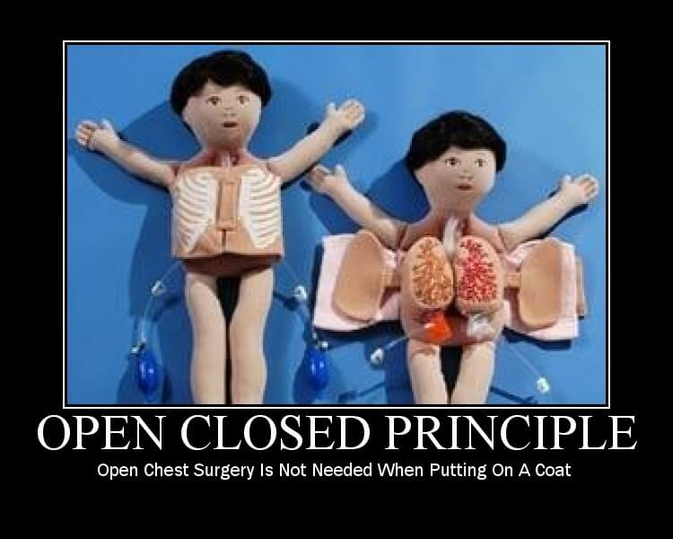
https://www.exceptionnotfound.net/simply-solid-the-open-closed-principle/

Slide 4
Why?
Changes in the existing code should be minimized, since it's assumed that the existing code is already unit tested and changes in already written code might affect the existing functionality in an unwanted manner.

Slide 5
Single responsibility vs Open/closed
„When we have code that has a single reason to change, introducing a new feature will create a secondary reason for that change. So both SRP and OCP would be violated. In the same way, if we have code that should only change when its main function changes and should remain unchanged when a new feature is added to it, thus respecting OCP, will mostly respect SRP also”.
https://code.tutsplus.com/tutorials/solid-part-2-the-openclosed-principle--net-36600

Slide 6
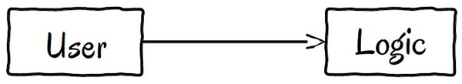
How to?
Notes:
Avoid basing on implementation

Slide 7
function testItCanGetTheProgressOfAFileAsAPercent() {
$file = new File();
$file->length = 200;
$file->sent = 100;
$progress = new Progress($file);
$this->assertEquals(50, $progress->getAsPercent());
}
class Progress {
private $file;
function __construct(File $file) {
$this->file = $file;
}
function getAsPercent() {
return $this->file->sent * 100 / $this->file->length;
}
}
class File {
public $length;
public $sent;
}
Notes:
Progress in sending file

Slide 8
New requirements
Add new resource – Music, which would be streamed and we want to check proces progres
Options to avoid changing od Progress class
Use dynamic typing
Use abstraction
Interface
Abstraction
Template Method

Slide 9
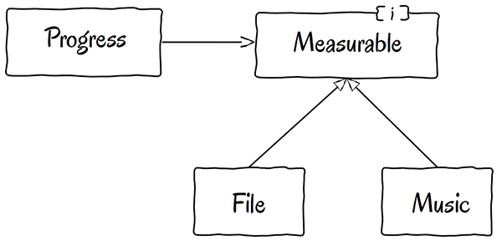
Define contract

Slide 10
Contract / methods
Be careful while declaring interface method
Does Progress need to set the values? Probably not
If you would define the any method, you would force all of the server classes to implement it
Avoid „I naming” (IFile or FileInterface) - interfaces belong to their clients, think about functionality and forget about the implementation
interface Measurable {
function getLength();
function getSent();
}

Slide 11
Naming
Implementation can be from various domains
There are files and music, but Progress can be used in racing symulator to measuree classes like Speed, Fuel, etc.
interface Measurable {
function getLength();
function getSent();
}
interface Measurable {
function getTotalSize();
function getMeasurement ();
}

Slide 12
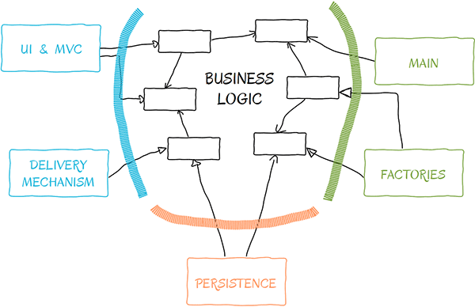
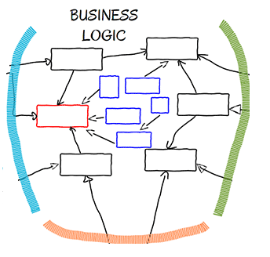
Adding a new module with OPC
Notes:
new classes - blue
affect only small part - red class

Slide 13
How to plan interfaces?
„Any exaggeration is bad. If you think about everything upfront, it is bad. If you think about nothing upfront, it is also bad.”
https://code.tutsplus.com/tutorials/solid-part-2-the-openclosed-principle--net-36600#comment-1565099179

Slide 14
Sources
https://code.tutsplus.com/tutorials/solid-part-2-the-openclosed-principle--net-36600
https://code.tutsplus.com/tutorials/solid-part-2-the-openclosed-principle--net-36600#comment-1565099179 – nice comment describing what question should be asked to know when to introduce interfaces
https://www.cs.duke.edu/courses/fall07/cps108/papers/ocp.pdf

