Slide 1

NEURAL NETWORK ARCHITECTURE
Deep Dive into the Components and Data Flows of Modern Artificial Intelligence
By: Timothy Quainoo

Slide 2



THE THREE PILLARS: LAYERS
1. INPUT LAYER
2. HIDDEN LAYERS
The entry point for raw data. Each neuron represents a feature from the dataset (e.g., pixel value, age, price). No computation happens here; it simply passes data forward.
The "Engine Room" where learning occurs. These layers apply mathematical transformations to extract complex features and patterns from the input data.
3. OUTPUT LAYER
The final destination. It produces the network's prediction—be it a class probability for image recognition or a numerical value for price forecasting.

Slide 3

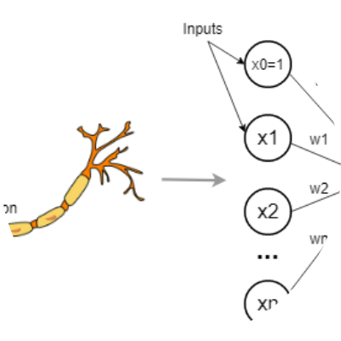
NEURONS: PROCESSING UNITS
THE ARTIFICIAL NEURON
Inspired by biological biology, the artificial neuron is a mathematical function that:
Aggregates: Sums multiple weighted inputs.
Computes: Applies a non-linear activation.
Fires: Passes the result to the next layer.

Slide 4

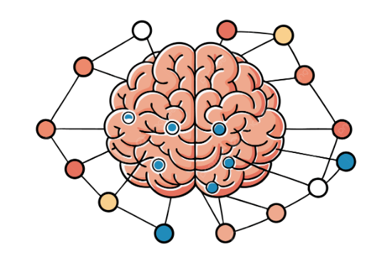


WEIGHTS & BIASES: TUNING
Weights (w) are the most critical tunable parameters. They determine the strength and "importance" of a connection between two neurons.
Biases (b) allow the activation function to shift, providing the flexibility needed to fit data that doesn't pass through the origin.

Slide 5
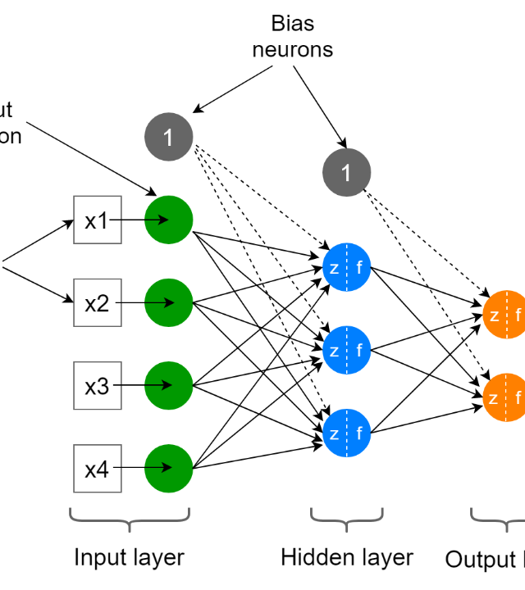
NETWORK ARCHITECTURE
VISUALIZING DATA FLOW
Data flows in a strictly "feedforward" manner during inference. Information is processed layer-by-layer, where each successive layer captures more abstract representations.
Input (Edges/Colors) → Hidden 1 (Textures) → Hidden 2 (Shapes) → Output (Objects).

Slide 6








ACTIVATION: NON-LINEARITY
SIGMOID
RELU
SOFTMAX
Squashes values between 0 and 1. Useful for probability-based output layers.
The standard for hidden layers. Simple, fast, and avoids vanishing gradients.
Turns multiple outputs into a probability distribution totaling 1.0.

Slide 7
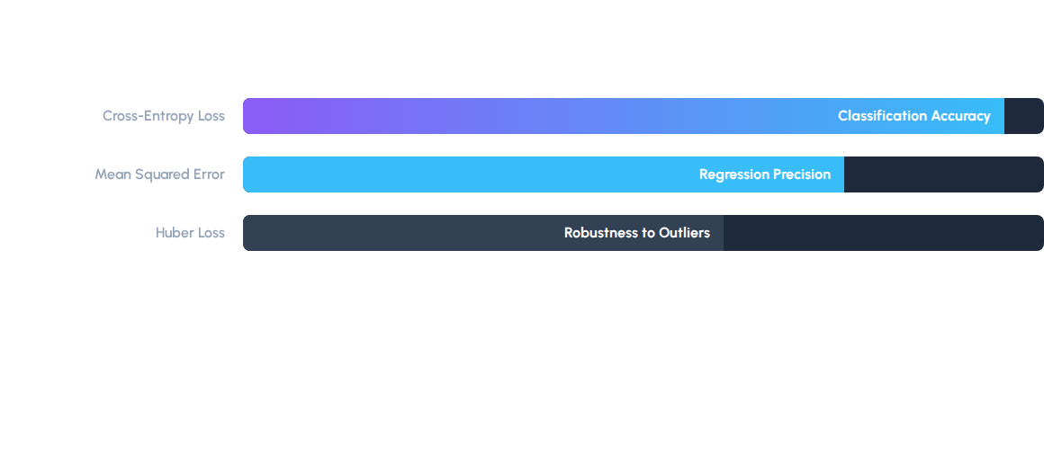
LOSS FUNCTIONS: OBJECTIVE
The Loss Function quantifies how far the model's prediction is from the ground truth. Minimizing this value is the primary goal of training.

Slide 8
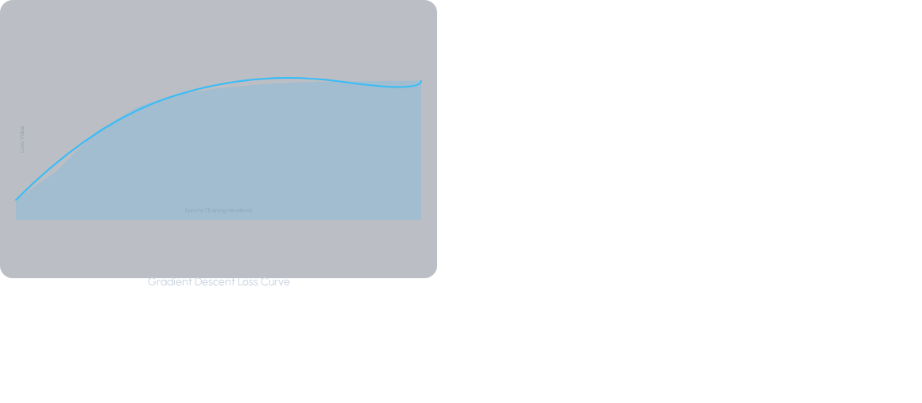
OPTIMIZATION: LEARNING
GRADIENT DESCENT
The "Engine" of learning. It calculates the gradient of the loss function with respect to the weights and nudges them in the direction that reduces error.
Stochastic GD: Fast, but noisy updates.
Adam: Adaptive moment estimation—the industry standard.

Slide 9
VISUALIZING INSIGHT
Demystifying the Black Box: Visualization transforms abstract matrix multiplications into interpretable hierarchical features.
Debugging Architectures: Spotting vanishing gradients or saturated neurons becomes trivial when viewing activation maps.
Bridging Theory & Practice: It allows researchers to communicate complex topological concepts to non-technical stakeholders.
Guiding Optimization: Visualizing the loss landscape helps in choosing the right learning rates and optimization paths.

Slide 10






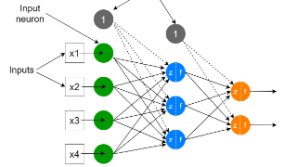
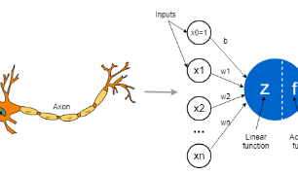
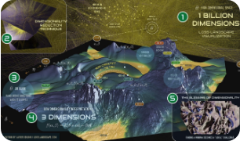
EXERCISE SUMMARY
HIERARCHY
INTERCONNECTIVITY
OPTIMIZATION
Deep learning is about composing simple operations into complex abstractions.
The power resides in the connections (synapses), not just individual units.
Training is a mathematical journey through a high-dimensional landscape.

Slide 11

ARTIFICIAL INTELLIGENCE IS NOT JUST CODE; IT IS A STRUCTURAL REPRESENTATION OF KNOWLEDGE.
Visualizing this structure is the first step toward true understanding.

Slide 12
Q&A
Any questions regarding Neural Network Components?
neural-vis-project.io
contact@deeplearning.edu

Slide 13





IMAGE SOURCES
https://towardsdatascience.com/wp-content/uploads/2021/12/1SgJPlfKHwL-qis-aL19Fyg.png
Source: towardsdatascience.com
https://png.pngtree.com/png-clipart/20250715/original/pngtree-a-human-brain-with-neural-network-layers-emphasizing-the-integration-of-png-image_21320085.png
Source: pngtree.com
https://miro.medium.com/v2/resize:fit:1400/1*bz59rluxfbLe55oQ3bIeEw.png
Source: medium.com
https://media.geeksforgeeks.org/wp-content/uploads/20250707102928968494/Sigmoid-Activation-Function.png
Source: www.geeksforgeeks.org
https://miro.medium.com/v2/resize:fit:1400/1*h93R4BUIdUO4Mtq_tsYPPg.jpeg
Source: medium.com

