Slide 1
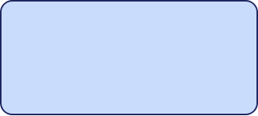





Azure DevOps Test Case Creator
Spreadsheet-driven workflow — create new test cases, skip existing ones
Spreadsheet
TypeScript script
Azure DevOps
.xlsx with test names
iterates rows, decides per row
work item REST API
If Test Case ID is present
If Test Case ID is empty
Skip the row — no ADO call, the existing ID is kept as-is.
Create the test case in ADO, then write the new ID back to the row.

Slide 2
Sample Run: Action Log
Real-time status updates written back to the shared source
System Logs
# | Test name | Test Case ID | Action Result
1 | Login with valid credentials | TC-1001 | Skip — already exists
2 | Login with invalid credentials | TC-1042 (new) | Created in ADO
3 | Logout from dashboard | TC-1019 | Skip — already exists
4 | Password reset flow | TC-1043 (new) | Created in ADO

Slide 3
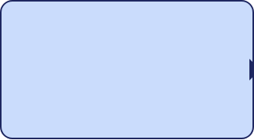

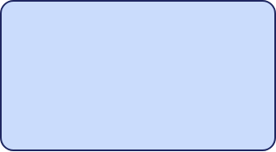




Test Execution & Result Publishing
Automated self-selection via unique ADO ID matching
Trigger
Read & Match
Publish
ADO Pipeline starts test
Lookup row by TC-ID
Update ADO with Pass/Fail
The Pattern
One shared spreadsheet for all test cases — each ADO test stays a thin wrapper that locates its own data row dynamically.

