Slide 1
Example of a binary relation (wasAssociatedWith) and the corresponding n-array relation modeled using Involvement
Activity
prov:wasAssociatedWith
Agent
Association
prov:agent
prov:qualifiedAssociation
prov:hadPlan
Plan
Staring-point relationships
Qualification relationships

Slide 2
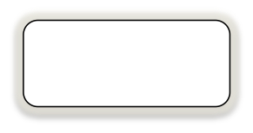
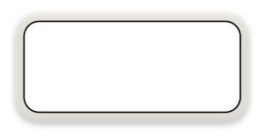

Core Terms
actedOnBehalfOf
wasDerivedFrom
wasAttributedTo
hadOriginalSource??
Agent
Entity
wasAssociatedWith
used
wasGeneratedBy
Activity
wasInformedBy
Replaced by Simple Terms slide

Slide 3
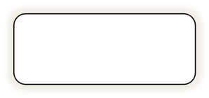
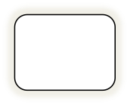



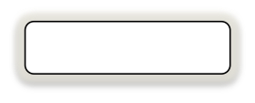
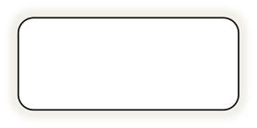
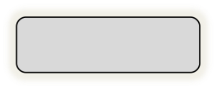
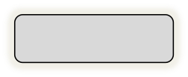
Simple Terms
actedOnBehalfOf
tracedTo
wasDerivedFrom
wasAttributedTo
Agent
Entity
Agent
Person
wasGeneratedBy
used
Organization
wasAssociatedWith
Activity
SoftwareAgent
Activity
startedAtTime
endedAtTime
wasInformedBy
xsd:dateTime
xsd:dateTime
Replaced by Starting-point Terms slide

Slide 4
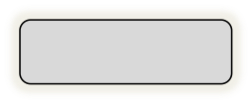
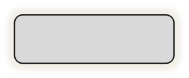
Starting-point Terms
actedOnBehalfOf
wasDerivedFrom
wasAttributedTo
Agent
Entity
Agent
wasGeneratedBy
used
wasAssociatedWith
Activity
Activity
startedAtTime
endedAtTime
wasInformedBy
wasStartedByActivity
xsd:dateTime
xsd:dateTime

Slide 5
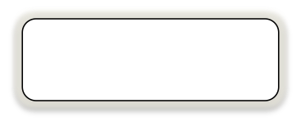
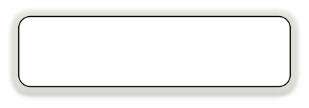
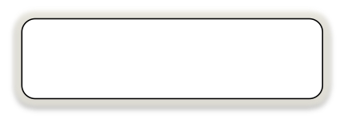


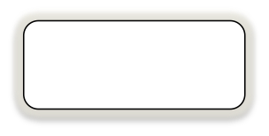
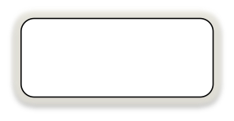
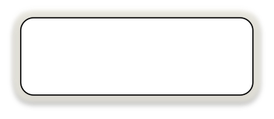
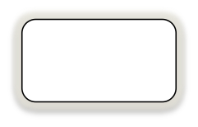
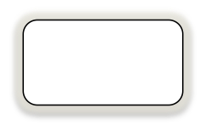
Hierarchy of Involvements
Involvement
ActivityInvolvement
EntityInvolvement
Generation
AgentInvolvement
Usage
Derivation
Responsibility
Association
Attribution
End
Start

